Slide 1
LO: To understand beliefs and teachings
To understand practices and lifestyles
To reflect
C: Christianity

Slide 2
The Transfiguration - Matthew 17:1-13
After six days Jesus took with him Peter, James and John the brother of James, and led them up a high mountain by themselves. There he was transfigured before them. His face shone like the sun, and his clothes became as white as the light. Just then there appeared before them Moses and Elijah, talking with Jesus.
Peter said to Jesus, “Lord, it is good for us to be here. If you wish, I will put up three shelters—one for you, one for Moses and one for Elijah.” While he was still speaking, a bright cloud covered them, and a voice from the cloud said, “This is my Son, whom I love; with him I am well pleased. Listen to him!”
When the disciples heard this, they fell facedown to the ground, terrified. But Jesus came and touched them. “Get up,” he said. “Don’t be afraid.” When they looked up, they saw no one except Jesus.
As they were coming down the mountain, Jesus instructed them, “Don’t tell anyone what you have seen, until the Son of Man has been raised from the dead.” The disciples asked him, “Why then do the teachers of the law say that Elijah must come first?” Jesus replied, “To be sure, Elijah comes and will restore all things. But I tell you, Elijah has already come, and they did not recognize him, but have done to him everything they wished. In the same way the Son of Man is going to suffer at their hands.” Then the disciples understood that he was talking to them about John the Baptist.

Slide 3
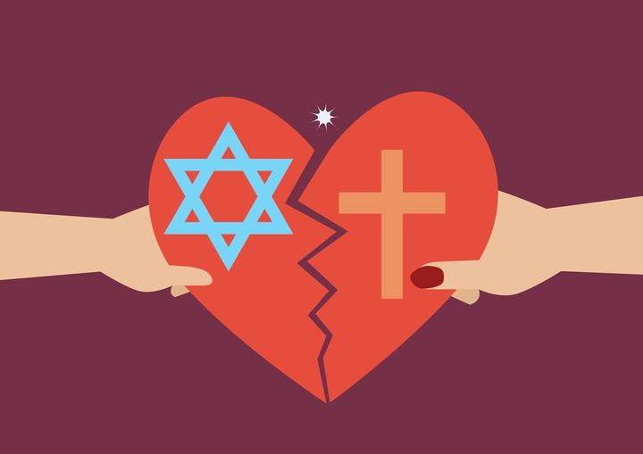
The difference between the traditional Jewish idea of a messiah and the new early Christian idea is an important distinction between the faiths, and is one of the major reasons which led the Jewish sect of Christianity to split from Judaism and become a separate religion.
The early Christians found their Messiah to be in Jesus, who was not an earthly king or a warrior but a man of peace.
More amazing still, Jesus was someone whose life, words and deeds made people believe that he was God in the flesh, and the culmination of God’s plan of salvation.

Slide 4

Create a list of all of the clues to the identity of Jesus from the transfiguration text.

Slide 5
Create a list of all of the clues to the identity of Jesus from the transfiguration text.
For example:
Jesus’ transfiguration - His face shone like the sun, and his clothes became as white as the light.
The prophets Moses and Elijah appeared and talked to Jesus.
Jesus led his disciples up the mountain.
A voice from the cloud said, “This is my Son, whom I love; with him I am well pleased. Listen to him!”

Slide 6
Activity:
Answer the questions below using the clues you identified and the clues on the previous slide.
Which would be the most persuasive for people at the time do you think? Why?
Why were some people not convinced? Or even hostile?

Slide 7
Red Pen
Paddling: If you had witnessed the transfiguration, would you believe that Jesus was the Messiah? Why/why not?
Snorkelling/Diving: If you had witnessed the transfiguration, would you believe that Jesus was the Messiah? Why/why not? Explain your reasoning.

