Slide 1
LO: Communicate geographically
C: Debate

Slide 2
We have come to the end of our topic.
What have we learned?
We have learned about how we are increasingly interconnected on a global scale.
We have also learned that this has happened in an uneven fashion and that there is lots of inequality in the world – people have experienced the effects of globalisation in different ways.

Slide 3
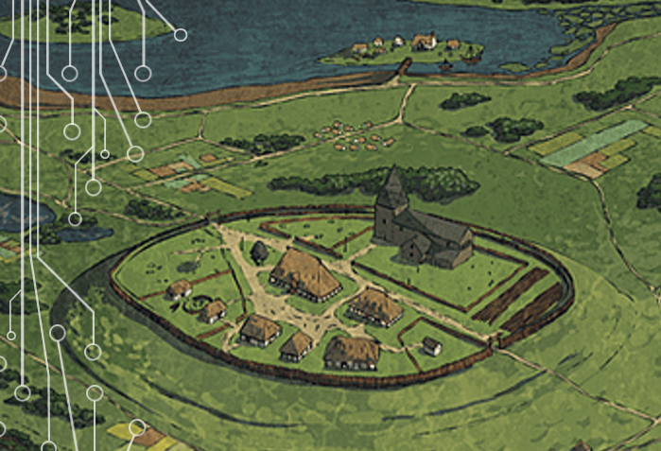
Talk to your partner: What are the most important or surprising things you have learned during this topic?
People settled in areas that suited their needs.
They started trading with each other.
This developed into the global trade that we have today.

Slide 4
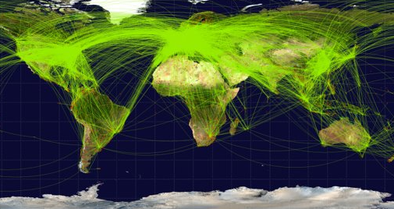
This trade began on a small-scale level, but has developed into huge corporations working in many areas of the globe. This has had both positive and negative effects on people in different areas.

Slide 5

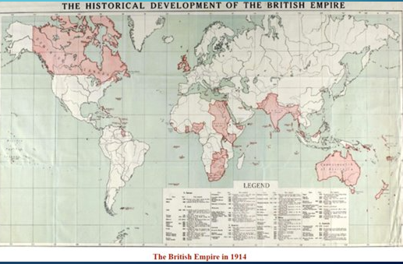
The British Empire developed partly as a result of the desire to trade. Viewpoints on the empire differ greatly.
.

Slide 6
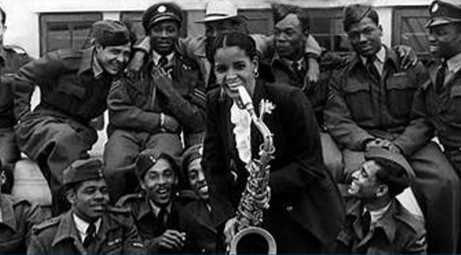
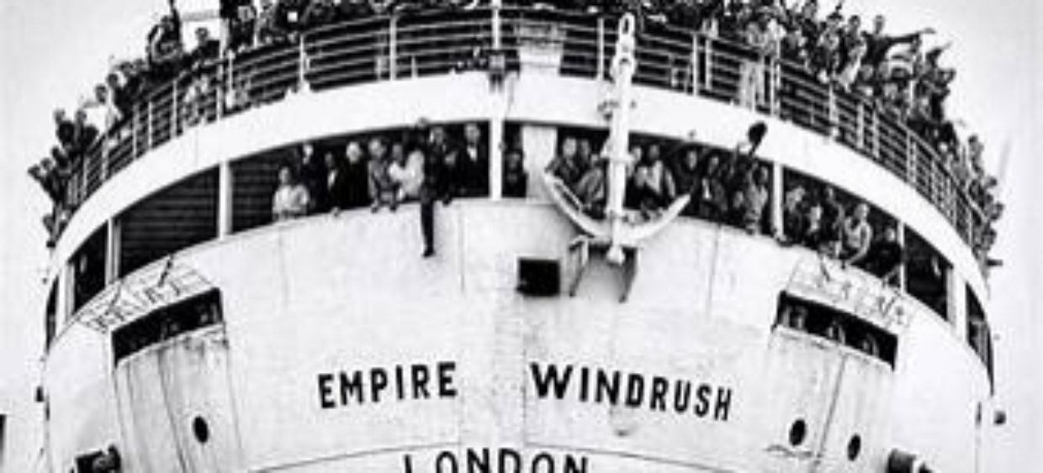
Finally, we learned about immigration from the colonies to Britain, the experience of people making Britain home and the effect on the nation.
.

Slide 7


Can you tell your partner some of the winners and losers in this global interconnected world?
Winners:
Multi-national companies making vast profits.
Citizens in wealthy nations paying less for their goods.
People in less wealthy nations who are employed by global companies.
Losers:
Exploited workers – poor pay and working conditions.
Environment – pollution from production of goods.
People in wealthy nations whose jobs have been moved abroad.

Slide 8
Activity
Watch this clip of Prime Minister’s questions: (skip through) https://www.youtube.com/watch?v=DWj20Ri-MmQ
We are going to have a class debate.
What question would you like to debate?
Are all countries equal?
What does it mean to be a global citizen?
Who gains and who loses from the interconnected world we live in?
Or something else?

Slide 9
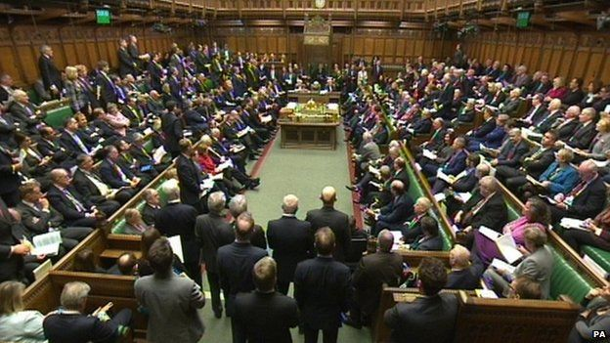
Activity
Divide class into two – one side for; the other against.
Work in groups of 6-7 to write the main points of your argument. Meet with the other group on your side of the debate, and discuss what you have written – create a final version of your arguments.
Debate: A ‘judge’ will moderate the
debate and ensure everyone can speak.

Slide 10
Plenary
Have you been convinced by the other side?
Did you have a definite answer or was the argument dependent on different viewpoints?
Did each side have valid claims? Did these claims sometimes conflict?

