Slide 1
LO: Describe how countries and geographical regions are interconnected.
C: Communicate geographically

Slide 2


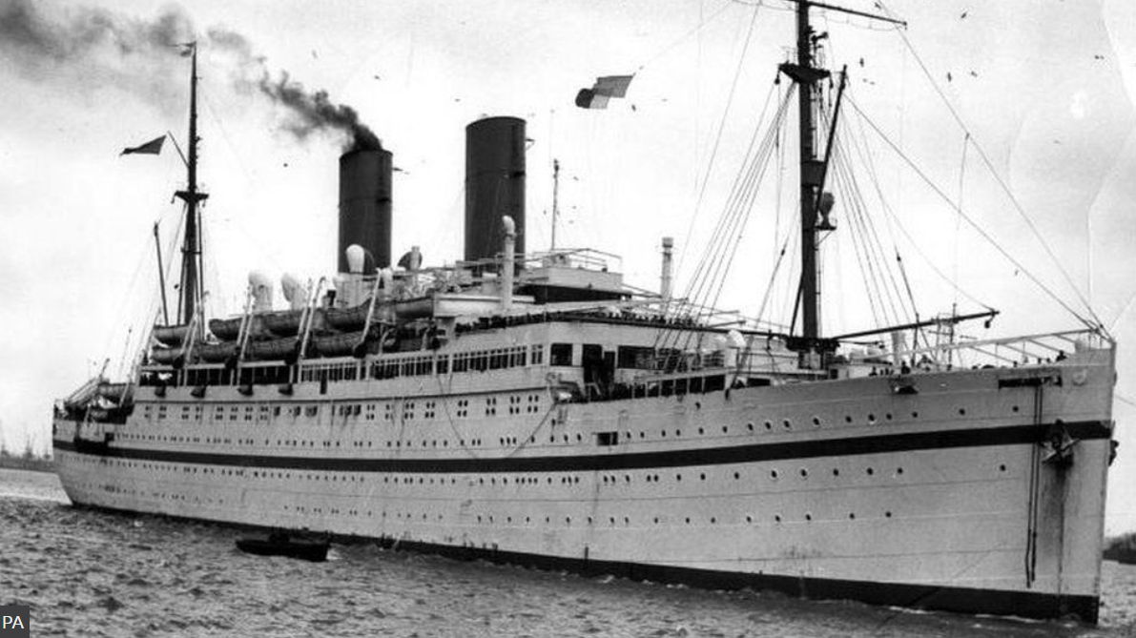
Tell your partner anything you know about the Windrush Generation?
People arriving in the UK between 1948 and 1971 from Caribbean countries have been labelled the Windrush generation.
It refers to the ship MV Empire Windrush, which docked in Tilbury on 22 June 1948, bringing workers from Jamaica, Trinidad and Tobago and other islands, to help fill post-war UK labour shortages.
https://www.bbc.co.uk/news/uk-43782241

Slide 3
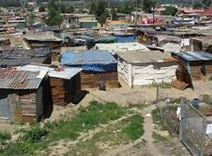
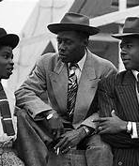
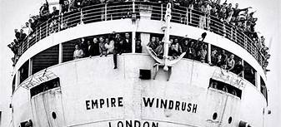
Talk to your partner:
Why did the UK need immigrants?
Why did people leave their homes and come to the UK?

Slide 4
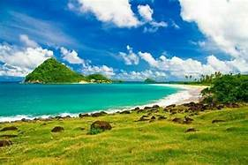
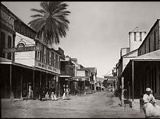
Watch Floella Benjamin’s video explaining who the Windrush Generation are:
https://www.bbc.co.uk/newsround/43793769
How do you think the UK was different to where the Windrush Generation had come from?
What do you think would be most difficult about coming to a new land, far away and so different from home?

Slide 5
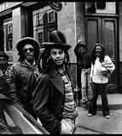
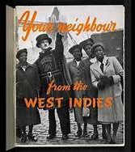
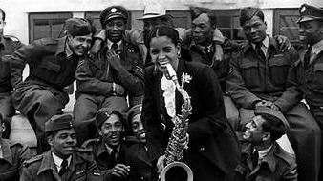
‘Windrush generation meets Newsround generation’
https://www.bbc.co.uk/newsround/43793769
Discuss the feelings experienced by people arriving in the UK.
How do you think the British people reacted to the immigrants arriving?
Did they welcome the new arrivals as friends or perhaps rivals?

Slide 6
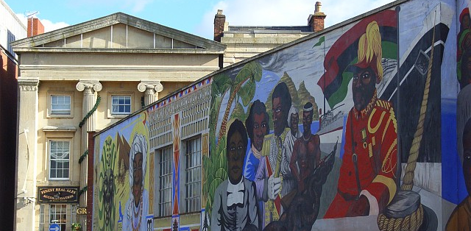
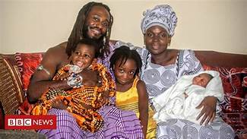
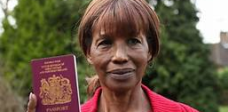
Watch Floella Benjamin’s video explaining the racism experienced.
https://www.bbc.co.uk/newsround/43793769
Do you think the experience of black people has changed in the UK now? How? Why?
What influence has the arrival of the Windrush Generation had on culture in Britain?

Slide 7
The Windrush Scandal
Thousands of people who arrived in the UK as children in the first wave of Commonwealth immigration were threatened with deportation.
They have lived and worked in the UK for decades but many were told they are here illegally.
https://www.bbc.co.uk/news/uk-politics-43726976

Slide 8
The Windrush Scandal
In August 2018, the Home Secretary Sajid Javid announced that 18 members of the Windrush generation, who could have been wrongfully removed or detained, would get a formal apology from the government.
He also said that anyone who had left the UK would also be helped to return.
The prime minister at the time, Theresa May, apologised and reassured them that no one from the Windrush generation will have to leave the UK.
She said Windrush migrants were "part of us" and that there was no question of forcing anyone who had made their life in the UK and was here legally to leave.
The government also announced that a day celebrating the contribution of the Windrush generation and their descendants - Windrush Day - would be held annually on 22 June.

Slide 9
Activity
Paddlers: Design a stamp or commemorative bank note to mark the coming of the Windrush to Britain.
Snorkellers and divers: Imagine you are one of the people who have come to the UK on Empire Windrush.
Write a letter to a loved one, family member or friend back in the West Indies.
Tell them: Where are you? What is it like? How you feel? What do you hope for? What are you worried about? What do you experience? Is it as expected? Better? Worse?
Red Pen: Why should Windrush Day be celebrated? What did the new mix of cultures mean for the UK?

Slide 10

Plenary
Windrush Day was established as a celebration to honour the enormous contribution those who made that journey - and others who followed from elsewhere - have made to Britain.
Explain to your partner why it is important to celebrate the arrival of the Windrush.

