Slide 1
LO: to understand what a network is
C: Family Network

Slide 2

Network
What do you think a ‘network’ is?
Let’s create a bubble map of our ideas.

Slide 3
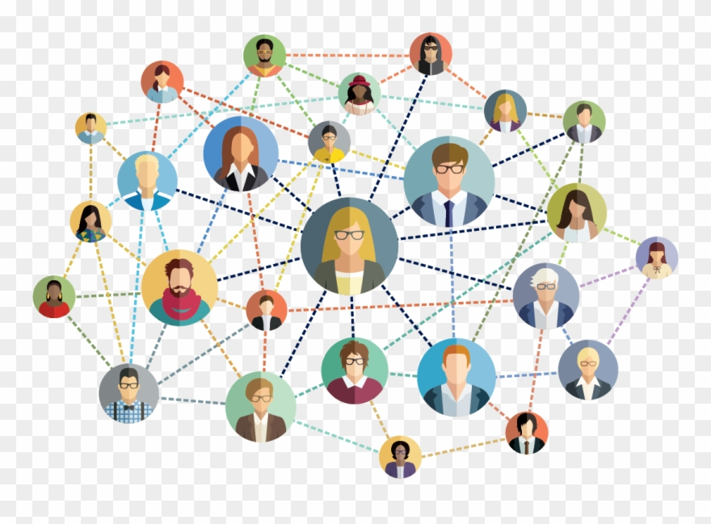
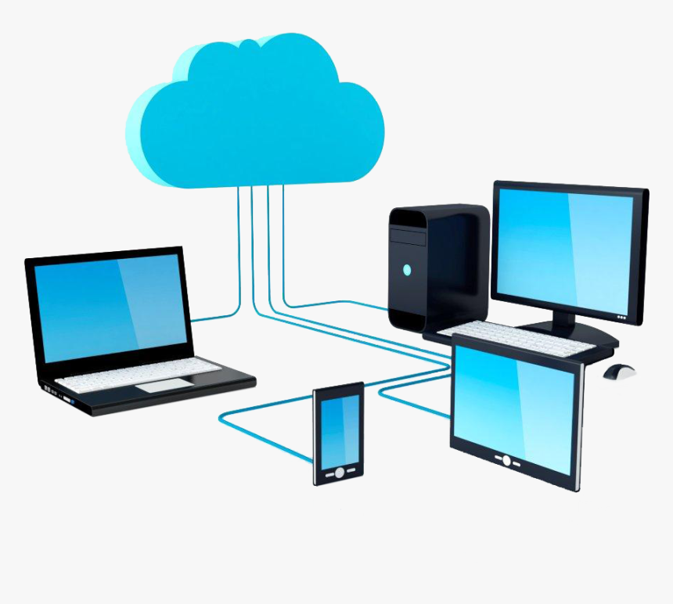
Network
A network is a group or system of interconnected people or things.

Slide 4
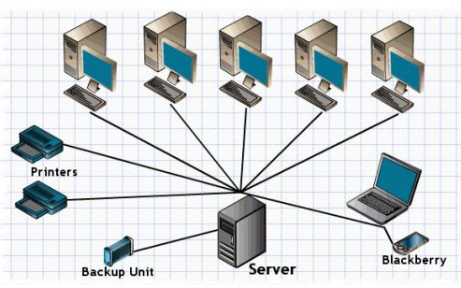
The heart of any school network is the server or servers.
These are computers made from the best components.
Typically, schools spend 10 times as much money on a server than any other computer, so it is a really important piece of equipment.

Slide 5
https://www.youtube.com/watch?v=c5q3XkTfamk

Slide 6
Network
A network is a group or system of interconnected people or things.

Slide 7
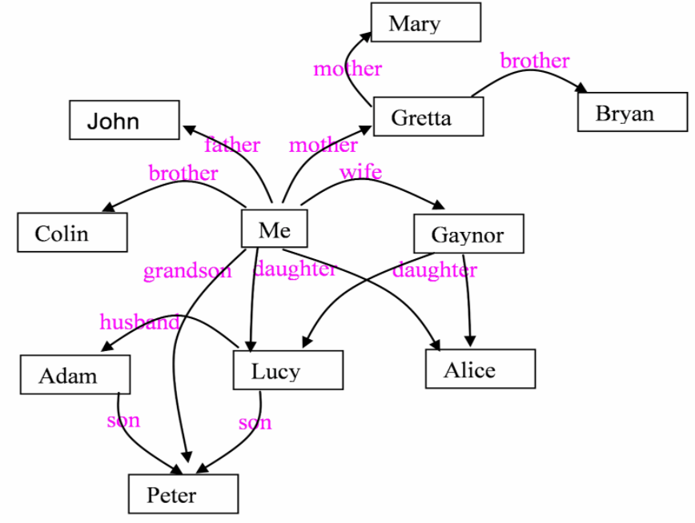
Family Network
A group or system of interconnected people or things.
What does your family network look like?
How are the people in your family interconnected?

Slide 8
Family network
Task 1: Write a definition for ‘network.’
Task 2: Draw your family or friends network on a piece of paper.
Place yourself in the middle and your network around you.

