Slide 1
LO: to understand evolution and inheritance
C: Adaptation

Slide 2
Starter
Look at the pictures of the foxes below.
Choose one fox to focus on.
Describe the environment that you think your fox lives in and how you think your fox’s characteristics have adapted to this environment.

Slide 3
Why do you think foxes differ so much?
In the Arctic, the fur is an obvious difference – colour and length.
How would a red fox, like the ones we have in the UK fare in the Arctic?

Slide 4
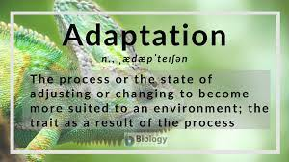
We call this ‘adaptation’ when certain characteristics become more common because they are more likely to help living things survive.

Slide 5
Why do foxes come in so many different ‘versions’?
They all have a common ancestor and in certain environments, certain features would have helped specific foxes to survive into adulthood and reproduce, passing on their genetic characteristics, so that eventually, certain characteristics end up being ‘selected’ naturally and become the common form of that fox (natural selection).

Slide 6
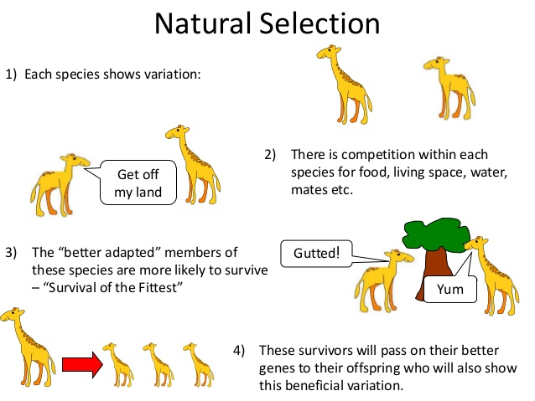
https://www.nhm.ac.uk/discover/what-is-natural-selection.html
Natural selection occurs in a population as a result of variation so as to deal with a changing environment.
Generally, natural selection in the animal world takes place over huge time scales, but there are examples where it has happened over decades (in micro-organisms it happens much quicker) through favourable mutations (random changes in characteristics).

Slide 7
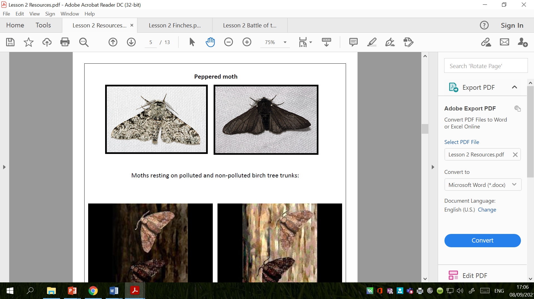
Mutations can prove useful in the game of survival!
For example – the peppered moth and the industrial revolution.
This moth changed hugely in appearance within the space of 50 years in the 19th century, and then changed back in the second half of the 20th century!
The colour of the moth and its impact on camouflage from potential predators is part of the explanation.
https://butterfly-conservation.org/moths/why-moths-matter/amazing-moths/peppered-moth-and-natural-selection
https://www.bbc.co.uk/bitesize/guides/ztn9y4j/revision/3

Slide 8
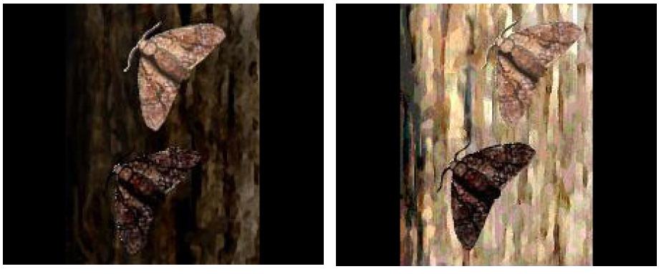

Slide 9
The speed with which an organism reproduces plays a role in evolution as it effects the length of time a successful characteristic can spread through a population.
Organisms that reproduce quickly, such as insects, will evolve quickly; those that reproduce slowly, such as humans, will evolve slowly.

Slide 10
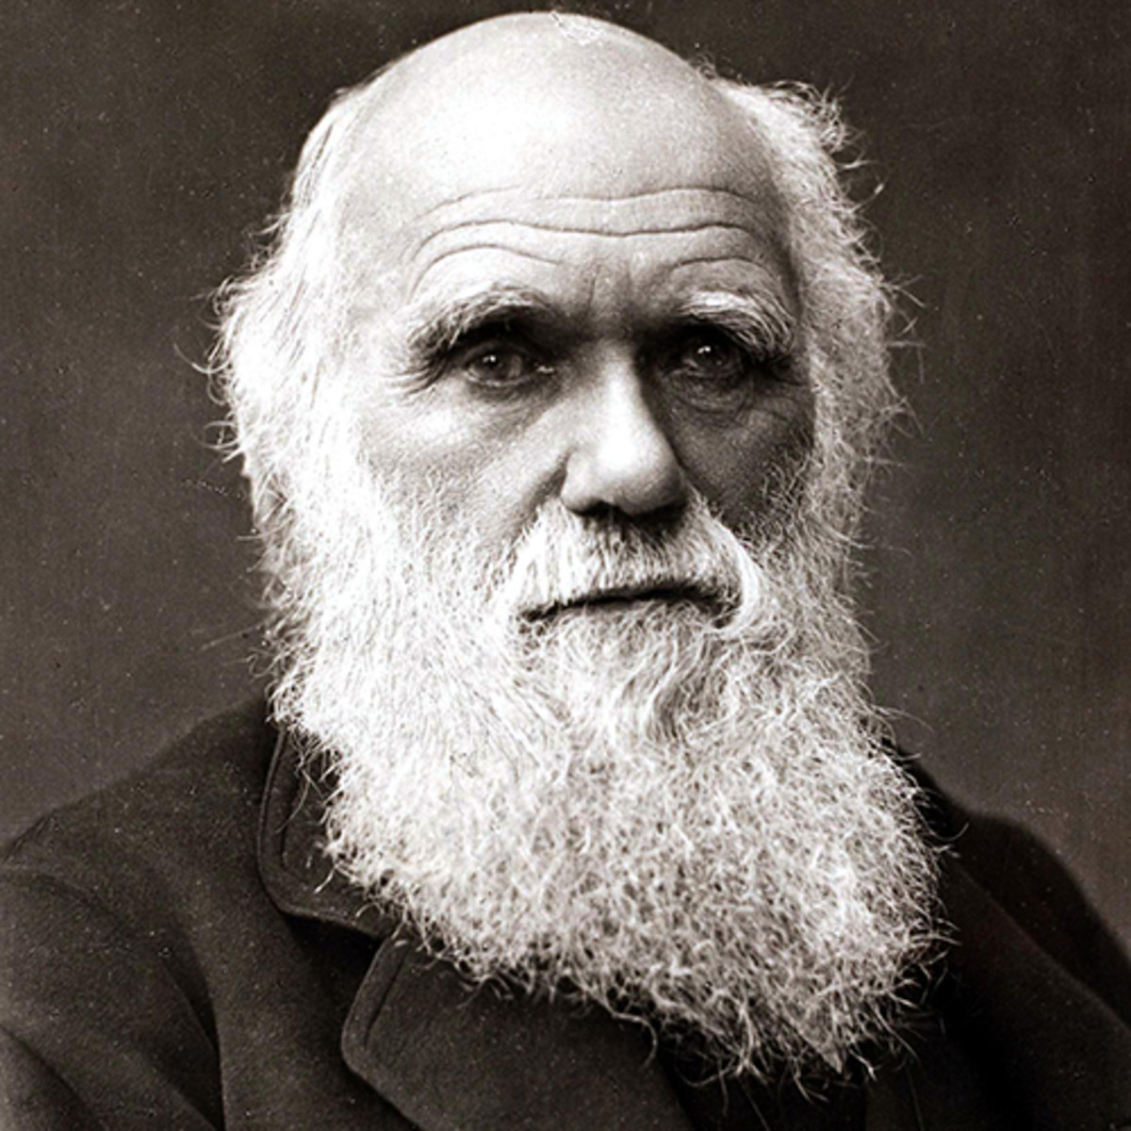
Have you heard of Charles Darwin?
https://www.pbslearningmedia.org/resource/tdc02.sci.life.evo.dar/evolving-ideas-who-was-charles-darwin/

Slide 11
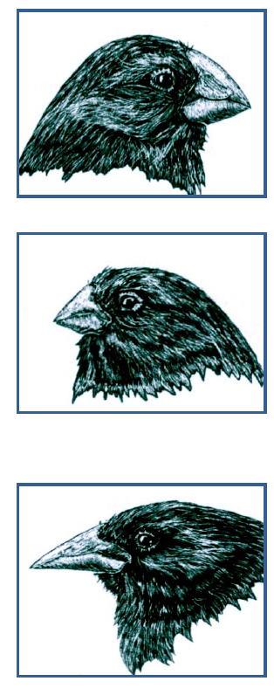
Look at the sheet on the website – it shows the variation in species of finch in the Galapagos Islands that Darwin found.
Can you suggest possible reasons for this variation?
Can you identify the various beaks that are suited to eating the available food on each given island and so had been ‘selected’ for over a long period of time?

Slide 12
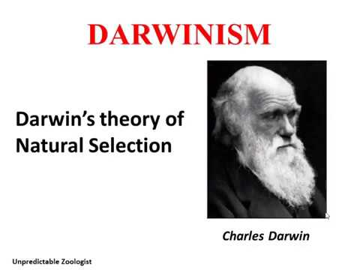
One of the conclusions that Darwin came to in his theory of natural selection, was that plants and animals change by chance (genetic mutation).
He also concluded that some of these changes made the animal or plant better suited to their environment; they are more likely to survive long enough to pass their changes to their offspring.
They have adapted better to their surroundings/habitat.

Slide 13
Battle of the Beaks!
In any habitat, food is limited and the types of foods available can vary.
Animals with variations allowing them to take advantage of available foods will be more likely to survive.
Animals with the most helpful adaptations will be the most likely to live long enough to pass their genes on to the next generation.
Many birds have evolved specialised beak shapes that are well suited to the available food sources in their environment.

Slide 14
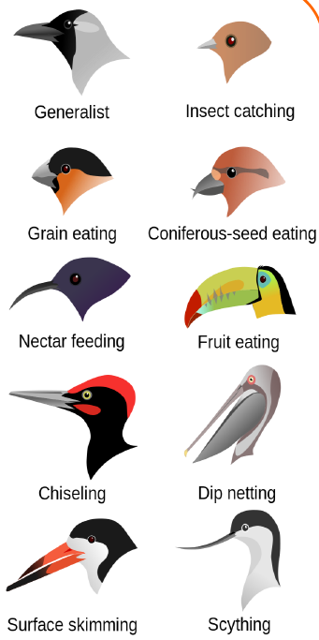
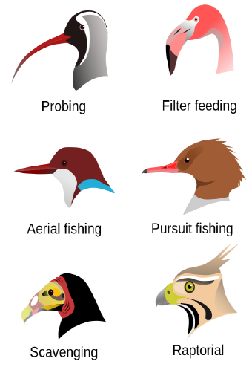
Look carefully at the beak shapes and consider why each shape is best for each food.

Slide 15
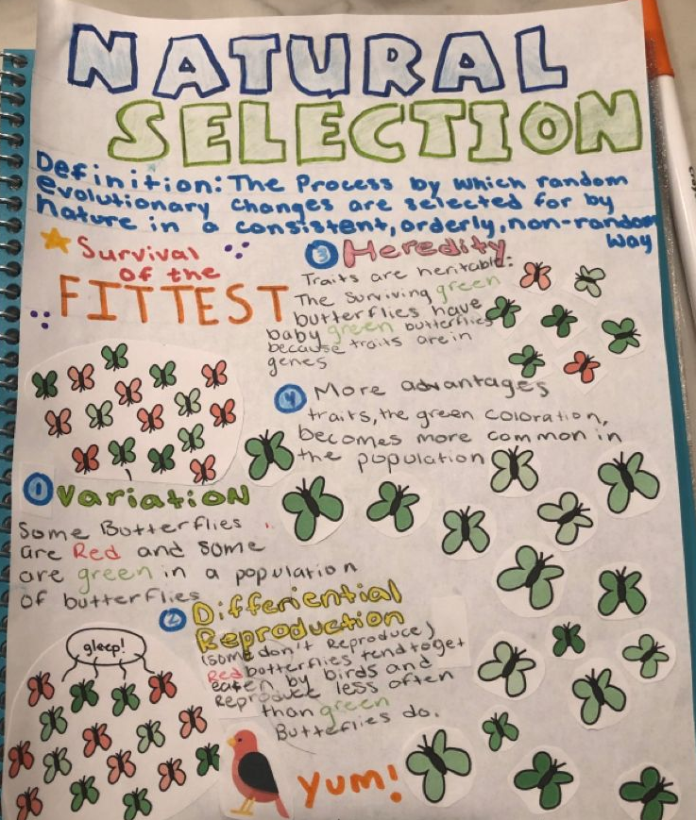
Activity:
Create a poster to show what you have learned in your Science today.
Make sure you refer to natural selection, Charles Darwin and the finches on the Galapagos Islands!

