Slide 1
LO: to understand values
to understand practices and lifestyles
C: Islam

Slide 2
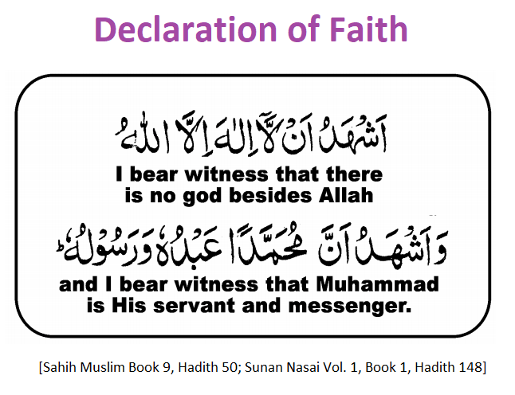
Shahada
The first pillar of Islam is the Shahada.
https://www.bbc.co.uk/bitesize/clips/zstfgk7

Slide 3
Muslims have a profession of faith which expresses two simple, but central beliefs that make a person a Muslim:
  There is no god but God (Allah)
  Muhammad (PBUH) is the prophet of God (Allah)
Muslims repeat these words when they pray.

Slide 4
It is not enough just to say Shahadah.
To be a Muslim, you must believe it, as well as say it throughout your life.
By saying Shahadah, Muslims are declaring that there is only one god and creator of all and that is Allah.
The word ‘Shahadah’ means ‘to testify.’ To testify is to make a statement about something that is sworn to be true.

Slide 5

Why do you think it is important for a Muslim to say this out loud?

Slide 6
Salat
The second pillar of Islam is Salat – Prayer.
Watch: www.bbc.co.uk/education/clips/zsqvcdm
Watch it once and listen carefully to what is being said.
Watch it twice and make notes on:
  How Muslims prepare for prayer
  How Muslims pray
  Why prayer is important

Slide 7
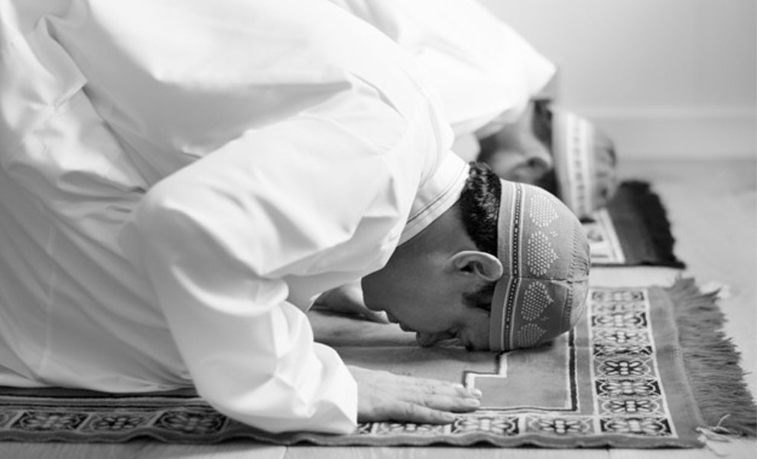
Salat
Salat is the Arabic word for ‘prayer.’
It teaches Muslims to pray five times a day, giving praise and thanks to Allah.
These prayers can be done anywhere.
Muslims believe that Salah is commanded by Allah in the Qur’an, which says: So exalt [Allah] with praise of your Lord and be of those who prostrate [to Him]. And worship your Lord until there comes to you a certainty [i.e. death]. (Qur’an 15:98–99).
Prayer is seen as daily communication with Allah.
Salat encourages self-discipline and keeps Muslims in close contact with Allah.
This gives them the strength to remain committed to living a good and purposeful life.

Slide 8
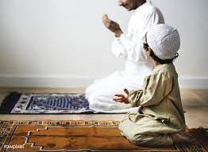
Most Muslims believe it is their duty to pray to Allah 5 times each day.
They believe that they need to pray 5 times to show their belief and be reminded of God so they do not forget about Him.
Praying 5 times a day reminds Muslims of God (Allah)’s greatness, forgiveness and peace.

Slide 9
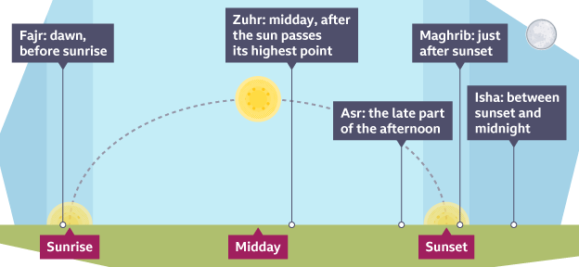
The Five Daily Prayers
Praying the same set prayers to the same routine is a sign of solidarity with all other Muslims all over the world.
It shows that everyone is equal.
Each of the five prayers is performed at a specific time of day:

Slide 10
The Five Daily Prayers
Fajr: This prayer starts off the day with the remembrance of God; it is performed before sunrise.
Dhuhr: After the day’s work has begun, one breaks shortly after noon to again remember God and seek His guidance.
‘Asr: In the late afternoon, people take a few minutes to remember God and the greater meaning of their lives.
Maghrib: Just after the sun goes down, Muslims remember God again as the day begins to come to a close.
‘Isha: Before retiring for the night, Muslims again take the time to remember God’s presence, guidance, mercy and forgiveness.

Slide 11
Preparing for Prayer
Before praying, Muslims prepare by performing an important set of actions so that all of their focus can be on God.
  Ritual Washing (Wudu) – Muslims perform a washing ritual so that they are spiritually clean. Mosques have washrooms where this washing can be performed. The ritual involves washing faces, hands and feet under running water.
  https://www.bbc.co.uk/teach/class-clips-video/religious-education-ks2-my-life-my-religion-washing-ritual-wudu/zvmrwty
  Facing the city of Mecca - Most Muslims face Mecca when they pray. Many prayer mats have a compass on it showing the direction of Mecca.
  https://www.al-habib.info/qibla-pointer/
  Niyyah – a conscious intention to pray. Prayer starts with a declaration of niyyah, showing that the worshipper is making an intentional effort to set time aside to communicate with God.

Slide 12
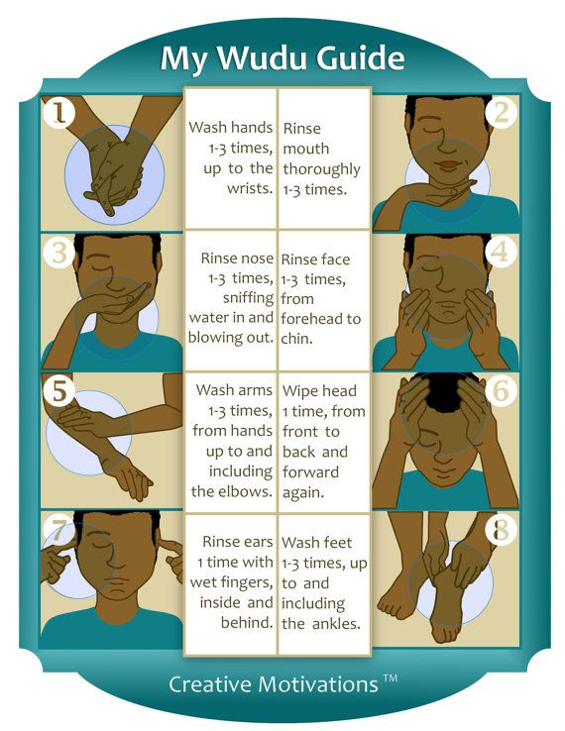

Slide 13
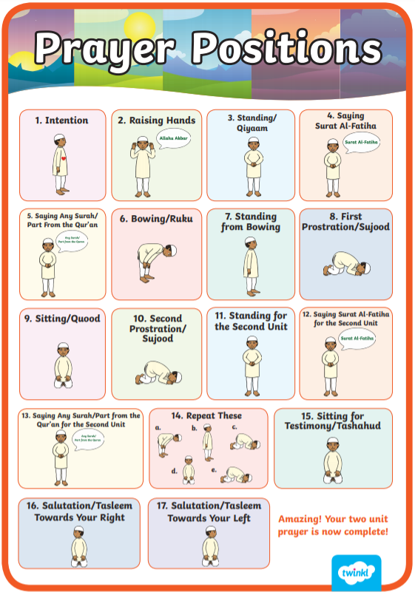
Prayer Positions
https://www.bbc.co.uk/teach/class-clips-video/religious-education-ks2-my-life-my-religion-prayer-in-islam/zjndxyc
https://www.bbc.co.uk/religion/galleries/salah/

Slide 14
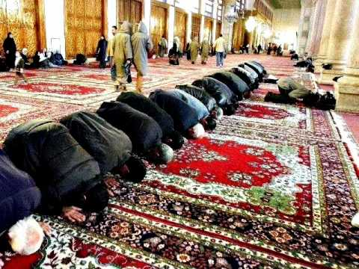
What is the purpose of Salat?
Salat ensures that Muslims maintain their faith and devotion to Allah, to increase taqwa (closeness to Allah) and to remain conscious of the importance of faith and submission to their creator.
‘Islam’ means submission: structuring life around regular prayer can show submission to God.
It’s a way of remembering God constantly throughout the day.
It shows commitment to God, as well as discipline and humility.
It can unite the Ummah (the Islamic community), because everyone is performing the same prayers.

Slide 15
Muslims believe they can worship God anywhere.
However, many Muslims choose to go to the Mosque for lunchtime prayers on a Friday, the Muslim holy day.
Do you know when the Christian Sabbath (holy day) is?
What about the Jewish Sabbath?

Slide 16
What have you learned?

Slide 17
Do you think it is necessary for Muslims to pray 5 times each day in order to show that they believe in God and are not forgetting about Him and to remember that every bit of their lives should reflect what God wants them to do?
Justify your reasons.

Slide 18
Activity
Paddling: create a double bubble map comparing how Christians and Muslims pray.
Snorkelling: Write 2 short paragraphs about the ways Christians and Muslims pray; one detailing the similarities you have identified and the other detailing the differences you have identified.
  You may like to refer to other religions in your answer too.
Diving: Write a paragraph answering the following questions:
  What is similar and what is different and distinct about the Muslim way of prayer?
  Why do you think this is?
  How is this similar or different to your own experience of prayer?
  What do you think the point of prayer is?

Slide 19
Red Pen
Paddling: How might praying 5 times a day affect a Muslim’s daily life? When would it be easiest/hardest?
Snorkelling: If a Muslim could only pray once, which do you think is the most important prayer? Why?
Diving: Do you think that praying 5 times a day would draw a Muslim closer to God (Allah) than a Muslim that didn’t pray 5 times a day? Why/why not?

Slide 20
Plenary
The Mool Mantra (Sikhism).
The Mool Mantra means ‘essential teaching’ and gives a short description of what God is like.
Sikhs frequently recite the Mool Mantra in worship, including their morning prayers. The first line is: ‘There is only one God.’
Listen to: https://www.sikhnet.com/gurbani/audio/mool-mantar-jaap (only the first 30 secs)

Slide 21
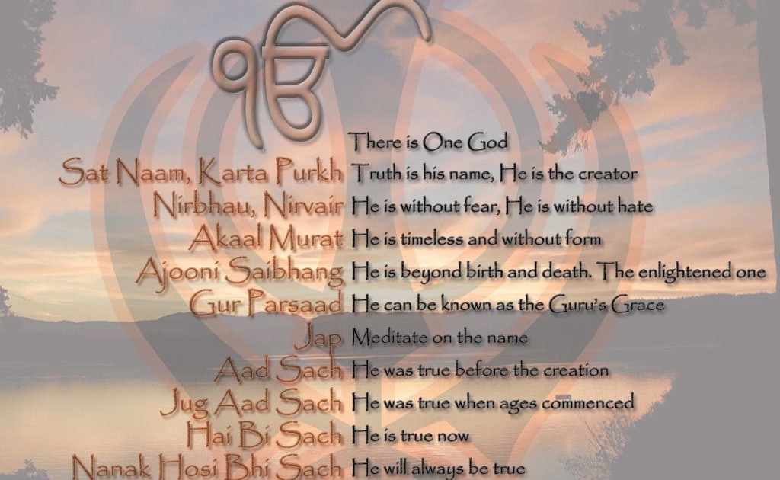

Slide 22
Plenary
The Apostles’ Creed/The Nicene Creed (Christianity).
The Creeds are a summary of what the Church teaches and of what Christians together believe.
The first line is: ‘I believe in God, the father almighty.’
One of the Creeds is usually recited during church services.

Slide 23
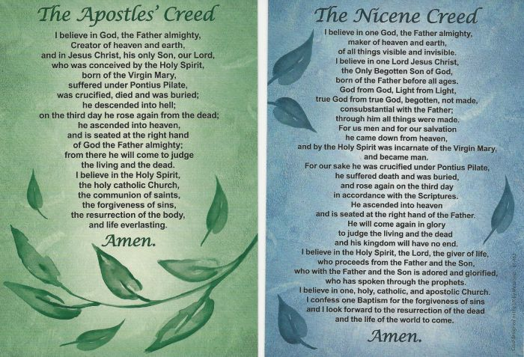

Slide 24
Plenary
What are the similarities/differences between these statements of believe/professions of faith?

