Slide 1
Year 6 | Week 2 | Day 4

Slide 2
Year 6 | Week 2 | Day 4

Slide 3


Arithmetic Starter

Slide 4
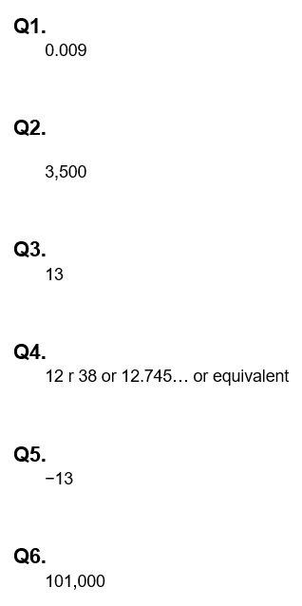
Arithmetic Starter - Answers

Slide 5
NEGATIVE NUMBERS (IN CONTEXT)

Slide 6
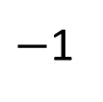
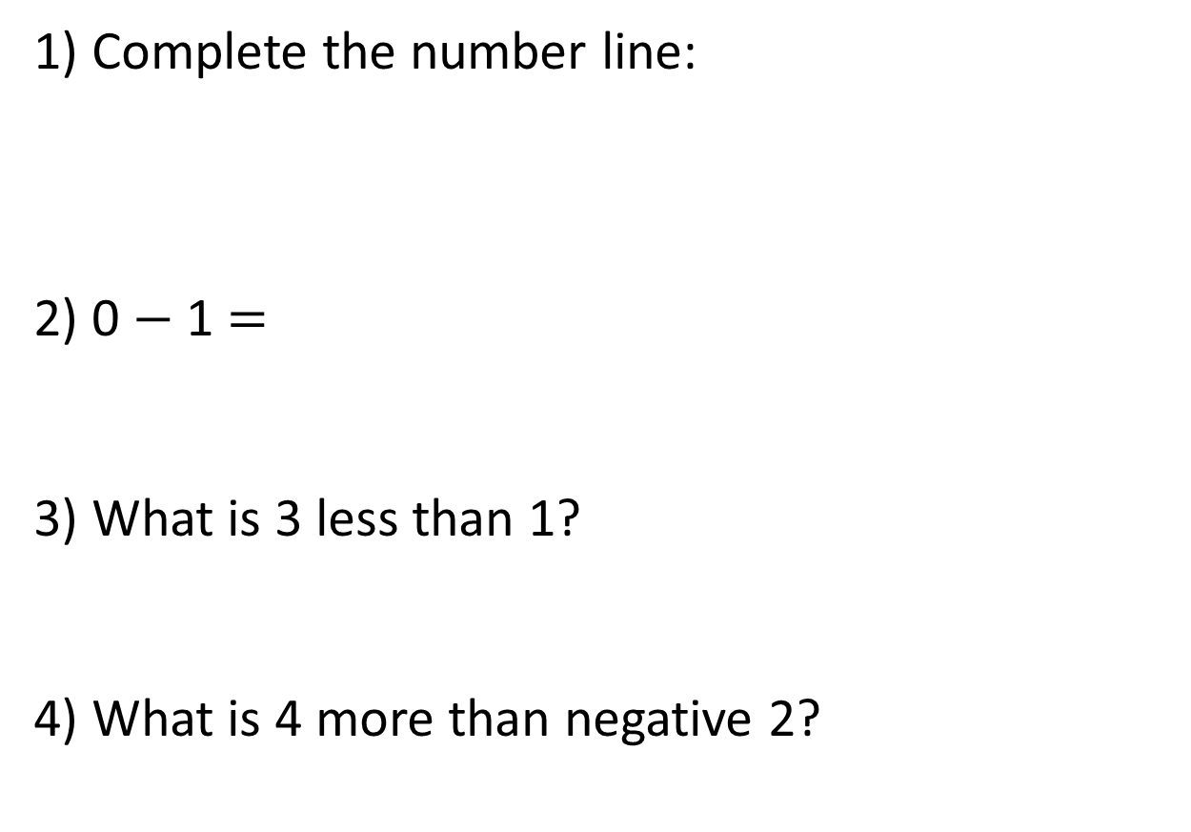
1) Complete the number line:
2) 0 $−$ 1 $=$
3) What is 3 less than 1?
4) What is 4 more than negative 2?
$−$1
0
2
3

Slide 7


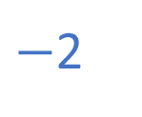
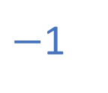
1) Complete the number line:
2) 0 $−$ 1 $=$
3) What is 3 less than 1?
4) What is 4 more than negative 2?
$−$3
$−$2
$−$1
0
1
2
3
$−$1
$−$2
2

Slide 8

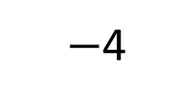
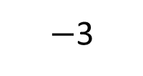
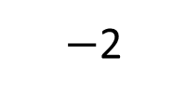
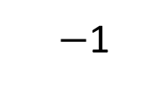
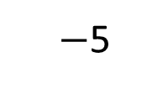
Have a think
$−$5
$−$4
$−$3
$−$2
$−$1
0
1
2
3
4
5
Where have you seen negative numbers before?

Slide 9


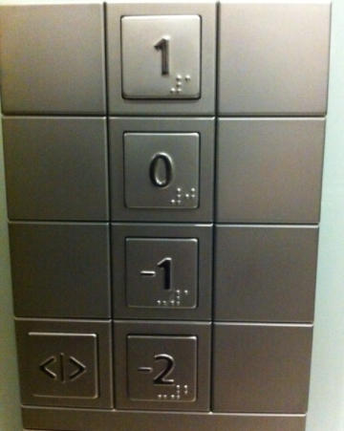
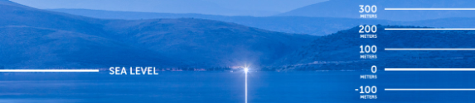
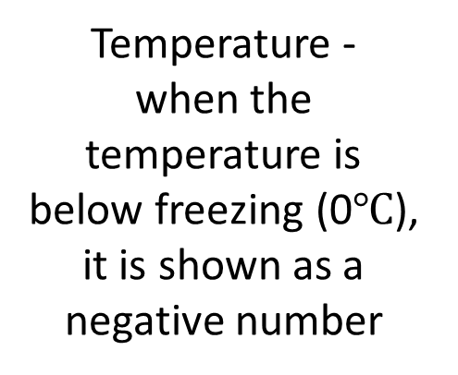
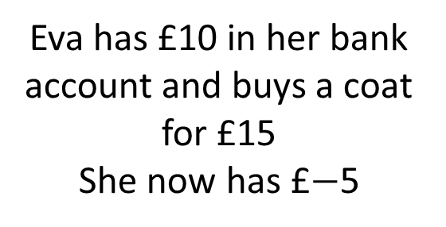
Temperature -
when the temperature is below freezing (0$℃$), it is shown as a negative number
Eva has £10 in her bank account and buys a coat for £15
She now has £$−$5
Negative numbers can be used to measure under sea level
Lift

Slide 10


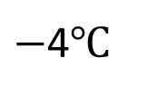
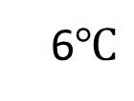
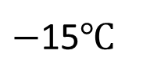
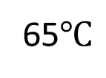
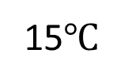
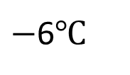
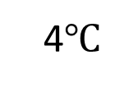
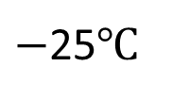
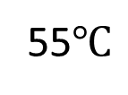
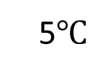
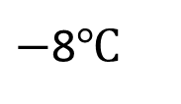
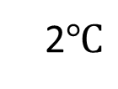
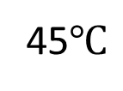
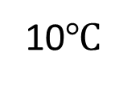
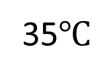
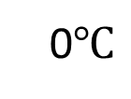
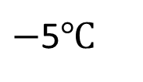
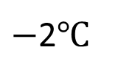
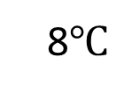
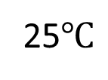
Have a think
10$℃$
65$℃$
8$℃$
55$℃$
6$℃$
45$℃$
4$℃$
35$℃$
2$℃$
25$℃$
0$℃$
15$℃$
$−$2$℃$
5$℃$
$−$4$℃$
$−$5$℃$
$−$6$℃$
$−$15$℃$
$−$8$℃$
$−$25$℃$
What’s the same and what’s different?

Slide 11
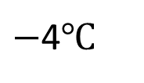
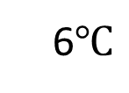
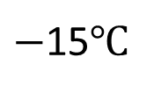
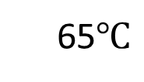
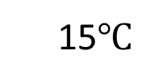
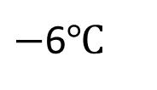
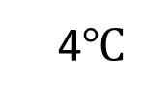
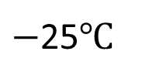
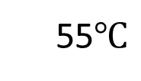
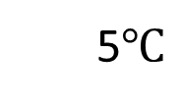
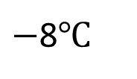
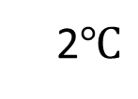
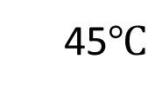
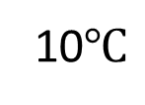
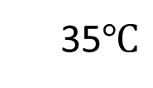
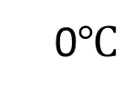





10$℃$
65$℃$
8$℃$
55$℃$
6$℃$
45$℃$
4$℃$
35$℃$
2$℃$
25$℃$
0$℃$
15$℃$
$−$2$℃$
5$℃$
$−$4$℃$
0$℃$
$−$5$℃$
$−$6$℃$
$−$15$℃$
$−$8$℃$
$−$25$℃$

Slide 12
























Paris
Milan
10$℃$
25$℃$
8$℃$
20$℃$
6$℃$
15$℃$
4$℃$
10$℃$
3
2$℃$
5$℃$
0$℃$
0$℃$
$−$2$℃$
$−$5$℃$
$−$4$℃$
$−$10$℃$
$−$5
$−$6$℃$
$−$15$℃$
$−$8$℃$
$−$20$℃$
Difference of 8$℃$

Slide 13













London | Chicago
9$℃$ | $−$4$℃$
How many degrees warmer is it in London?
$−$10
$−$9
$−$8
$−$7
$−$6
$−$5
$−$4
$−$3
$−$2
$−$1
0
1
2
3
4
5
6
7
8
9
10
4
9
$−$4
0
9
13$℃$ warmer in London

Slide 14




Have a think
It’s 18$℃$ inside and $−$6$℃$ outside. The difference in temperature is 12$℃$
24$℃$
6
18
$−$6
0
18

Slide 15


Slide 16


Slide 17

Look at a world map and locate different countries.
Choose a month and
research the average
temperatures for the
countries.
Investigate:
What do you notice about the location of countries and their temperatures?
What’s the difference between the temperature of two countries?
Which country is the coldest/hottest? How much cooler/hotter are they than the other?
Is this the same in different months?

Slide 18
Plenary
Explain to your partner what mistakes people may make when working with negative numbers
Where would you use negative numbers in a real-life situation?

