Slide 1
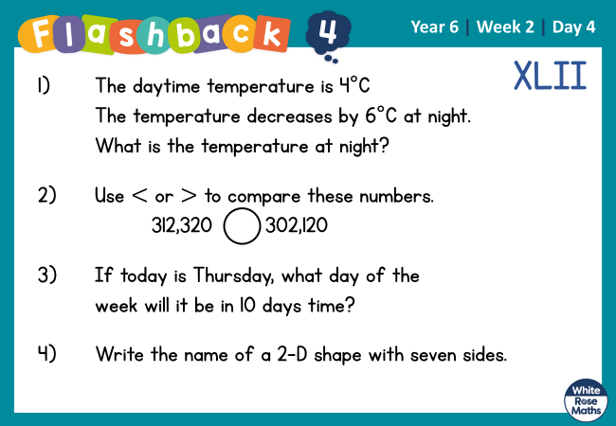

Slide 2
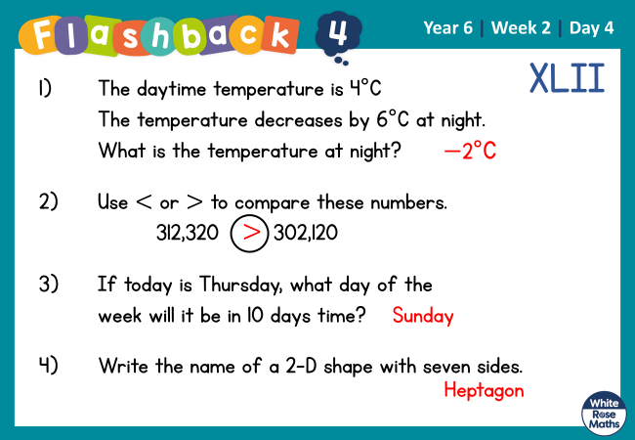

Slide 3


Arithmetic Starter

Slide 4
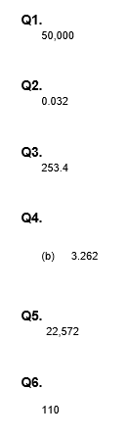
Arithmetic Starter - Answers

Slide 5
ROUND ANY NUMBER

Slide 6
1) Round 3,404 to the nearest 10
2) Round 3,404 to nearest 100
3) Which multiple of 1,000 is 5,770 closest to?

Slide 7
1) Round 3,404 to the nearest 10
2) Round 3,404 to nearest 100
3) Which multiple of 1,000 is 5,770 closest to?
3,400
3,400
6,000

Slide 8







32,847
Have a think
TTh | Th | H | T | O
When rounding to the nearest 1,000 you look at the 1,000 column.

Slide 9
32,847
33,000
TTh | Th | H | T | O
32,000
33,000
32,847

Slide 10
Round 427,241 to the nearest 10,000
420,000
430,000
430,000
427,241
Round 427,241 to the nearest 100,000
400,000
500,000
427,241
400,000

Slide 11
What could the missing digits be if each number rounds to 14,000 when rounded to the nearest 1,000?
0,1,2,3,4
3
1
0
4
2
14, 52
1 ,643
4
3
3
13,500
13,700
13,900
14,100
14,300
14,500
14,499
13,600
13,800
14,000
14,200
14,400

Slide 12

A and B are integers.
Have a think
A = 20,000 when rounded to the nearest 10,000
B = 20,000 when rounded to the nearest 1,000
What is the greatest possible value of A + B?
A
15,000
17,000
19,000
21,000
23,000
25,000
16,000
18,000
20,000
22,000
24,000
Greatest integer for A $=$ 24,999

Slide 13


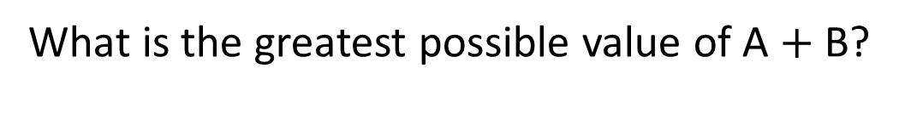

A and B are integers.
B = 20,000 when rounded to the nearest 1,000
What is the greatest possible value of A $+$ B?
B
19,500
19,700
19,900
20,100
20,300
20,500
19,600
19,800
20,000
20,200
20,400
Greatest integer for A $=$ 24,999
Greatest integer for B $=$ 20,499
24,999 $+$ 20,499 $=$
45,498

Slide 14
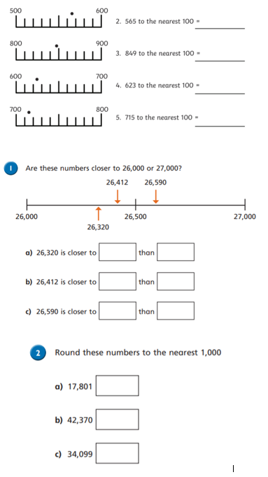
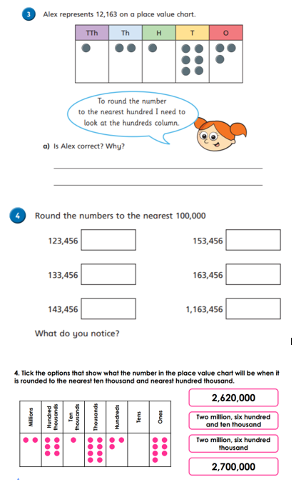
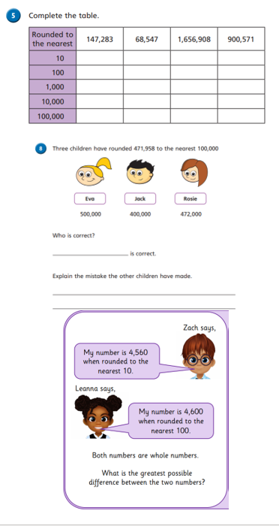
Independent Activity
Paddling Snorkelling Diving

Slide 15
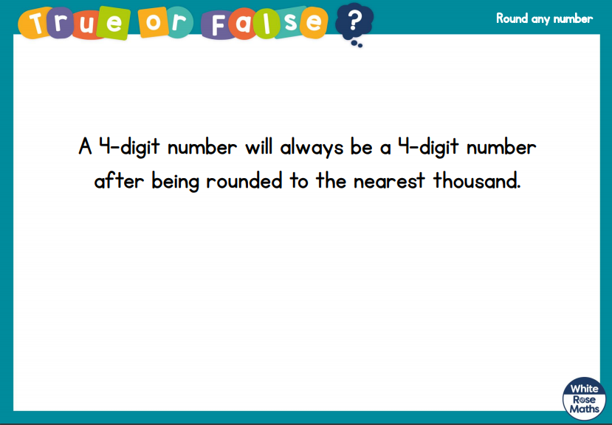
Plenary

Slide 16


