Slide 1
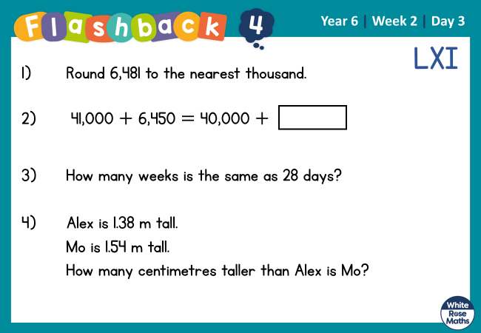

Slide 2
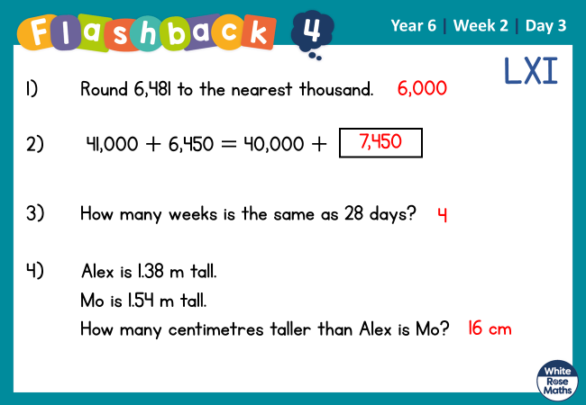

Slide 3


Arithmetic Starter

Slide 4
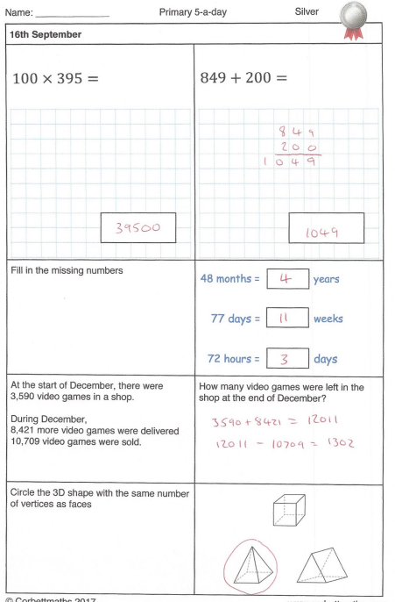
Arithmetic Starter - Answers

Slide 5


Slide 6
1) Which multiples of 10 does 73 lie between?
2) 4,000 _____ 3,800 _____
3) 8,800 8,900 _____ _____
4) Which multiples of 100 does 449 lie between?

Slide 7
1) Which multiples of 10 does 73 lie between?
2) 4,000 _____ 3,800 _____
3) 8,800 8,900 _____ _____
4) Which multiples of 100 does 449 lie between?
70 and 80
3,900
3,700
9,000
9,100
400 and 500

Slide 8
Round 37 to the nearest 10
40
30
40
37
Round 422 to the nearest 10
420
420
430
422

Slide 9


Have a think
Round 1,245 to the nearest 10
1,250
You can’t round this number to the nearest 10 because the ones is a 5
1,240
1,250
1,245

Slide 10
Have a think
Round these numbers to the nearest 100
3,472
100
3,400
3,450
3,500
3,472
4,376
4,400

Slide 11
Round 2,855 to the nearest 1,000
3,000
2,000
2,500
3,000
2,855

Slide 12
Have a think
Which numbers round to 31,000 when rounded to the nearest 1,000?
30,535
29,992
31,000
30,000
31,530
31,350
32,000
31,000

Slide 13

I’m thinking of an integer that is 23,100 when rounded to the nearest 100
What is the smallest number Jack could be thinking of?
23,050
23,050
23,070
23,090
23,110
23,130
23,150
23,060
23,080
23,100
23,120
23,140
What is the greatest number Jack could be thinking of?
23,149
Have a think

Slide 14
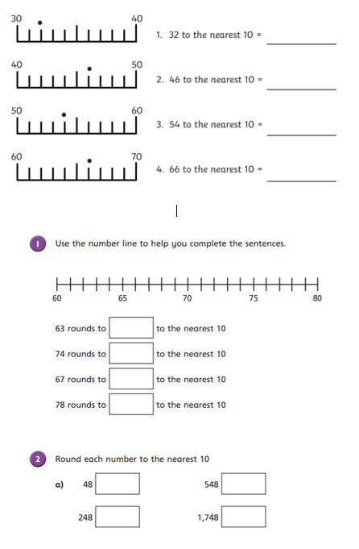
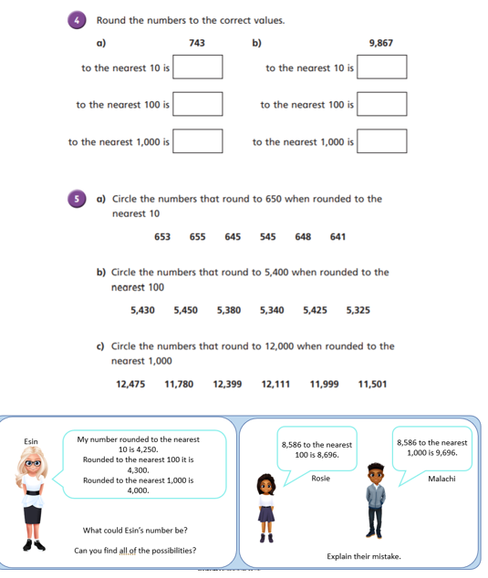
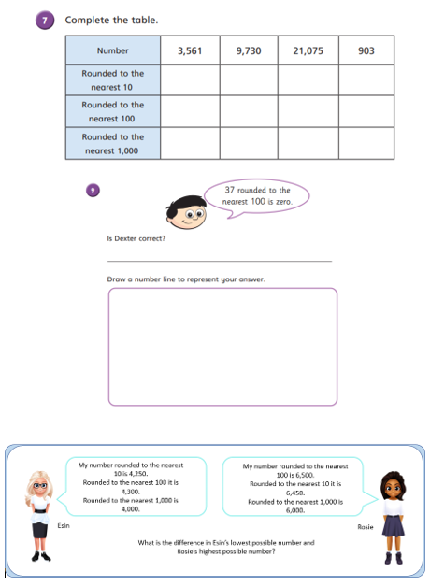
Independent Activity
Paddling Snorkelling Diving

Slide 15
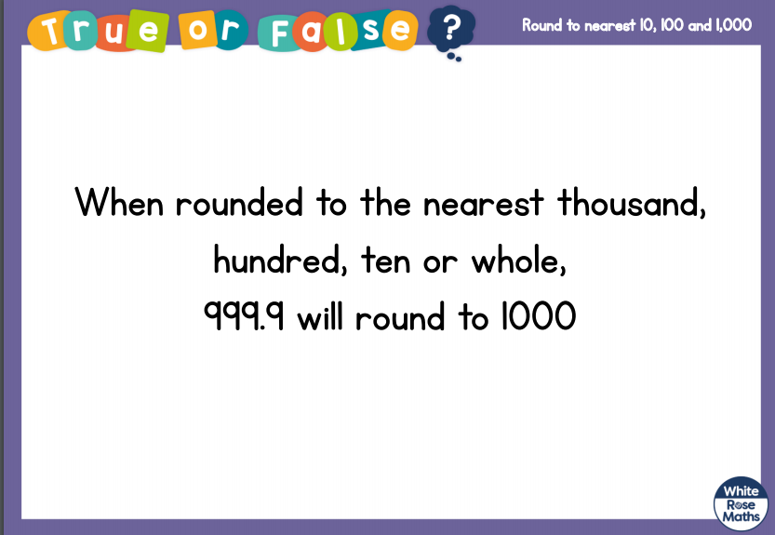
Plenary

Slide 16


