Slide 1
Year 6 | Week 1 | Day 4

Slide 2
Year 6 | Week 1 | Day 4

Slide 3


Arithmetic Starter

Slide 4
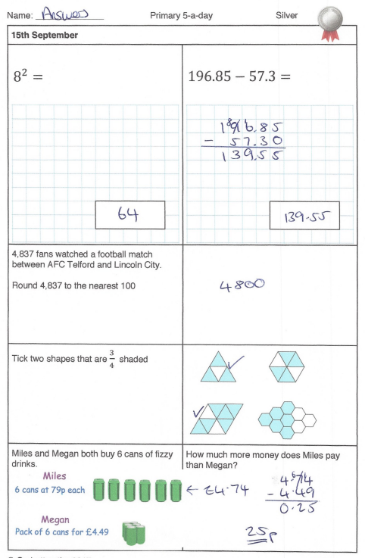
Arithmetic Starter - Answers

Slide 5


Slide 6
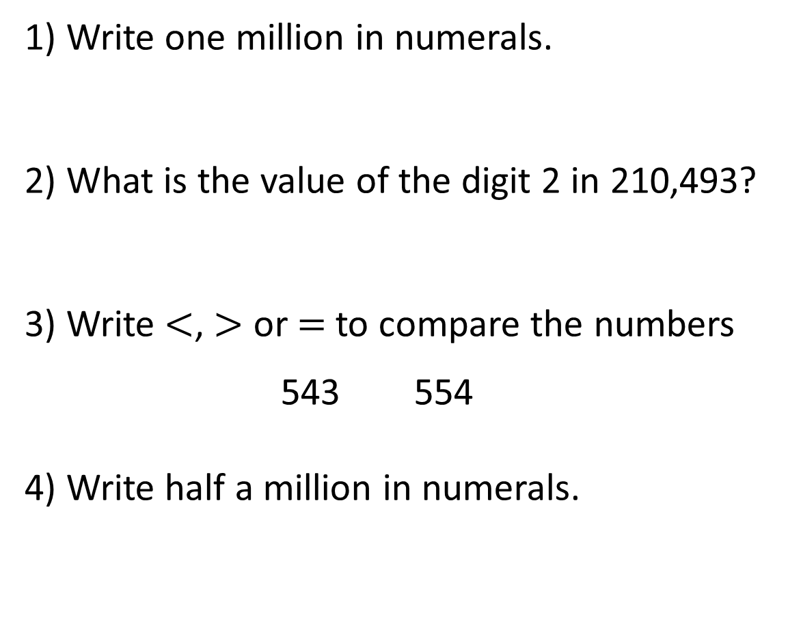
1) Write one million in numerals.
2) What is the value of the digit 2 in 210,493?
3) Write $<$, $>$ or $=$ to compare the numbers
543 554
4) Write half a million in numerals.

Slide 7

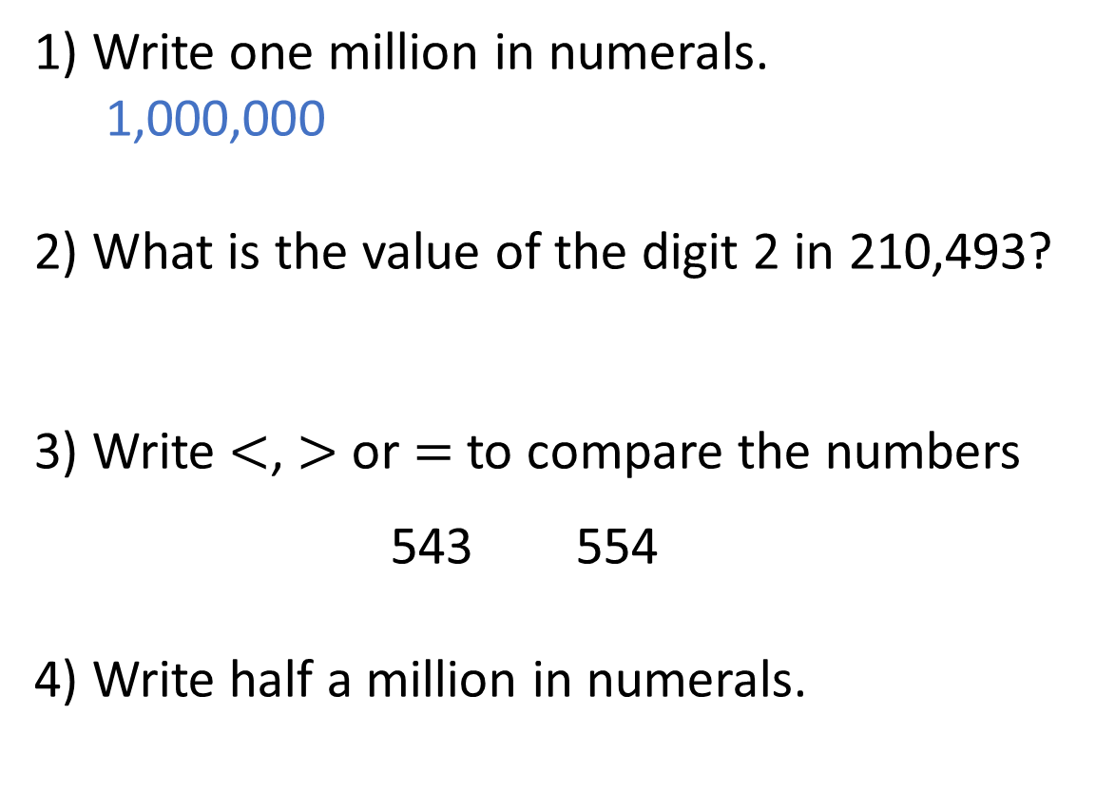
1) Write one million in numerals.
1,000,000
2) What is the value of the digit 2 in 210,493?
3) Write $<$, $>$or $=$ to compare the numbers
543 554
4) Write half a million in numerals.
200,000
$$<$$
500,000

Slide 8


Have a think
73,421 is greater than 132,812 because 7 is greater than 1

Slide 9

M | HTh | TTh | Th | H | T | O
0
7
3
4
2
1
1
3
2
8
1
2
73,421
$$<$$
132,812

Slide 10

Have a think
M | HTh | TTh | Th | H | T | O
2
1
2
7
3
1
2
3
3
8
1
4
212,731
$$<$$
233,814

Slide 11

Have a think
What could the missing digits be?
127
$$>$$
12_

Slide 12

Hundreds | Tens | Ones
Hundreds | Tens | Ones
120, 121, 122,
123, 124, 125, 126
127
12_
0
1
2
3
4
5
6
$$>$$
7

Slide 13
The table shows the height of 5 mountains.
Mountain | Height (m)
Mount Elbrus | 5,642
Kilimanjaro | 5,895
Aconcagua | 6,962
Mont Blanc | 4,810
Mount Everest | 8,848
Write the names of the mountains in order starting with the highest.

Slide 14
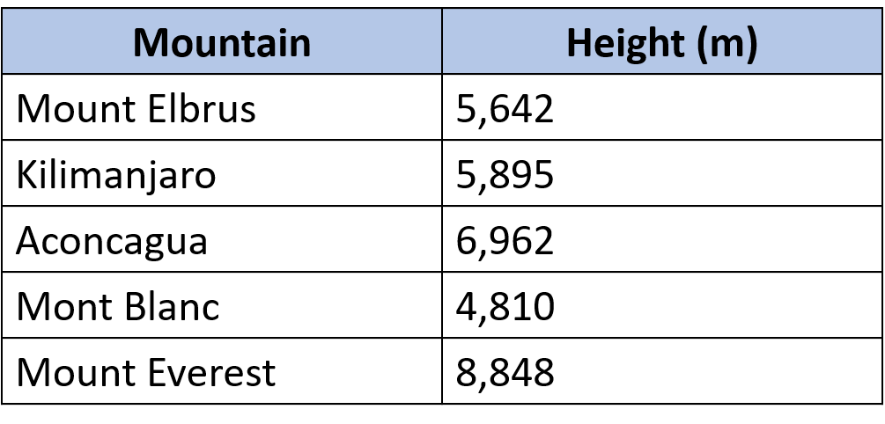
Write the names of the mountains in order starting with the highest.
Thousands | Hundreds | Tens | Ones
5
6
4
2
5
8
9
5
6
9
6
2
4
8
1
0
8
8
4
8
Mount Everest,
Aconcagua,
Kilimanjaro,
Mount Elbrus,
Mont Blanc

Slide 15
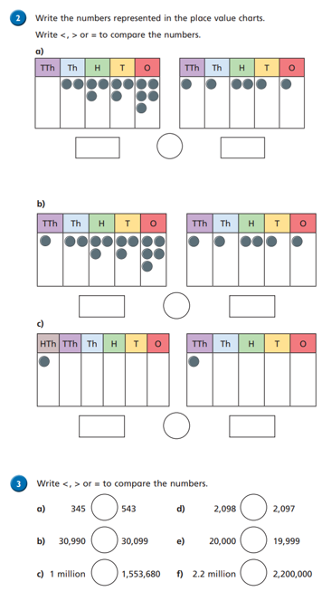
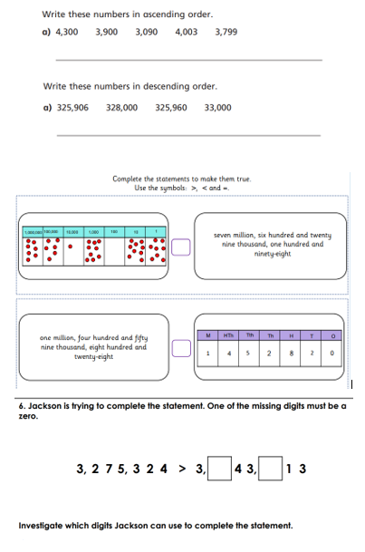
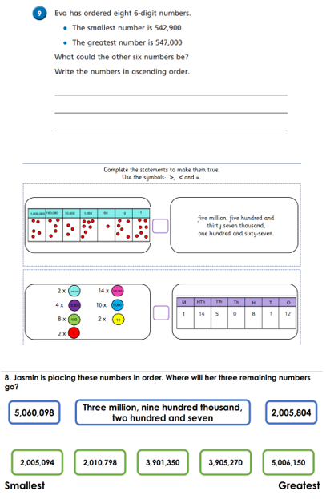
Independent Activity
Paddling Snorkelling Diving

Slide 16
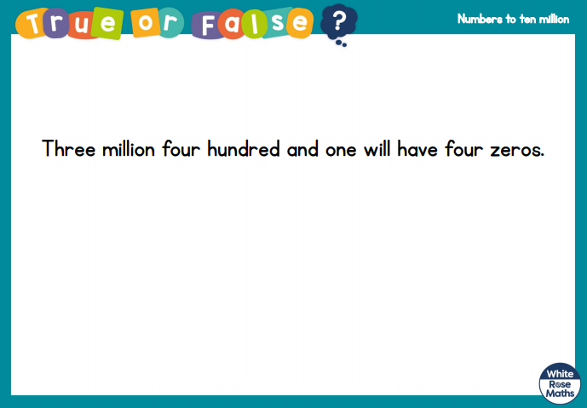
Plenary

Slide 17


