Slide 1
Monday 13th September 2021
LO: to write with purpose
to use imaginative description
to use paragraphs
C: Pandora’s Box

Slide 2
Starter
Paragraphs
What can you tell me about paragraphs?
Create a bubble map of what you know.

Slide 3
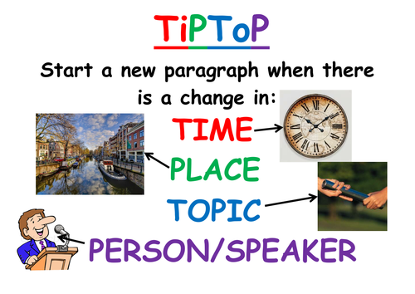
https://www.bbc.co.uk/bitesize/articles/zm9dqp3
What can you tell me about paragraphs now?
Is there anything you want to add to the bubble map?

Slide 4

Remember:
Paragraphs are sections of text used to structure writing to make it clear and easy to read.
They are a section of writing consisting of one or more sentences grouped together and discussing one main subject.
New paragraphs are signaled by leaving a line blank.
Paragraphs help to structure text; every new paragraph starts on a new line.
We start a new paragraph to signal that the person, place, time or topic of the sentences has changed.
In fiction texts, paragraphs are usually used to mark breaks in time.
A new paragraph may also be started if the point of view switches from one character to another.

Slide 5
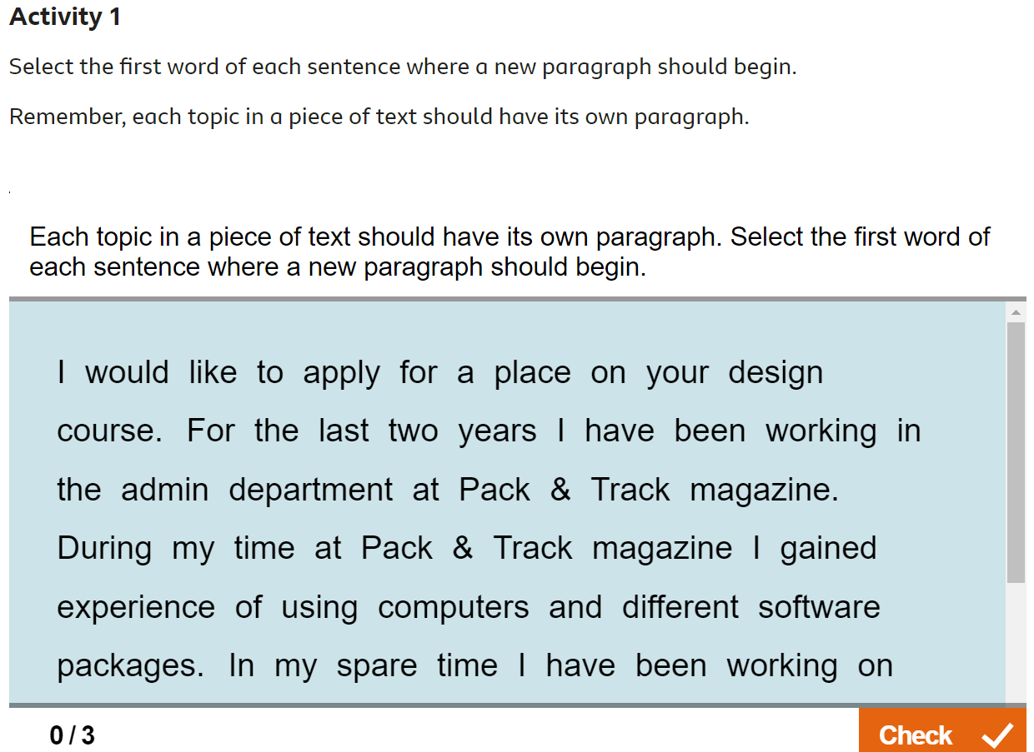
https://www.bbc.co.uk/bitesize/articles/zm9dqp3
Complete Activity 1 on the webpage below.

Slide 6
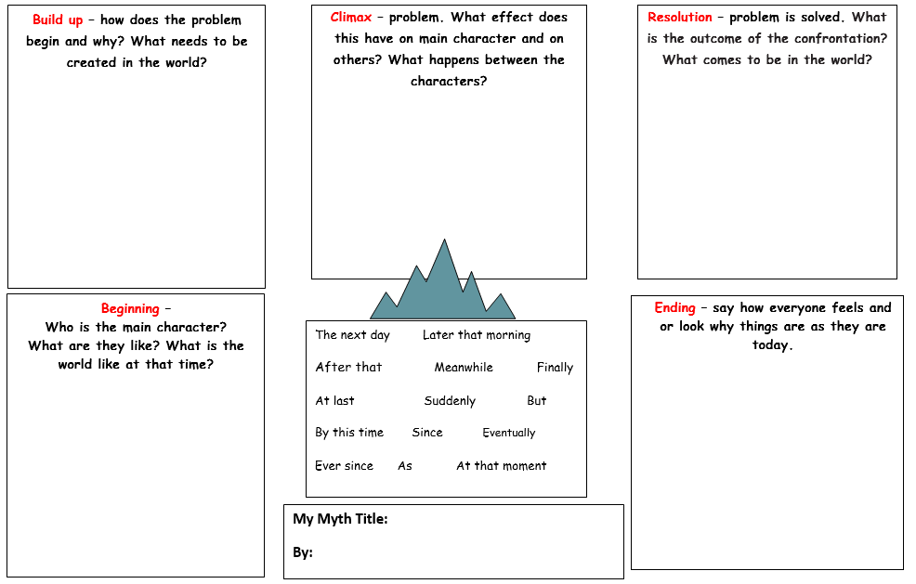
You are going to write the beginning of your myth today!
Look back at your planning template from last week.
What information should you be including in the ‘beginning’ of your myth?
What will you include in your beginning?

Slide 7
My Myth
What features of writing can you identify?
What has impress you with my writing?
Is there anything I could do to improve?
What have I included from the checklist?
What is left to include?
Jot down any impressive words/phrases that you would like to magpie.
As Zeus, the King of the Gods, stood on the edge of the picturesque clifftop and surveyed the world below him, he smiled wearily. The tranquil, blue sea sparkled like a rare jewel and rippled softly in the breeze. All was quiet except for the soothing, rhythmic splash of the waves rolling onto the beach. His piercing, blue eyes followed the narrow, winding coastal path to the village below, to the world he had created with Prometheus. It was thriving. The people of the Earth were content, for Zeus had provided for them. There were no troubles, arguments or concerns. It was idyllic. Zeus looked approvingly at Prometheus who had helped the King of the Gods by moulding the people out of clay.

Slide 8
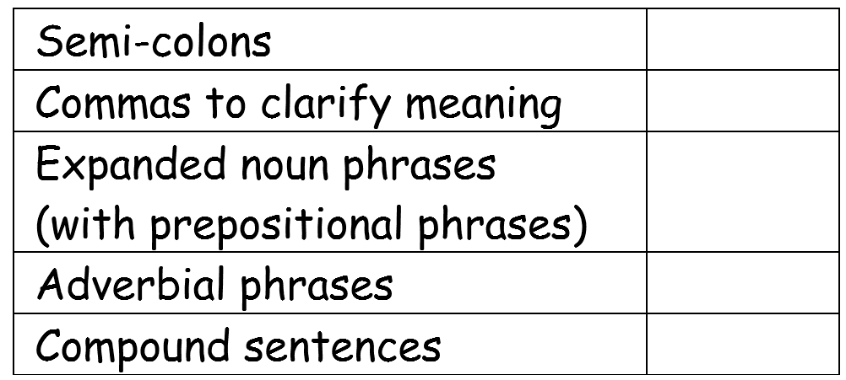
I am looking for all of these things in your writing this week.
You don’t have to include everything on the checklist in your writing today.
We have looked at each of the features on this checklist in our English lessons over the last week or so.

Slide 9
Activity
Use your planning template from last week to write your ‘beginning.’

Slide 10
Red Pen
Look back over your writing from today.
Do all of your sentences make sense?
How many features of the checklist have you included? Have you used them correctly?
Could you write a sentence or two now to tick off any more items on the checklist?

Slide 11
Tuesday 14th September 2021
LO: to write with purpose
to use imaginative description
to use paragraphs
C: Pandora’s Box

Slide 12

Starter
Do you know what this punctuation mark is?
Do you know what it is used for in writing?

Slide 13
This is a semi-colon!
Semi-colons are used to separate two independent (main) clauses that are closely related.
The clauses must be on the same theme and must not be joined together with a conjunction. The semi-colon takes the place of the conjunction within the sentence.
Both parts must be linked (about the same topic).
They are often used to contrast.
As with commas and full stops, semi-colons make the reader ‘pause’ when they come across them.
A reader should pause for a short time with a comma, for longer and more deliberately with a semi-colon and longest for a full stop.

Slide 14
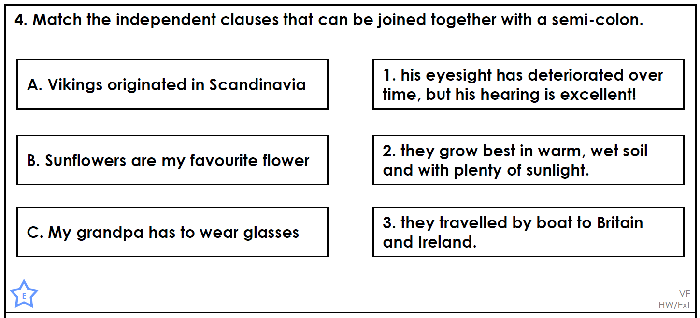
Answer the question below.

Slide 15
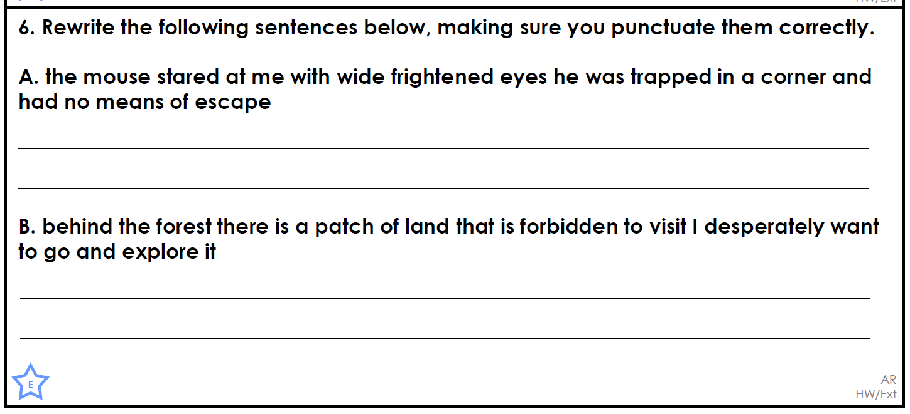
Answer the question below.

Slide 16
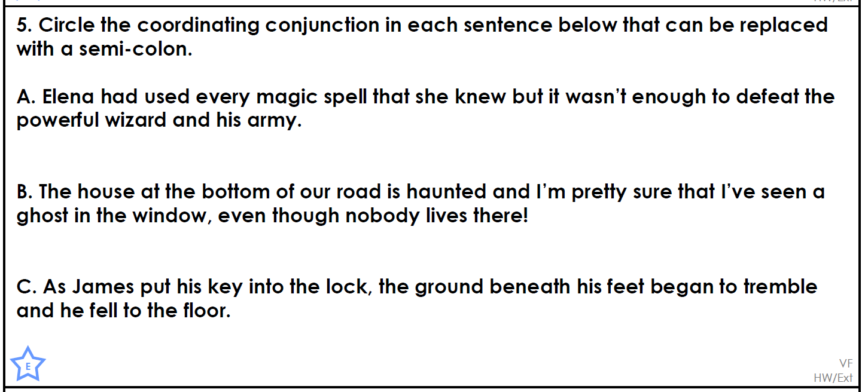
Answer the question below.

Slide 17
Today, you are going to be writing your ‘build up’ and climax/problem.’
Look back at your planning template from last week.
What information should you be including in the ‘build up/climax’ of your myth?
What will you include in your build up/climax?

Slide 18
Think of sentences with semi-colons that you can use in your writing today.
Write your ideas down so you can remember them!
Use the sentence starters below to help you.
Some…; others…
Zeus believed…; Prometheus believed…
Prometheus…; however, …
The woman was…; her…
E.g.
Some think Zeus’ actions were malicious; others believe they were justifiable.
Zeus believed the gods were superior to mankind; Prometheus believed they were equal.
Prometheus suffered a fate worse than death; however, he did not regret his actions.
The woman was slim and dainty; her narrow, pointed face was frame by a mass of curly, black hair.

Slide 19
Remember: I am looking for all of these things in your writing this week.
You don’t have to include everything on the checklist in your writing today.
We have looked at each of the features on this checklist in our English lessons over the last week or so.

Slide 20
My Myth
What features of writing can you identify?
What has impress you with my writing?
Is there anything I could do to improve?
What have I included from the checklist?
What is left to include?
Jot down any impressive words/phrases that you would like to magpie.
The earth was harmonious, until the fateful day when Prometheus disobeyed Zeus. Prometheus had watched his humans suffering, shivering in the dark and eating raw meat. With no heat source on Earth, mankind were desperately cold and hungry. He was deeply troubled and upset by the struggle his creation faced every day, so he asked Zeus if he could give the people of the earth fire. Without hesitation, Zeus refused, selfishly claiming that fire was only for the gods. Prometheus ignored Zeus’ instructions; he decided to give man fire regardless. As the vulnerable, defenseless humans shivered in the dark eating, Prometheus crept up to Mount Olympus and broke off a blazing beam of sun for the suffering people.
Zeus was enraged by Prometheus’ betrayal. He roared wildly with anger; Prometheus must face the consequences of his actions. Zeus punished Prometheus, with a cruel plan. Shaking with anger, Zeus shackled Prometheus to a jagged rock with unbreakable, titanium chains far away in the mountains where nobody would find him.

Slide 21
My Myth
What features of writing can you identify?
What has impress you with my writing?
Is there anything I could do to improve?
What have I included from the checklist?
What is left to include?
Jot down any impressive words/phrases that you would like to magpie.
Unfortunately, Zeus had not finished there. He decided to punish mankind for accepting Prometheus’ gift. Some believe Zeus’ actions were malicious; others think they were justifiable. With the help of the God Hephaestos, Zeus created a beautiful, inquisitive woman named Pandora to use in his vengeful scheme. The woman was slim and dainty; her narrow, pointed face was framed by a mass of curly, black hair. She had wide, bulging eyes like a frog, that stared as if she were in a trance and a tiny rosebud mouth.
He sent her to Earth with a gift. Some say it was an intricately decorated, wooden box with a heavy, rusting lock; others say it was a clouded, glass jar. Zeus expressly told Pandora not to open it. He warned her that grievous things would occur if she did. Pandora’s eyes twinkled excitedly and her fingers twitched. She was exceptionally mystified, yet Pandora reluctantly agreed.

Slide 22
Did you notice that I used paragraphs in my writing?
Remember:
Paragraphs help to structure text; every new paragraph starts on a new line.
We start a new paragraph to signal that the person, place, time or topic of the sentences has changed.
In fiction texts, paragraphs are usually used to mark breaks in time. a new paragraph may also be started if the point of view switches from one character to another.

Slide 23
Activity
Use your planning template from last week to write your ‘build up’ and ‘climax/problem.’
Diving: ensure your stories are historically accurate. Use the Ancient Greek Fact Files to help you.

Slide 24
Red Pen
Look back over your writing from today.
Do all of your sentences make sense?
Have you started a new paragraph when the person, place, time or topic of your sentences have changed? If you haven’t – show me with an arrow where your new paragraph should go.
How many features of the checklist have you included? Have you used them correctly?
Could you write a sentence or two now to tick off any more items on the checklist?

Slide 25
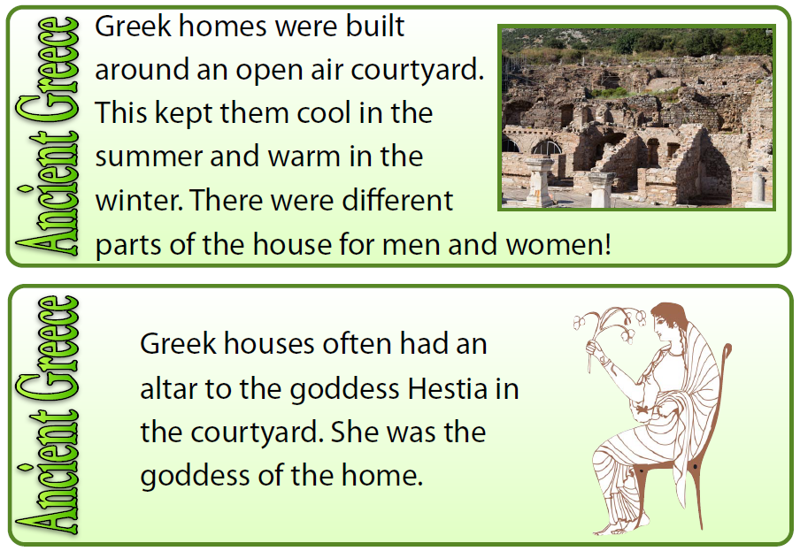
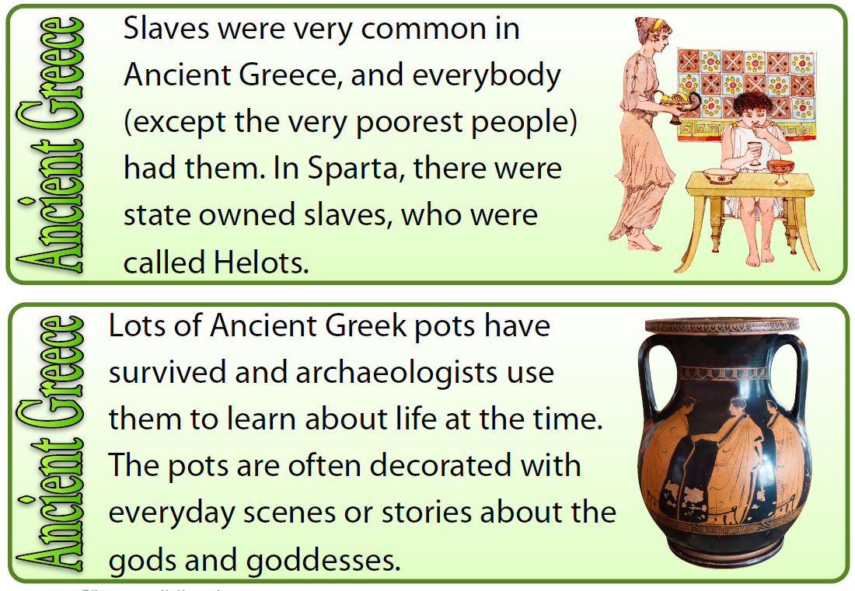
Divers
What can you remember about ancient Greeks from Year 5?
What would the Greek times have been like?
I would like your stories to be historically accurate and refer to aspects of the Greek times in order to make your stories more genuine.
E.g. what would their clothing have been like?
How would they have travelled?
How would they have sent a message to someone?
What food might they have eaten?

Slide 26
Wednesday 15th September 2021
LO: to write with purpose
to use imaginative description
to use paragraphs
C: Pandora’s Box

Slide 27
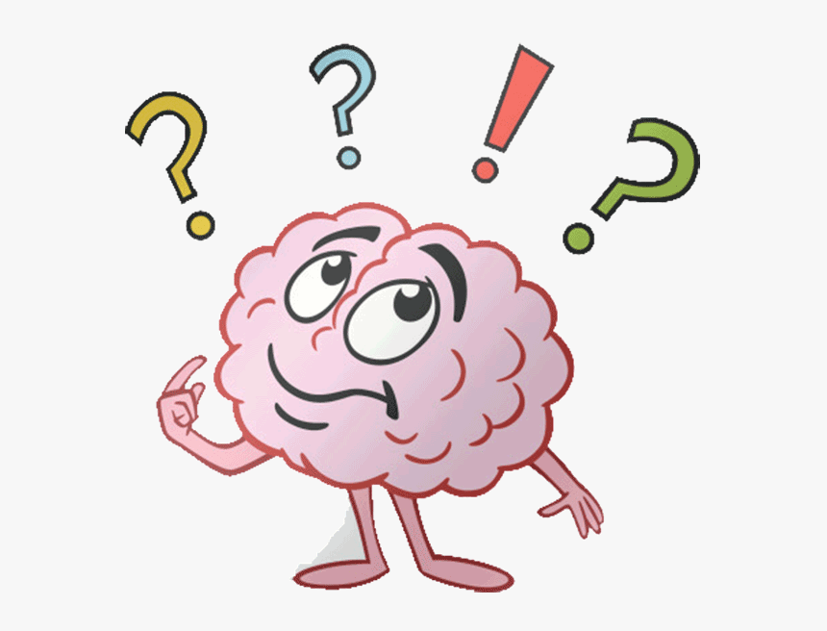
What are adverbial phrases?
They are like adverbs.
They add more information to the sentence, but they use more than one word to describe the verb.
Adverbial phrases can make a sentence more interesting and exciting.
They can tell us how, when, where, why and how long a verb is done.
Can you think of any examples of adverbial phrases?

Slide 28
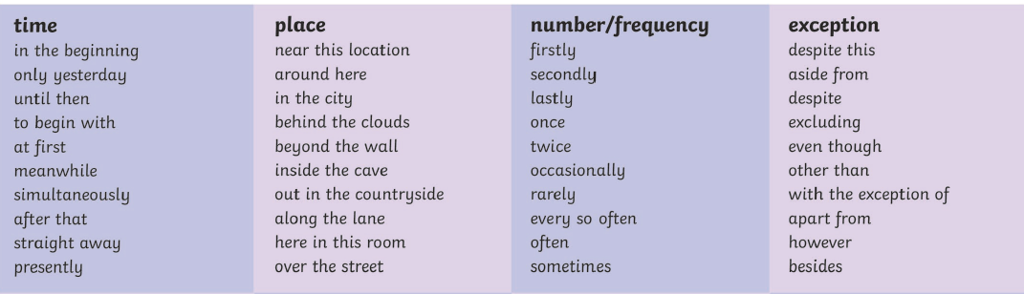
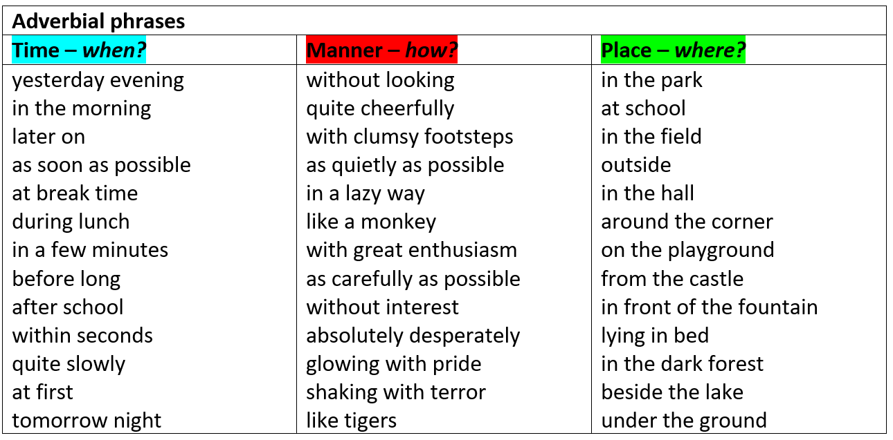

Slide 29
Today, you are going to be writing your ‘resolution’ and ‘ending.’
Look back at your planning template from last week.
What information should we be including in the ‘resolution/ending’ of our myth?
What will you include in your resolution/ending?

Slide 30
Think of sentences with adverbial phrases that you can use in your writing today.
Write your ideas down so you can remember them!

Slide 31
We have looked at each of the features on this checklist in our English lessons over the last week or so.
Which features have you included in your writing already?
Which features do you need to include in your writing today?

Slide 32
My Myth
What features of writing can you identify?
What has impress you with my writing?
Is there anything I could do to improve?
What have I included from the checklist?
What is left to include?
Jot down any impressive words/phrases that you would like to magpie.
At first, Pandora had no desire to open the box; she had promised Zeus that the lid would remain firmly closed. However, as time passed, Pandora’s thoughts about the box’s contents grew until she could think of little else. She could no longer stand the torture of not knowing what was inside the beautiful box. For days, Pandora clutched the delicate, sealed box to her chest, for she was desperate to open it. Every day, she would gently caress the carved woodwork and fiddle clumsily with the golden clasp. Consumed by her curiosity, Pandora was driven to the box. She was determined, for she believed the box contained a bountiful treasure of jewels.

Slide 33
My Myth
What features of writing can you identify?
What has impress you with my writing?
Is there anything I could do to improve?
What have I included from the checklist?
What is left to include?
Jot down any impressive words/phrases that you would like to magpie.
Finally, Pandora could stand it no longer. The house was silent and absolutely still; she realised this was her chance to open the curious, detailed box. Her fingers anxiously clasped the lock. Hardly able to breathe, heart beating with excitement, Pandora broke the lock and gingerly lifted the lid. Before she could peer inside, there was an ear-piercing scream from within. Jumping back in terror, Pandora watched with horror as all of the evils now known to mankind poured out of the box, polluting her wonderful world.
Racism. Sexism. Poverty. War. Hatred. Cruelty.
Pandora screamed with fear and desperately tried to slam the lid down, but it was too late. The evils had already escaped into the world. Some believe that Pandora was impatient; others think she was simply curious.
As the last destructive creature left the box, a distraught Pandora noticed a tiny flicker of light from within which fluttered and flew gracefully upwards and away.
LOVE.

Slide 34
Did you notice I used paragraphs and adverbial phrases?
Remember you should be aiming to use these in your writing today!

Slide 35
Activity
Use your planning template from last week to write your ‘resolution’ and ‘ending.’

Slide 36
Red Pen
Look back over your writing from today.
Do all of your sentences make sense?
Have you started a new paragraph when the person, place, time or topic of your sentences have changed? If you haven’t – show me with an arrow where your new paragraph should go.
How many features of the checklist have you included? Have you used them correctly?
Could you write a sentence or two now to tick off any more items on the checklist?

Slide 37
Thursday 16th September 2021
LO: to write with purpose
to punctuate accurately
C: Pandora’s Box

Slide 38
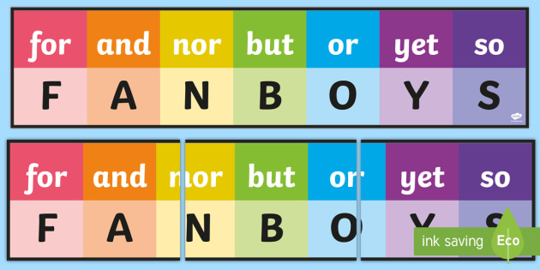
Starter
What is this?
What does it stand for?

Slide 39
FANBOYS helps us to remember coordinating conjunctions.
Remember: a conjunction links words, phrases or clauses together.
Coordinating conjunctions are conjunctions that go between, and links, words, phrases, clauses or sentences of equal importance.
Compound sentences are formed when two main (independent) clauses are linked together using coordinating conjunctions

Slide 40
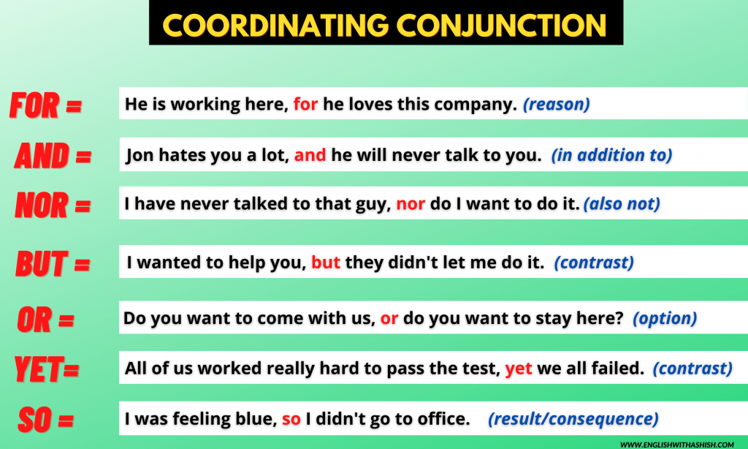
Do you know the meaning of each conjunction?

Slide 41
Have you used FANBOYS conjunctions in your myths?
Look through your work and identify any coordinating conjunctions you have used in your writing.
If you haven’t used any sentences with these conjunctions, think of some sentences now!
Try to use a range of conjunctions.
See if you can add coordinating conjunctions to your writing when you edit today.

Slide 42

Look back at your work.
What have you done well?
What features have you correctly used?
What do you need to improve?
What features have you not included from the checklist?

Slide 43
Activity
Edit and improve your myth.
Red Pen: ask an adult to read through your work. What have you done well? What do you need to do to improve? Ask an adult to help you improve their work: it may be correcting spelling mistakes, rewriting sentences which don’t make sense, correcting the use of semi-colons or commas, improving your vocabulary choices etc.

