Slide 1
LO: To understand evolution and inheritance
To work scientifically
C: Evolution

Slide 2
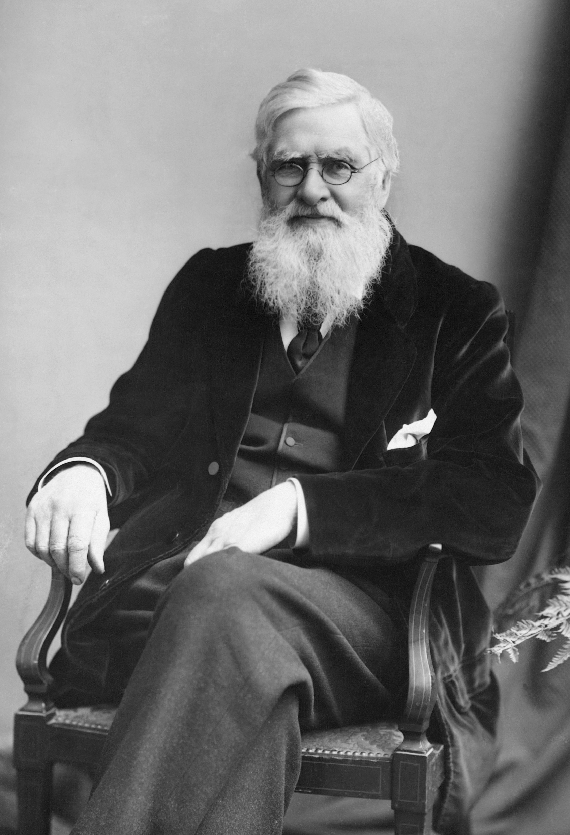
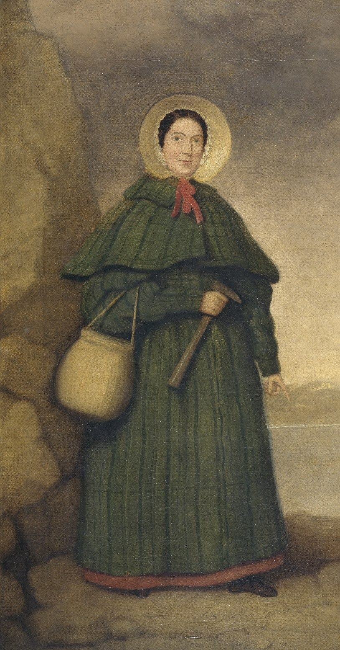
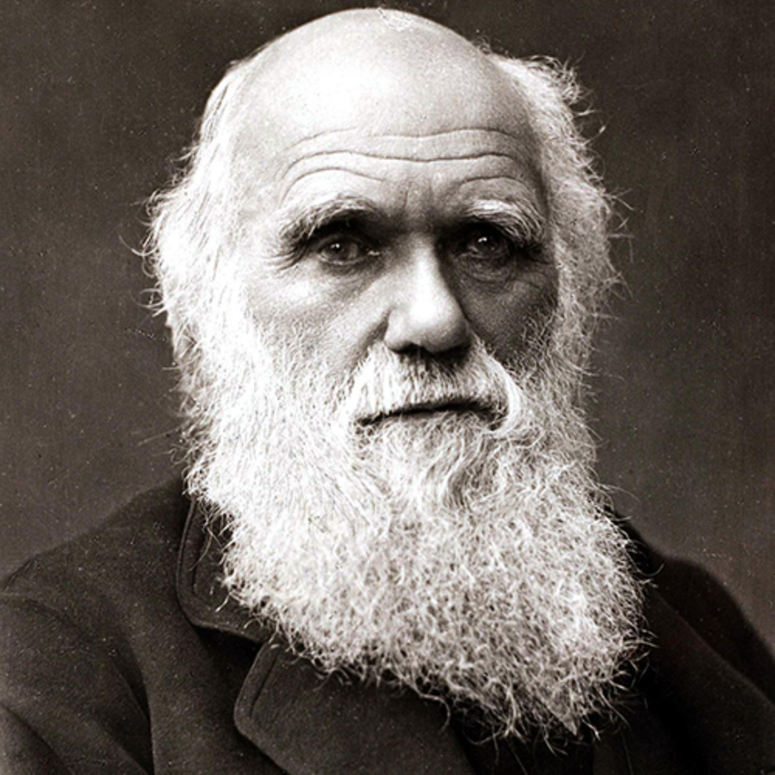
Starter
What facts did you learn about the three key evolution scientists (Anning, Darwin and Wallace) last week?

Slide 3
Starter
These scientists used processes to develop their theories, for example finding and using the fossil record, observing living things and their environments, looking for patterns in nature etc.
It is this scientific approach that has given rise and helped to support theories of evolution.

Slide 4

Starter
What is a theory?
A theory is a logical idea based on the interpretation of scientific investigations, observations and evidence.

Slide 5
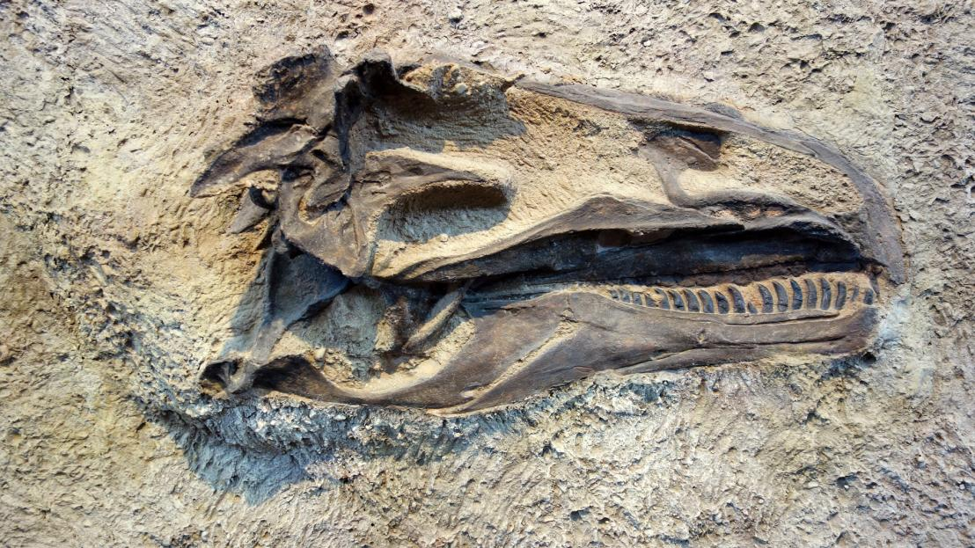
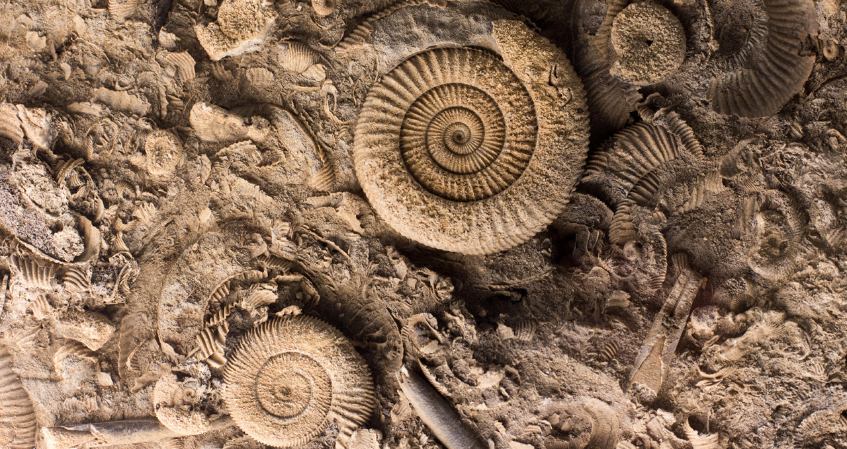
What is a fossil?
How are fossils formed?

Slide 6
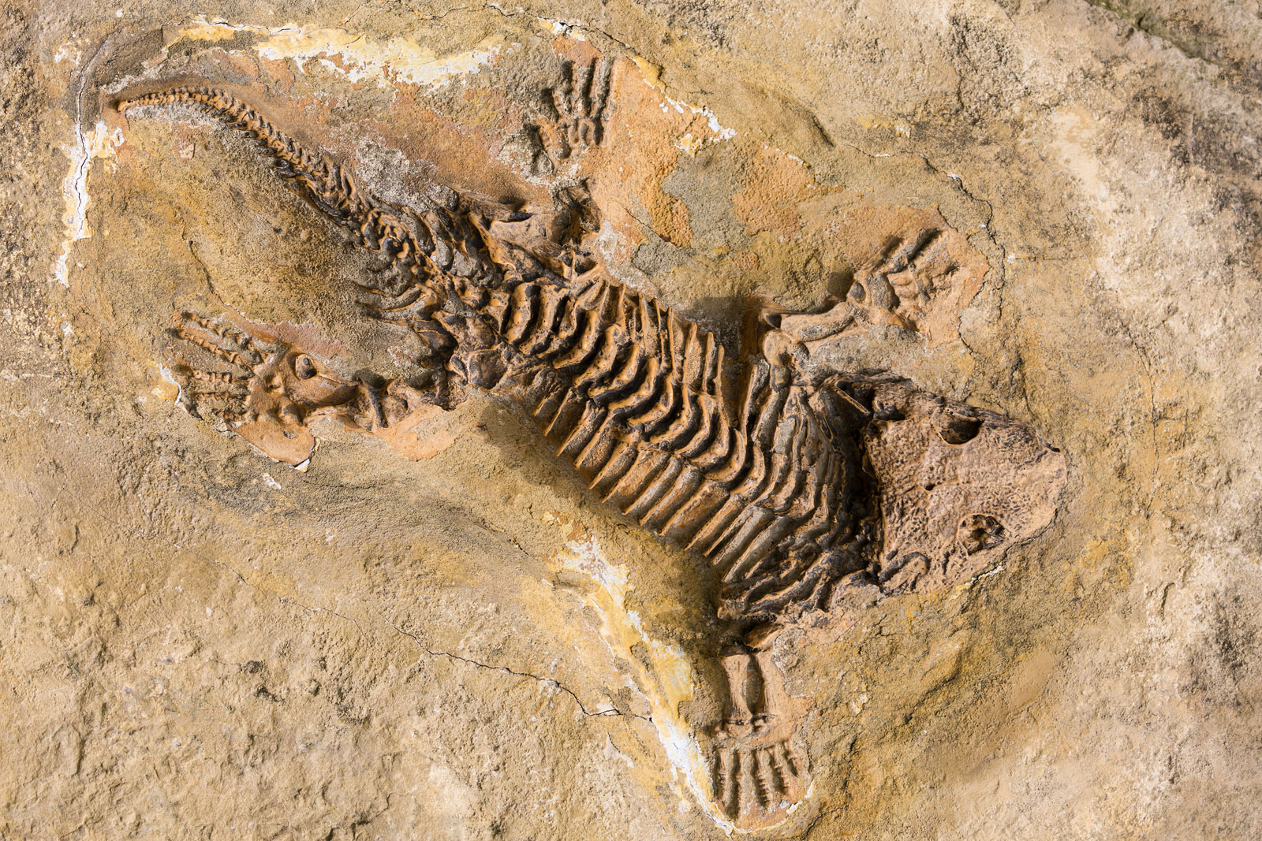
Fossils are the stone remains of dead animals or plants.
Fossils are usually the skeletons of animals and plants, but not always.
Fossils can also be things made by animals like footprints or waste!

Slide 7
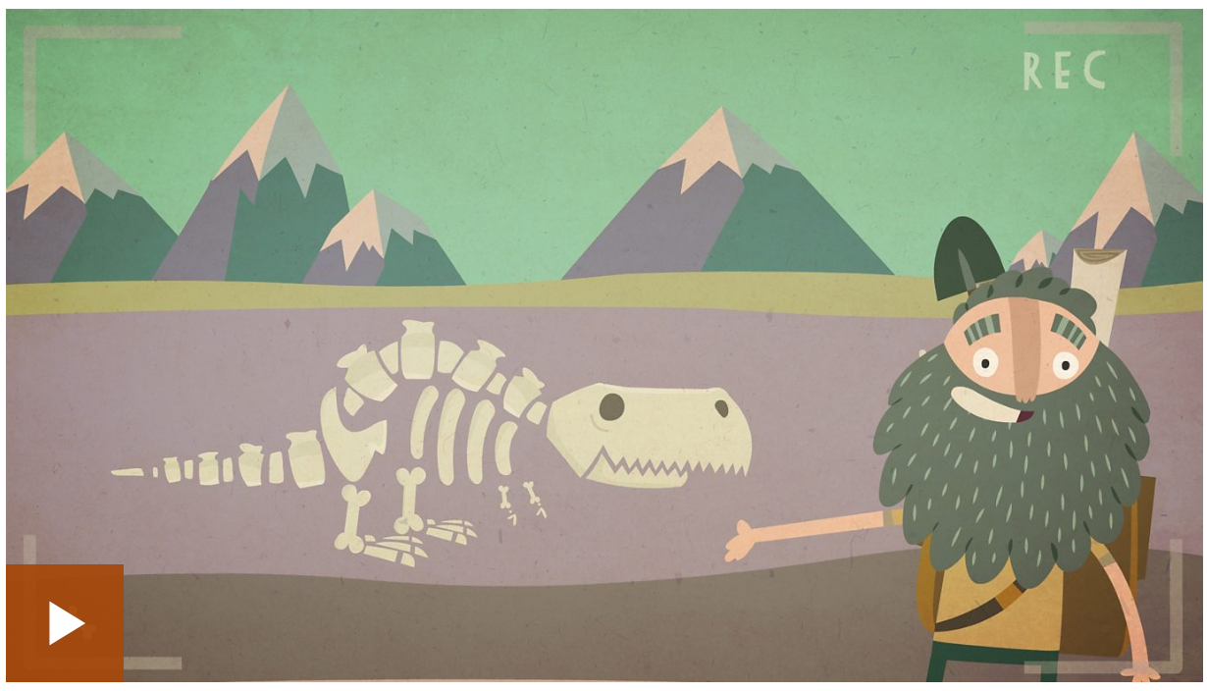
https://www.bbc.co.uk/bitesize/topics/z9bbkqt/articles/z2ym2p3

Slide 8
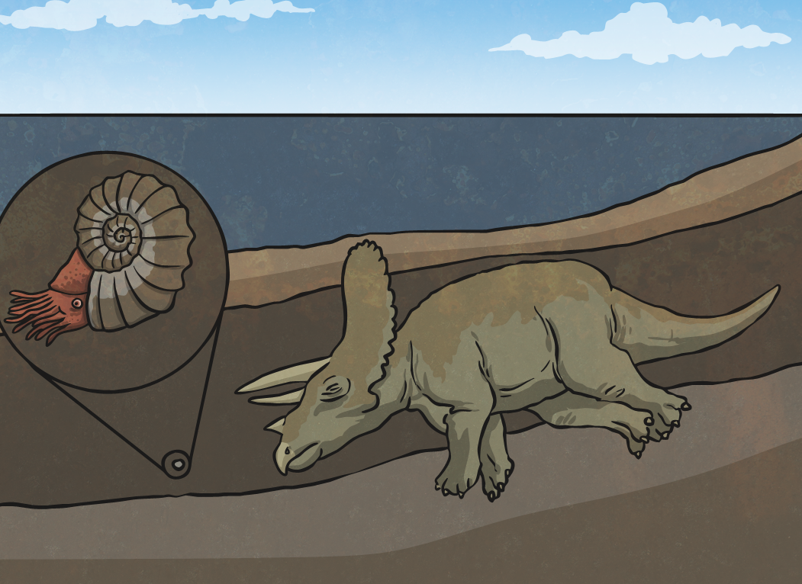
How is a Fossil Made?
An animal or creature dies. Its remains get covered in mud and dirt over time.

Slide 9
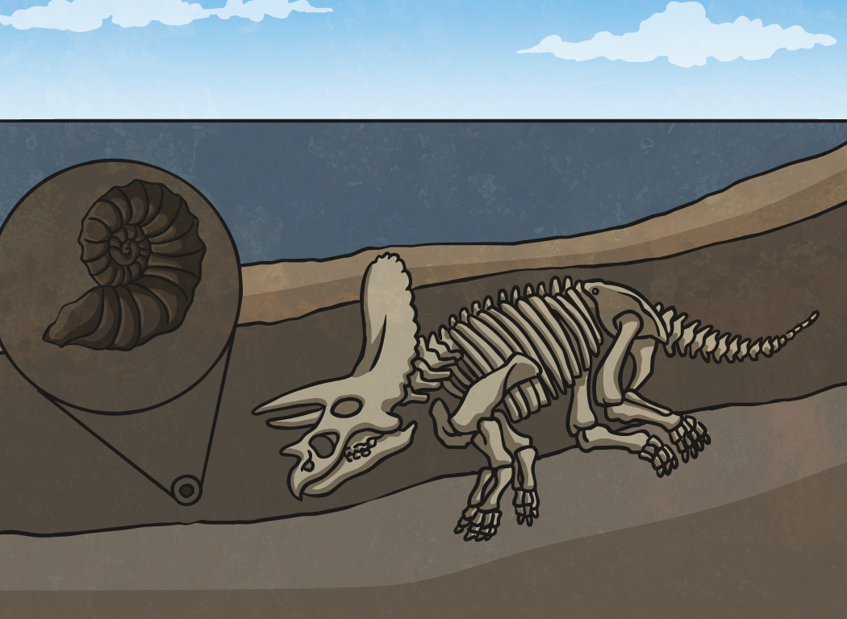
How is a Fossil Made?
Over thousands of years, pressure builds up from all the layers of rock and mud covering the skeleton. The skeleton is dissolved by ground water. This makes a perfect mould of the skeleton.

Slide 10
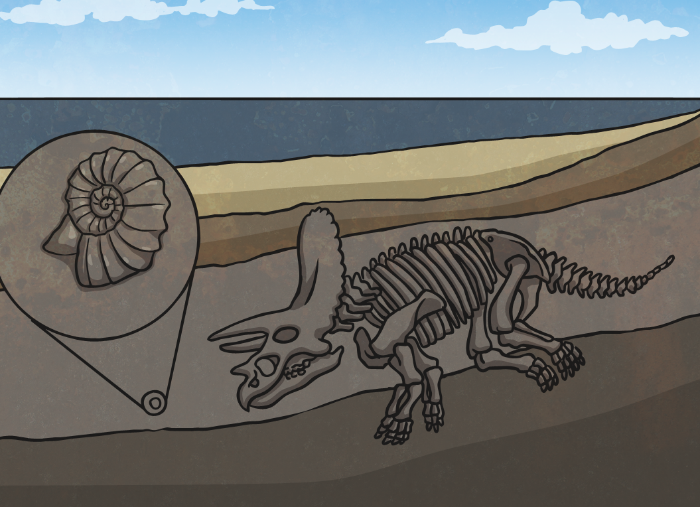
How is a Fossil Made?
Minerals in the ground water begin to fill the mould of the skeleton. These minerals form rock within the mould (this takes at least 10,000 years).

Slide 11
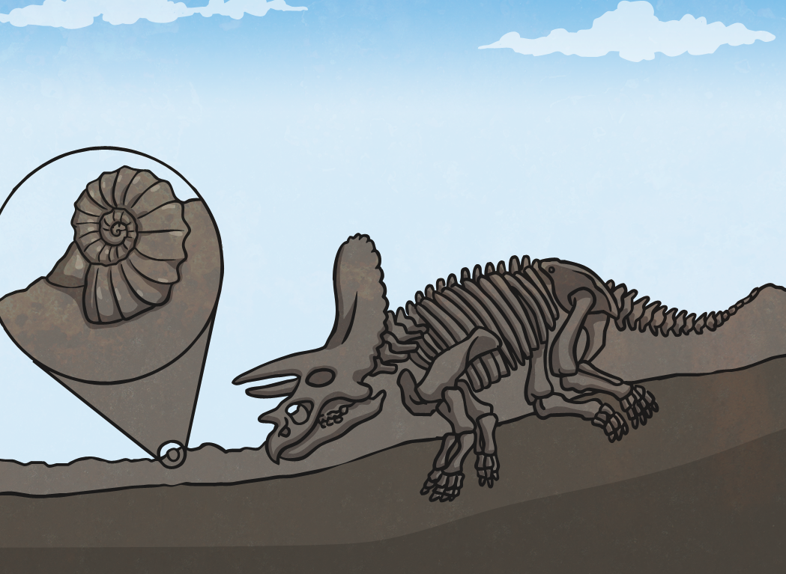
How is a Fossil Made?
Finally all that’s left is a perfect fossilised skeleton. Over time, the layers of rock and earth erode away leaving the fossil to be found.

Slide 12
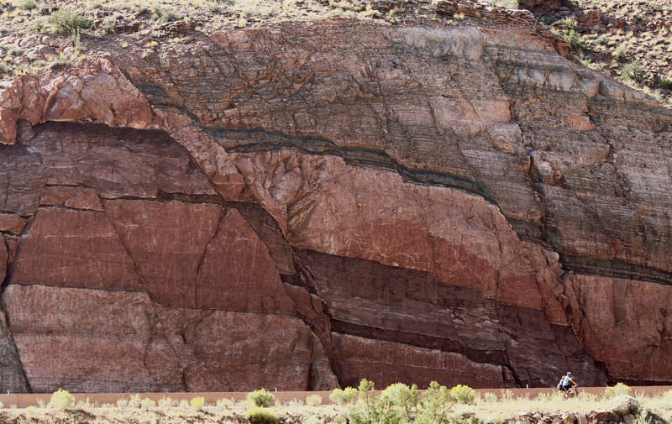
The process of fossilisation needs very specific conditions which means that the ‘fossil record’ can often seem sparse.
How do we know when creatures lived from fossils?
By aging the rock.
The deeper the fossil is found, the older it is likely to be as older rock is generally further into the earth.

Slide 13
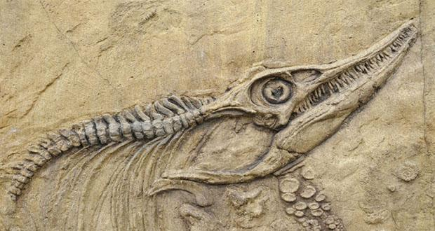
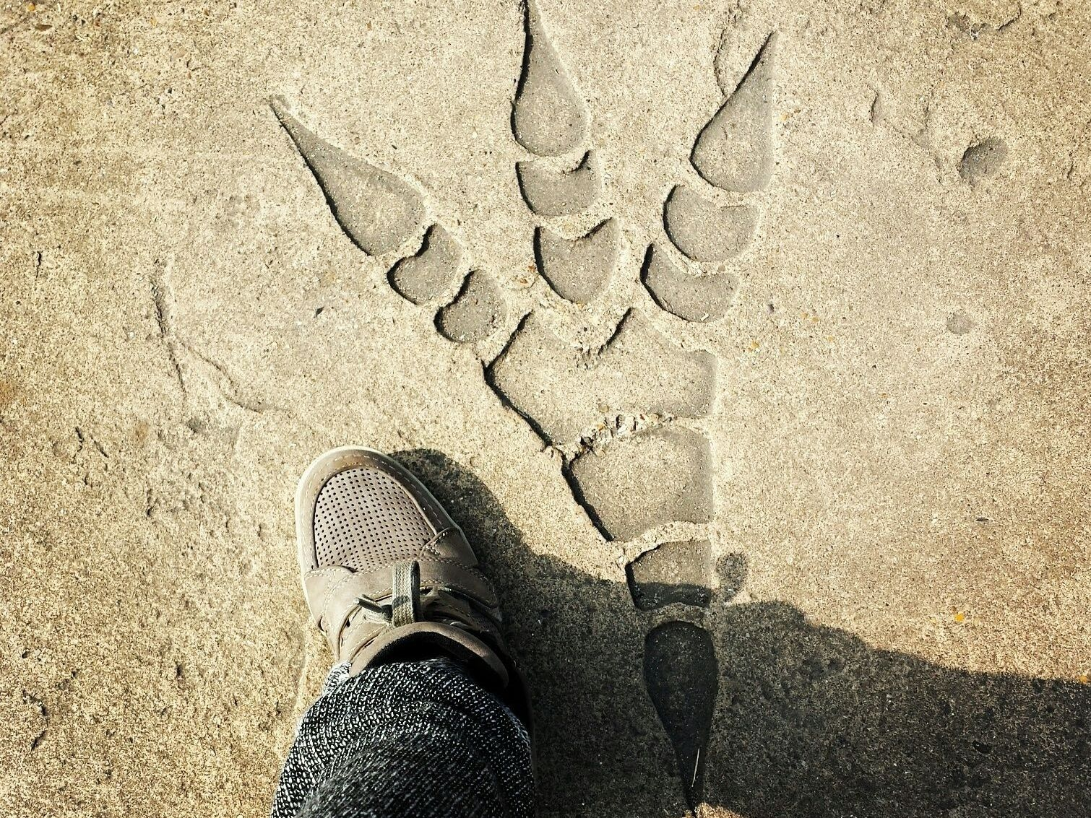
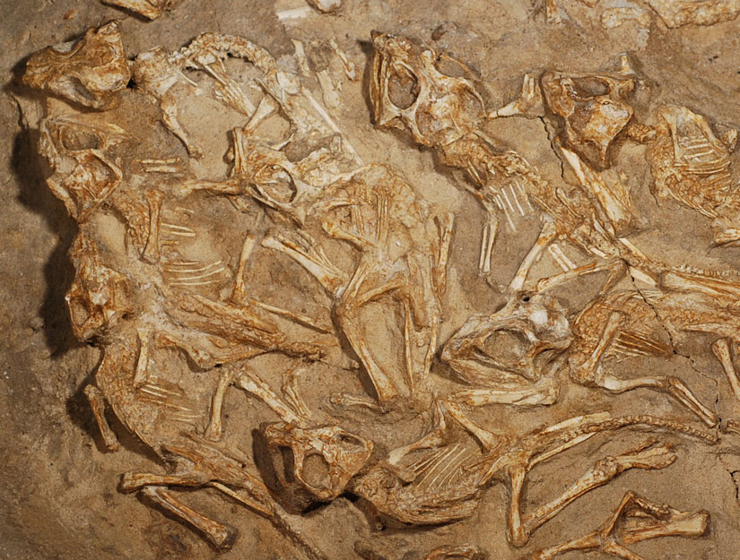
What can fossils tell us about?
Anatomy, movements (footprints), behaviour (nests) etc.

Slide 14

Today, you are going to have a go at being evolutionary scientists!
You will be given some of the evidence and observations available to Anning, Darwin and Wallace.
You will need to try to identify ways in which your evidence supports the evolutionary theory.

Slide 15
Activity
Look at the scientist’s challenges on the website and the associated evidence along with the theory that the evidence should back up.
You will need to study the evidence in order to draw logical conclusions to back up the theories.

Slide 16
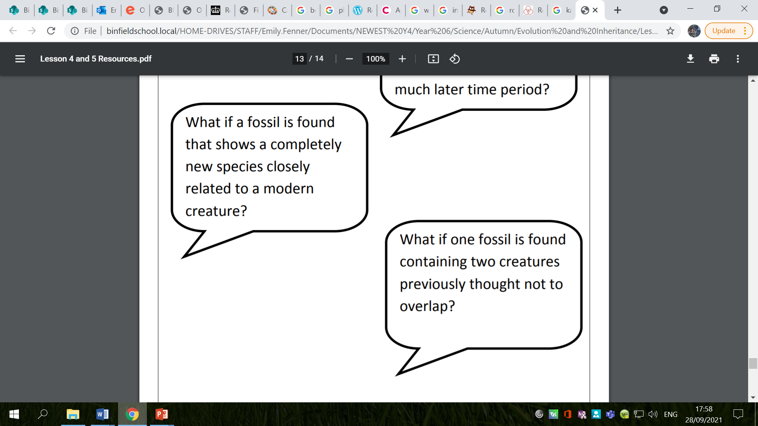
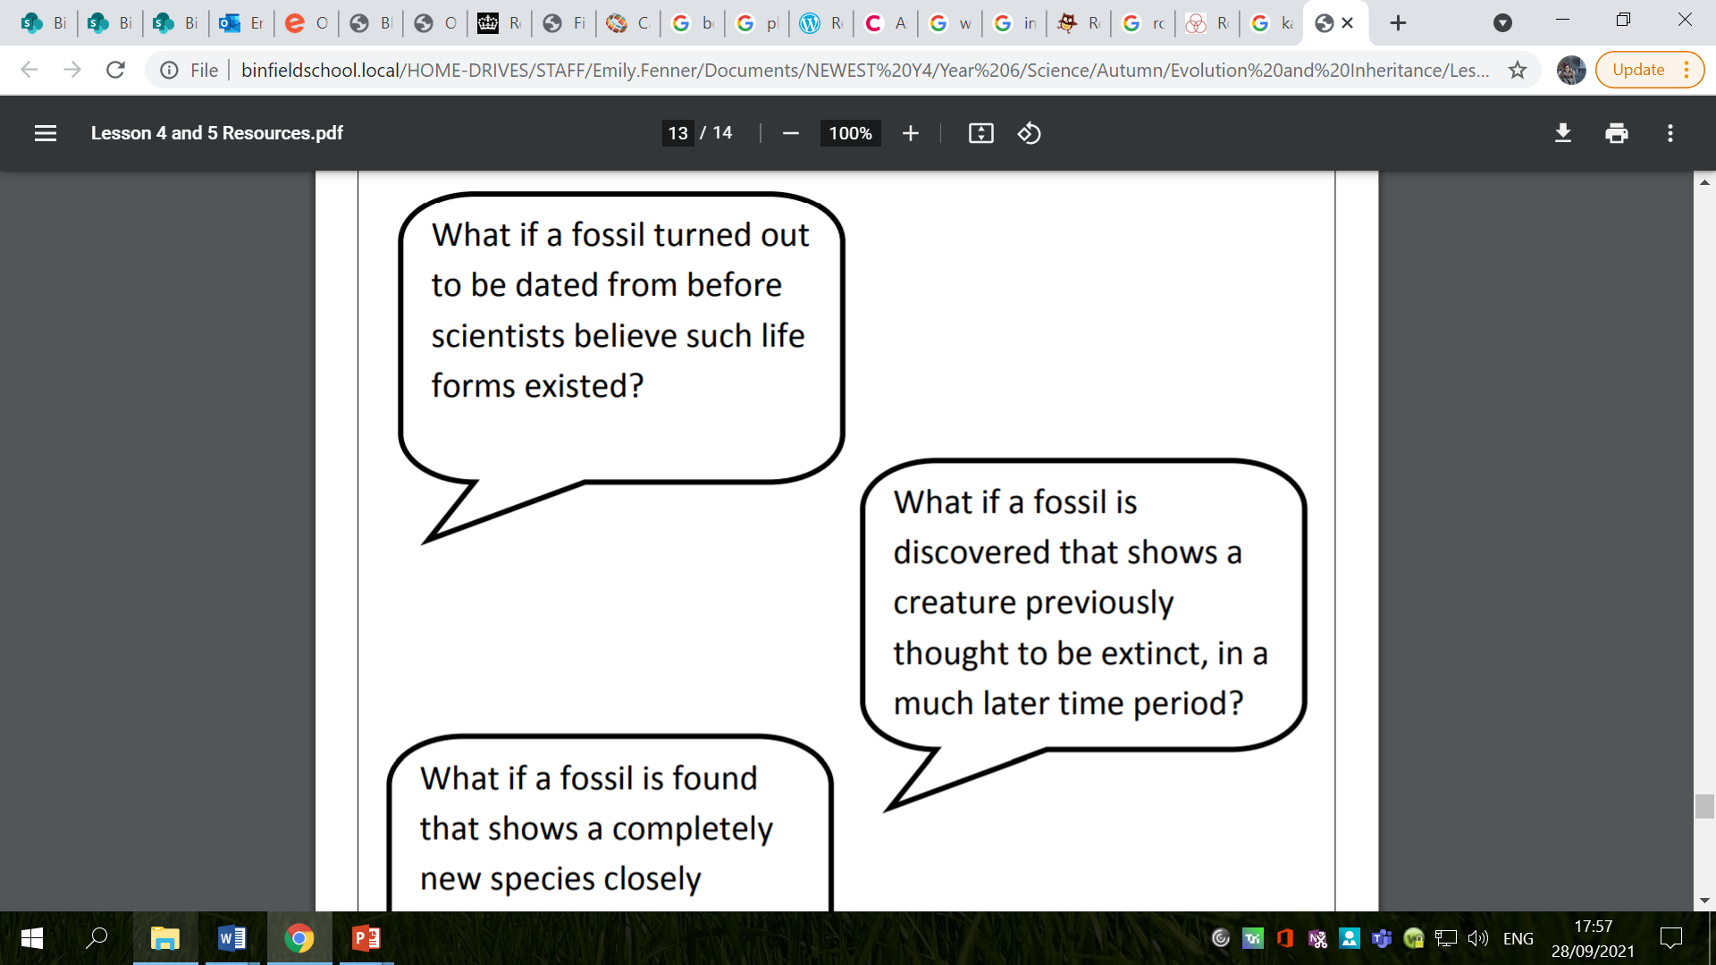
Red Pen
The fossil record is relatively patchy due to the tricky and very unique circumstances under which fossils are formed. New discoveries often challenge current thinking.
Choose one of the ‘what if’ questions below and write what you think might happen if the scenario actually happened:

Slide 17
Plenary
All three key evolution scientists (and scientists today) face scrutiny from others in the world or science (and religion) where counter-arguments or even ridicule may even be expressed.

Slide 18
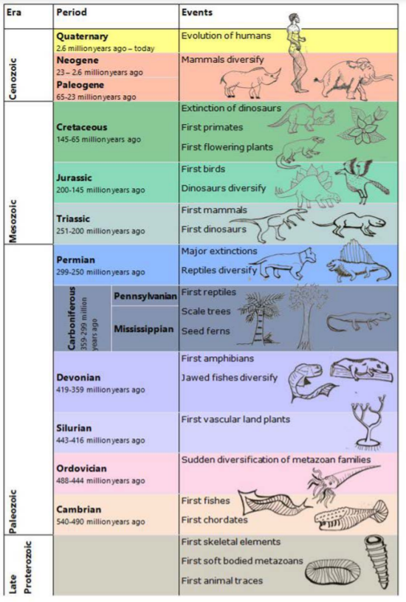
Plenary
If this was represented by an hour – in the overall history of the Earth, humans appeared only in the last minute!

