Slide 1
LO: To investigate patterns
LO: to communicate geographically
C: globalisation

Slide 2








Starter – How many logos can you identify?

Slide 3

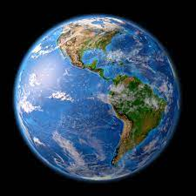
Talk to your partner!
Why were you able to recognise so many of these symbols?
Do you think a child in Ghana or india would be able to recognise as many as you did?
Explain your reasoning behind your answer.

Slide 4
Globalisation – what do you think it means?
Globalisation is the process by which the world is becoming increasingly interconnected. We now communicate, trade, travel and share each other’s cultures more easily around the world.

Slide 5
  HOW GLOBAL ARE YOU?
Where were your parents born?
Where were your clothes made?
Where are the films you watch made?
What type of food do you eat?
Where do you go on holiday?
What sports do you like? What countries are they played in?

Slide 6
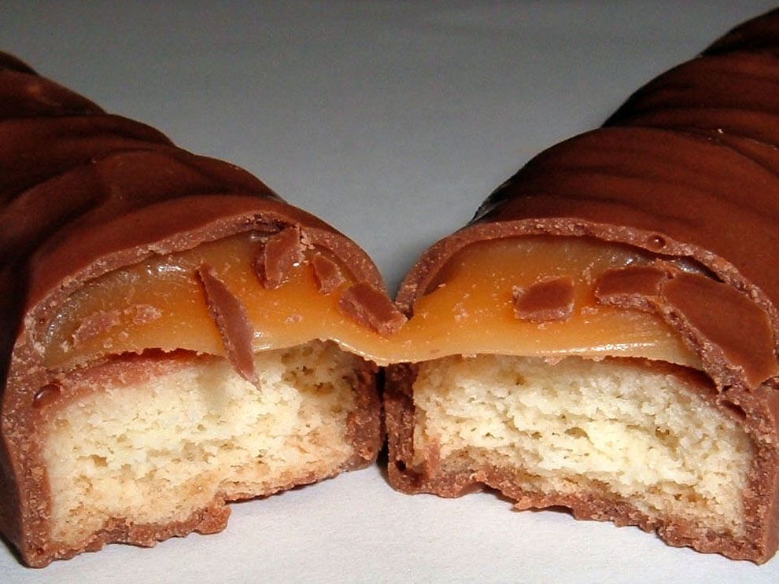
WHAT DO YOU THINK A GLOBAL SUPPLY CHAIN IS?
A supply chain is a network of people and activities that help move a product from its place of origin to its final destination.
Watch the video about how the cocoa bean gets to the shops.
https://www.youtube.com/watch?v=PGaLWuLzHBU

Slide 7
What do you think is needed to make a chocolate bar? Where do you think these resources come from?
Discuss with your partner and write a list of everything you can think of on your whiteboard.
Cocoa—West Africa, Central and South America, and parts of Asia
Nuts—China and India
Aluminum Foil (for wrapper)—West Indies, North America, and Australia
Sugar—Brazil (primarily), India, and China
Paper (for wrapper)—North America
Raisins—California, Turkey, Chile
Milk—Worldwide
Syrup—United States, Europe, Brazil, and Mexico
Vanilla—Madagascar, Indonesia, China, and Mexico

Slide 8
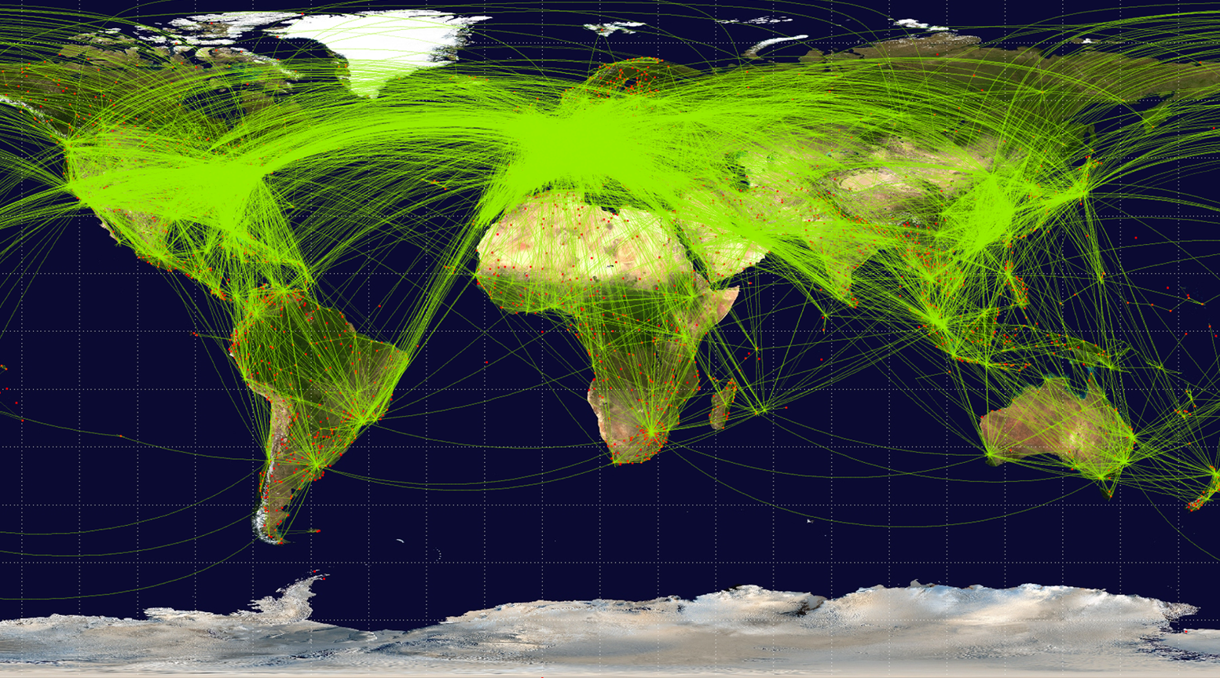
Activity
Imagine a chocolate bar is made just for you and is coming all the way to Binfield. On your map, use an atlas to locate all the countries and continents that produce the different things that are needed to make a chocolate bar.
Draw arrows connecting the different aspects of the food chain to Binfield Village.
Red Pen: imagine you are a child worker on a cocoa plantation in Ghana, and companies stop buying your cocoa beans. Write an explanation of the impact you think this would this have on you and your community.

Slide 9
Plenary
Discuss with your partner:
Is globalisation is good for everyone involved?
What could be the positive effects?
What could be the negative effects?

