Slide 1
LO: Plan a collage using taught techniques about an emotive subject.
LO: Combine visual and tactile qualities.
C: Embellishments.

Slide 2
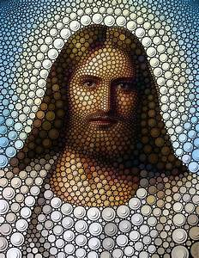

We have learned many ways to create texture using mixed
media.
Can you remember some of those techniques? Which technique
worked well and which was not so successful?
Today, you will plan your own artwork on a subject you feel
strongly about.
Discuss with your partner – what topic do you feel strongly
about and how could you make a collage, using mixed media,
to represent your feelings?

Slide 3
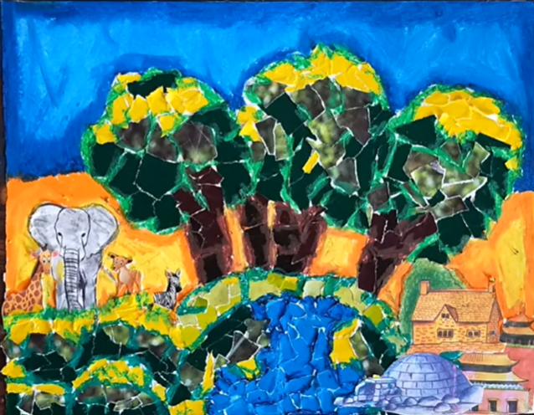
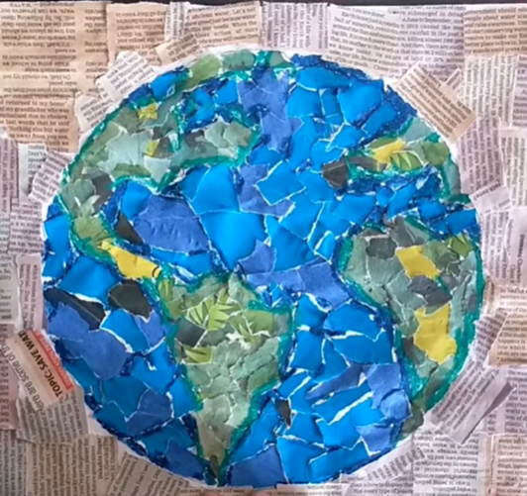
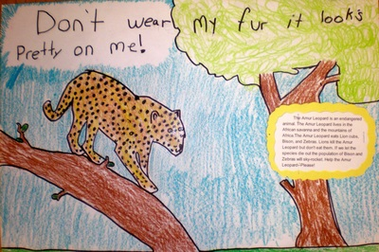
You may have thought of some of the following themes for your collage:
The environment
Climate change
Endangered species

Slide 4
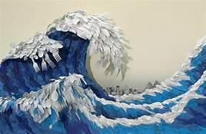

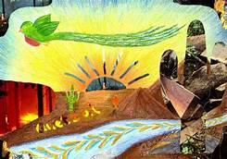
Other possible topics include: bullying, plastic in the oceans, deforestation, hunting, horse racing, friendship.
Whatever you personally feel strongly about is what you should base your own artwork on.
Remember, you should include many, if not all, of the techniques we have been learning about in your collage. Before creating your collage, you must know what your collage will be based on and have sketched a plan so you have an idea of what your finished piece will look like.

Slide 5
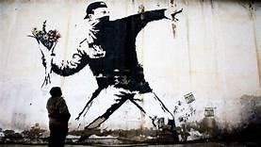
Watch these videos to get some inspiration for your collages:
https://www.youtube.com/watch?v=VAqrANN1U4M
https://www.youtube.com/watch?v=2IpkU936AMQ
https://www.youtube.com/watch?v=z8JcVFmSed4

Slide 6
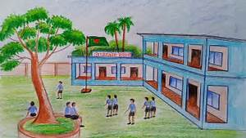
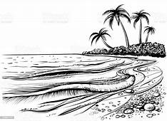
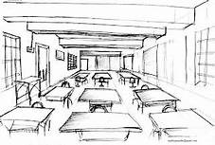
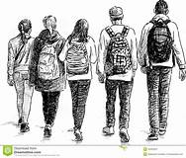
Activity
Use a full page in your sketch book and plan your collage. Consider what embellishments are going to go where, what the background is going to consist of and what mixed media you will use to get a textured effect.

Slide 7
Plenary
Explain to your partner how you are going to embellish your collage and which materials you are going to use.

