Slide 1
Tuesday 4th May 2021
L.O: To understand texts- retrieval skills
C: Boy

Slide 2
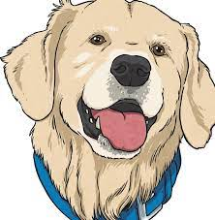
Today we are going to read the end of the Goat’s Tobacco!
We are going to use our retrieval skills to act it all out!

Slide 3
Starter: Let’s Reflect
Let’s look at some of your amazing prediction drawings!
How likely do you think these things are to happen?

Slide 4
Class Read
Class Read p.157-161
Whilst we read, think about the tone and expression of each character’s speech.

Slide 5
Our task:
To work in small groups to role-play what happened!
We need to focus on our tone and expression.

Slide 6
Our task:
Paddlers: Discuss your ideas with the TA to help you feel more confident!
Snorkellers: Role-play whilst focusing on your tone and expression.
Divers: Role-play by using evidence from the text.

