Slide 1
Our learning charter
PSHCE

Slide 2
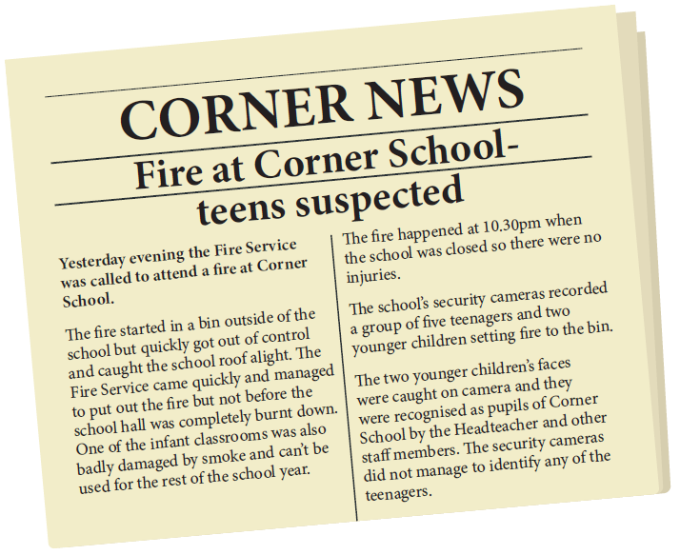
Read the scenario and think about what you understand to have happened.

Slide 3
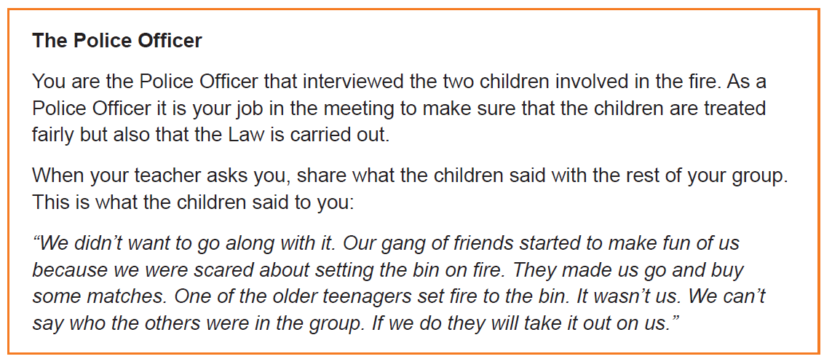
Perspectives:
  The school’s headteacher
  A police officer
  A person from the Fire Service
  The children’s class teacher
  The children’s parents
  Imagine there is a meeting in the headteacher’s office to discuss the children in the scenario.
  Try and think about how each person might feel and what they might say in a meeting about the fire.
  The information you have on the role-play cards will help you.

Slide 4
Activity
Read each character’s role play card.
Come to a decision about what should happen to the two younger children who were involved in setting the bin alight.
You need to justify your decision using your discussions and evidence.
You will have the rest of this lesson and some time in the next lesson to explain your decision.

Slide 5
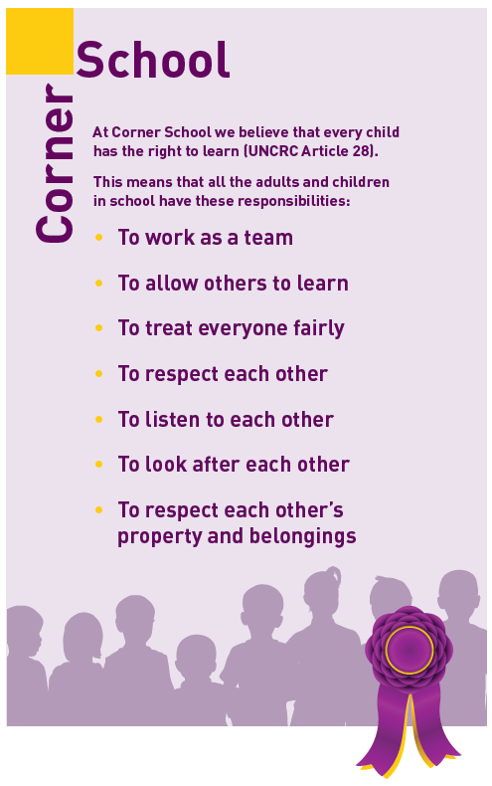
activity
Look at the school’s learning charter too.

Slide 6

What rights have been broken? (Think beyond the right to learn)
Have the two children in the scenario behaved responsibly?
Were there things that might have made responsible choices more difficult for the two children?
Jot down some notes/ideas on a piece of paper – you will need to remember your thoughts next week.

