Slide 1
LO: to understand values
to understand practices and lifestyles
C: Islam

Slide 2
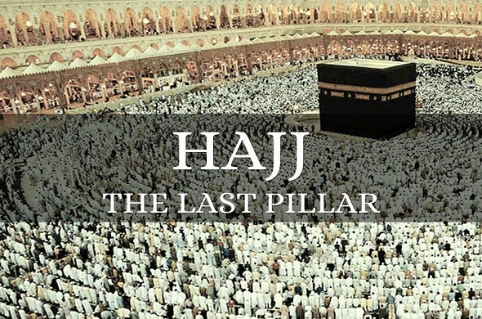

Hajj
Hajj is the fifth pillar of Islam.
It is a pilgrimage that Muslims make.
What is a pilgrimage?
Hint: you may remember the Hindu pilgrimage to the River Ganges you looked at in Year 5).

Slide 3
A pilgrimage is…
A pilgrimage is a sacred journey, undertaken for a spiritual purpose.
Pilgrims are different from tourists: they travel for spiritual reasons, not just to relax or for fun.
Pilgrimage is a search for meaning, purpose, values or truth.
People go on pilgrimages for many reasons.
Some religions require or encourage believers to make a pilgrimage as an expression of faith.
People may also journey to a shrine because they want a favour, such as a cure for an illness, from a saint or divine being.
Others give thanks or ask to be forgiven for a wrong they have done.

Slide 4
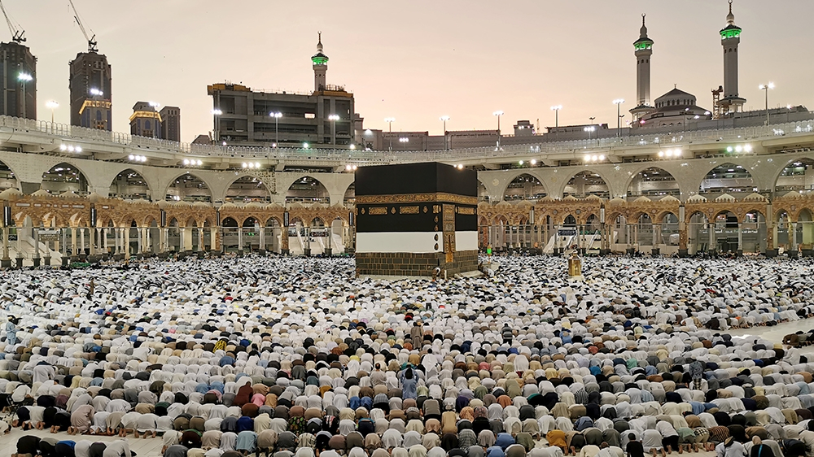
Muslims are expected to visit Makkah at least once in their lifetime, if conditions allow.
Muslims try to go to Makkah during Dhu al-Hijah, the twelfth month of the Islamic calendar.
Makkah is in Saudi Arabia.
This is where the Prophet Muhammad (PBUH) was born and had his first revelation from Allah.

Slide 5
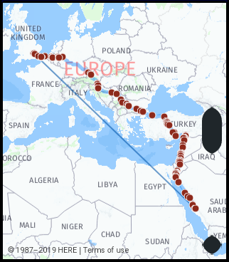
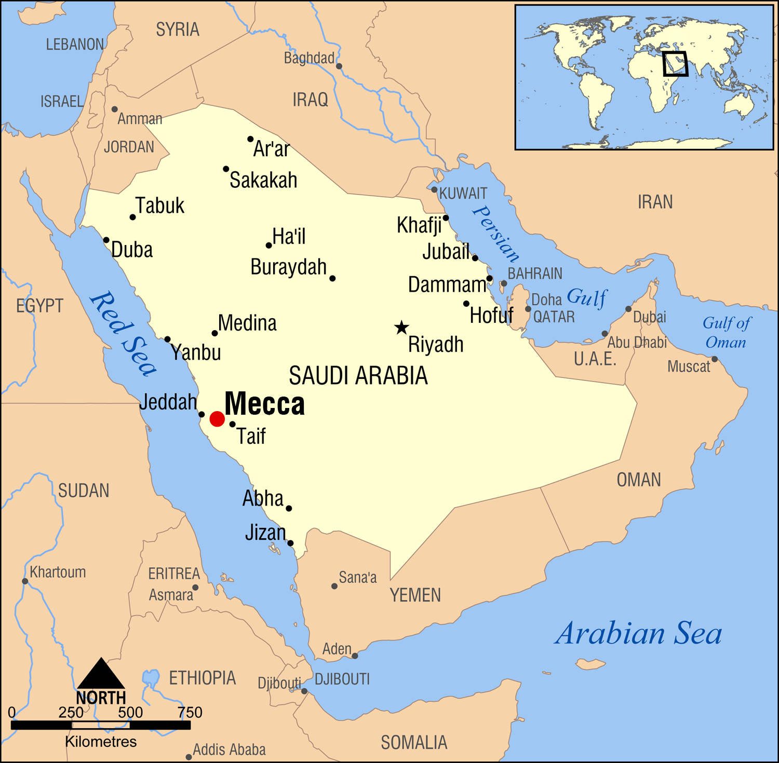

Slide 6
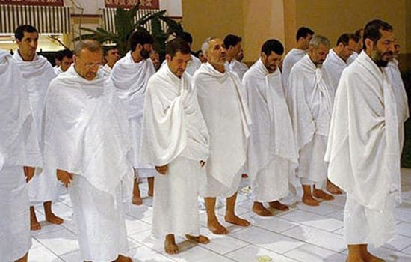
Hajj is the gathering of Muslims from all over the world, who take part in an act of worship.
It is a physically demanding journey that Muslims believe offers a chance to wipe clean past sins and start anew before Allah.
No matter who they are, this act of worship brings all Muslims together as one.
Everyone is expected to wear an ihram which is special clothing made from two sheets of white cloth.
This is so that everyone is seen as equal, regardless of who they are.

Slide 7
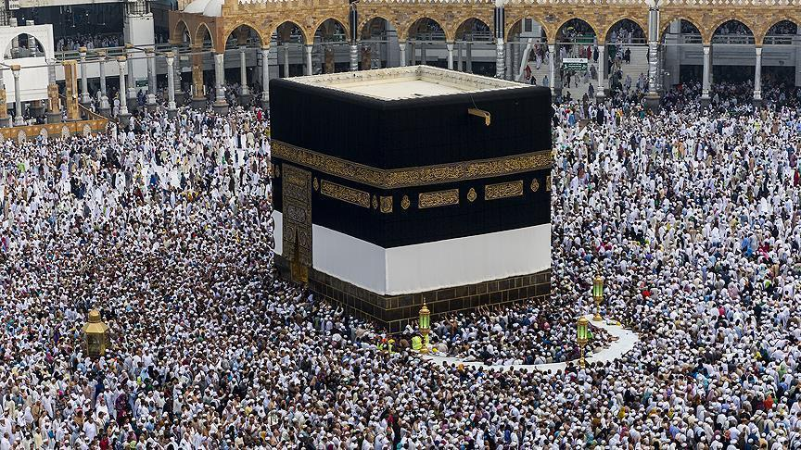
Hajj is important as Muslims believe it is commanded by Allah.
The Qur’an speaks of the Ka’ba as a place of security and prayer to which Muslims should return and give praise to Allah.

Slide 8
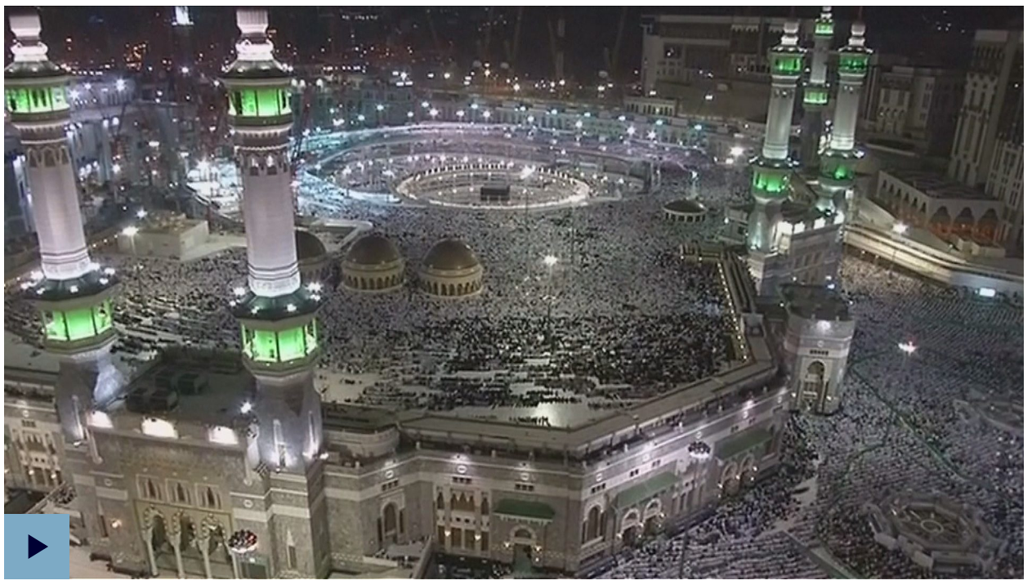
https://www.bbc.co.uk/teach/class-clips-video/religious-education-ks2-my-life-my-religion-muslim-pilgrimage-hajj/zndfcqt

Slide 9
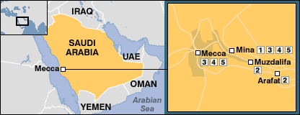
Hajj
The fifth pillar of Islam, Hajj is mandatory once in a life-time for all Muslim adults if they are financially and physically able to do so.
It takes place every year during Dhul Hijjah – the 12th month of the Islamic calendar.
The Hajj journey

Slide 10
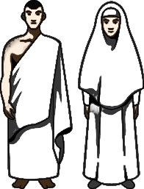
The state of Ihram
Pilgrims begin by announcing their intent (niyya) to perform hajj, upon which they enter into the state of ihram.
The state of ihram calls for certain conditions that need to be maintained throughout the duration of hajj.
Men wear two pieces of unstitched cloth, signifying simplicity (typically white)
Women wear clothing covering everything other than the face and hands.

Slide 11
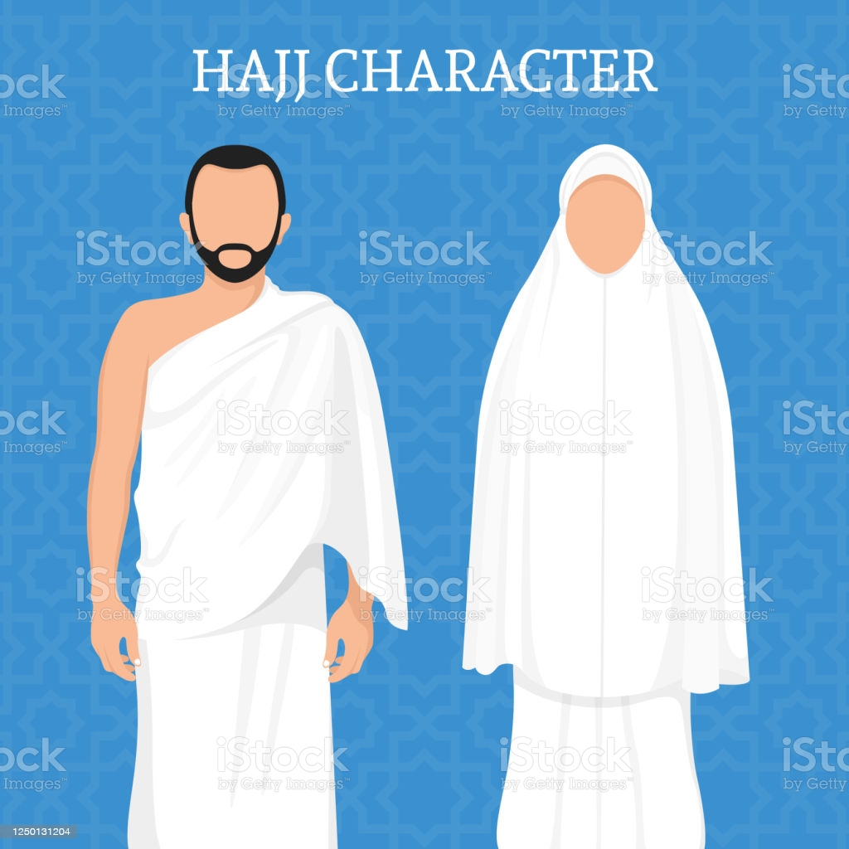
The stages of Hajj
1. Intention & Talbiya
Pilgrims announce their intent to perform the Hajj at a designated prayer point (miqat) and enter the state of ihram.
Pilgrims then utter the following prayer (talbiya) and typically repeat it until they arrive at Mecca.
“Here I am, at your service O Lord. Here I am at your service, you who have no partners. All praise, all bounty, all sovereignty is Yours alone, you have no partners.”
Entering the state of ihram is an important step.

Slide 12
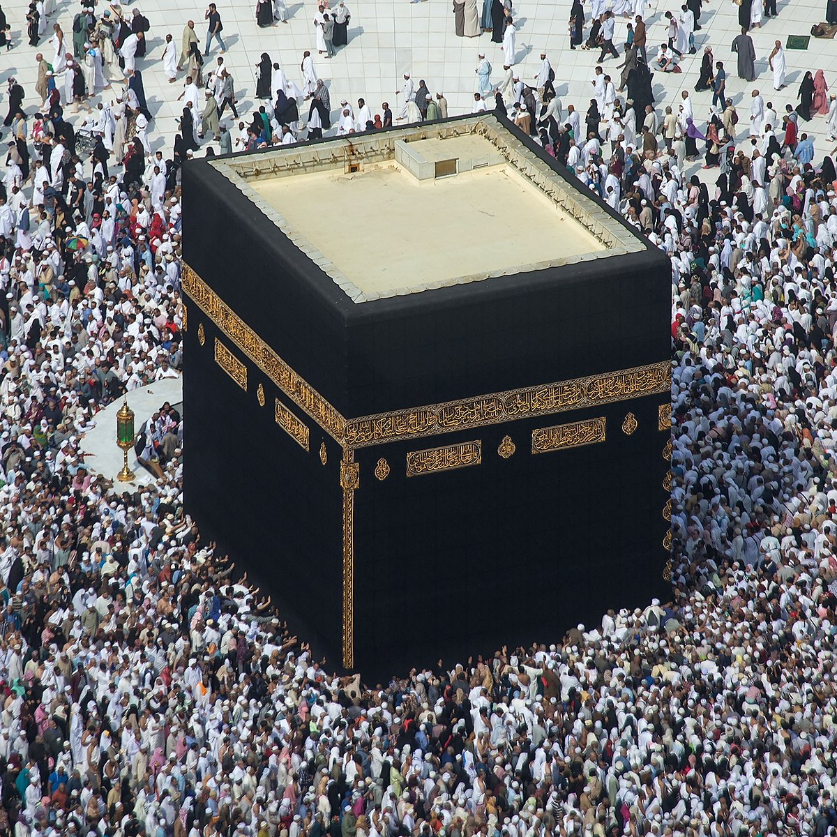
2. Tawaf (Circumambulation)
Once in Mecca, pilgrims go around the Ka’abah 7 times, counter-clockwise.
The Tawaf symbolises the Oneness of Allah and His centricity of existence.
On every round, pilgrims point towards the Black Stone located in the Eastern corner and remember the pledge to faith, asking the Black Stone to testify that they upheld their pledge.
The Tawaf ends with 2 units of prayer.

Slide 13
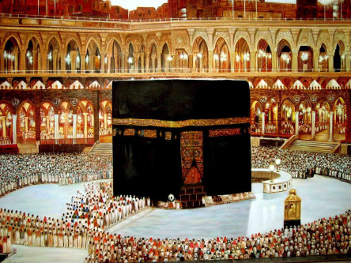
Isma’il’s resting place
The black stone
The station of Ibrahim

Slide 14
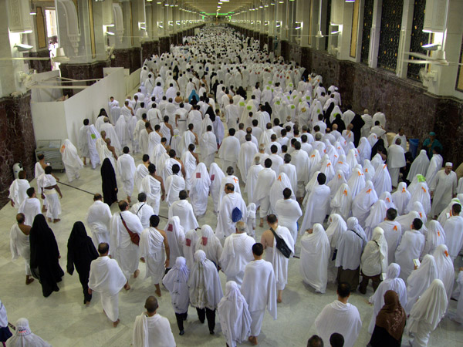
3. Sa’ i (the Walk)
Pilgrims then walk between the two mountains of Safa and Marwa a total of 7 times.
4. Taqseer (Cutting hair)
At the end of the Sa’i, pilgrims cut some of their hair or clip their nails, upon which they exit the state of ihram.

Slide 15
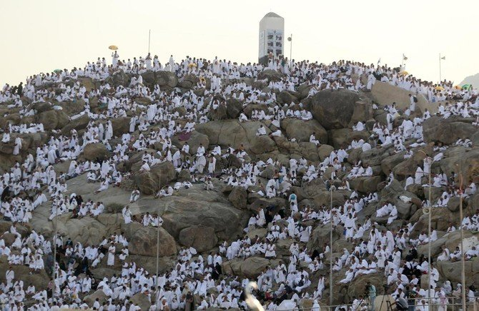
5. Arafat
Pilgrims enter into the state of ihram again and head towards Arafat, a dry and plain desert land.
They must remain in Arafat between noon and sunset.
Pilgrims camping in Arafat tend to spend their time seeking forgiveness (although there is requirement for prayer).
Some pilgrims climb Jabal al Rahma (the mountain of mercy) seeking forgiveness.

Slide 16
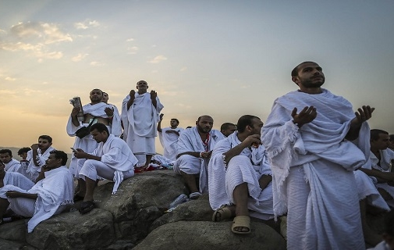
“Only You do I beseech, so do not disappoint me. Only for Your favours do I desire, so do not deprive me. Only to Your side do I resort, so do not set me aside.”
Extract from Dua Hussain - a prayer recited on Arafa day

Slide 17
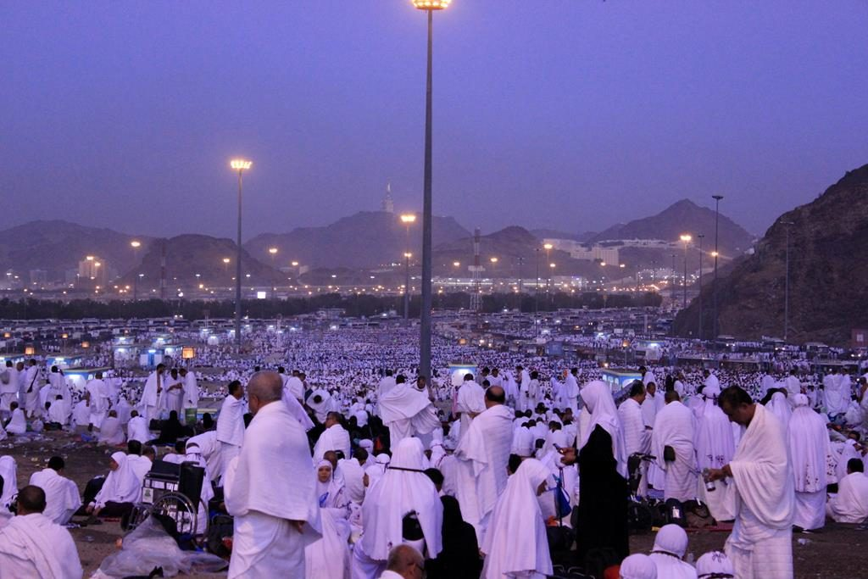
6. Muzdalifa
After sunset, pilgrims leave Arafat and travel to Muzdalifa, a desert plain land.
From the grounds of Muzdalifa, they collect stones.
This signifies a gathering of arms to be used against the devils for the next 3 days.

Slide 18
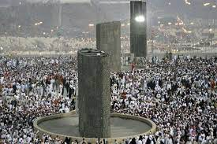
7. Mina
At dawn on Eid day, the pilgrims arrive at Mina where they throw 7 stones at 1 of 3 boulders symbolising Satan.
Pilgrims then offer a sacrifice after which they can cut their hair or trim nails and in so doing, exit the state of ihram.
Pilgrims camp in Mina that night and the next.
During the day, pilgrims repeat the pelting of 7 stones at each boulder for 2 days. In throwing the stones, they confront their inner demons.

Slide 19
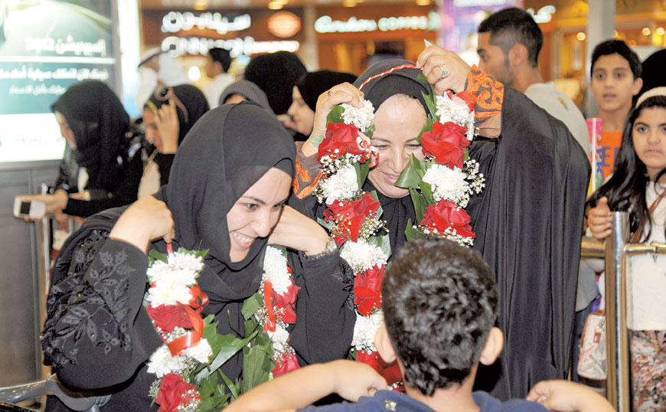
8. Tawaf
Pilgrims end their Hajj where they began, with circumambulating the Ka’bah 7 times.
Pilgrims who have just completed their Hajj hold a special status and earn the title “Hajji”.
The Hajj absolves pilgrims of all past sins. Families and friends traditionally greet pilgrims returning home with gifts.

Slide 20
Activity
Paddling | Snorkelling | Diving
Imagine you have completed the Hajj. Explain what you think will have impressed you most and what will be your most striking memory. | Imagine that you are travelling home from Hajj. You are to write a postcard to a friend or family member about your experience. You need to include the following information: Explain why you have just gone on Hajj Describe what you can see Explain how it has made you feel What can you smell? What can you hear? What are you touching? | Imagine that you are travelling home from Hajj. You are to write a diary entry sharing your experience. You need to include the following information: Explain why you have just gone on Hajj Describe what you can see Explain how it has made you feel What can you smell? What can you hear? What are you touching? Can you explain how/why this journey makes you feel closer to God?

Slide 21
Red Pen
Paddling: If you were going on a sacred journey, where would you go and why?
Snorkelling and Diving: Summarise the reasons why Muslims go on pilgrimage in 5 sentences.
Reduce to 5 words.
Now to 1 word.

Slide 22
Plenary: Jewish Pilgrimage
Jerusalem remains an important place of pilgrimage for Jewish people.
According to Jewish tradition, all of creation began in Jerusalem.
Many Jewish people visit Jerusalem today as the focal point of their religion and face towards it when they pray as a sign of its importance. In fact, synagogues are traditionally orientated towards Jerusalem and Jews position themselves towards Jerusalem while reciting the Amidah.
Visiting The Western Wall is a reminder to Jewish people of their history, but also gives them a link with the holiest site, the Temple. It is the closest Jewish people can get to the presence of God.
Also, as the Western Wall has not been destroyed, it is a symbol of hope to the Jewish people that they too will last forever.
There are many rituals that take place at the Western Wall. People write prayers on small pieces of paper and push them in between the cracks of the wall. As Jews believe that the wall is a symbol of God's presence, many believe that God can actually see what has been written.

Slide 23
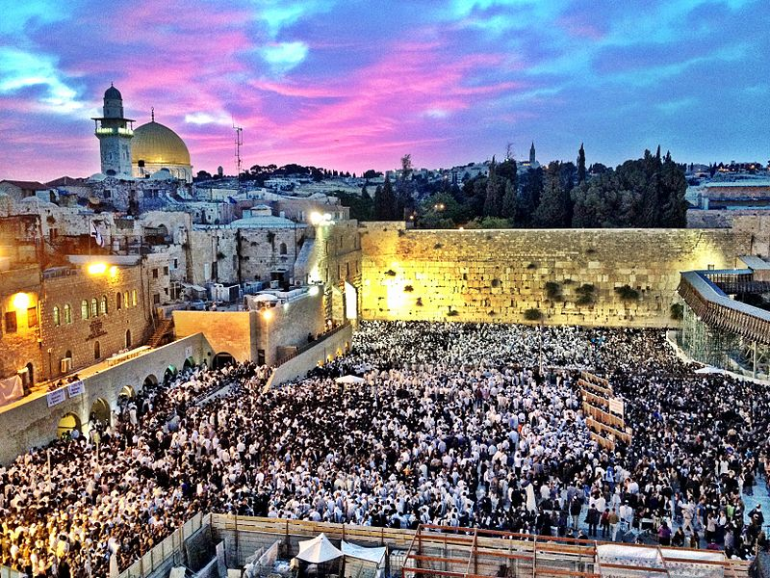
Plenary: Jewish Pilgrimage

Slide 24
Plenary: Christian Pilgrimage
Jerusalem is an important place of pilgrimage for Christians, just as it is for Jews.
Christians believe that Jesus visited Jerusalem at Passover time and spent the week leading up to his death there.
Christian pilgrims visit Jerusalem, therefore, to remember key events in Jesus' final week, known as Holy Week.
Places that Christian pilgrims might visit include:
The Garden of Gethsemane - this is believed to be where Jesus prayed before he was arrested by the Romans and put to death. Christians visit here for contemplation and prayer.
Church of the Holy Sepulchre - this church is said to be built on the site where Jesus was crucified, as well as his place of burial.
Via Dolorosa – this is a special route that Christian pilgrims walk from the outskirts of Jerusalem to the Church of the Holy Sepulchre, especially on Good Friday. It is believed to be the very path that Jesus took carrying his cross on the way to his crucifixion.
Church of the Ascension - this is said to mark the site of the Ascension, when Jesus rose into Heaven forty days after his resurrection. There is a stone inside the Church, believed to be imprinted with his footstep.

Slide 25
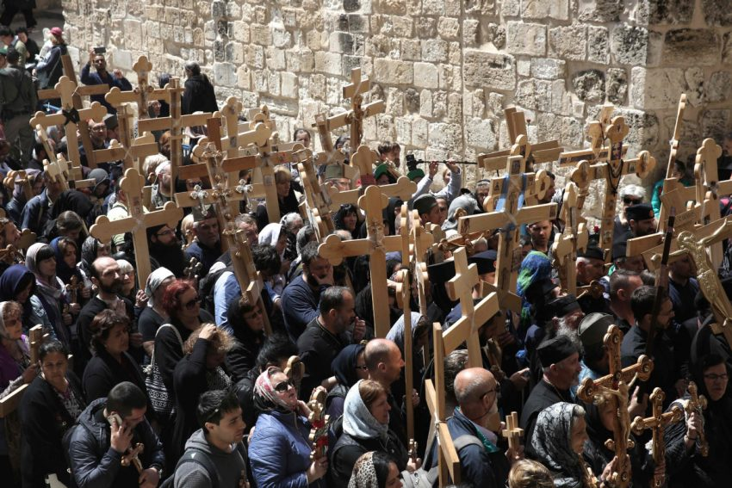
Plenary: Christian Pilgrimage
Many Christians believe that undertaking a pilgrimage to Jerusalem can bring them closer to the experience of Jesus as he approached his death.
Christians believe that this will help them to develop spiritually and become closer to God.

Slide 26
Plenary: Christian (Catholic) Pilgrimage
The pilgrimage site of Lourdes is near the Pyrenees mountains in France.
Every year, it is visited by millions of pilgrims, particularly Roman Catholics.
They come to Lourdes to see the site of a famous vision experienced by a young girl called Bernadette Soubirous and to be healed by its supposedly miraculous waters.
Christian pilgrims now visit and pray in the Sanctuary of Our Lady of Lourdes and worship at the grotto where the vision is said to have taken place.
Pilgrims also take part in a Torchlight Marian Procession which takes place every evening before a service of mass takes place in the grotto. Pilgrims also confess their sins at the Reconciliation Chapel.
Lourdes is considered a special place to visit because prayers and services are believed to bring real blessings to the pilgrim.
Pilgrims may visit to be cleansed of their sins and to be cured of their illnesses. It is believed that spring water from the grotto can heal people if they are sick. Millions of visitors come to Lourdes each year in the hope of being cured.

Slide 27
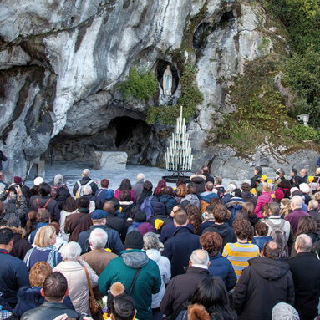
Plenary: Christian (Catholic) Pilgrimage
The opportunity to focus closely on their faith helps pilgrims feel secure in the knowledge that God will look after them, forgive them for their sins and even cure them of their illnesses.

Slide 28
Plenary: Christian Pilgrimage
Pilgrimage is not compulsory in Christianity, but many Christians choose to undertake journeys to holy sites to:
  deepen their connection with God
  feel connected to the worldwide community of Christians
  learn more about the history of Christianity
  see sites where miracles happened and receive special blessings
  seek healing or acceptance of ailments

Slide 29
Plenary: Sikh Pilgrimage
For many Sikhs, going on a pilgrimage is important.
When they go on a pilgrimage, Sikhs often visit important sites in India and the Punjab, where Sikhism began.
Many Sikhs make a pilgrimage to the Harmandir Sahib in Amritsar, in North India. Harmandir means ‘The Temple of God’ and Sahib is a sign of respect. The Harmandir Sahib is also known as the Golden Temple and is the most famous place of worship for Sikhs.
The benefits of pilgrimage for Sikhs include:
  strengthening their faith
  providing time dedicated to spiritual reflection
  learning more about the history of Sikhism and the Gurus’ lives
  helping them better understand the principles of Sikhism

Slide 30
Plenary: Sikh Pilgrimage
The Harmandir Sahib is surrounded by a pool of clear water that is sacred to Sikhs. The sacred water is believed to have healing powers.
A continuous reading of the Guru Granth Sahib is performed each day.
Each day the langar serves around 50,000 people from all over the world. This reminds Sikhs of the oneness of humanity.
Sikhs want to visit the Harmandir Sahib because it helps them to remember the oneness of God and the oneness of humanity. Sikhs consider it to be a pleasure and an honour to visit the Harmandir Sahib.

Slide 31
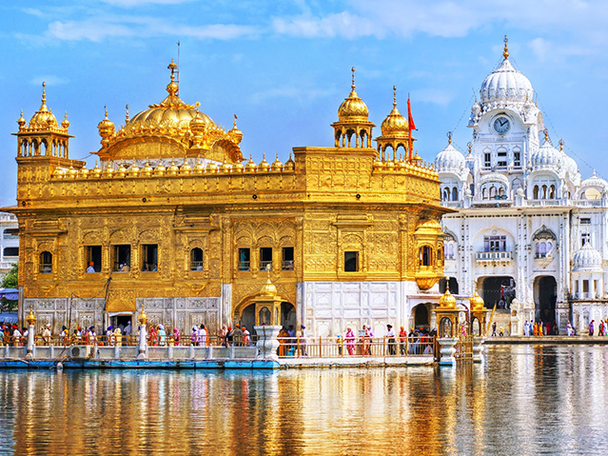
Plenary: Sikh Pilgrimage

Slide 32
Plenary: Hindu Pilgrimage
The River Ganges is important in its own right. Some Hindus believe that it flowed from heaven to purify humans.
There are various locations along the River Ganges which can attract millions of pilgrims.
Many Hindus believe water (known as 'Gangaa jal') from anywhere on the River Ganges is purifying and holy.
People enter the Ganges in order to purify themselves. Many pilgrims also take home small containers of water from there to give to friends and family who are not able to attend.
Many pilgrimage sites are situated near to the River Ganges and reflect how important it is to Hindus.
Many stories in scripture feature the river. The very popular avatar of Lord Vishnu as Krishna is believed to have lived at Gokul, on the Yamuna River. The young Lord Ganesh is also shown having adventures in and around the river.

Slide 33
Plenary: Hindu Pilgrimage
Hindus go on pilgrimage for many reasons, including:
  to seek pure understanding of Brahman (or Ultimate Reality)
  to express their faith
  to fulfil a spiritual promise
  to remember a relative who has died
  to gain insight into stories of the gods and goddesses
  to work towards liberation, or moksha
Hindus achieve these purposes through ritual bathing, among many other community activities.

Slide 34
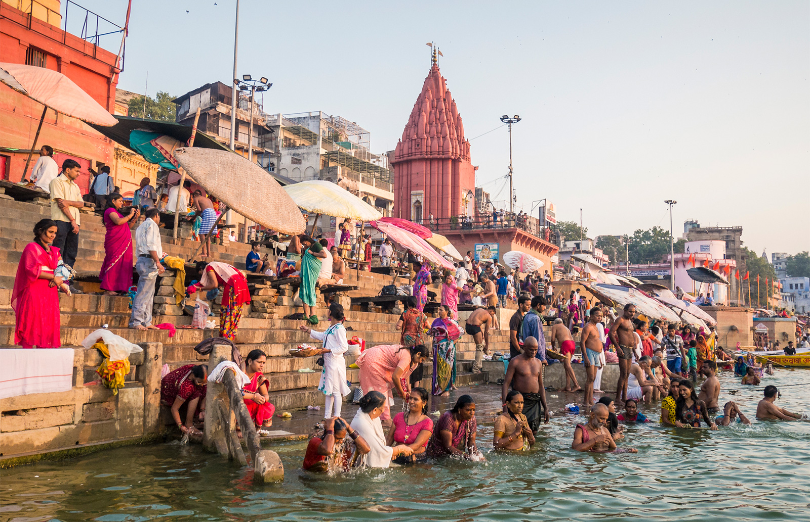
Plenary: Hindu Pilgrimage

Slide 35

Plenary
What are the similarities and differences between these religious pilgrimages?

