Slide 1
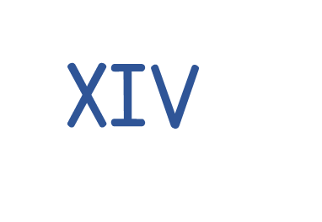
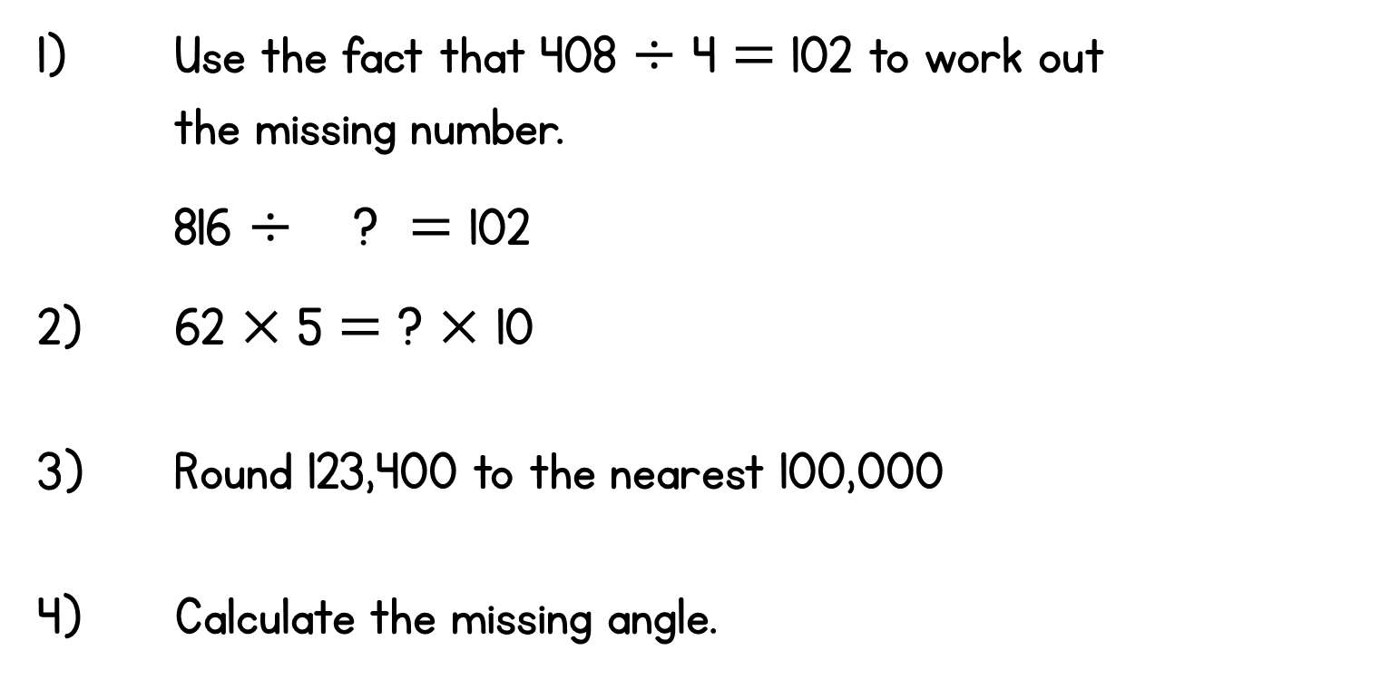



Year 6 | Week 4 | Day 5
85$°$
50$°$

Slide 2

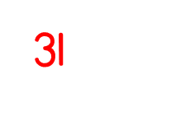
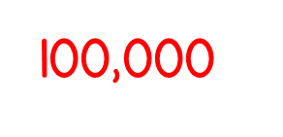

Year 6 | Week 4 | Day 5
85$°$
50$°$

Slide 3


Arithmetic Starter

Slide 4
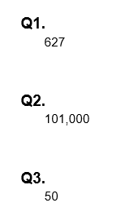
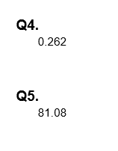
Arithmetic Starter - Answers

Slide 5
SHORT DIVISION

Slide 6
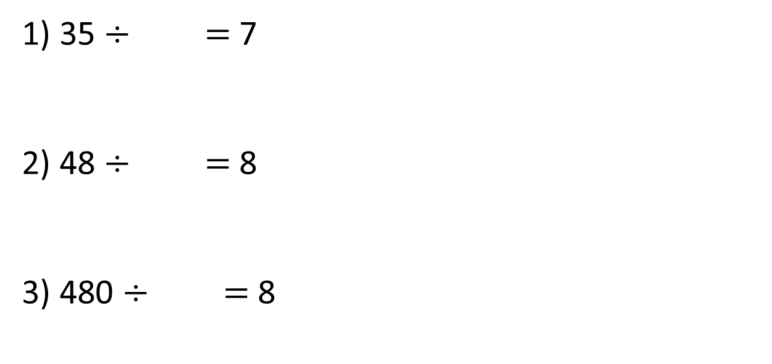
1) 35 $÷$ $=$ 7
2) 48 $÷$ $=$ 8
3) 480 $÷$ $=$ 8

Slide 7
1) 35 $÷$ $=$ 7
2) 48 $÷$ $=$ 8
3) 480 $÷$ $=$ 8
5
6
60

Slide 8

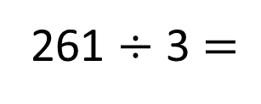
Eva has 261 straws. She wants to make them into triangles. How many triangles can she make?
261 $÷$ 3 $=$
87
3 | 2 | 6 | 1
0
8
7
2
2

Slide 9




Tommy has 262 straws. He wants to make them into triangles. How many triangles can he make?
Dora has 263 straws. She wants to make them into triangles. How many triangles can she make?
Jack has 264 straws. He wants to make them into triangles. How many triangles can he make?
Have a think

Slide 10
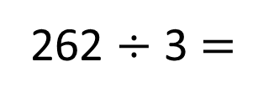
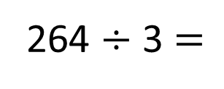
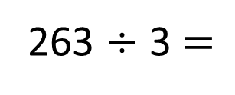
Tommy has 262 straws. He wants to make them into triangles. How many triangles can he make?
262 $÷$ 3 $=$
87 r1
Dora has 263 straws. She wants to make them into triangles. How many triangles can she make?
263 $÷$ 3 $=$
87 r2
Jack has 264 straws. He wants to make them into triangles. How many triangles can he make?
264 $÷$ 3 $=$
88

Slide 11

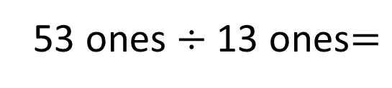
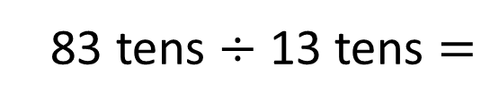
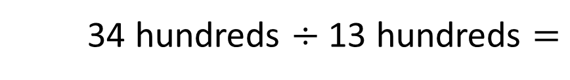
3,433 $÷$ 13
13 | 3 | 4 | 3 | 3
r 1
0
2
6
4
3
8
5
26
39
52
65
78
91
104
117
2 r8
34 hundreds $÷$ 13 hundreds $=$
6 r 5
83 tens $÷$ 13 tens $=$
53 ones $÷$ 13 ones$=$
4 r 1

Slide 12

Ron is thinking of a number between 700 and 730
He divides it by 4 and there is a remainder of 1
He divides it by 5 and there is a remainder of 1
He divides it by 6 and there is a remainder of 1
What is Ron’s number?
Have a think

Slide 13
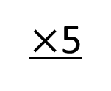
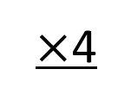
Ron is thinking of a number between 700 and 730
He divides it by 4 and there is a remainder of 1
He divides it by 5 and there is a remainder of 1
$×$4
$×$5
4
5
5
6
8
9
0
1
2
3
6
7
0
1

Slide 14
Ron is thinking of a number between 700 and 730
He divides it by 6 and there is a remainder of 1
7
1
6 | 7 | 0 | 1
3
6 | 7 | 1 | 1
6 | 7 | 2 | 1
1
1
6
r5
1
1
8
r3
1
2
0
r1
1
4
1
5
1
721
Have a think

Slide 15
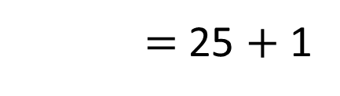
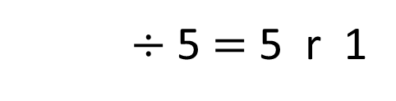

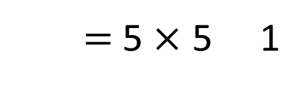
 |  | 7 | 6 | 5 | r 1
5
2
6
$÷$ 5 $=$ 5 r 1
r
$$+$$
$=$ 5 $×$ 5 1
$=$ 25 $+$ 1
26

Slide 16
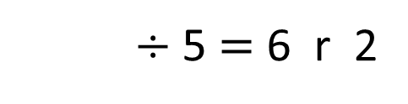

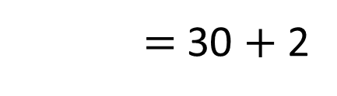
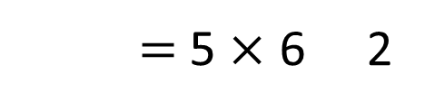
 |  | 7 | 6 | 5 | r 1
5
3
2
2
6
$÷$ 5 $=$ 6 r 2
$=$ 5 $×$ 6 2
r
$$+$$
32
$=$ 30 $+$ 2

Slide 17
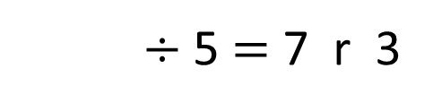

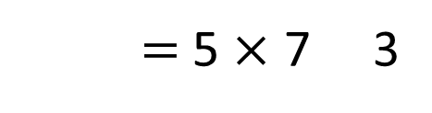
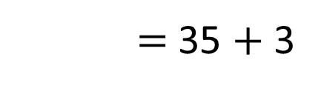
 |  | 7 | 6 | 5 | r 1
5
3
8
3
2
2
6
$÷$ 5 $=$ 7 r 3
$$+$$
r
$=$ 5 $×$ 7 3
$=$ 35 $+$ 3
38

Slide 18
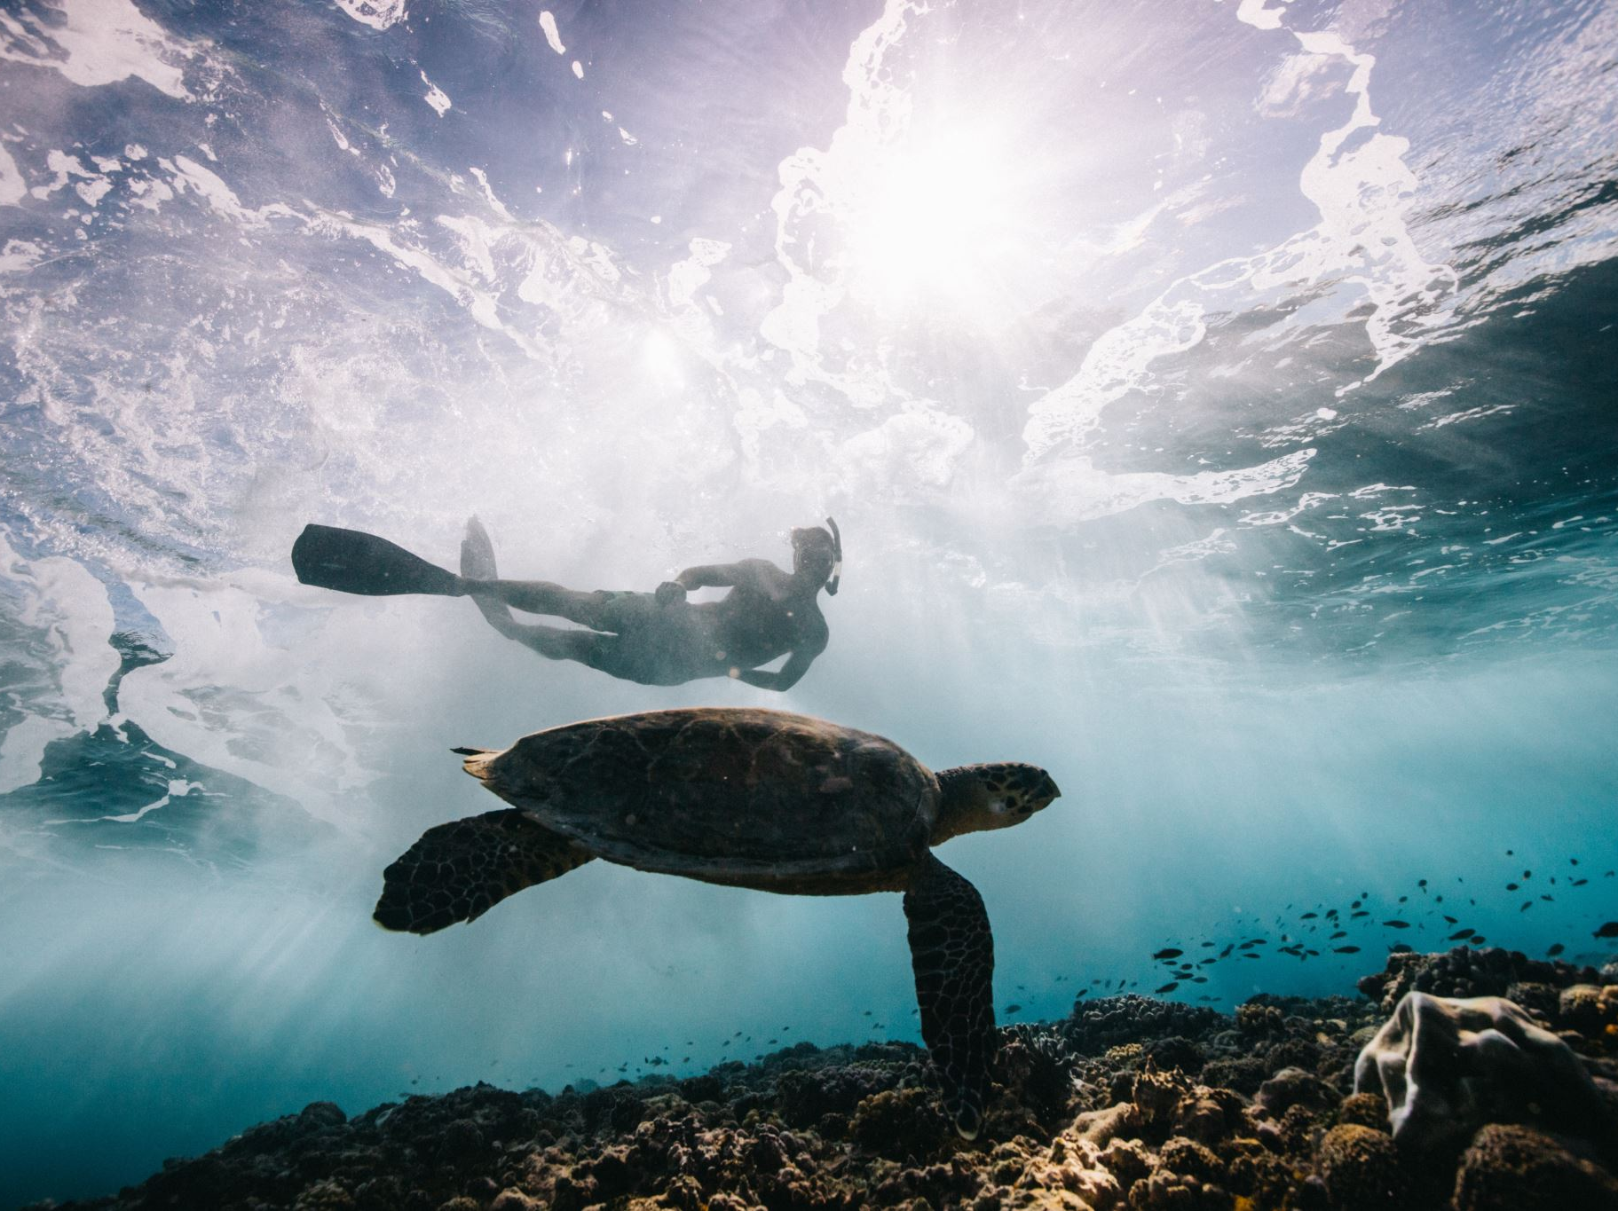
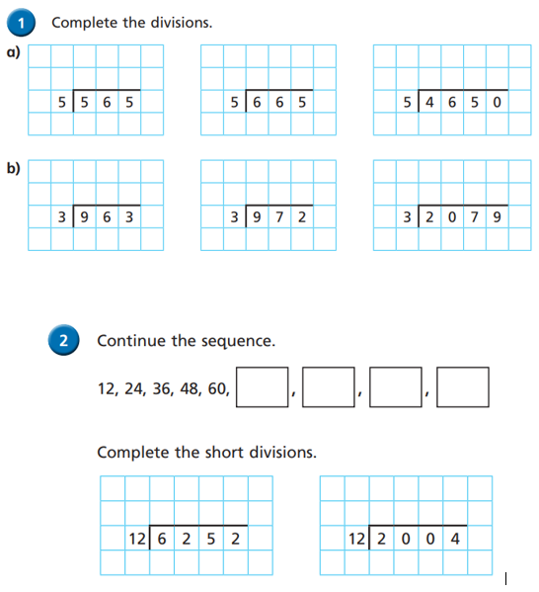
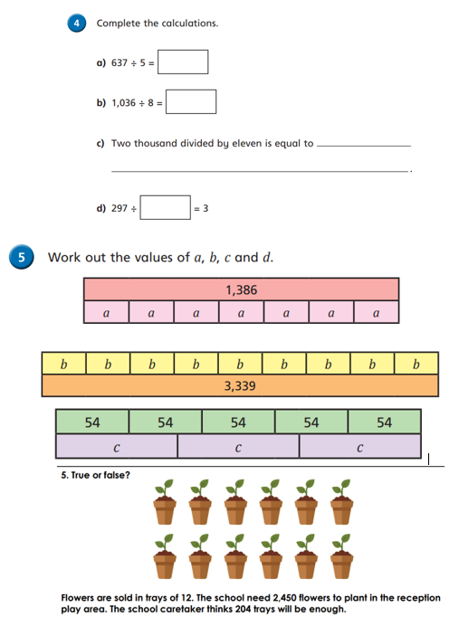
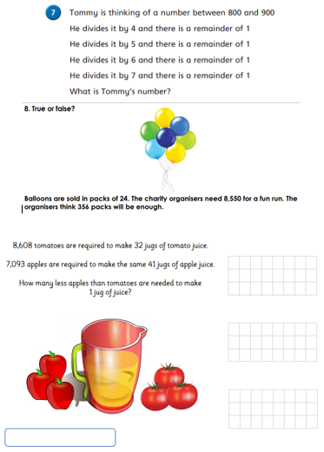
Independent Activity
Paddling Snorkelling Diving

Slide 19
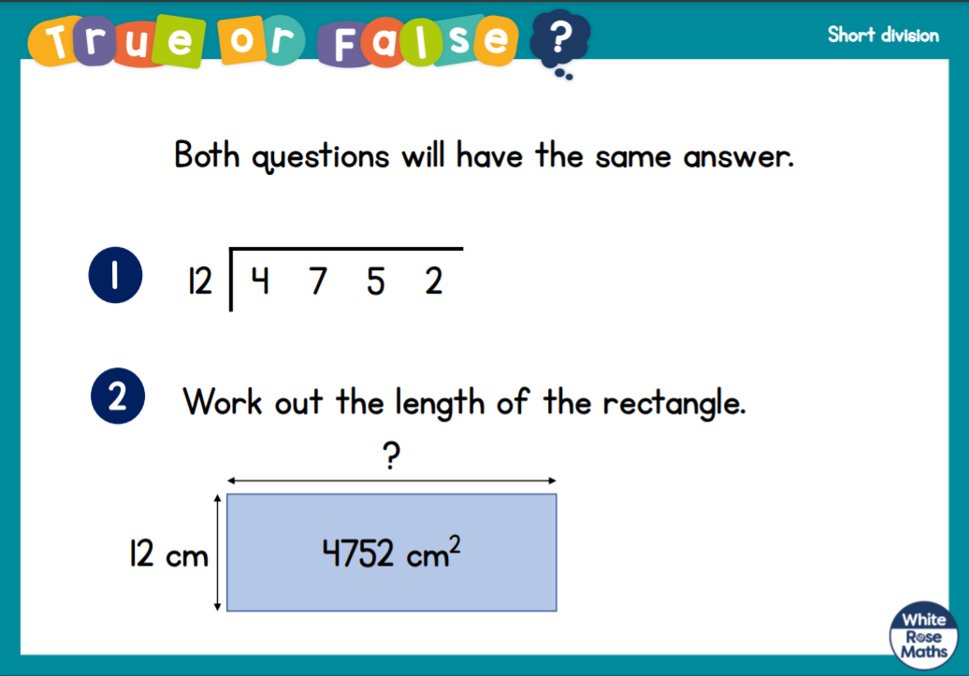




Slide 20


