Slide 1

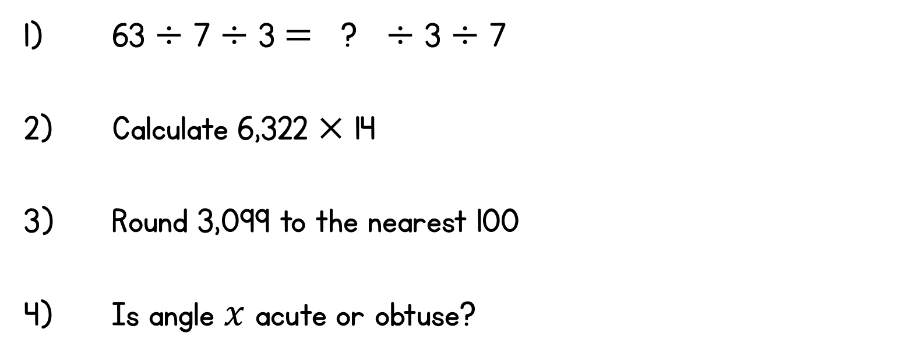

Year 6 | Week 4 | Day 4

Slide 2
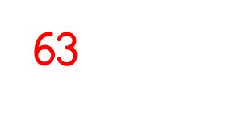
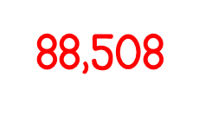
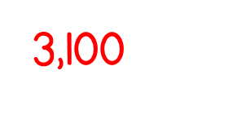

Year 6 | Week 4 | Day 4

Slide 3


Arithmetic Starter

Slide 4
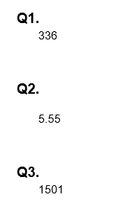
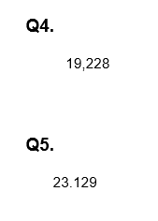
Arithmetic Starter - Answers

Slide 5


Slide 6
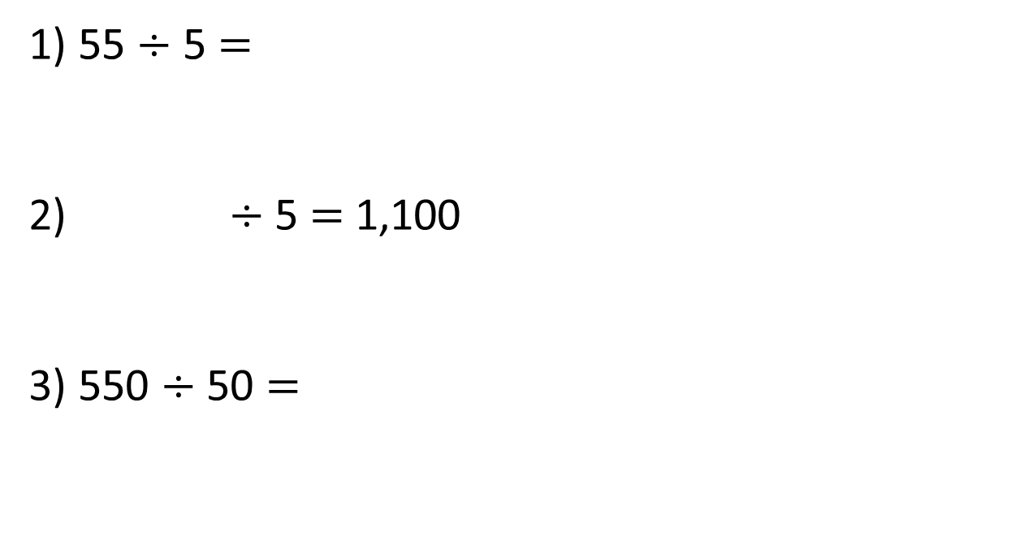
1) 55 $÷$ 5 $=$
2) $÷$ 5 $=$ 1,100
3) 550 $÷$ 50 $=$

Slide 7
1) 55 $÷$ 5 $=$
2) $÷$ 5 $=$ 1,100
3) 550 $÷$ 50 $=$
11
5,500
11

Slide 8


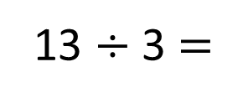
Eva has 13 straws. She wants to make them into triangles. How many triangles can she make?
13 $÷$ 3 $=$
4 r1

Slide 9




Tommy has 14 straws. He wants to make them into triangles. How many triangles can he make?
Dora has 15 straws. She wants to make them into triangles. How many triangles can she make?
Jack has 16 straws. He wants to make them into triangles. How many triangles can he make?
Have a think

Slide 10
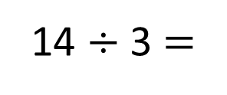
Tommy has 14 straws. He wants to make them into triangles. How many triangles can he make?
14 $÷$ 3 $=$
4 r2

Slide 11
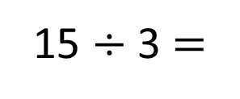
Dora has 15 straws. She wants to make them into triangles. How many triangles can she make?
15 $÷$ 3 $=$
5

Slide 12
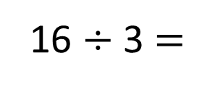
Jack has 16 straws. He wants to make them into triangles. How many triangles can he make?
16 $÷$ 3 $=$
5 r1

Slide 13
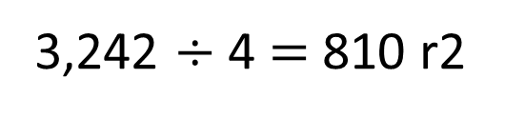
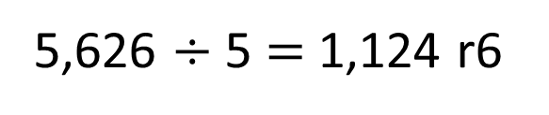
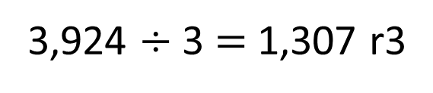
Have a think
Could these calculations be correct?
3,924 $÷$ 3 $=$ 1,307 r3
3,242 $÷$ 4 $=$ 810 r2
5,626 $÷$ 5 $=$ 1,124 r6
Could be correct | Definitely incorrect

Slide 14





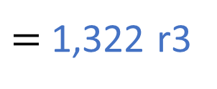
5,291 $÷$ 4
$=$ 1,322 r3
Thousands | Hundreds | Tens | Ones
4 | 5 | 2 | 9 | 1
1
3
2
2
r3
1
1

Slide 15

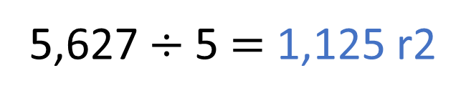
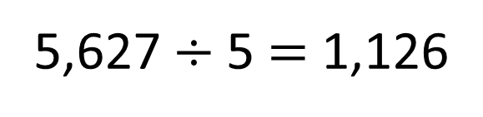
Have a think
5,627 $÷$5 $=$ 1,126
The 5 times table is in a pattern: 5, 10, 15, 20 …
5,627 is a whole number but it doesn’t end in a 5 or a 0 so the answer must have a remainder.
5,627 $÷$5 $=$ 1,125 r2

Slide 16
There are 349 people at a wedding. They are sitting at tables in groups of 8
How many tables are needed?
8 | 3 | 4 | 9
0
4
3
r5
3
2
Have a think
We need 44 tables
We need 43 tables

Slide 17
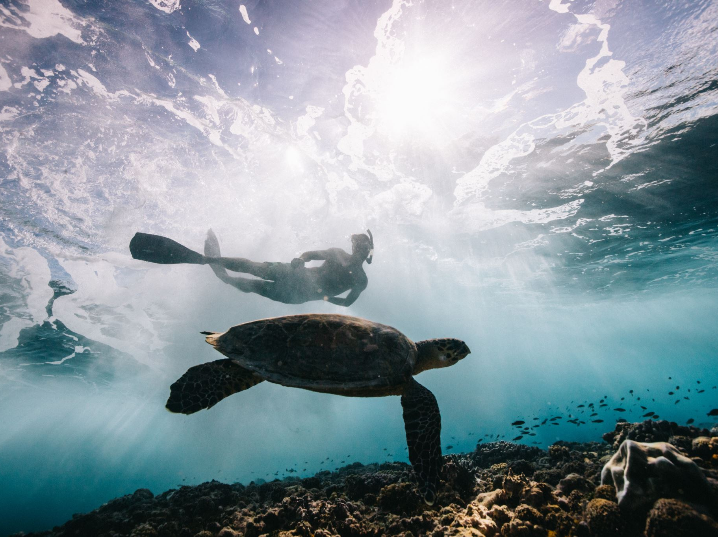
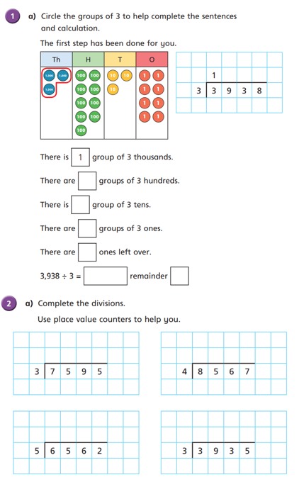
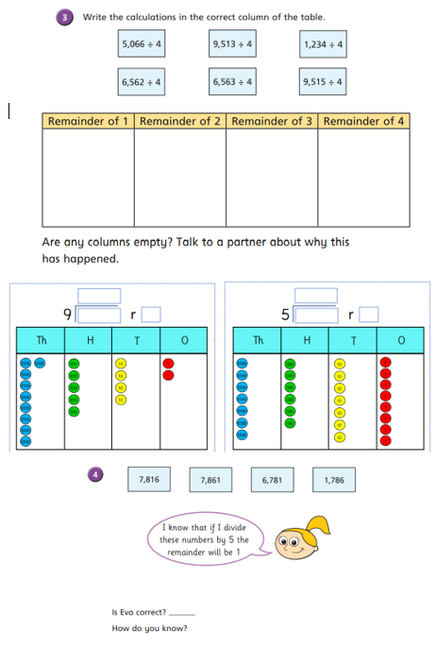
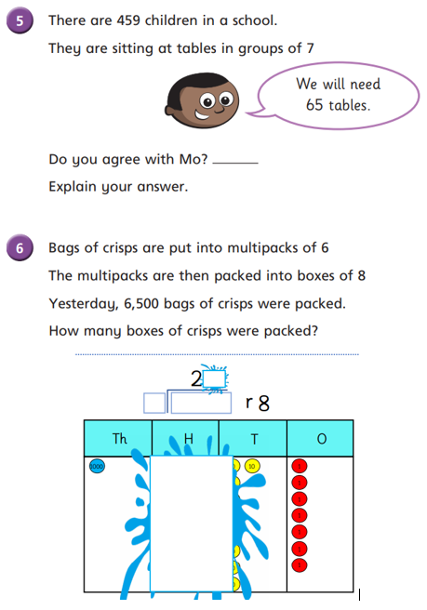
Independent Activity
Paddling Snorkelling Diving

Slide 18
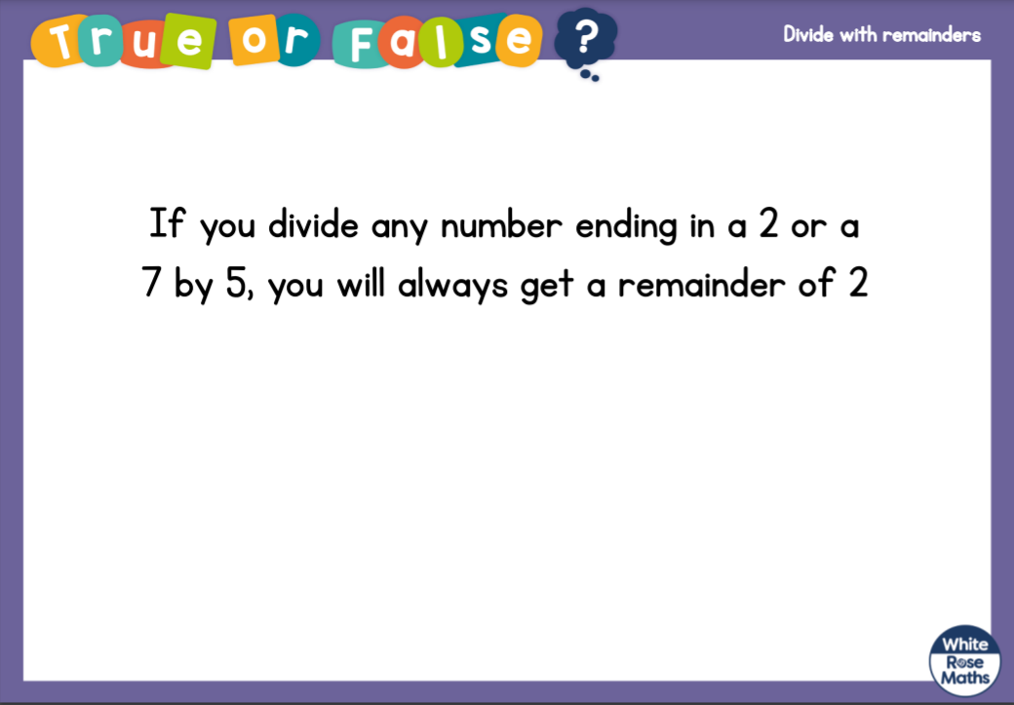



Slide 19



