Slide 1

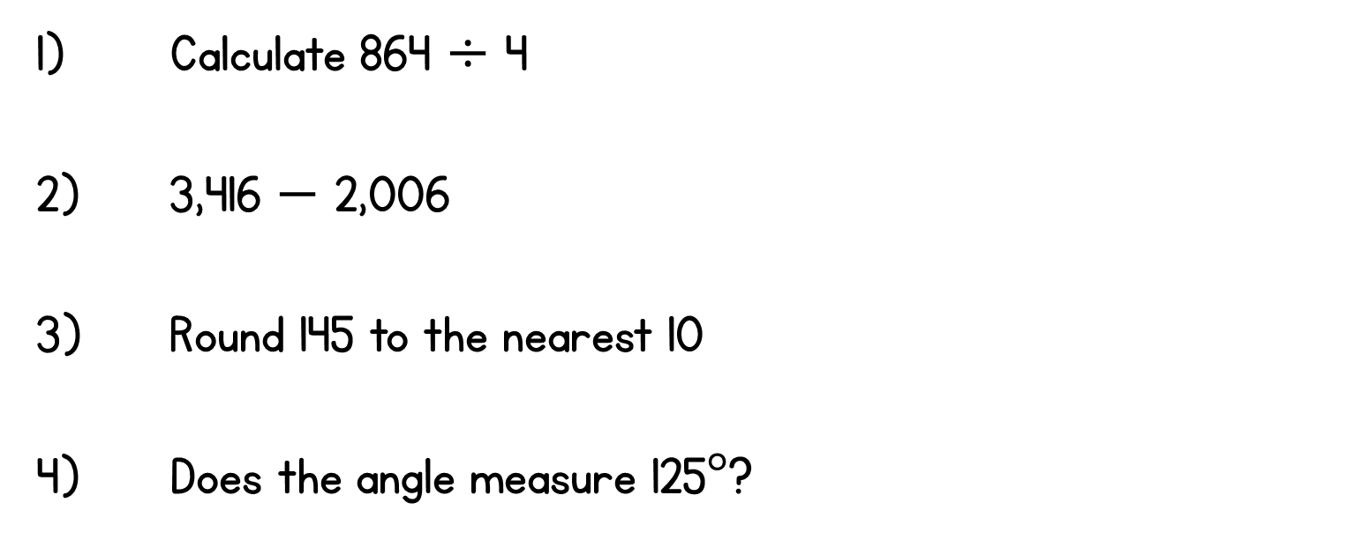
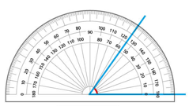
Year 6 | Week 4 | Day 3

Slide 2
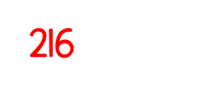
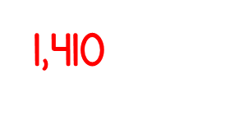
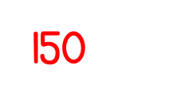
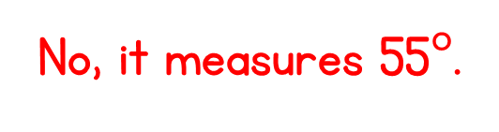
Year 6 | Week 4 | Day 3

Slide 3


Arithmetic Starter

Slide 4


Arithmetic Starter - Answers

Slide 5


Slide 6
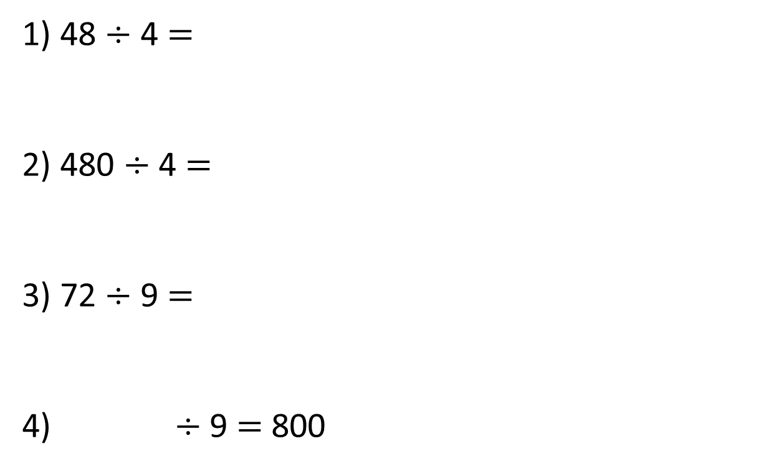
1) 48 $÷$ 4 $=$
2) 480 $÷$ 4 $=$
3) 72 $÷$ 9 $=$
4) $÷$ 9 $=$ 800

Slide 7
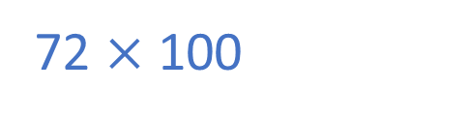
12
1) 48 $÷$ 4 $=$
2) 480 $÷$ 4 $=$
3) 72 $÷$ 9 $=$
4) $÷$ 9 $=$ 800
120
8
7,200
72 $×$ 100

Slide 8

There are 4,884 crayons and they come in packs of 4
How many packs are there?

Slide 9

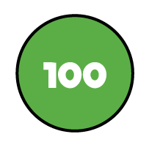


There are 4,884 crayons and they come in packs of 4
How many packs are there?
Thousands | Hundreds | Tens | Ones
4 | 4 | 8 | 8 | 4
1
2
2
1
1,221 packs

Slide 10


9,306 $÷$3
Have a think
Thousands | Hundreds | Tens | Ones
3 | 9 | 3 | 0 | 6
3
1
0
2

Slide 11

4,324 $÷$ 2
Thousands | Hundreds | Tens | Ones
2 | 4 | 3 | 2 | 4
2
1
6
2
1

Slide 12

8,212 $÷$ 4
Have a think
Thousands | Hundreds | Tens | Ones
4 | 8 | 2 | 1 | 2
2
0
5
3
2
1
4 tens
8 tens
12 tens
16 tens
20 tens
24 tens

Slide 13
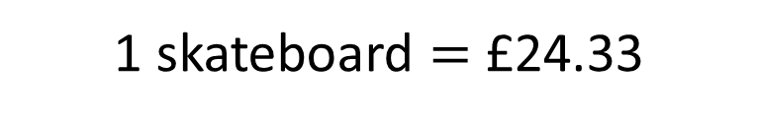
3 skateboards cost £72.99
How much does one cost?
.
3 | 7 | 2 | 9 | 9
2
4
.
3
3
1
1 skateboard $=$ £24.33

Slide 14
 | 9 | 4 | 2
3
1
4
3
3
1
9
Thousands | Hundreds | Tens | Ones

Slide 15
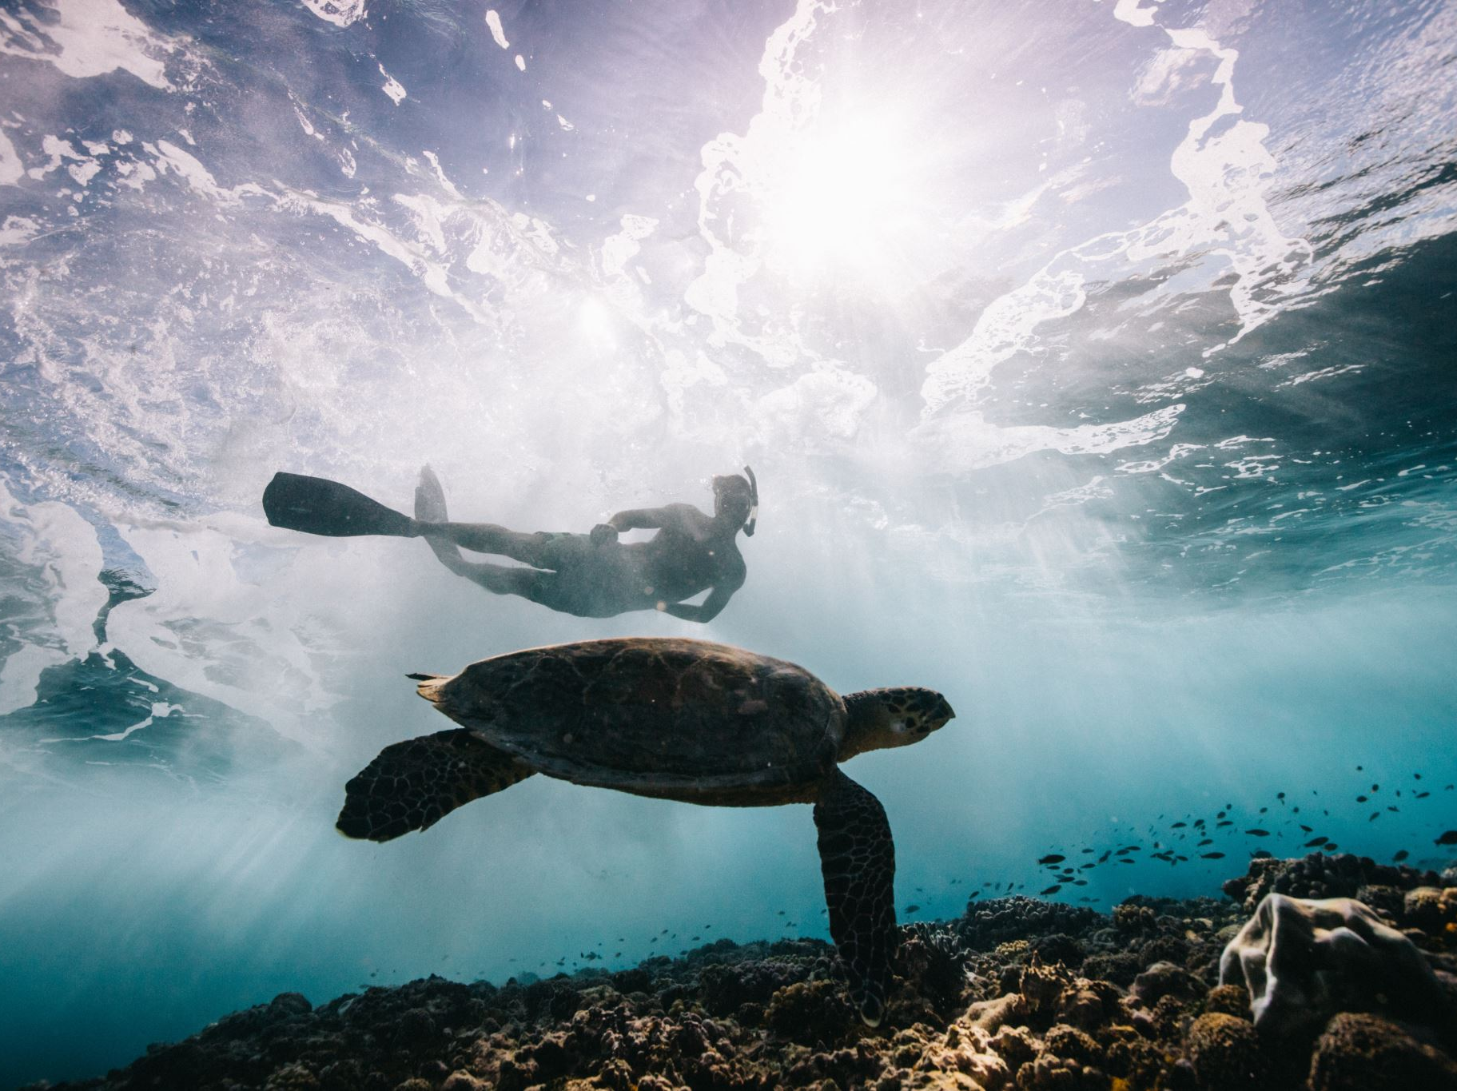
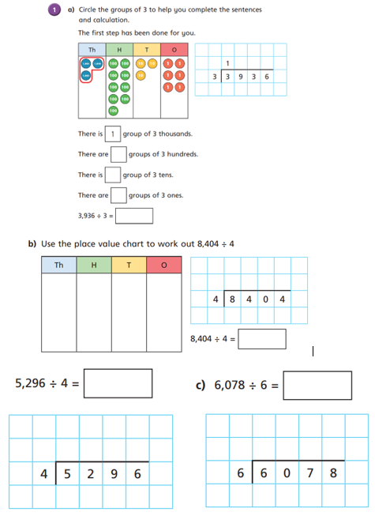
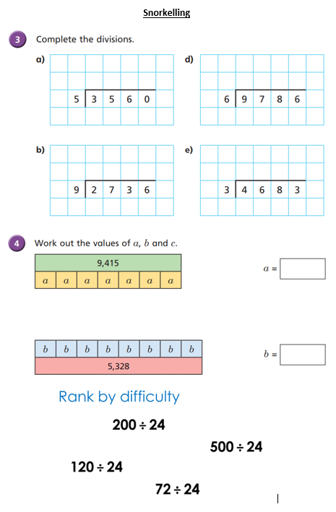
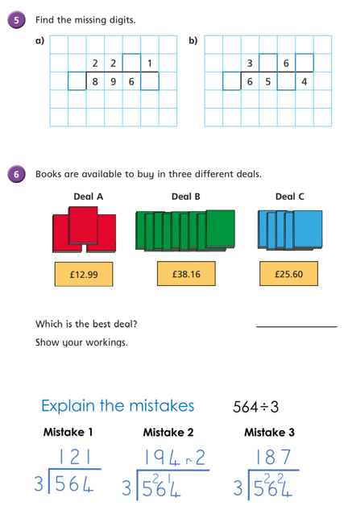
Independent Activity
Paddling Snorkelling Diving

Slide 16
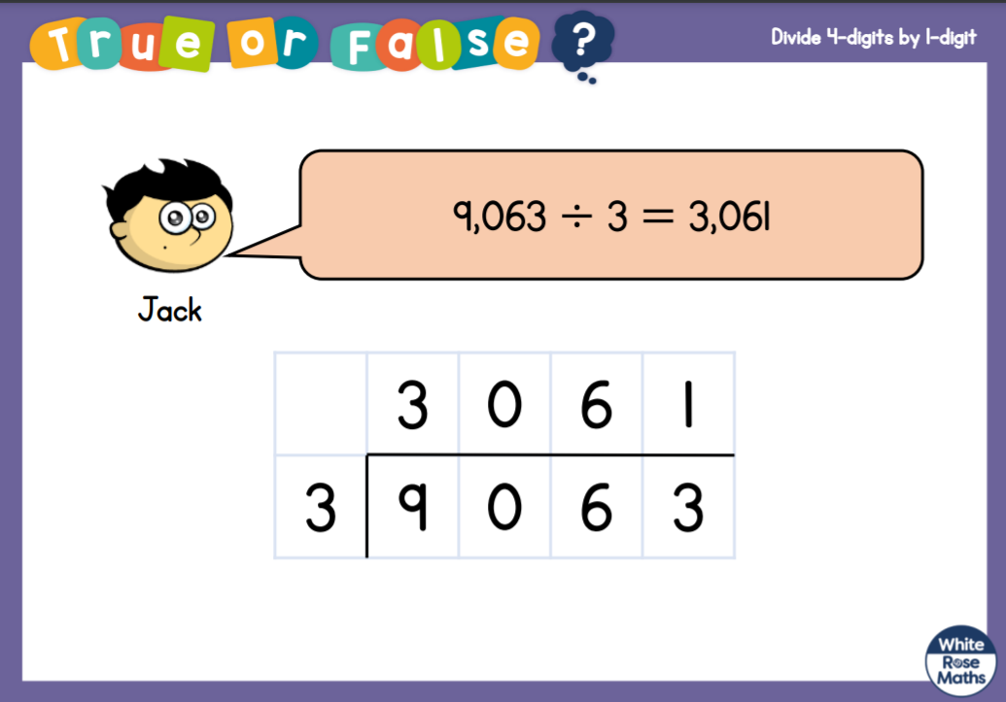



Slide 17


