Slide 1
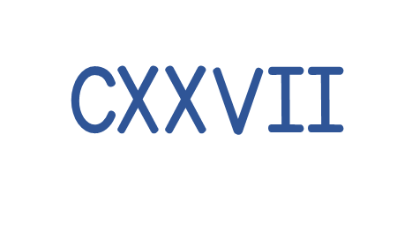
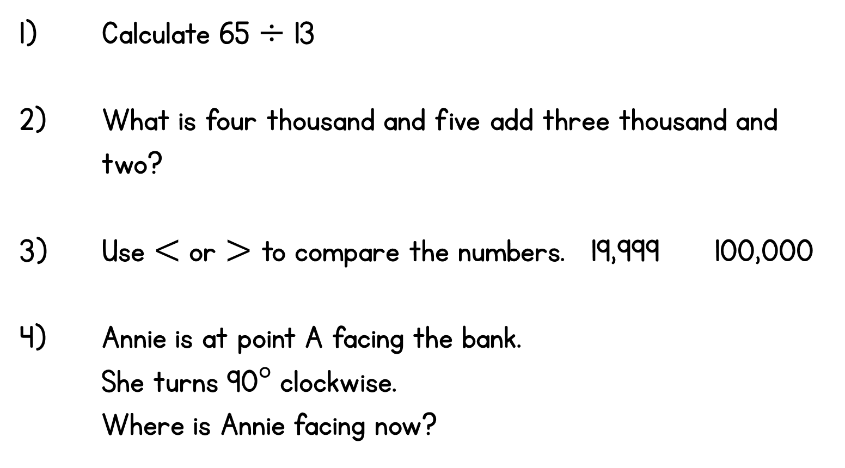
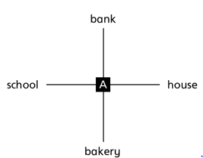
Year 6 | Week 4 | Day 1

Slide 2
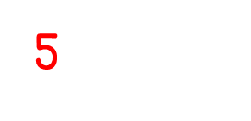
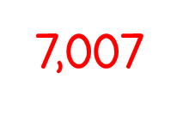


Year 6 | Week 4 | Day 1

Slide 3


Arithmetic Starter

Slide 4
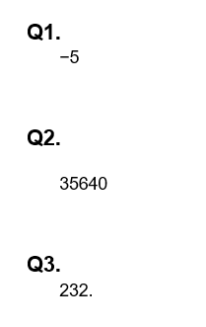
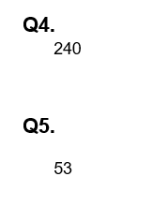
Arithmetic Starter - Answers

Slide 5


Slide 6
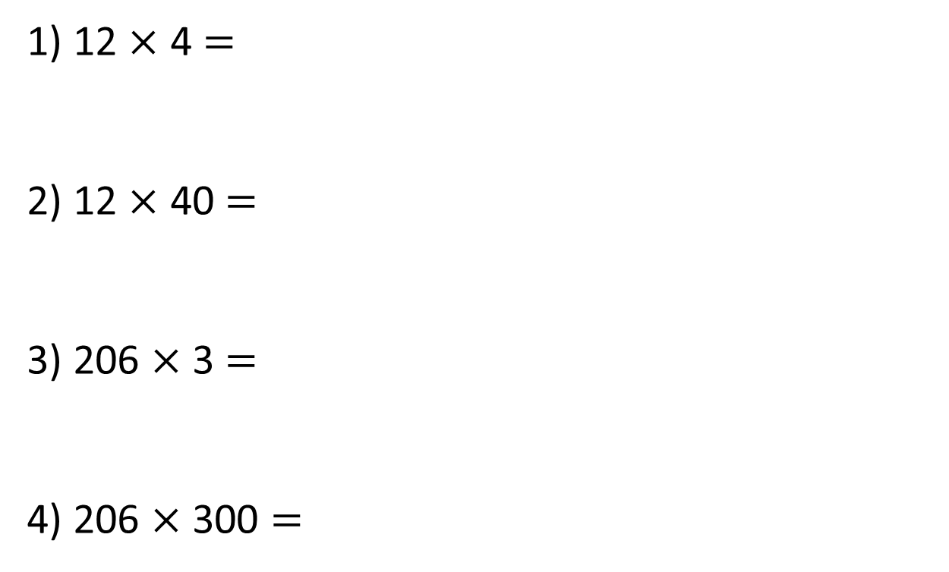
1) 12 $×$ 4 $=$
2) 12 $×$ 40 $=$
3) 206 $×$ 3 $=$
4) 206 $×$ 300 $=$

Slide 7
1) 12 $×$ 4 $=$
2) 12 $×$ 40 $=$
3) 206 $×$ 3 $=$
4) 206 $×$ 300 $=$
48
480
618
61,800

Slide 8


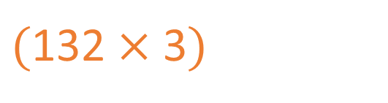
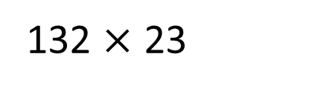
132 $×$ 23
Th | H | T | O
 | 1 | 3 | 2
 |  | 2
$$×$$
3
3
9
6
$($132 $×$ 3$)$
$$+$$

Slide 9
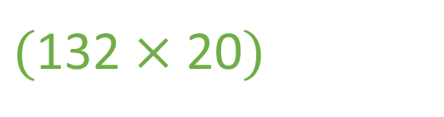
132 $×$ 23
Th | H | T | O
 | 1 | 3 | 2
 |  |  | 3
$$×$$
2
3
9
6
$($132 $×$ 3$)$
2
6
4
0
$($132 $×$ 20$)$
$$+$$
3
0
3
6
1
1

Slide 10

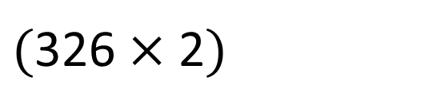
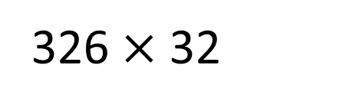
326 $×$ 32
Have a think
Th | H | T | O
 | 3 | 2 | 6
 |  | 3 | 2
$$×$$
6
5
2
$($326 $×$ 2$)$
1
$$+$$

Slide 11
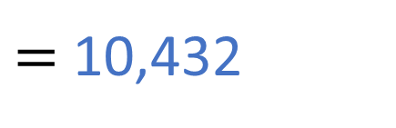
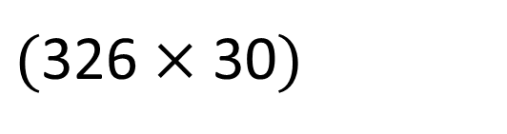
326 $×$ 32
$=$ 10,432
Th | H | T | O
 | 3 | 2 | 6
 |  | 3 | 2
$$×$$
6
5
2
$($326 $×$ 2$)$
1
9
7
8
0
$($326 $×$ 30$)$
$$+$$
1
1
0
4
3
2
1
1

Slide 12



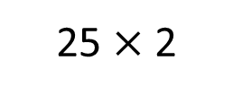


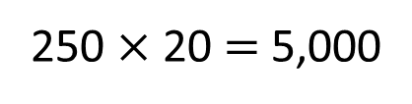
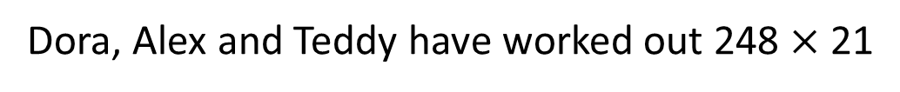
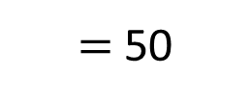
Dora, Alex and Teddy have worked out 248 $×$ 21
Dora
Alex
Teddy
2,976
5,208
7,688
How can we use estimating to help us check who is correct?
248 $×$ 21
250
20
$$×$$
$=$ 50
25 $×$ 2
250 $×$ 20 $=$ 5,000

Slide 13


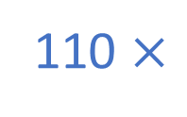
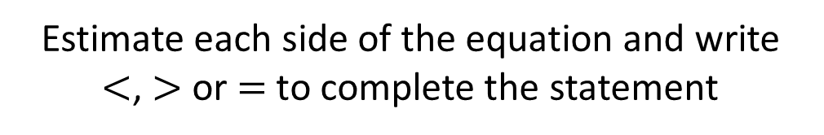
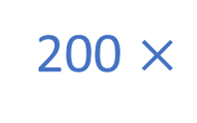

Estimate each side of the equation and write $<$, $>$ or $=$ to complete the statement
181 $×$ 24
$$<$$
112 $×$ 63
200 $×$
20
110 $×$
60
4,000
6,600
Have a think

Slide 14

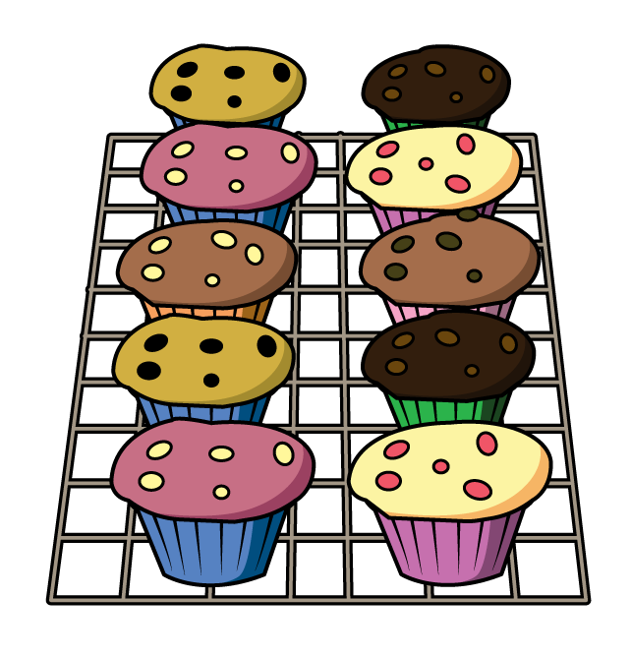
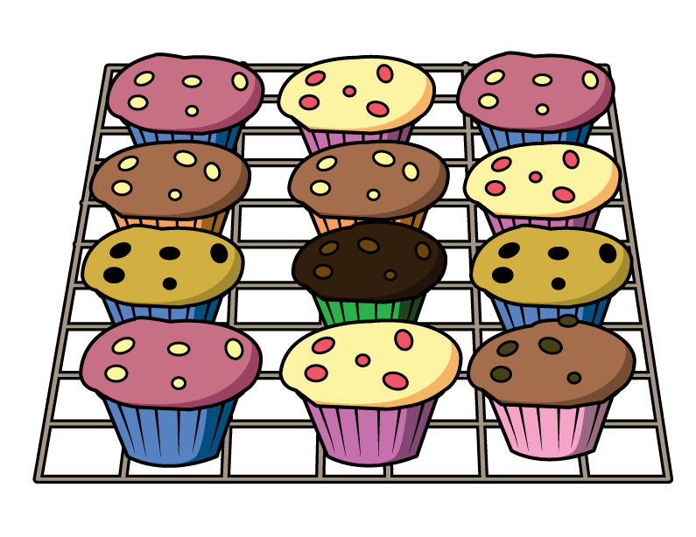
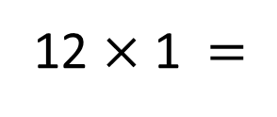
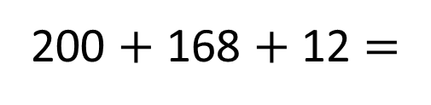
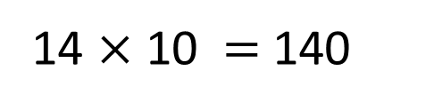
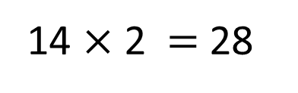
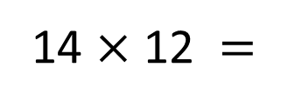
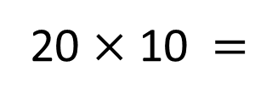
Mo orders muffins for a party.
He orders 12 of box A,
20 of box B
and 14 of box C.
How many muffins does Mo order?
Box A
Box B
Box C
12 $×$ 1 $=$
12
20 $×$ 10 $=$
200
14 $×$ 12 $=$
168
14 $×$ 2 $=$ 28
200 $+$ 168 $+$ 12 $=$
380
14 $×$ 10 $=$ 140

Slide 15

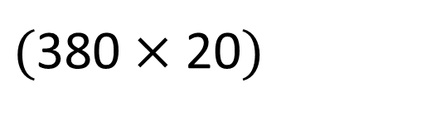
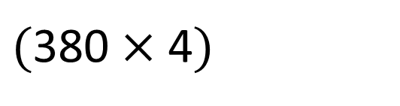

380
How many muffins does Mo order?
Each muffin costs 24p.
How much does Mo spend on muffins?
9120p
Th | H | T | O
 | 3 | 8 | 0
 |  | 2 | 4
$$×$$
$($380 $×$ 4$)$
1
5
2
0
3
7
6
0
0
$($380 $×$ 20$)$
$$+$$
1
9
1
2
0
1

Slide 16
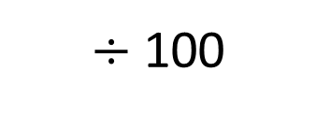
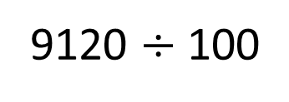
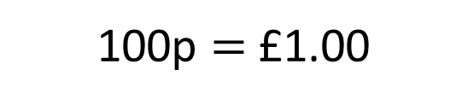
380
How many muffins does Mo order?
Each muffin costs 24p.
How much does Mo spend on muffins?
9120p
$÷$ 100
100p $=$ £1.00
9120 $÷$ 100
TTh | Th | H | T | O | Tth | Hth | Thth
9
1
2
0
£91.20

Slide 17
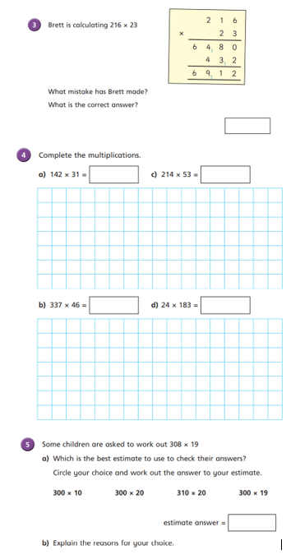
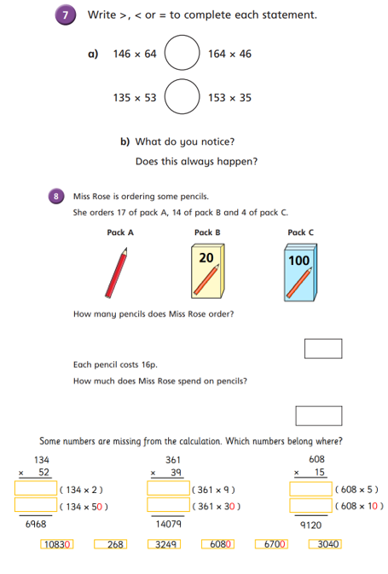
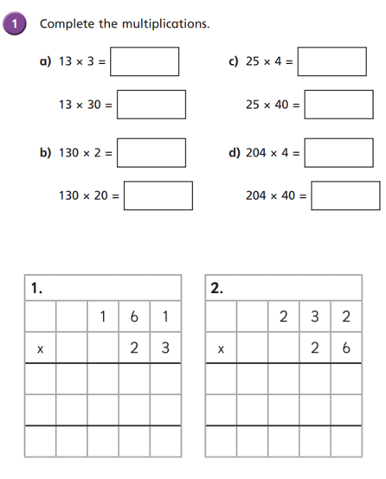
Independent Activity
Paddling Snorkelling Diving

Slide 18
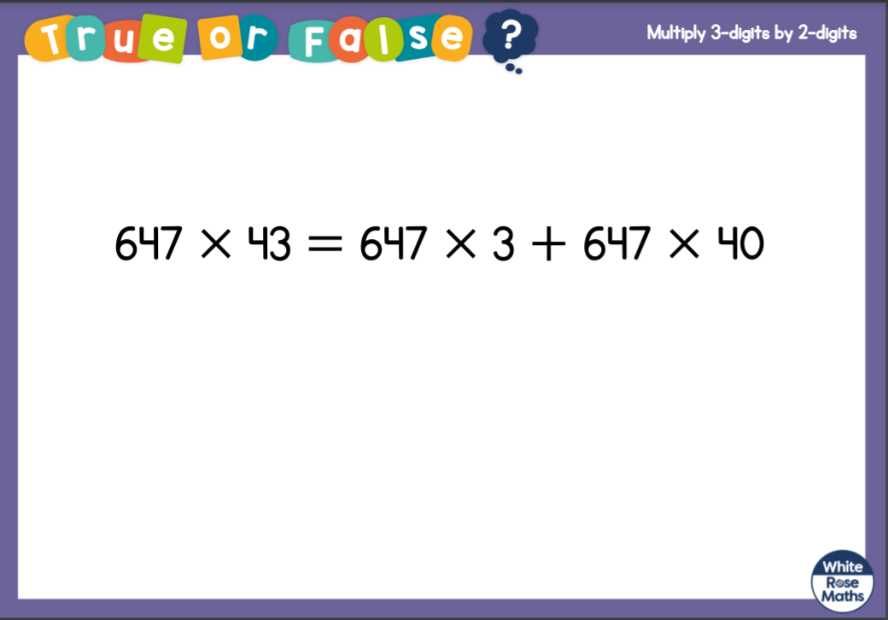


Slide 19


