Slide 1
Monday 4th October 2021
LO: To write with purpose
To use imaginative description
C: Informal Recounts

Slide 2
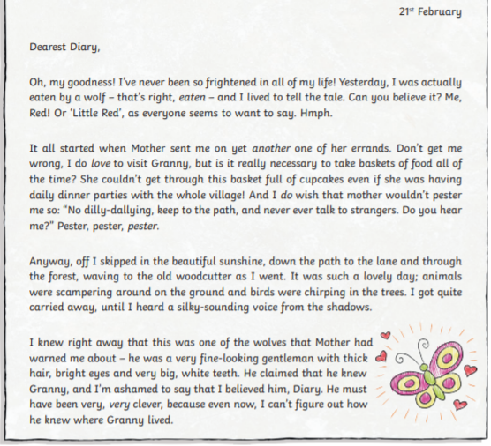
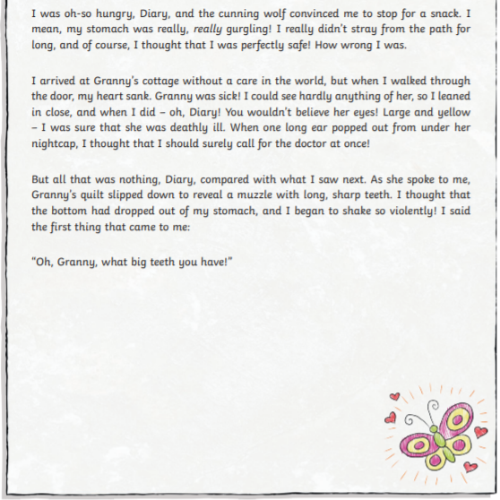
What is this?
What type of text is it?

Slide 3
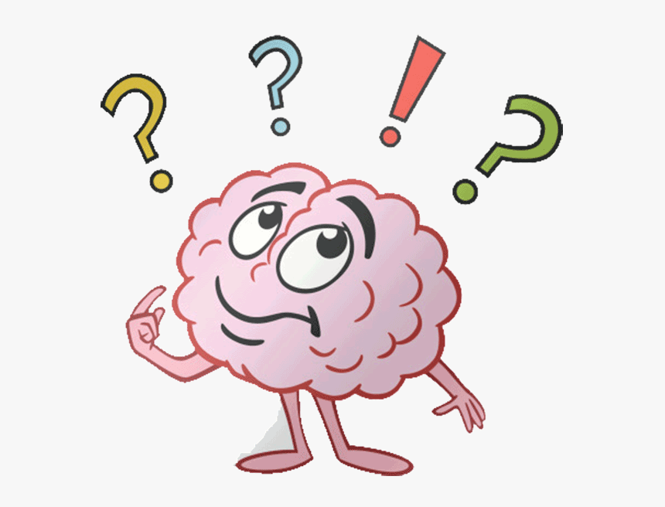
A diary entry is an informal recount.
What do you know about informal recounts?
What are the features of informal recounts?

Slide 4
https://www.bbc.co.uk/bitesize/articles/z4qtqfr
A recount is a way of telling others what has happened to you. A diary entry is a type of recount.
Write your recount in the first person because it happened to you!
Use the past tense because it has already happened.
Have a clear structure. Use paragraphs to separate different events and ideas.
Within each paragraph include observations (what you saw), thoughts and feelings.
Diaries (recounts) are written in the order in which they happened - chronological order. Use time conjunctions like primarily, next, then and finally to show this.
Use description to add detail so the reader can build an image in their head.
Use emotive language so the reader understands your point of view.

Slide 5
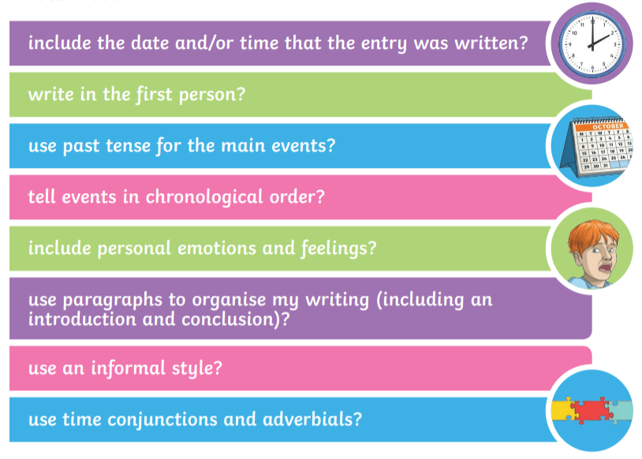

Slide 6
Your writing over the next couple of weeks will be different to your newspaper writing as you will be changing from formal to informal language.
What type of language might we use with informal writing?

Slide 7
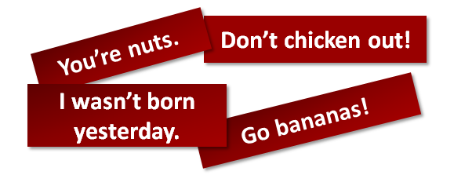
We call this colloquial language!
This just means casual and conversational language – how you would speak with your friends!

Slide 8

Activity 1
Create a checklist for informal recounts.
What do you need to be including in your writing next week?
You will be using your checklists to help you with your diary writing next week!

Slide 9
We will be writing a diary entry from Rose Blanche’s point of view.
You are going to write about Rose Blanche’s day on the day she finds the children.
What events occurred beforehand?
i.e. the truck broke down, the boy escaped, the mayor caught him, Rose followed the truck etc.
You do not have to write from Rose’s POV if you don’t want to. You could imagine that Rose had a friend with her and pretend to be her friend!

Slide 10
Imagine you are Rose Blanche/her friend and this scene is in front of you.
What can you see?
What can you feel?
What can you hear?
What can you smell?
What can you taste?
Rose’s physical reactions could be included here, e.g. she could feel her heart racing in her chest, she could hear the thud of her blood pumping in her head, she felt sick to her stomach etc.

Slide 11
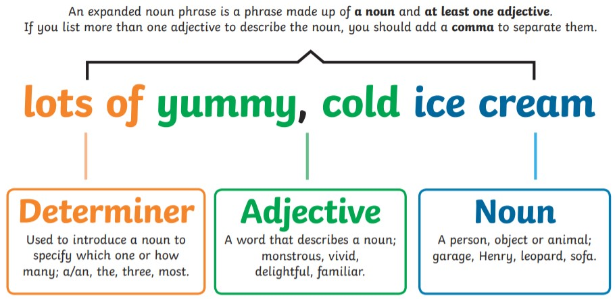
heavenly, creamy

Slide 12
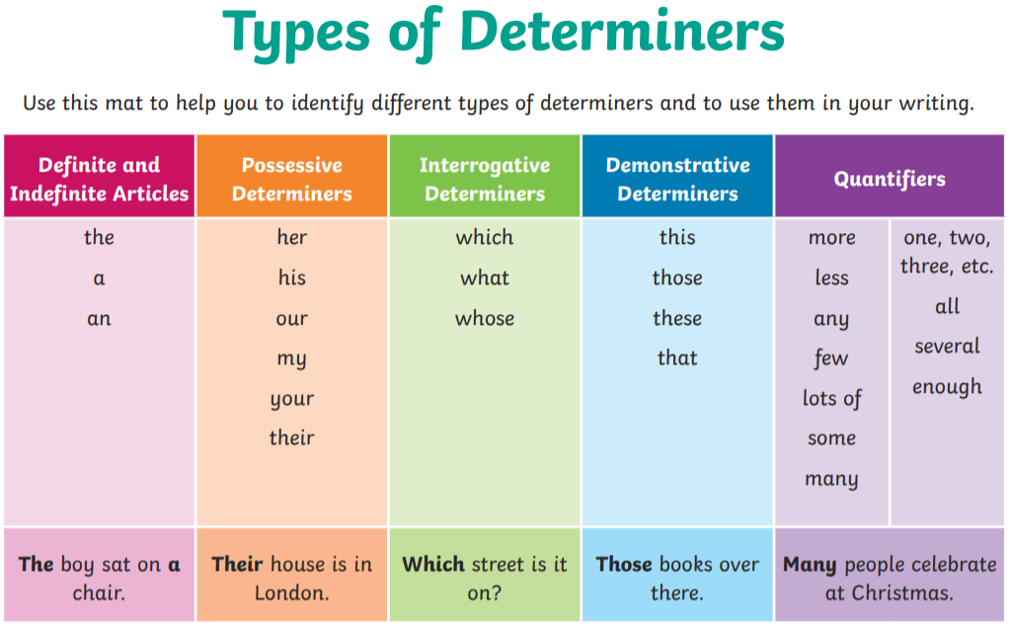

Slide 13
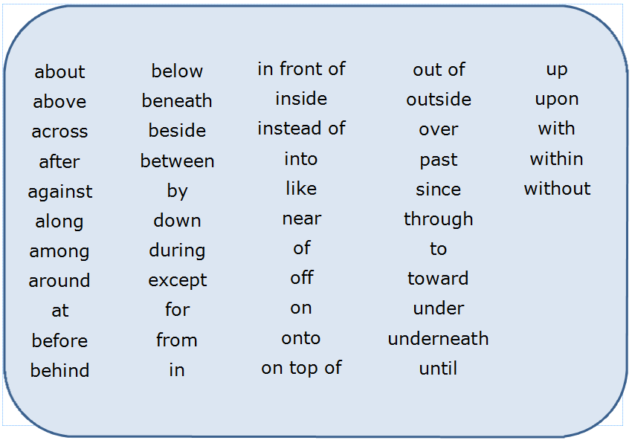
Remember you can add detail/information to your expanded noun phrases by using prepositions.

Slide 14
Turn your ideas into expanded noun phrases.
Make sure you are using impressive vocabulary!
Have you used determiners in your expanded noun phrases?

Slide 15
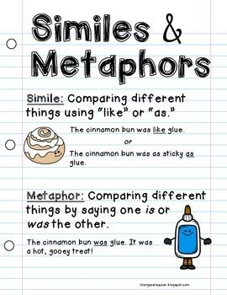
Activity 2
Stick in the illustration and label it with expanded noun phrases.
What can Rose see, hear, feel, smell, taste? Etc.
Snorkelling and Diving: try to use impressive vocabulary in your expanded noun phrases. Use a thesaurus to improve your adjectives.
Red Pen: Add some similes and metaphors to the illustration to describe the scene.

Slide 16
Tuesday 5th October 2021
LO: To organise writing appropriately
To use sentences appropriately
C: Informal Recounts

Slide 17
What are adverbial phrases?
What are fronted adverbials?

Slide 18
Adverbial Phrase
Fronted Adverbial
An adverbial phrase is like an adverb, it adds more information to the sentence, but it uses more than one word to describe the verb.
For example: The farmer drove the tractor in the evening.
Adverbial phrases can describe how, when or where a verb is done.
How = The bees flew wildly.
When = The bees flew all of a sudden.
Where = The bees flew through the air.
A fronted adverbial is when the adverbial word or phrase is moved to the front of the sentence, before the verb.
"Earlier today, I discovered fronted adverbials."
Here, 'earlier today' is a fronted adverbial.

Slide 19
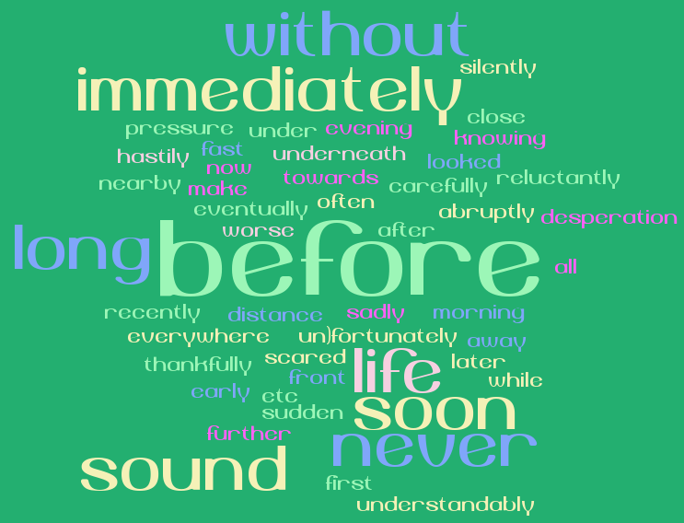
Look back at the illustration from last lesson.
What adverbial phrases/fronted adverbials might you use in your writing?
Think about Rose’s day – how could we add more information/detail to her actions?
Remember that a comma should be used AFTER the fronted adverbial.

Slide 20
Activity 1
Write a lit of adverbial phrases/fronted adverbials that you could use in your diary entry from Rose Blanche’s POV.

Slide 21

What tense will we be writing in?
Why?

Slide 22
https://youtu.be/RJAqKEljAFw https://www.youtube.com/watch?v=odDSbWHUGYk&t=46s
Past Simple Tense
Past Progressive Tense
The past simple tense describes something that took place at a specific time and has finished, e.g. I walked the dog yesterday.
The past progressive tense describes an action that took place in the past over a period of time, e.g. I was walking the dog when it started raining.
The past progressive tense is formed by using the past for the verb ‘to be’ and by adding the suffix ‘ing’ to the main verb.

Slide 23
Think of some sentences you could use in your diary entries which are written in the past simple or past progressive tenses.
Use your learning from the starter activity and your descriptions from last lesson in your sentences.
Are your sentences structured correctly? Punctuated correctly?
Can you improve any of the vocabulary?
What tense have you written in? How do you know?

Slide 24
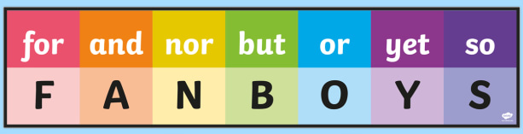

Activity 2
Write sentences from Rose Blanche’s POV in the past simple and past progressive tenses.
You should include some of your adverbial phrases and fronted adverbials from the starter activity and the descriptive vocabulary from last lesson in your writing.
Red Pen: Write compound or complex sentences in the past simple and past progressive tenses.

Slide 25
Wednesday 6th October 2021
LO: To write with purpose
To use sentence appropriately
C: Informal Recounts

Slide 26

What type of language should we be using in our diary entries?
Colloquial language.
Colloquial language is the way we all speak when in informal situations, like with our friends or family.
It includes words and phrases that are particular to our age group and the area where we live as well as expressions that are part of your own vocabulary.
This means colloquial language can include slang.
These non-standard English words are easily understood by certain groups of people, but might be unfamiliar to other groups.
In colloquial language, it is also common to use contrations, e.g. ‘gonna’ for ‘going to,’ ‘innit’ for ‘isn’t it’ and ‘I ain’t’ for ‘I am not.’

Slide 27
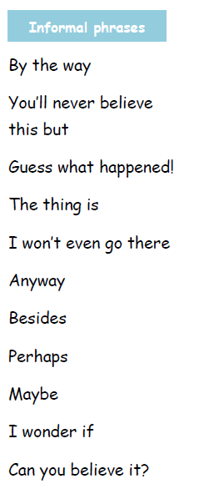
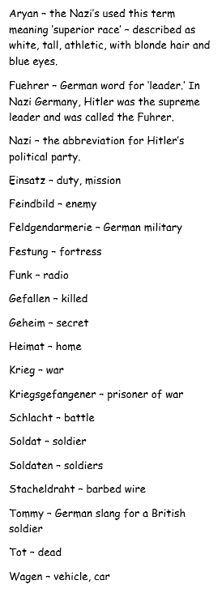
Consider how Rose Blanche might talk to her friends.
What words might she use in her diary entry?
Remember: this story is set during WWII, so Rose would not be using modern day slang.

Slide 28
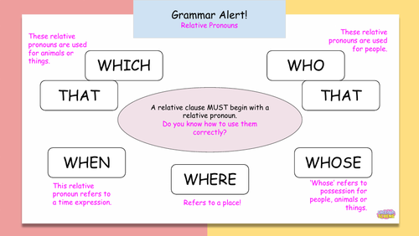
Do you know what these are?

Slide 29
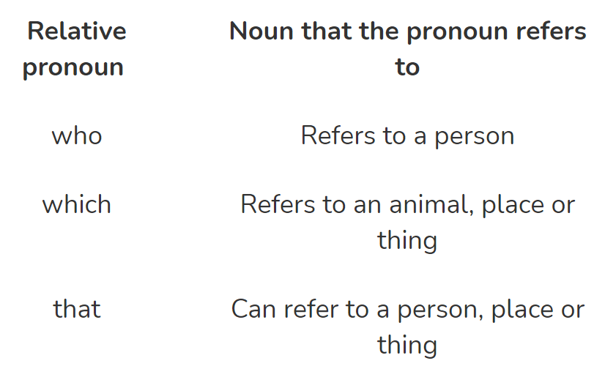
They are relative pronouns and can be used to introduce relative clauses.
They are used to refer back to something that’s already been mentioned in the sentence.
Make sure you are using the correct relative pronouns in your writing!

Slide 30
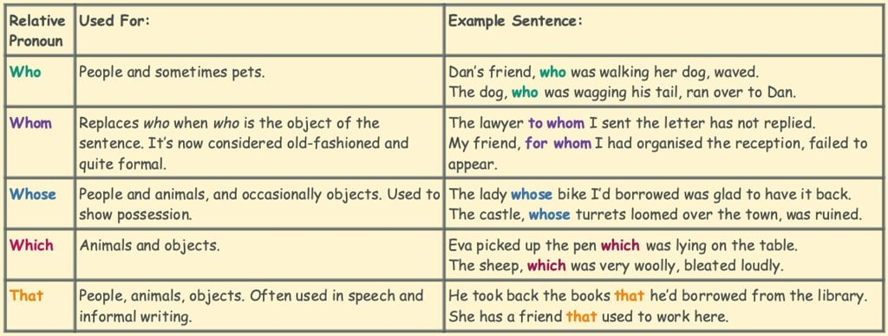
Can you spot any embedded clauses in the examples?
Remember: you need to use a comma either side of the embedded clause in your writing!

Slide 31
Look back at the illustration from Monday’s lesson.
Think of some sentences you could use in your diary entries which have relative clauses and use colloquial language.
Use your descriptions from Monday’s lesson in your sentences.
Challenge: use adverbial phrases from last lesson.
Share your sentences with the class.
Have you punctuated your sentences correctly? Especially if you are using embedded clauses!

Slide 32
Activities
Activity 1: Write a lit of relative pronouns that you could use in your diary entry from Rose Blanche’s POV.
Activity 2: Write sentences from Rose Blanche’s POV which have relative clauses and colloquial language.
Try to include relative clauses, descriptive language and adverbial phrases. Use our work from the previous two lessons to help you.
Challenge: can you include some war time slang in your sentences?

Slide 33
Red Pen
Write compound or complex sentences with relative clauses.

Slide 34
Thursday 7th October 2021
LO: To write with purpose
To use sentences appropriately
C: Informal Recounts

Slide 35
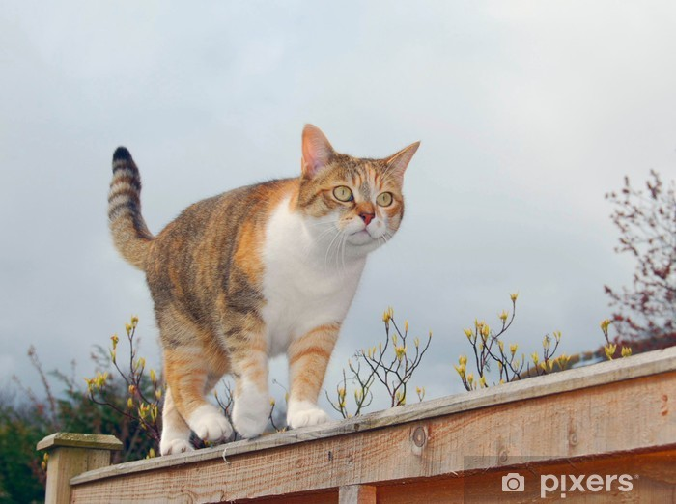
Starter: Mucking About With A Sentence
The cat ran along the wall.
Can we alter the sentence type?
Try to turn the sentence into a question.
An exclamation.
A command.
A compound sentence.
A complex sentence.
Do you know what the different sentence types are?

Slide 36

What are rhetorical questions?
Questions which do not require an answer as the person asking the question either already knows the answer or isn’t expecting one in return.
Could we use rhetorical questions in our diary entries?
Yes! Rose could ask her diary a question but she wouldn’t be expecting it to answer!

Slide 37
What rhetorical questions could we use in our diaries?
Remember: there should be a question mark at the end of a question!

Slide 38
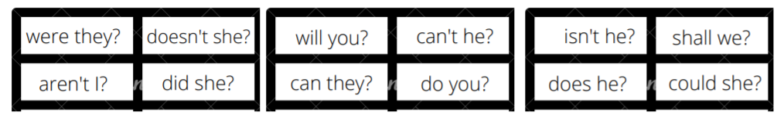
Have you heard of the term ‘question tags’?
We can add question tags like ‘isn’t it?’ ‘can you?’ or ‘didn’t they?’ to a statement to make it into a question.
Question tags are more common in speaking than writing.

Slide 39
Why do we use question tags?
To confirm or check information or ask for agreement
  You want to come with me, don’t you?
  You can swim, can’t you?
  You don’t know where the boss is, do you?
  That film was fantastic, wasn’t it?
To check whether something is true
  The meeting’s tomorrow at 9am, isn’t it?
  You won’t go without me, will you?
To encourage a reply from the person we are speaking to
  You played very well, didn’t you?

Slide 40
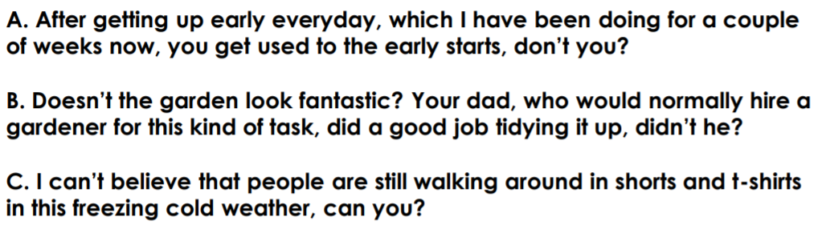

Slide 41
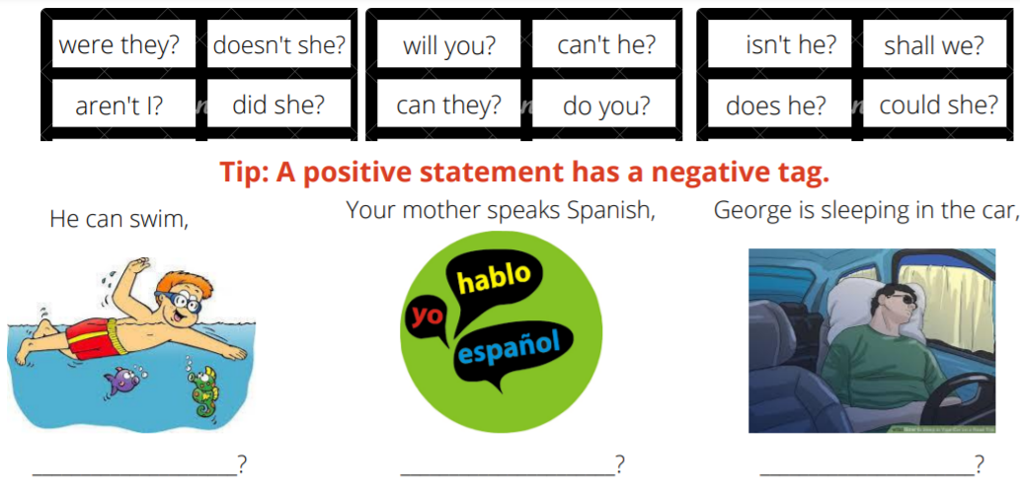
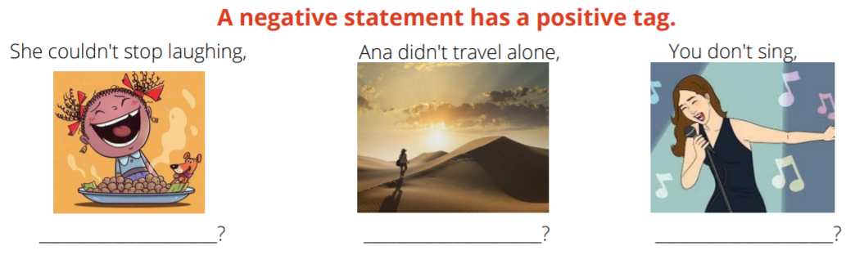

Slide 42
What questions with question tags could we use in our diaries?
Remember:
  There should be a question mark at the end of a question!
  A comma should be used at the end of the statement before the question tag.

Slide 43
Activities
Activity 1: Create a bubble map of rhetorical questions/question tags that you could use in your diary entry.
Activity 2: imagine that Rose has just stumbled upon the children behind the fence. Write a short paragraph from her POV describing the scene in front of her.
Use all of the learning from this week to help you, i.e. the descriptive phrases from Monday, adverbial phrases, fronted adverbials, relative clauses and rhetorical questions with question tags.
You sentences should include past progressive and past simple tense AND be written in colloquial language!
Challenge: include compound and complex sentences in your writing.

Slide 44
Red Pen
Consider some semi-colon sentences you could use in your diary entries.
Top Tip: use a semi-colon instead of the conjunction ‘but.’
e.g. I crawled cautiously under the rigid barrier; I knew it was forbidden.
I wanted to say something; I couldn’t find the words.
Some believe the war is just and right; others believe it is a horrible waste of life.

