Slide 1
LO: To reflect.
C: Christianity – Eternality

Slide 2

Starter
What does eternal mean?

Slide 3
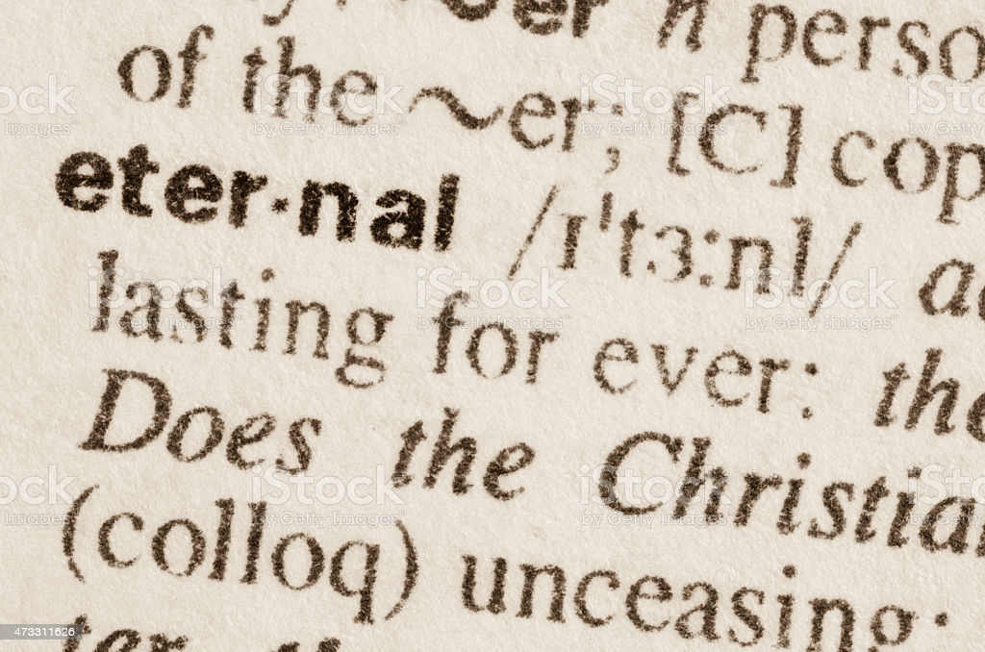
Eternal
Lasting or existing forever; without end.

Slide 4
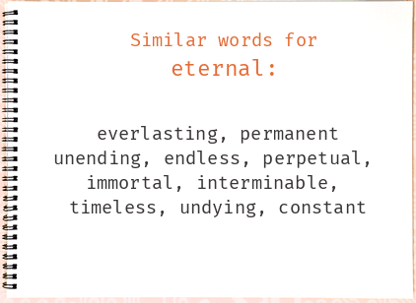
Starter
What synonyms of eternal can you think of?
Create a bubble map of our ideas.
e.g. forever, endless, everlasting

Slide 5
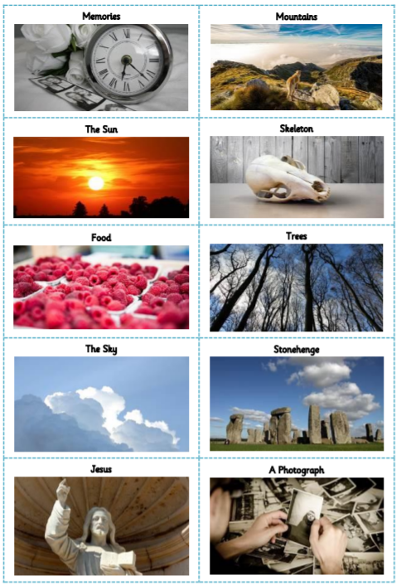
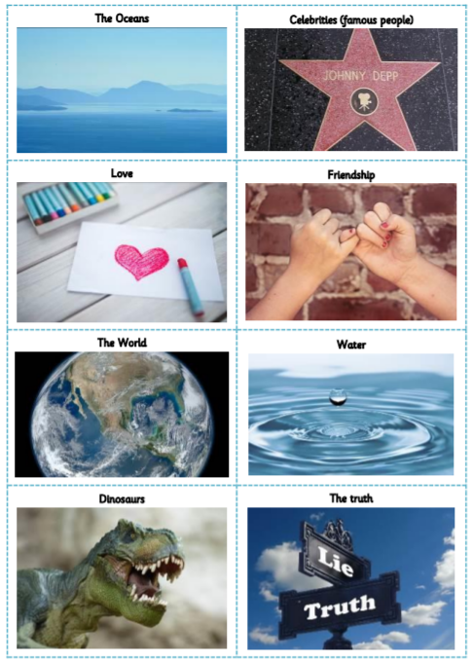
Which of these do you think will last forever?
Sort the images according to those that you think will last forever.
Can you explain and justify your thoughts?

Slide 6
Think of ideas for each heading.
Write your ideas under the headings.
Has lasted my lifetime so far | I think will last forever | I wish would last forever
Look at the list of things you wish would last forever.
Why do you wish they would last forever? How do you feel about these things?
e.g. security, safe, reassuring

Slide 7
Does anything last forever?
Doesn’t everything change all of the time?
Try to explain and justify your thoughts to the question.

Slide 8

In Buddhism
Many Buddhists believe that everything changes, e.g. even a chair – one minute it has someone sitting on it, the next it doesn’t.
Do you agree with this belief? Why (not)?

Slide 9
Activity
Answer the questions below to demonstrate your current beliefs on eternality:
Q1 – What do we mean by ‘eternal’?
Q2 – Will anything last forever? Explain your thinking.
Paddling: complete the sheet.
Snorkelling/Diving: write a short paragraph explaining what is meant by ‘eternal’ and outlining your own personal response to the question – Will anything last forever?

Slide 10
Red Pen
Paddling Red Pen: Consider the positives and negatives of some things lasting forever.
Snorkelling/Diving Red Pen: Do you agree with the Buddhist belief that everything changes all of the time? explain your thinking.

Slide 11

Plenary
How do you feel about the idea of eternity?
Can you choose adjectives to describe your feelings?

