Slide 1
Personal learning goals
PSHCE

Slide 2
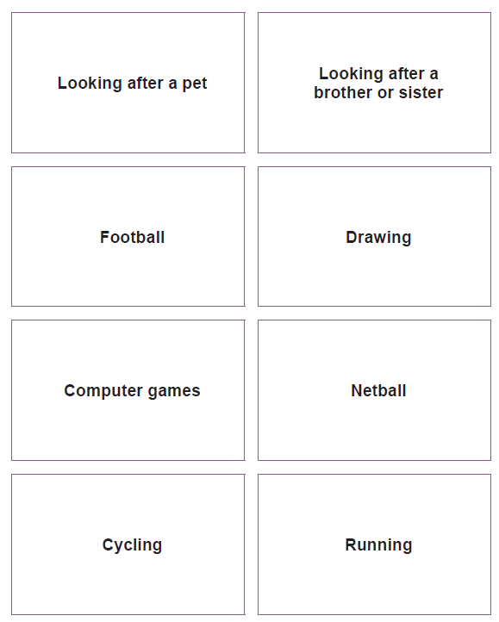
strength
Look at the strength cards in front of you.
Which card(s) describe a strength you have?
What personal or learning strengths do you have?
How does your strength make you feel?

Slide 3

Think about a realistic goal or dream you have for yourself.
Share some of your ideas with the class.

Slide 4

What is a realistic goal?
Do you have a realistic or unrealistic goal?

Slide 5

Why is it important to have goals?
Why is it important to stretch yourself to reach them?
Why is it important to speak your dreams and goals out loud or to write them down?

Slide 6
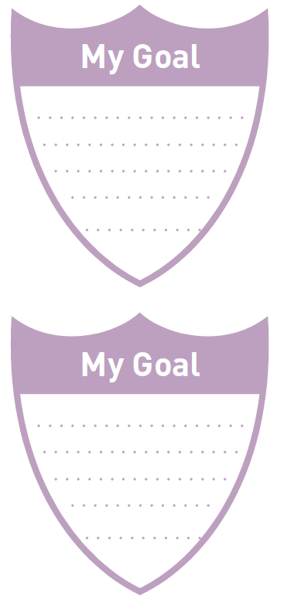
Activity
You have two ‘goal cards.’
Think of two goals for yourself – one needs to be a school-based goal, e.g. to speak confidently in assembly, to become better at spelling etc. the other goal can be an aspiration for outside school, e.g. to gain my yellow belt in Karate, to have a pet dog etc.
In our next lesson, we will be thinking about the steps we might take to reach our goal.

