Slide 1


Women in History
LO: To understand chronology.
C: Timelines

Slide 2
Famous Women in History
Do you know of any discrimination women have faced in the past or closer to the present day?
Think about about a famous woman you know; what was she famous for?
They can be from any period of history.

Slide 3
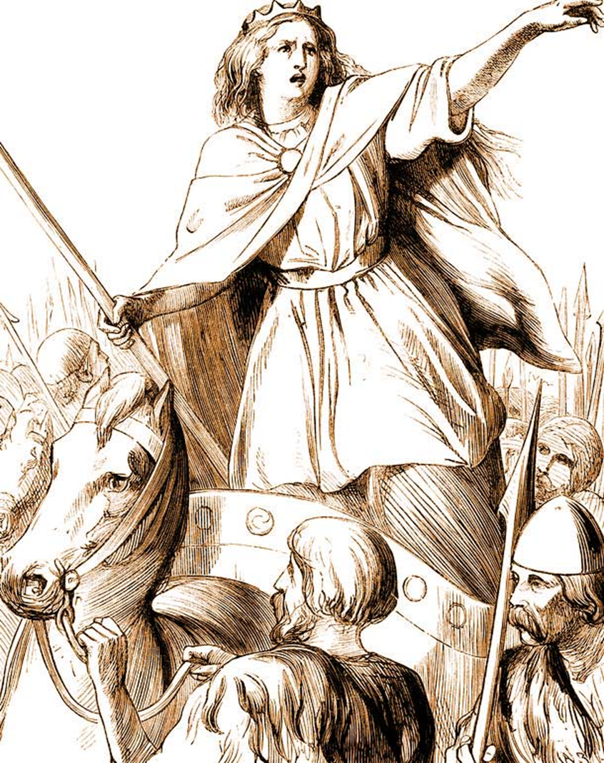
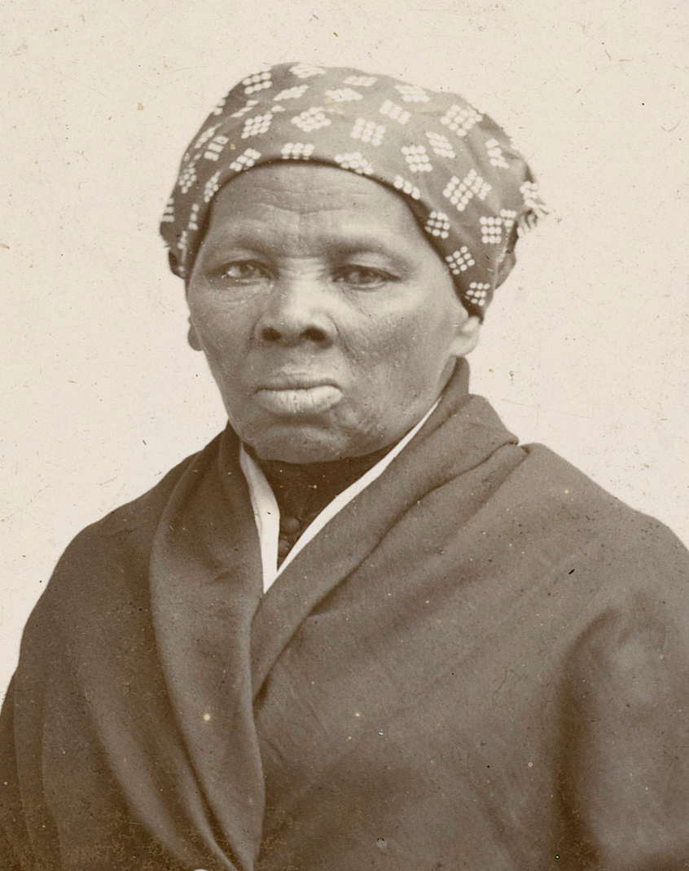
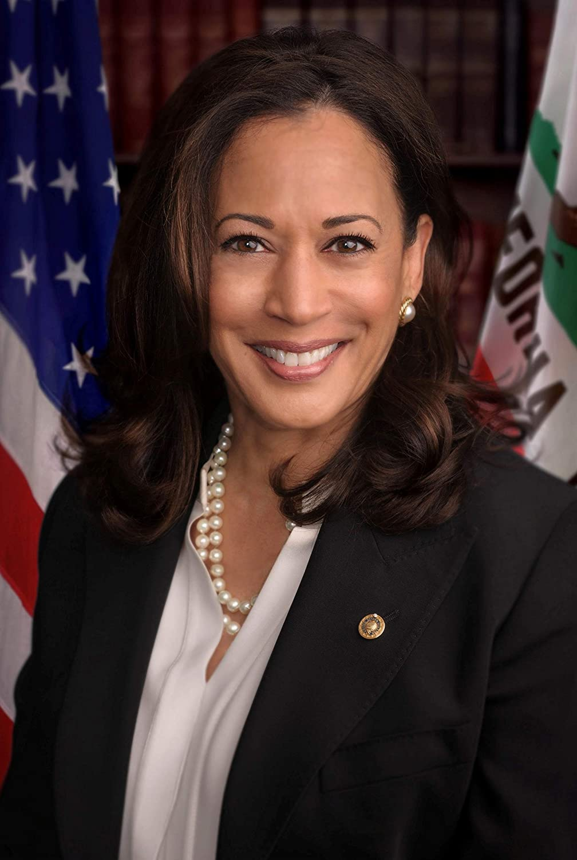
Have you heard of these pioneers?
Boudicca (60 – 61AD)
The rebel queen of the ancient British Celtic Iceni tribe, who led an army against the Romans in AD 60/61. After suffering a public flogging and witnessing her two daughters being attacked, Boudicca raised an army that destroyed Roman strongholds.
Harriet Tubman (1822 – 1913)
Tubman was an American abolitionist and political activist. Born into slavery, Tubman escaped and made 13 missions to rescue over 70 enslaved people, using a network of antislavery activists and safe houses known as the Underground Railroad.
Kamala Harris (1964 – present)
On 20th January 2021, Kamala Harris became the first woman and the first African American and South Asian person to become the Vice President of the United States.

Slide 4
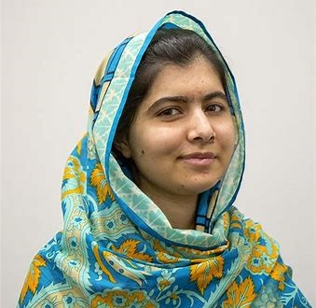
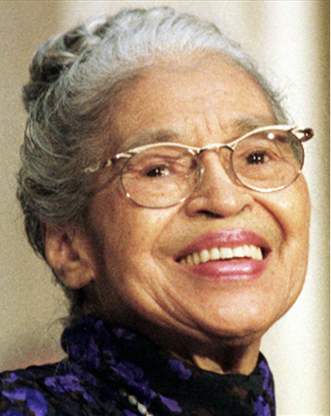
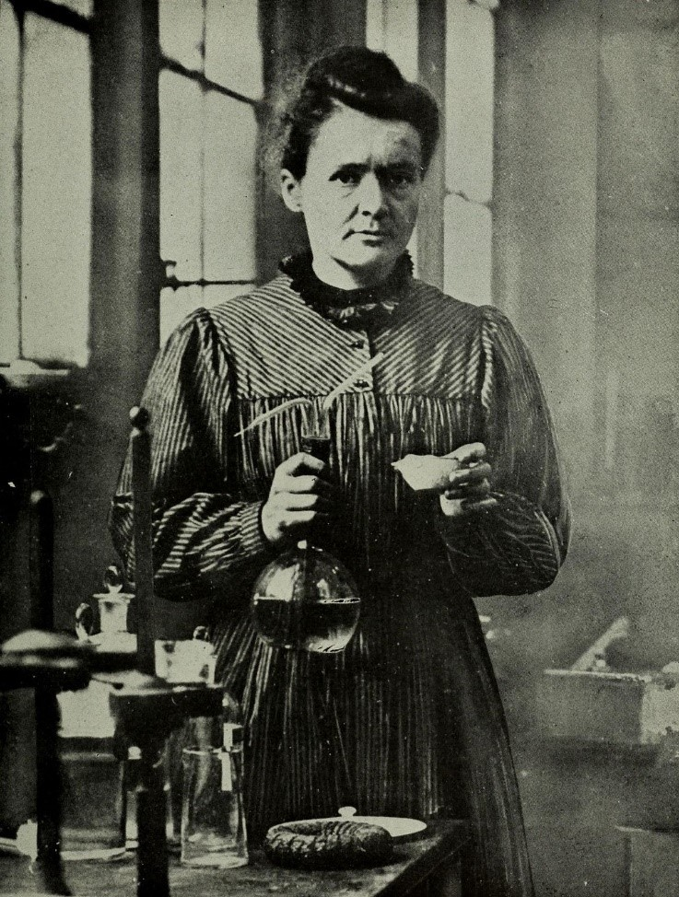
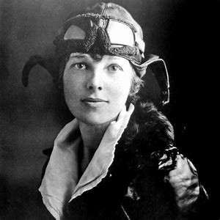
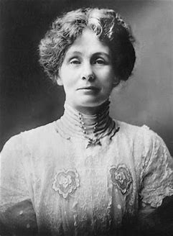
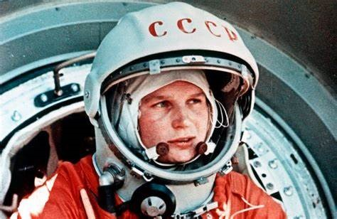
There are many more women who have changed history and challenged the dominant ideas of their time.
We will be researching their lives and discovering some of their achievements.

Slide 5


Slide 6


Slide 7
Activity
Look at list of names. Your task is to research more information on these women and write a brief description of their achievements.
Joan of Arc
Margaret Thatcher
Marie Curie
Mary Anning
Mary Seacole
Amelia Earhart
Emmeline Pankhurst
Rosa Parks

