Slide 1
Wednesday 5th January 2022
LO: To spell correctly.
To punctuate accurately.
To use sentences appropriately.
C: Grammar Recap

Slide 2


What do you know about word classes?
Can you think of any word classes?
Create a bubble map of your ideas.

Slide 3
Verbs
What is a verb?
Can you think of an example?

Slide 4
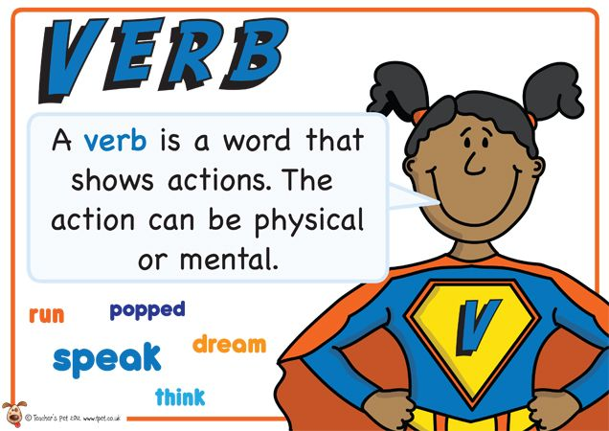
Verbs
A verb is a word used to describe an action, state or occurrence.
Verbs can be used to describe an action, that’s doing something.
They can also be used to describe a state of being, that’s feeling something.
Or a verb can be used to describe an occurrence, that’s something happening.

Slide 5
Nouns
What is a noun?
Can you think of an example?

Slide 6
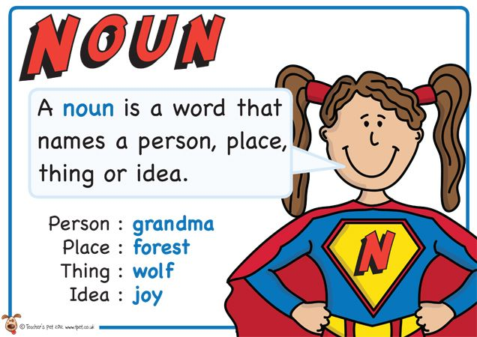
Nouns
A noun is a naming word.
It is a thing, a person, an animal or a place.

Slide 7
Adverbs
What is an adverb?
Can you think of an example?

Slide 8
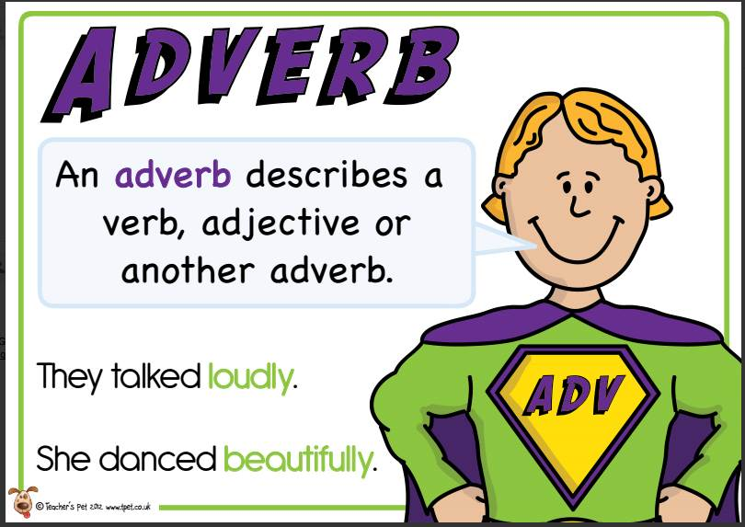
Adverbs
An adverb is simply a word that describes a verb (an action or a doing word).

Slide 9
Adjectives
What is an adjective?
Can you think of an example?

Slide 10
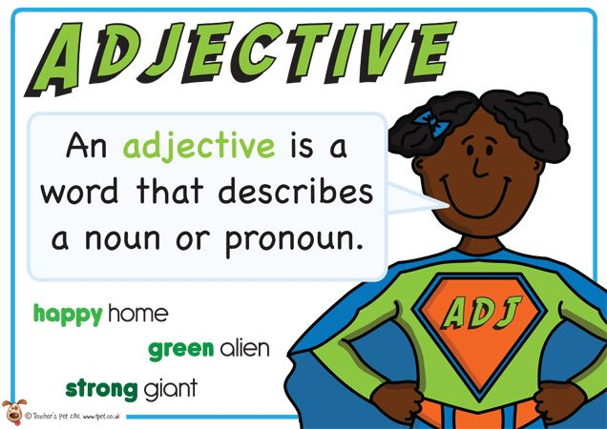
Adjectives
An adjective is a word that describes a noun.

Slide 11
Determiners
What is a determiner?
Can you think of an example?

Slide 12
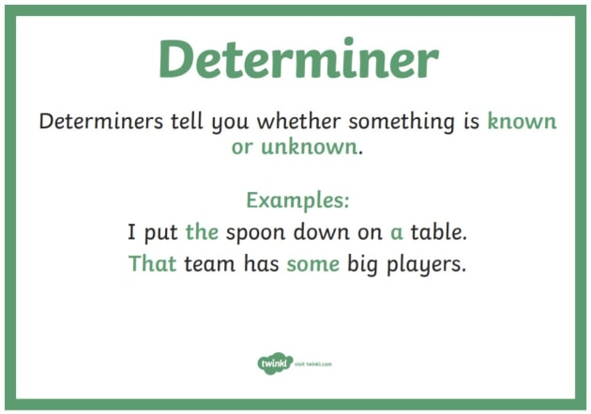
Determiners
Words that add detail to nouns, e.g. how many of something there is, what order they come in, or which thing is being discussed.
Examples of determiners are: the, a, an, her, his, our, my, your, their, which, whose, this, these, that, more, less, several, some, many.

Slide 13
Pronouns
What is a pronoun?
Can you think of an example?

Slide 14
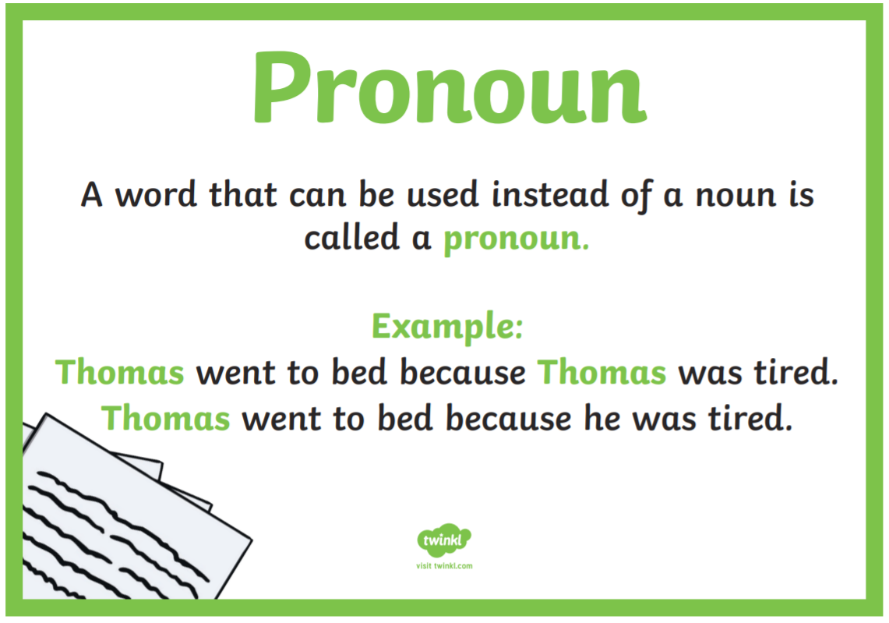
Pronouns
A pronoun is a word used to replace a noun.
Examples of pronouns are: he, she, it, they.

Slide 15
Conjunctions
What is a conjunction?
Can you think of an example?

Slide 16
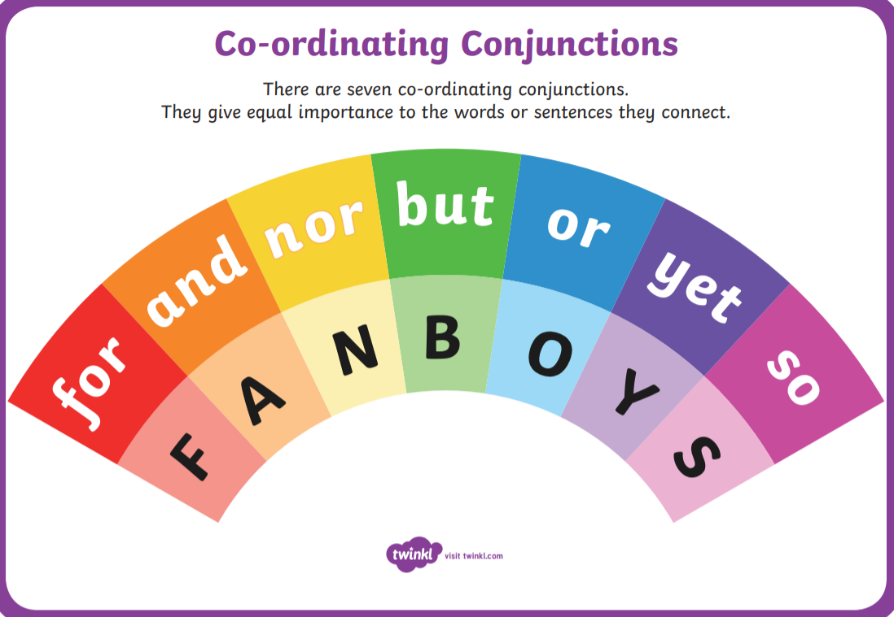
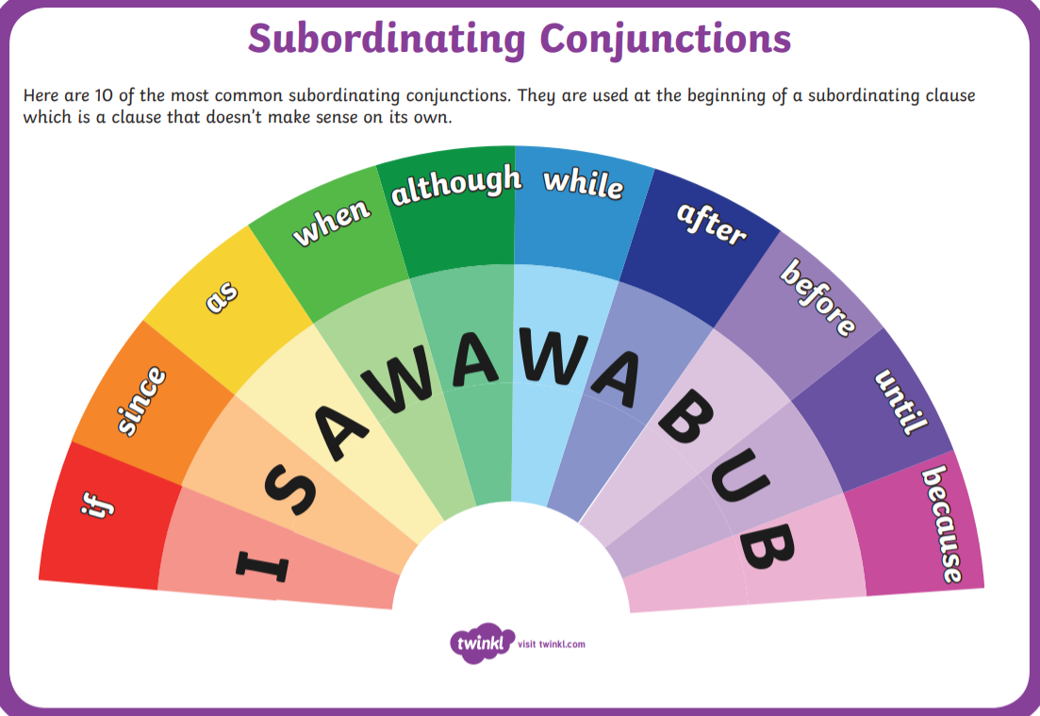
Conjunctions
A conjunction connects two clauses in a sentence.

Slide 17
Preposition
What is a preposition?
Can you think of an example?

Slide 18
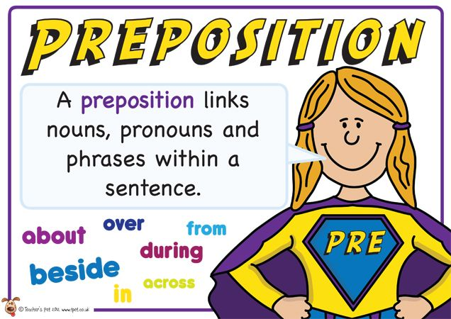
Preposition
A preposition is a word that tells you where or when something is in relation to something else.
Examples of prepositions include words like after, before, on, under, inside and outside.

Slide 19
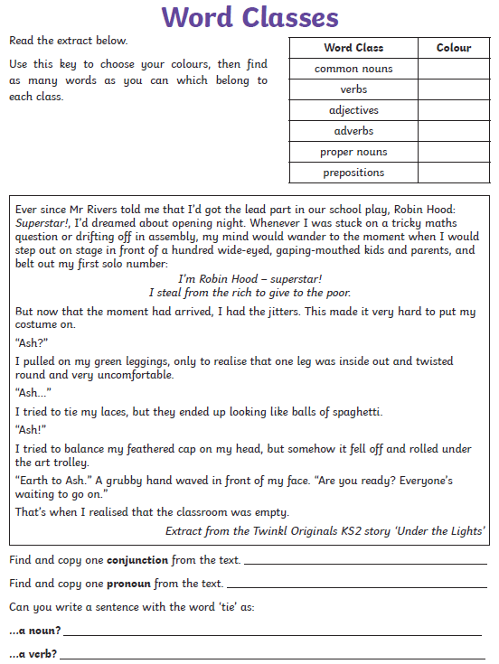
Word Class Activity Sheet
1. Colour code the word classes.
2. Read the extract.
3. Highlight the different word classes you can find.

Slide 20
Before we begin…
Modal verbs are used with other verbs to describe how likely something is to happen or to show how certain we are of something happening.
One day, the girl might be Queen.
Modal verbs include: may, ought to, could, should, must, will, would,, might, can.
Which of these modal verbs suggests a possible event?
Which suggest a definite event?

Slide 21
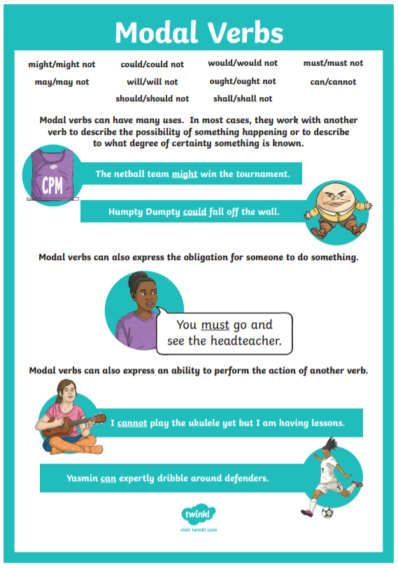

Slide 22
Before we begin…
In addition to modal verbs, some adverbs can be used to describe how likely it is that something will happen.
These are called ‘adverbs of possibility.’
Some of the most common adverbs of possibility are:
He is definitely coming to the party.
Maybe I’ll win the lottery this week.
Certainly | Definitely | Maybe | Possibly
Clearly | Obviously | Perhaps | Probably

Slide 23

Escape The Room!
You were on your way home when you realised that you had left your homework in your tray.
You run back into class to get it and hear a loud bang.
You have accidentally been locked in the classroom and you could be here all night!
Solve the clues and puzzles hidden around the room and reveal the keypad code needed to open the door,
The clues could be anywhere, so you need to keep your eyes peeled and your mind sharp!
Good luck!

Slide 24

Ask an adult to hide the clues around the house! (You could hide them yourself or just look at the clues – whatever is best for you.)
When you find a clue that has been hidden, find the answer and reveal one of the digits to the keypad code.
Record your answer on the answer sheet.
Once you have discovered the ten-digit code for the keypad, check the answer and find out if you can escape the room!

Slide 25
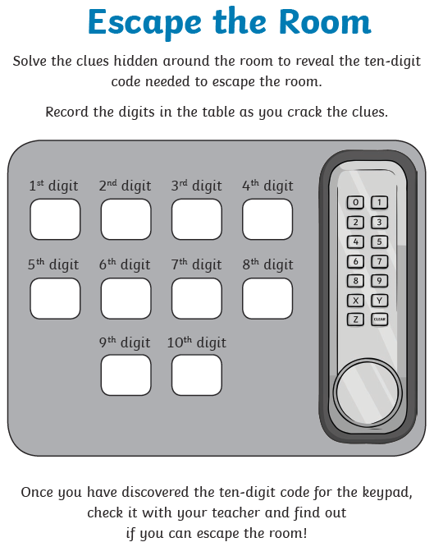
Activity
Complete the Escape the Room game.

Slide 26
Red Pen
Any children who have correctly found the code can move on to the red pen question.
Create your own ‘escape room’ with SPaG clues.
Use the clues from today’s lesson as a model.
What SPaG questions will you ask?
What will your answers be?
Make sure you create an answer sheet for whoever is leading the escape room activity!

Slide 27
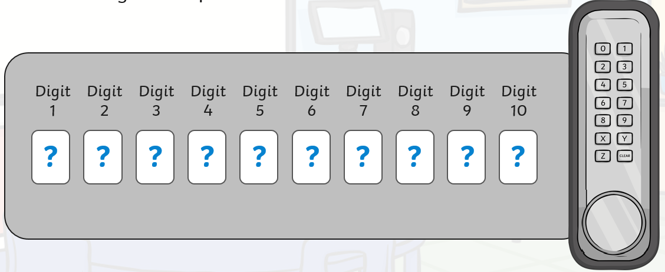
Plenary
Do you have the code for the door?
Check your answers on our class page!

Slide 28
Thursday 6th January 2021
LO: To organise writing appropriately.
To spell correctly.
To punctuate accurately.
To use sentences appropriately.
C: Grammar Recap

Slide 29
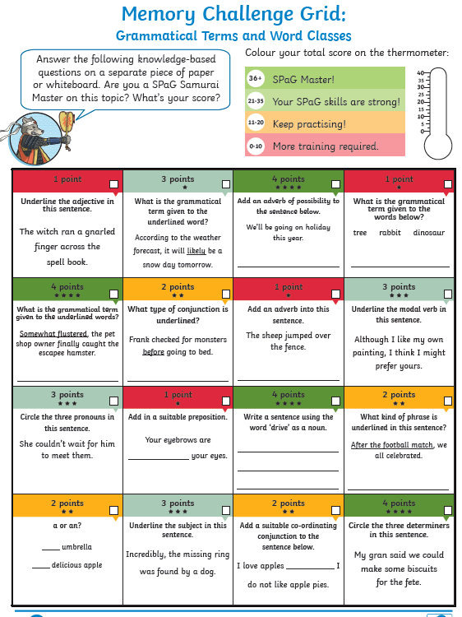
Starter
Complete the challenge independently.
You do not have to answer every question – if there is a question that is too hard, you should skip it and move on.
You could start with the 1-point questions and then move on to the 2/3-point questions.
Divers: Challenge! Start with the 2/3-point questions.

Slide 30
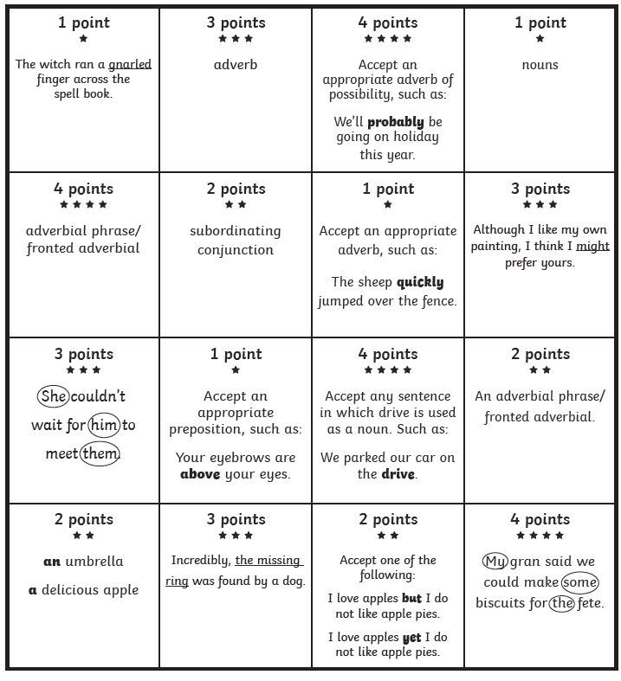

Starter
Check your answers!

Slide 31
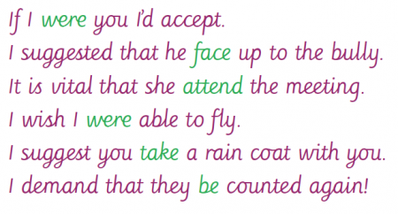
Before we begin…
The subjunctive is a verb form or mood used to express things that could or should happen.
It is used to explore a hypothetical situation (e.g. If I were you…) or to express a wish, a hope, a command, a demand, or a suggestion (e.g. I demand he be present).
For example:

Slide 32

SPaG Hunt!
Ask an adult to hide the SPaG questions around the house! (You could hide them yourself or just look at the questions – whatever is best for you.)
Find the questions and then answer them on the answer sheet.

Slide 33
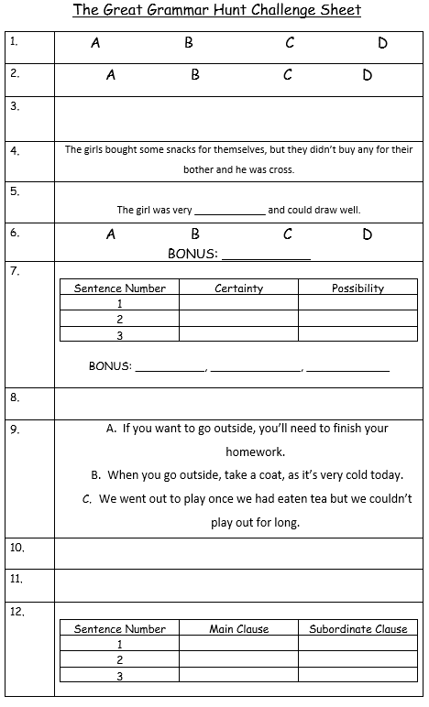
Activity
Complete the SPaG Question hunt!

Slide 34
Red Pen
SPaG Challenges!
Complete these sentences in an interesting way. Even through it rained, Despite being exhausted, Although the forecast wasn’t good, Without realising, Although it was an awful idea, | Which fronted adverbial would make sense? …the board drifted away towards the horizon. List as many as you can. | Extend these sentences using a subordinate clause. Connor blew out his birthday candles. Jim pressed the seeds into the soil. The troll was lurking under the bridge. The dragon breathed fire over the village.

Slide 35

Plenary
Check the answers on the class page!

