Slide 1
LO: To develop ideas and spot potential in unexpected results as work progresses.
C: Mixed media collage.

Slide 2
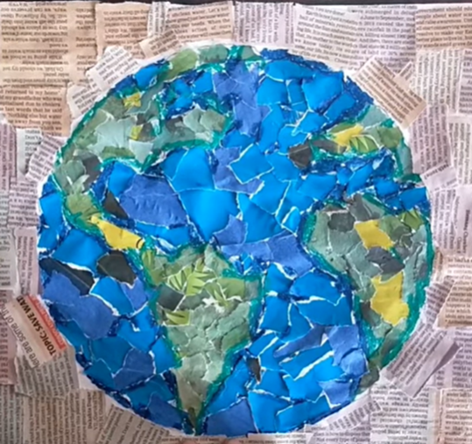
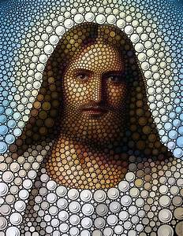
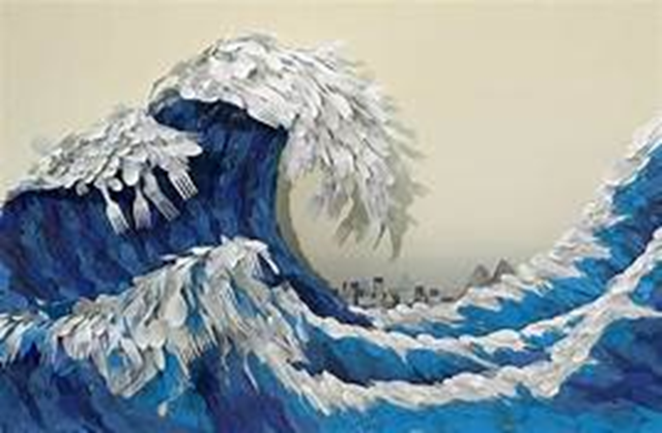
Today you will be creating your own artwork.
You have been taught different techniques and you should use whichever media suits your theme best. You have complete freedom to use any of the resources that you think will help you to express yourself and illustrate the idea you are trying to get across.

Slide 3
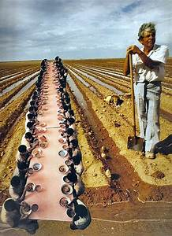
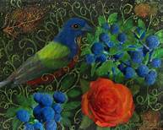
You should create your background first. Once you have done this, you can then start to build up your collage over the top of it. You may need to leave it to dry before adding to it, but you do not necessarily have to. There are some effective techniques that you can use while your paint is still wet.
Watch this video for some final ideas: https://www.youtube.com/watch?v=Ih7PfwLNfoU

Slide 4
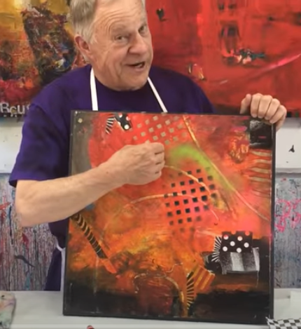
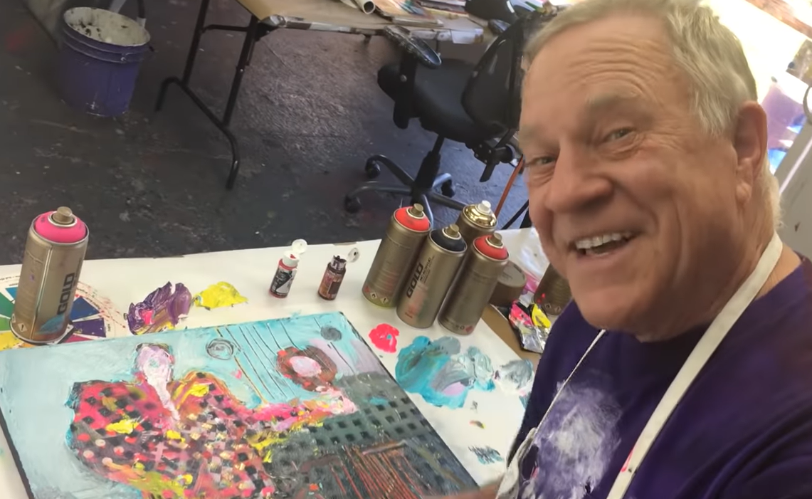
Sometimes when being creating a piece of art, the results may not be what we expected.
This is a normal process in the life of an artist. We need to be creative and adjust our techniques or our ideas. So don’t despair if you get an unexpected result; use it and change it into something new!
Let’s watch our friend Bob Blast again! https://www.youtube.com/watch?v=gv8gqIYN4T4
Bob is not happy!

Slide 5
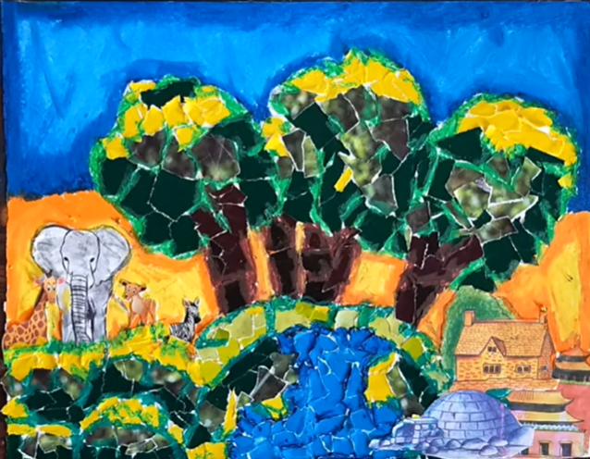

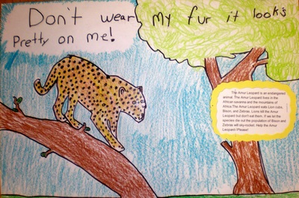
Let’s re-cap on some ideas:
The environment
Climate change
Endangered species

Slide 6

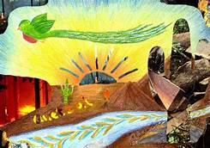
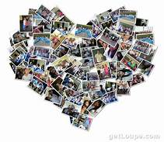
Plastic in the oceans
Deforestation Friendship

Slide 7

Activity
You have already planned your artwork – use that plan as the base of your idea, but don’t be afraid to adjust your work based on the effect you have created.
Be like Bob!

Slide 8
Plenary
Discuss your creation with a partner.
Explain what went well, what didn’t go so well and how you overcame any problems you encountered.

