Slide 1

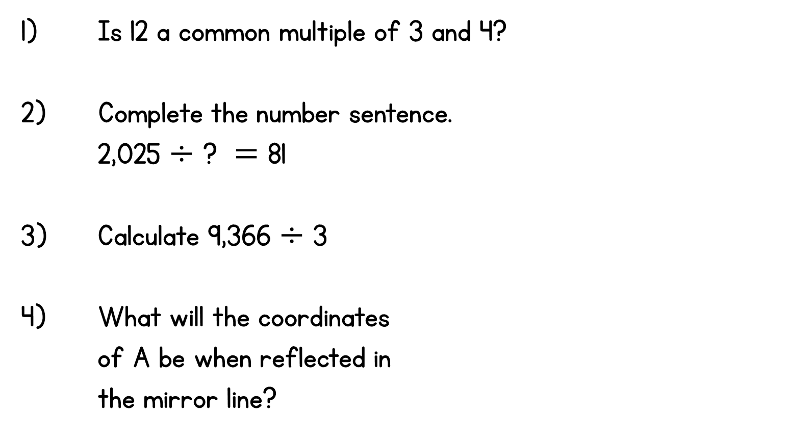
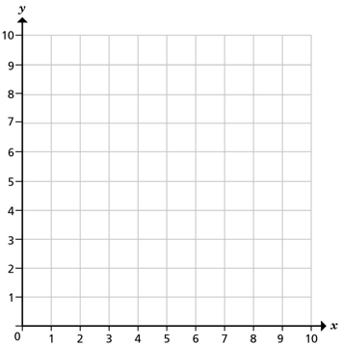
Year 6 | Week 6 | Day 2
A
C
B

Slide 2

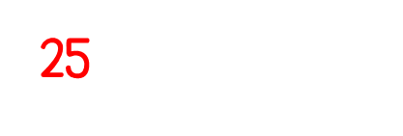
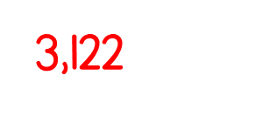
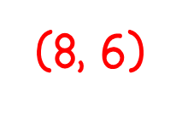
Year 6 | Week 6 | Day 2
A
C
B

Slide 3


Arithmetic Starter

Slide 4
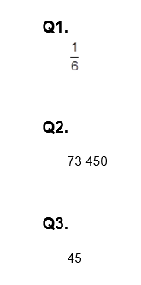
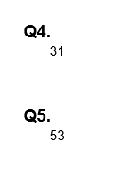
Arithmetic Starter - Answers

Slide 5


Slide 6
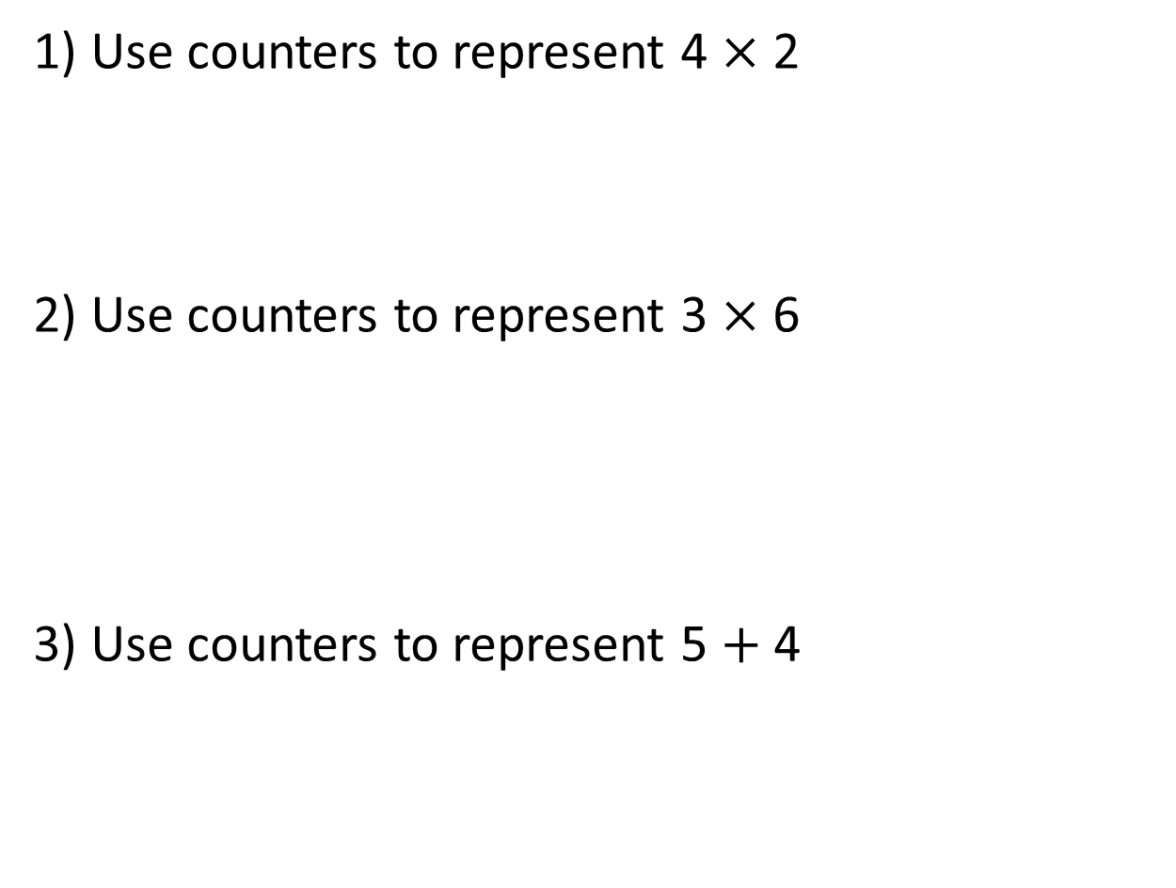
1) Use counters to represent 4 $×$ 2
2) Use counters to represent 3 $×$ 6
3) Use counters to represent 5 $+$ 4

Slide 7
1) Use counters to represent 4 $×$ 2
2) Use counters to represent 3 $×$ 6
3) Use counters to represent 5 $+$ 4

Slide 8

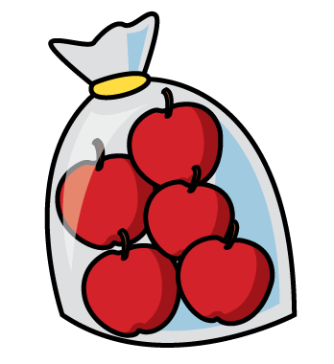

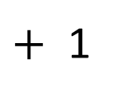
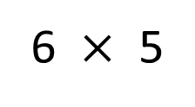
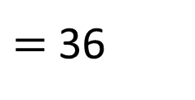

Dexter has 6 bags and each bag has 5 apples in.
He adds 1 more apple to each bag.
How many apples does Dexter have in total?
6 $×$ 5
$($ $)$
$+$ 1
$=$ 36

Slide 9
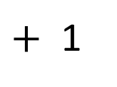
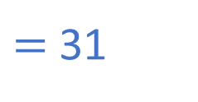
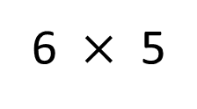
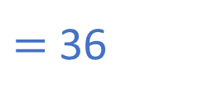

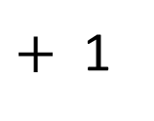

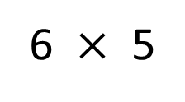

In mixed order calculations, calculations are not always carried out from left to right.
brackets
indices
$÷$ $×$
$+$ $−$
6
6 $×$ 5
$($ $)$
$+$ 1
$=$ 36
30
6 $×$ 5
$+$ 1
$=$ 31

Slide 10
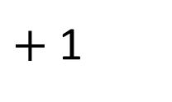



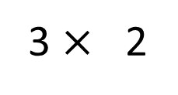
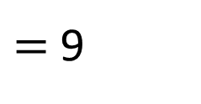
3
$($ $)$
3 $×$ 2
$+$ 1
$=$ 9
brackets
indices
$÷$ $×$
$+$ $−$

Slide 11
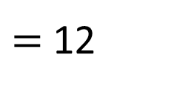
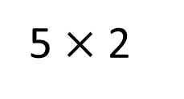
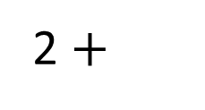
10
2 $+$
5 $×$ 2
$=$ 12
brackets
indices
$÷$ $×$
$+$ $−$

Slide 12


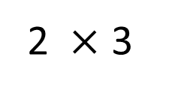
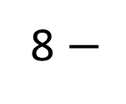
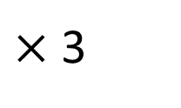
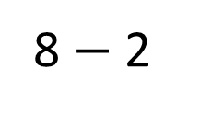
$($ $)$
8 $−$ 2
$×$ 3
8 $−$
2 $×$ 3
What’s the same?
What’s different?
brackets
indices
$÷$ $×$
$+$ $−$
Have a think

Slide 13
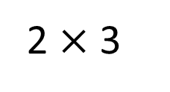
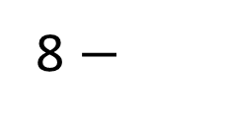
6
6
$($ $)$
8 $−$
2 $×$ 3
2 $×$ 3
8 $−$
brackets
indices
$÷$ $×$
$+$ $−$

Slide 14

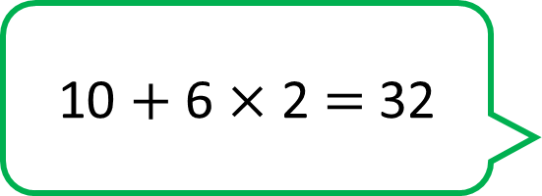
10 $+$ 6 $×$ 2 $=$ 32
brackets
indices
$÷$ $×$
$+$ $−$
Have a think

Slide 15


10 $+$ 6 $×$ 2 $=$ 32
$($ $)$

Slide 16

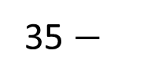
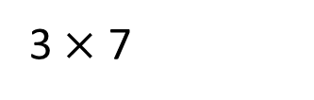
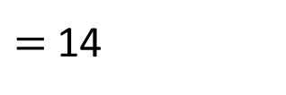
Annie has 35 stickers.
She gives 3 of her friends 7 stickers each.
Write a calculation to work out how many stickers Annie is left with.
3 $×$ 7
35 $−$
$=$ 14
brackets
indices
$÷$ $×$
$+$ $−$
Have a think

Slide 17
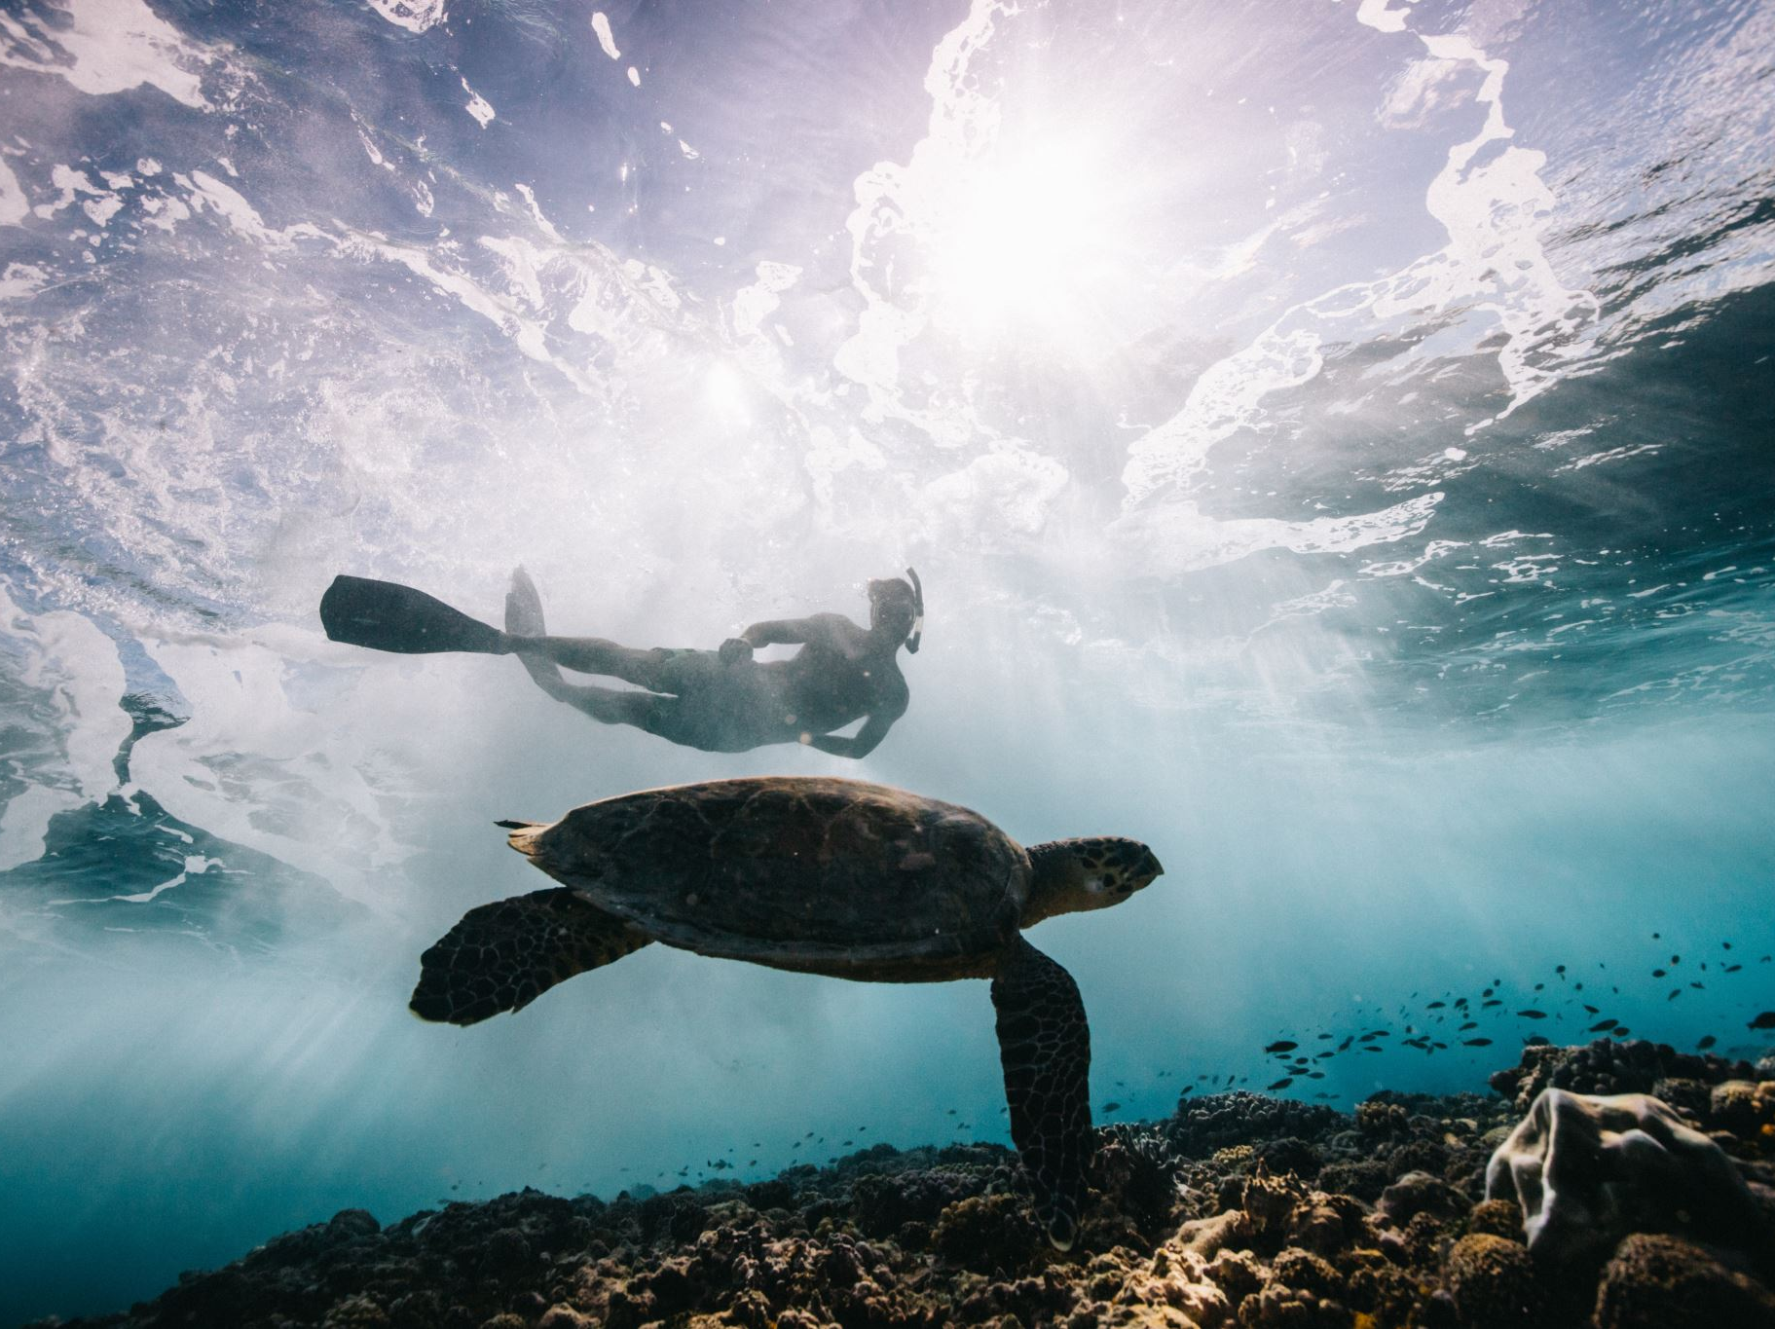
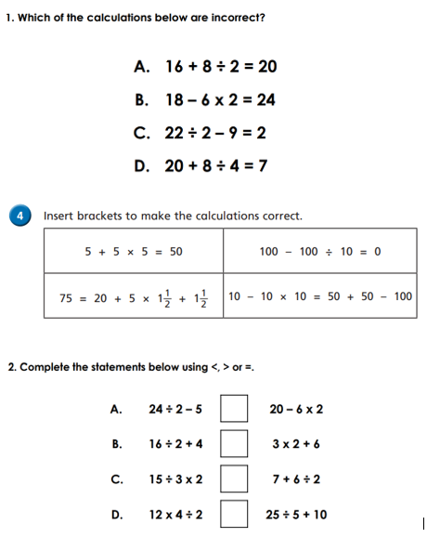
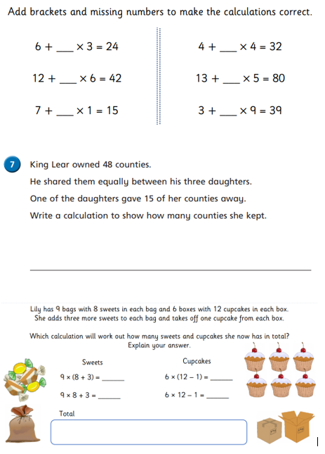
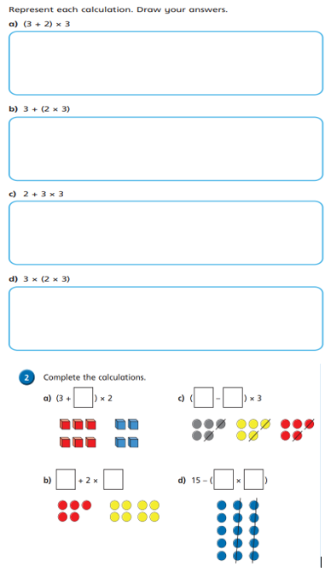
Independent Activity
Paddling Snorkelling Diving

Slide 18
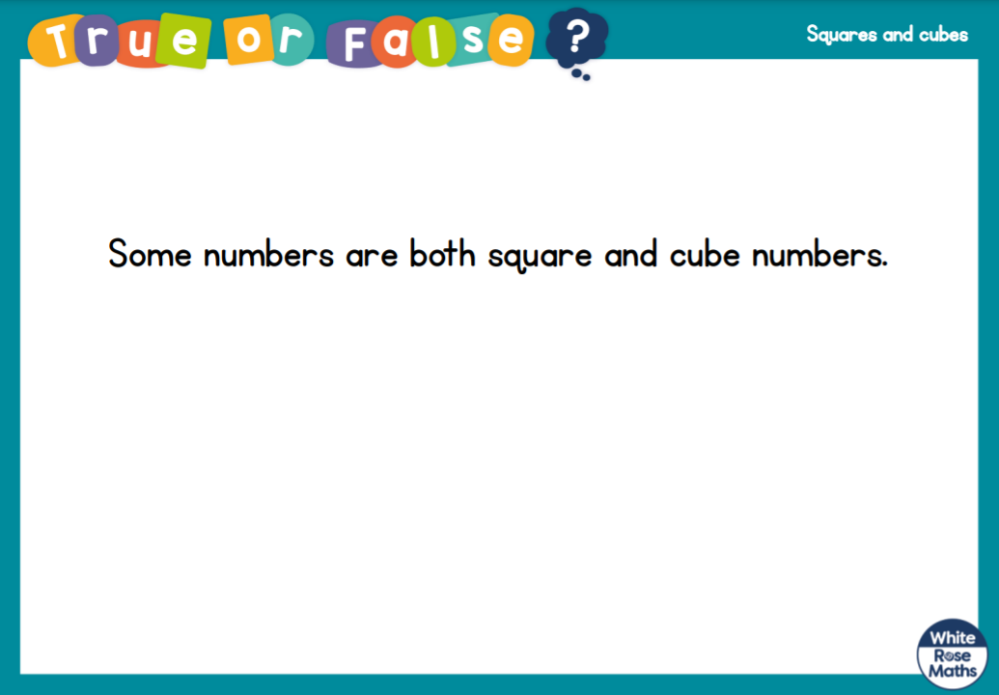
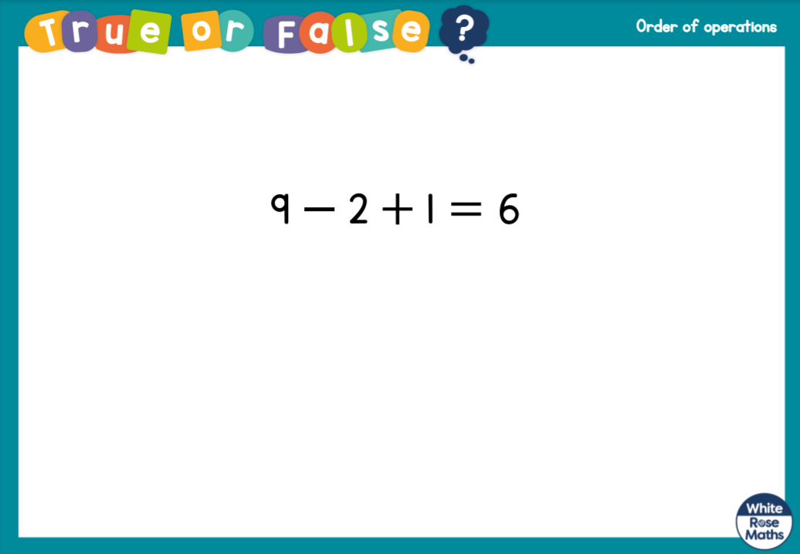



Slide 19


