Slide 1
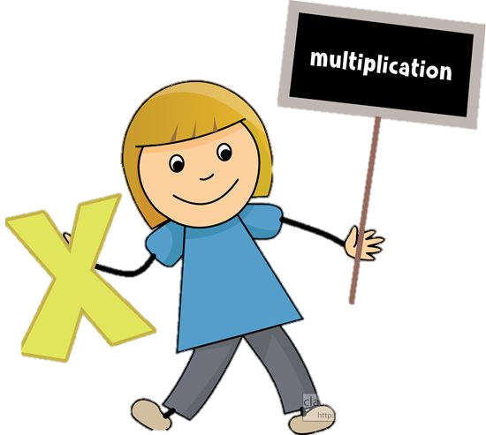
11.1.2021
L.O: Multiplication and Divison
C: Equal Groups

Slide 2
Our Starting Question!
What does EQUAL mean?

Slide 3





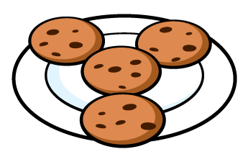


Are the groups equal or not equal?
2) Are the groups equal or not equal?
3) Are the groups equal or not equal?

Slide 4
Are the groups equal or not equal?
2) Are the groups equal or not equal?
3) Are the groups equal or not equal?
not equal
equal
equal

Slide 5
So what have we learnt?

Slide 6
So what have we learnt?
The LAYOUT of a group does not matter as long as the QUANTITY/AMOUNT is EQUAL.

Slide 8





3
There are _____ plates.
There are _____ strawberries on each plate.
There are ____ equal groups of ____
5
3
5

Slide 9


5
There are _____ dice.
There are _____ spots on each dice.
There are ____ equal groups of ____
4
5
4
Have a think

Slide 10
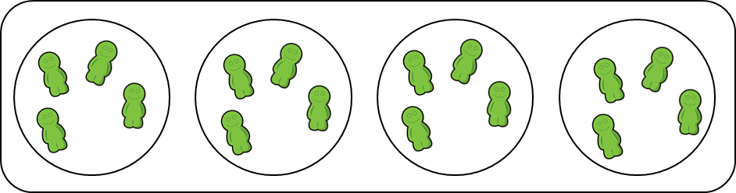
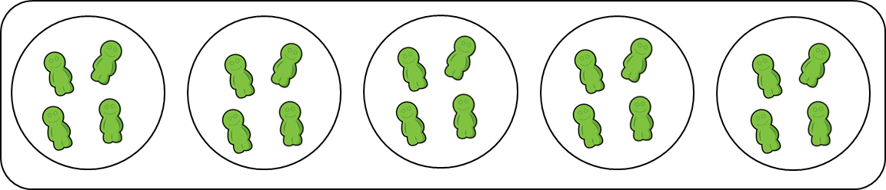

Have a think
4 groups of 5
4 groups of 4
5 groups of 4

Slide 11
Your Turn!
On your whiteboard, please can you draw a pictorial representation (a picture) to show
Five equal groups of two.

Slide 12
Your Turn!
Which of these pictures do you think shows this:
Five equal groups of two.

Slide 13




I tried to make 3 equal groups but it didn’t work.
Have a think
2 equal groups
4 equal groups

Slide 14


Have a think
So can I
I can see 3 groups of 6

Slide 15
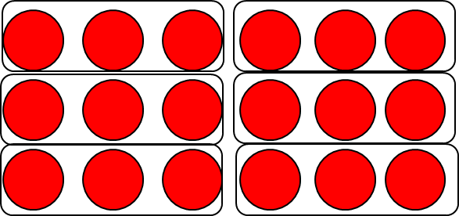
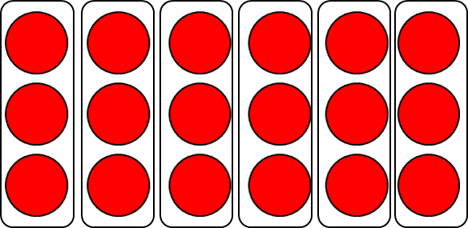
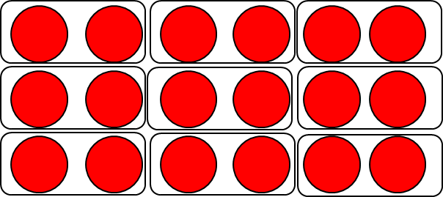
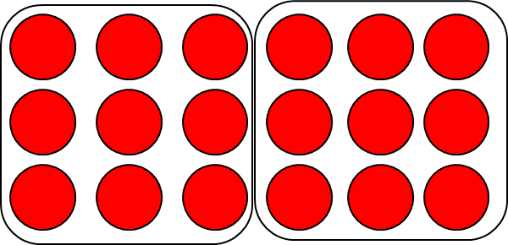
6 equal groups of 3
9 equal groups of 2
2 equal groups of 9

Slide 16
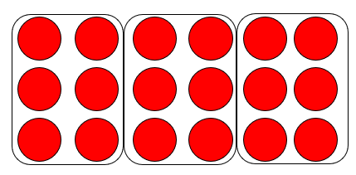

3 equal groups of 6
6 equal groups of 3
9 equal groups of 2
2 equal groups of 9
1 group of 18
18 groups of 1

Slide 17




How many cubes will I need to add to make 4 groups of 3?
Have a think
4 groups of 2 $=$ 2 groups of 4
4 groups of 3 $=$ 3 groups of 4

Slide 18
Your Turn!
Choose a sheet to complete which is your level!
They are all on the class pages!

