Slide 1
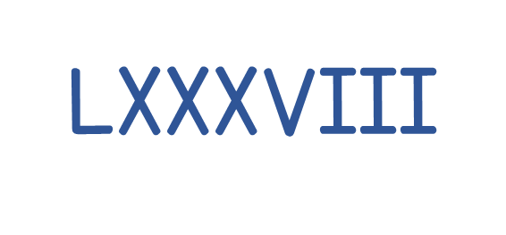
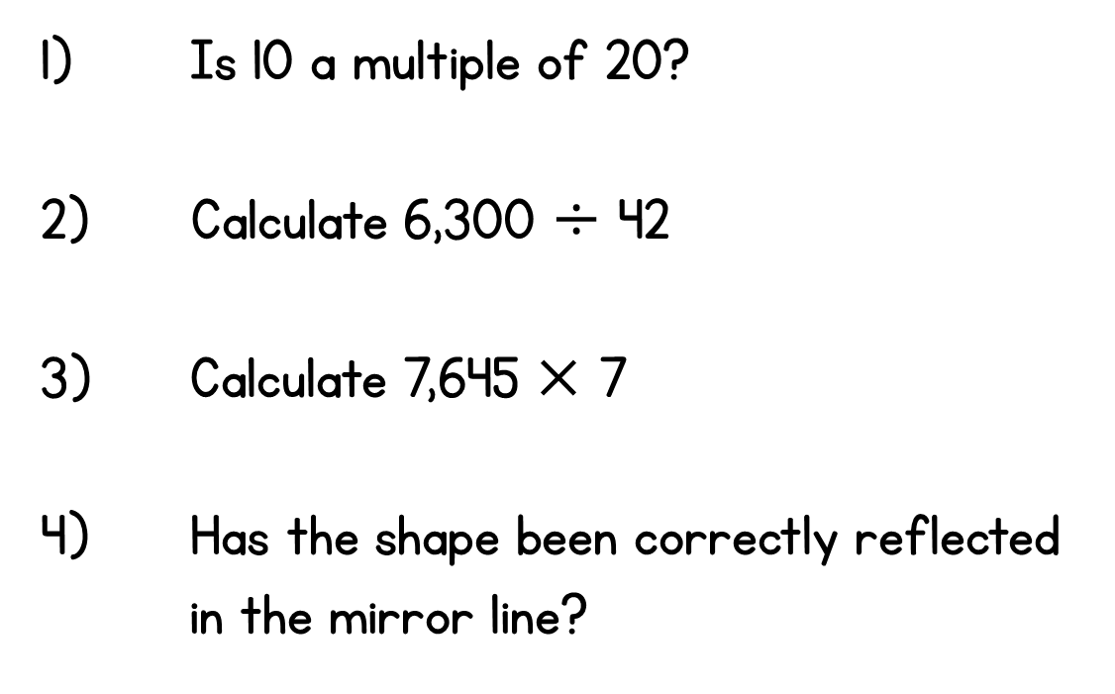
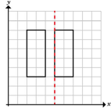
Year 6 | Week 6 | Day 1

Slide 2

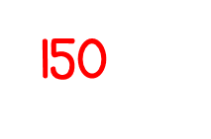
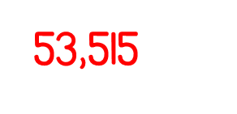

Year 6 | Week 6 | Day 1

Slide 3


Arithmetic Starter

Slide 4
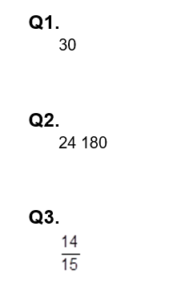
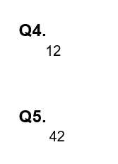
Arithmetic Starter - Answers

Slide 5


Slide 6
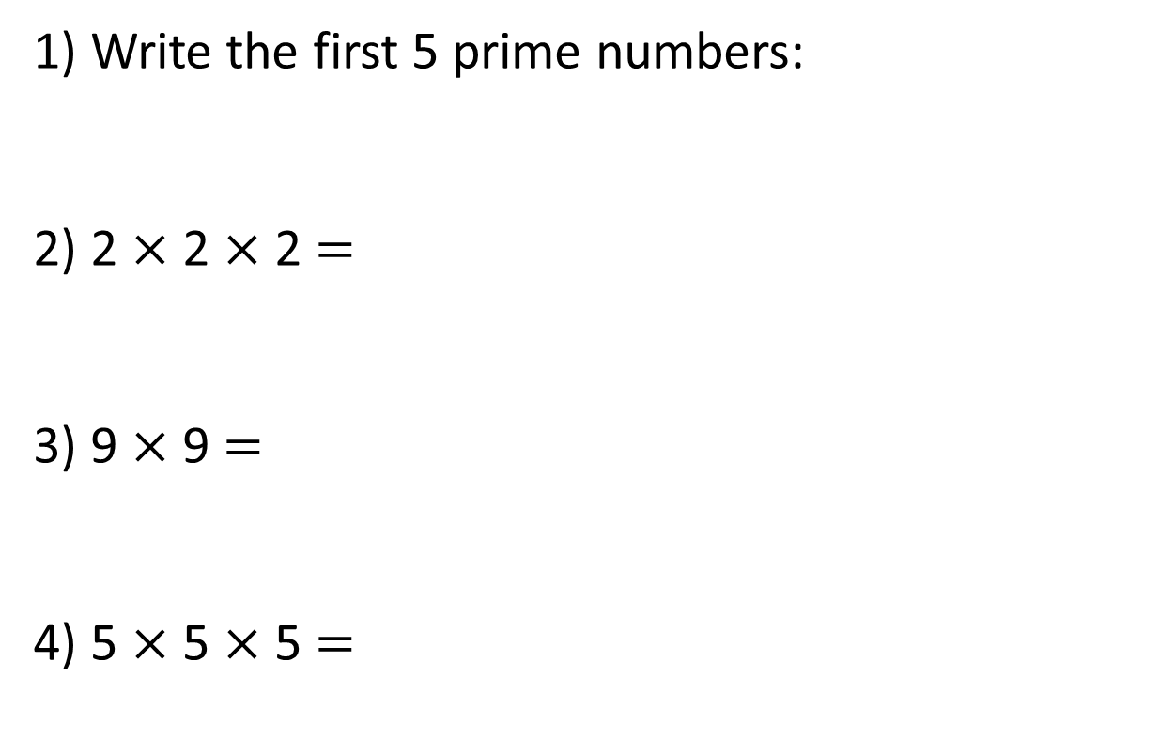
1) Write the first 5 prime numbers:
2) 2 $×$ 2 $×$ 2 $=$
3) 9 $×$ 9 $=$
4) 5 $×$ 5 $×$ 5 $=$

Slide 7
1) Write the first 5 prime numbers:
2) 2 $×$ 2 $×$ 2 $=$
3) 9 $×$ 9 $=$
4) 5 $×$ 5 $×$ 5 $=$
2, 3, 5, 7, 11
8
81
125

Slide 8

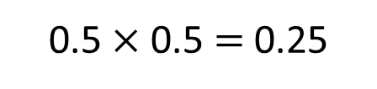
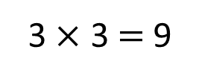
Which of these numbers are square numbers?
How can you prove it?
9
0.25
16
8
3 $×$ 3 $=$ 9
0.5 $×$ 0.5 $=$ 0.25
The result of a number multiplied by itself
Has to be a whole number
Have a think

Slide 9
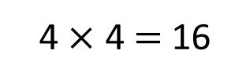
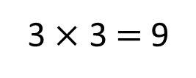
Which of these numbers are square numbers?
How can you prove it?
9
16
8
3 $×$ 3 $=$ 9
4 $×$ 4 $=$ 16
The result of a number multiplied by itself
Has to be a whole number
Has to build a complete square
Has to build a square

Slide 10
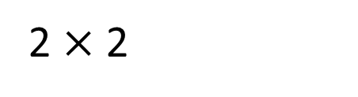
Square numbers
The result of a number multiplied by itself
Has to be a whole number
Has to build a complete square
2²
Two squared
2 $×$ 2

Slide 11

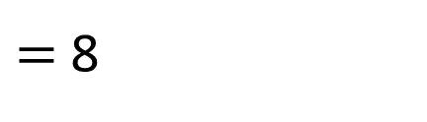
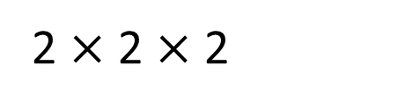
Cube numbers
The result of a number multiplied by itself and then multiplied by itself again
2³
Two cubed
2 $×$ 2 $×$ 2
$=$ 8

Slide 12
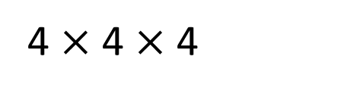
How many cubes do you need to build a 4 $×$ 4 $×$ 4 cube?
4³
4 cubed
4 $×$ 4 $×$ 4
64 cubes
Have a think
Paddlers: how many cubes do you need to build a 3 X 3 X 3 cube?
Divers: how many cubes do you need to build a 8 X 8 X 8 cube?
Divers: 512

Slide 13

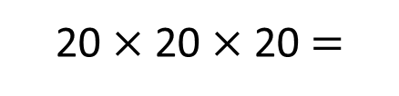
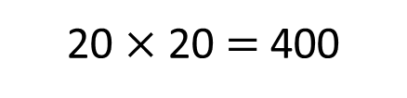
Dexter works out 20 squared
Annie works out 20 cubed
Find the difference between Dexter’s and Annie’s numbers.
Dexter:
20 $×$ 20 $=$ 400
Annie:
20 $×$ 20 $×$ 20 $=$
8,000
8,000 $−$ 400 $=$ 7,600
Paddlers: Find the difference between 4 squared and 4 cubed.

Slide 14



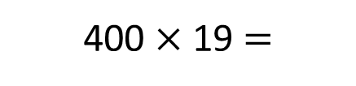
Dexter works out 20 squared
Annie works out 20 cubed
Find the difference between Dexter’s and Annie’s numbers.
400 $×$ 19
Dexter:
20²
400
Annie:
400
Th | H | T | O
 | 4 | 0 | 0
 |  | 1 | 9
400 $×$ 19 $=$
7,600
Have a think
$$×$$
3
6
0
0
What if Dexter was working out 17² and Annie was working out 17³?
$$+$$
4
0
0
0
7
6
0
0

Slide 15





What if Dexter was working out 17² and Annie was working out 17³?
Th | H | T | O
 |  | 1 | 7
 |  | 1 | 7
Th | H | T | O
 | 2 | 8 | 9
 |  | 1 | 7
Th | H | T | O
4 | 9 | 1 | 3
 | 2 | 8 | 9
8
1
0
1
$$×$$
$$×$$
$$−$$
1
1
9
2
0
2
3
4
6
2
4
$$+$$
1
7
0
$$+$$
8
9
0
2
2
8
9
4
9
1
3

Slide 16

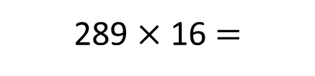
What if Dexter was working out 17² and Annie was working out 17³?
289 $×$ 16
Dexter:
17²
289
Annie:
289
Th | H | T | O
 | 2 | 8 | 9
 |  | 1 | 6
289 $×$ 16 $=$
4,624
$$×$$
1
7
3
4
$$+$$
2
8
9
0
4
6
2
4

Slide 17
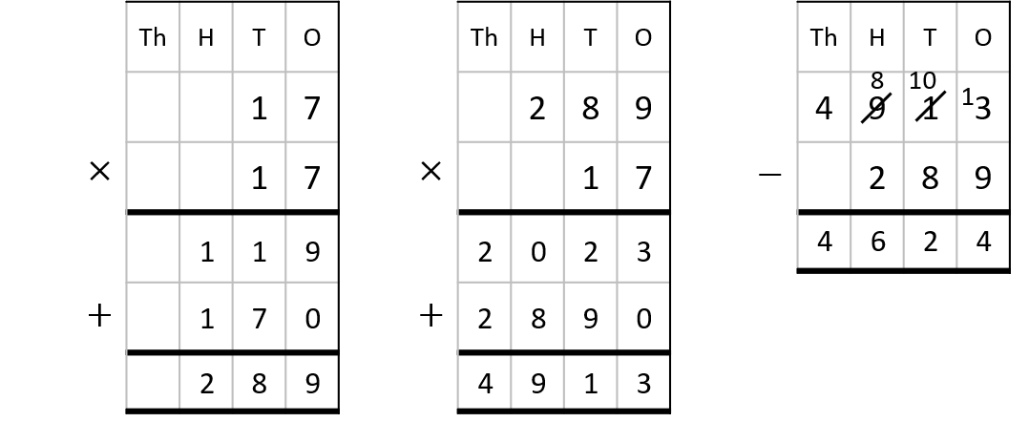
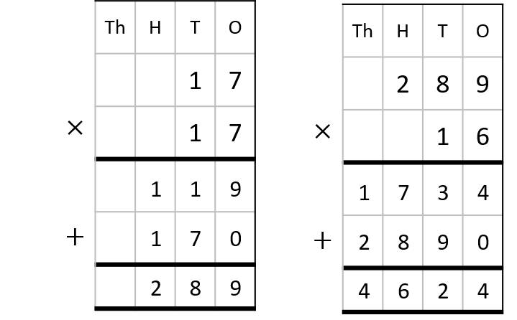
What if Dexter was working out 17² and Annie was working out 17³?
What’s the same?
What’s different?
Have a think

Slide 18
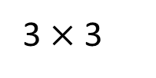
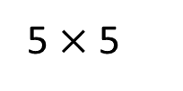
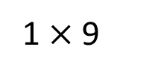
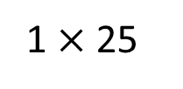
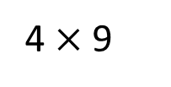
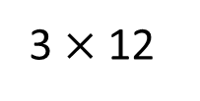
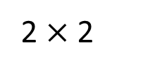
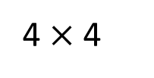
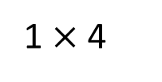
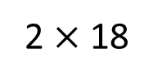
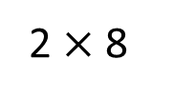
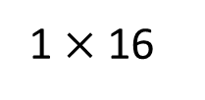
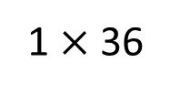
When Mo adds two numbers he gets a prime number.
When he multiplies them he gets a square number.
1
4
9
1
1 $×$ 4
2 $×$ 2
1 $×$ 9
3 $×$ 3
16
25
36
1 $×$ 16
4 $×$ 4
1 $×$ 36
4 $×$ 9
2 $×$ 8
1 $×$ 25
5 $×$ 5
2 $×$ 18
3 $×$ 12
2, 3, 5, 7, 11, 13, 17, 19, 23,

Slide 19
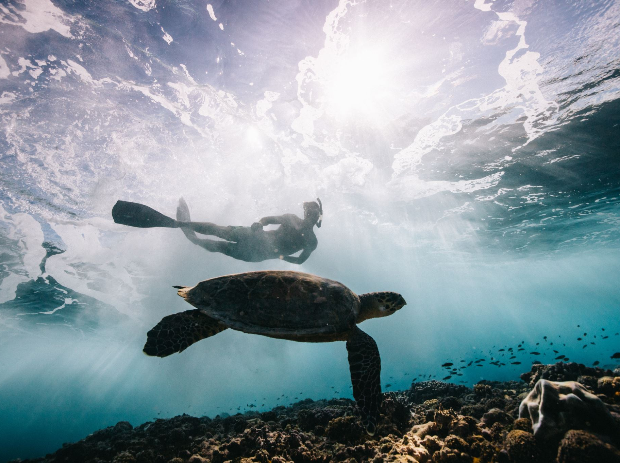
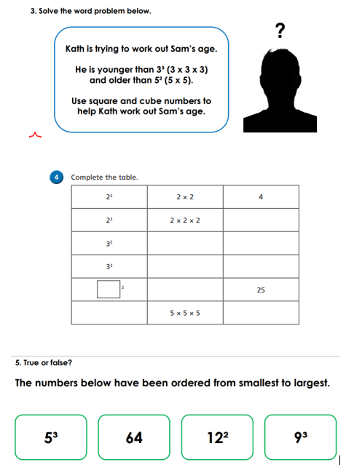
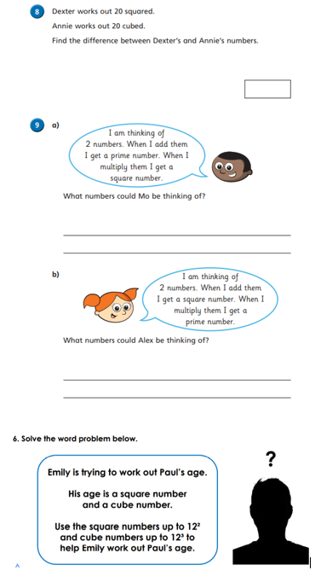
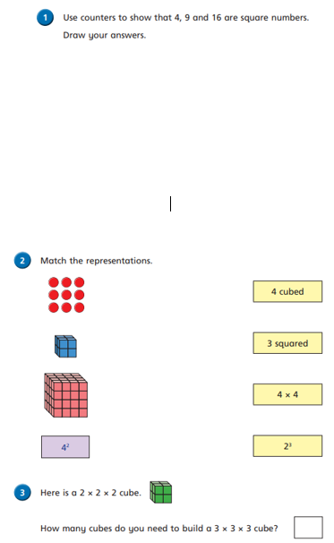
Independent Activity
Paddling Snorkelling Diving

Slide 20
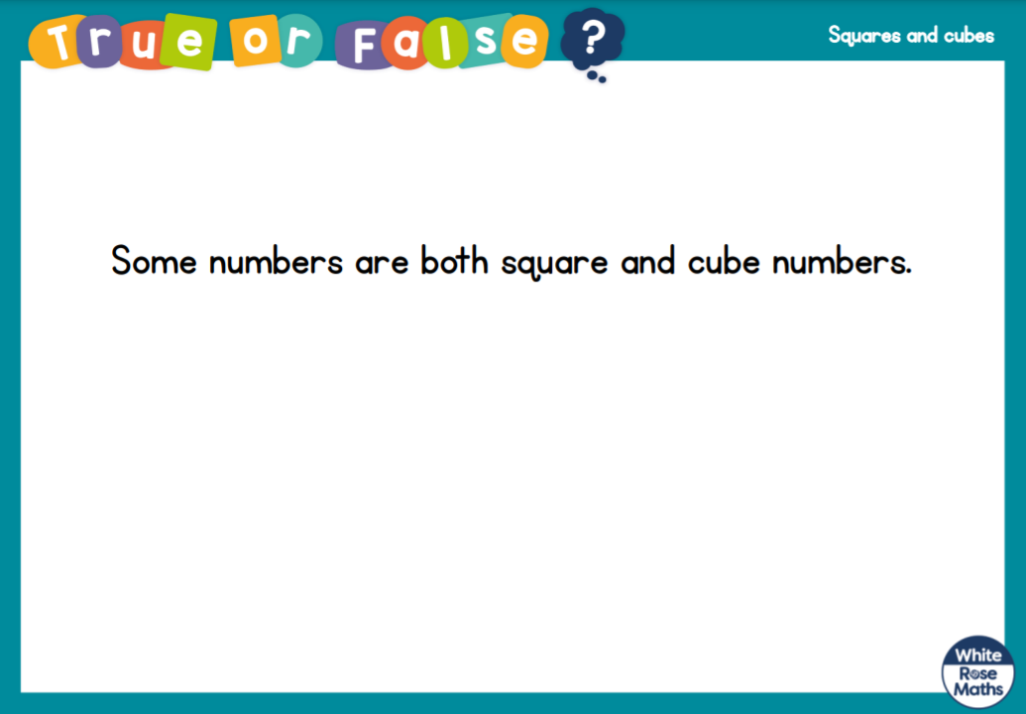



Slide 21


