Slide 1
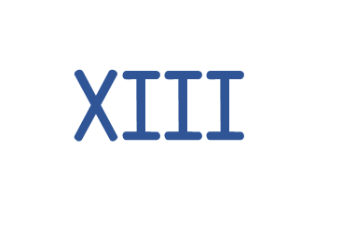
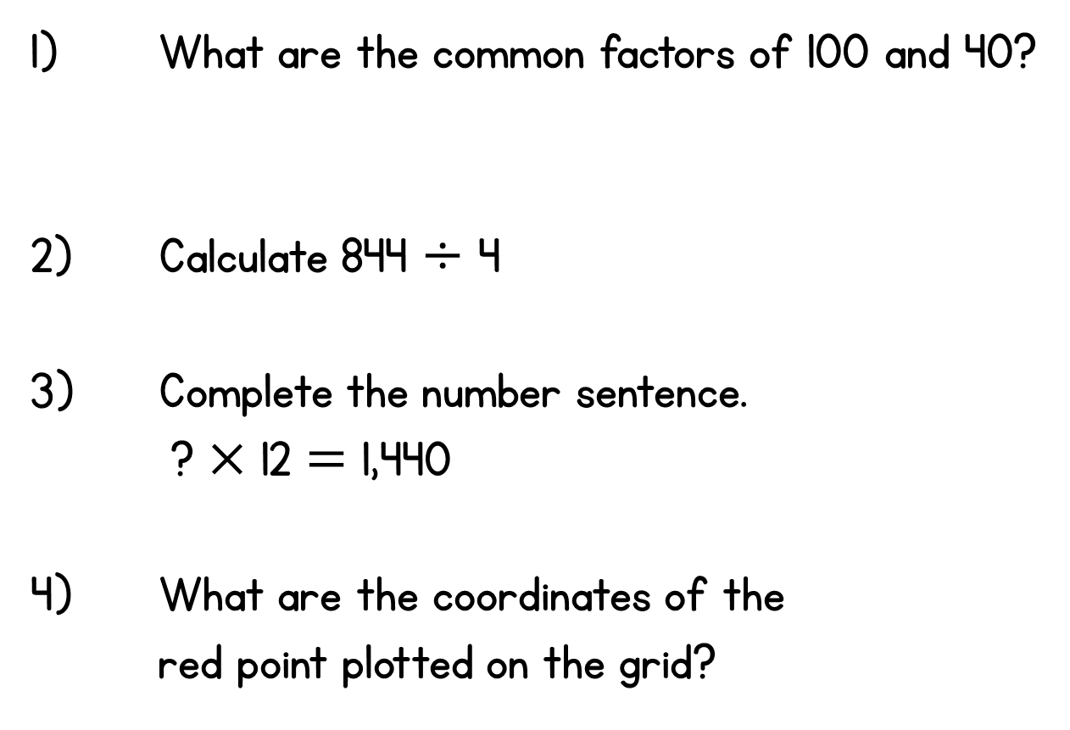
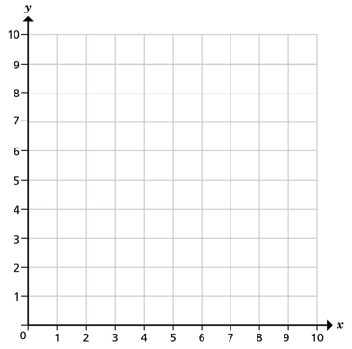
Year 6 | Week 5 | Day 5

Slide 2
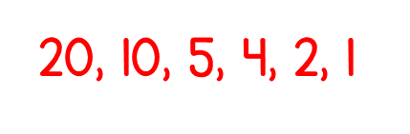

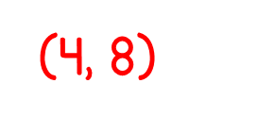
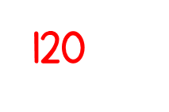
Year 6 | Week 5 | Day 5

Slide 3


Arithmetic Starter

Slide 4
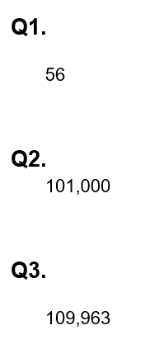
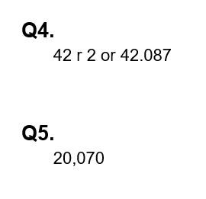
Arithmetic Starter - Answers

Slide 5


Slide 6
1) Find all the factors of 32
2) Write the first 6 multiples of 6
3) Write the first 6 multiples of 4
4) Write the first 3 common multiple of 4 and 6

Slide 7
1) Find all the factors of 32
2) Write the first 6 multiples of 6
3) Write the first 6 multiples of 4
4) Write the first 3 common multiple of 4 and 6
1, 2, 4, 8, 16, 32
6, 12, 18, 24, 30, 36
4, 8, 12, 16, 20, 24
12,
24,
36

Slide 8

What do you notice?
Find the factors of 8:
1 and 8
8
2 and 4
1, 2, 4, 8
Find the factors of 7:
1 and 7
7
1, 7
Find the factors of 1:
1
1
Have a think

Slide 9

All prime numbers must be odd because all even numbers will also have a factor of 2
1 and 22
22
2 and 11
1, 2, 11, 22
1 and 40
40
5 and 8
2 and 20
4 and 10
1, 2, 4, 5, 8, 10, 20, 40
Have a think! Does this rule sound reasonable? Are there any exceptions to this rule?

Slide 10
All prime numbers must be odd because all even numbers will also have a factor of 2
1 and 2
2
1, 2
2 is the only even prime number

Slide 11
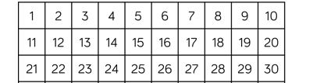
Find all the prime numbers between 1 and 30
2, 3, 5, 7, 11, 13, 17, 19, 23, 29

Slide 12
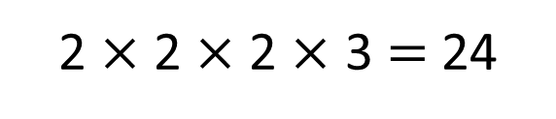
Find all the prime factors of 24
24
2
12
4
3
2
2
A factor which is also a prime number is called a prime factor
2 $×$ 2 $×$ 2 $×$ 3 $=$ 24

Slide 13
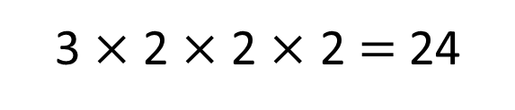
Find all the prime factors of 24
24
6
4
3
2
2
2
3 $×$ 2 $×$ 2 $×$ 2 $=$ 24

Slide 14
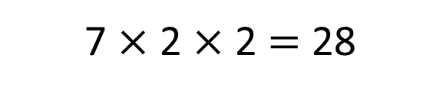
Find all the prime factors of 28
28
14
2
7
2
7 $×$ 2 $×$ 2 $=$ 28
Have a think

Slide 15
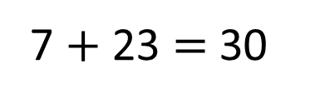
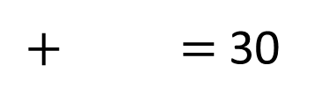
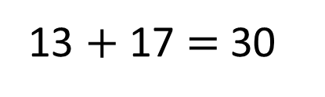
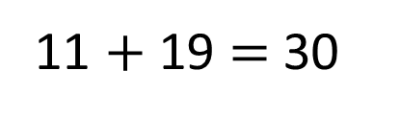
Paddlers: Which prime numbers add up to 30?
Have a think
Have a think
$+$ $=$ 30
7 $+$ 23 $=$ 30
11 $+$ 19 $=$ 30
13 $+$ 17 $=$ 30
and are both prime numbers
How many different solutions are there?
Divers: find all the solutions and check with your partner to see if they agree. If you believe you have found them all, how many solutions would there be if the answer was 40?

Slide 16

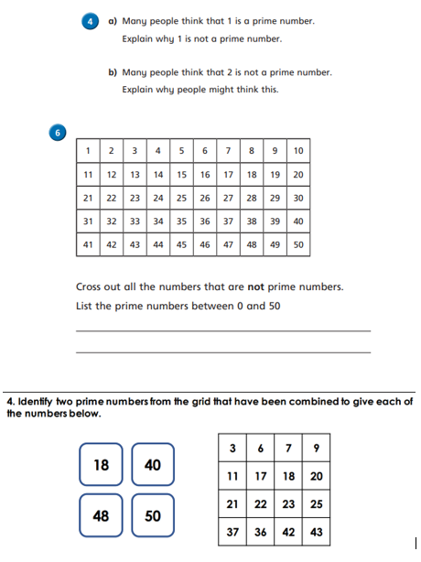
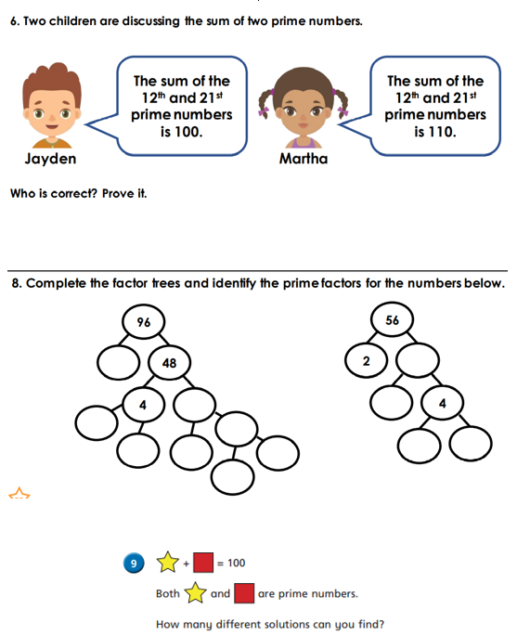
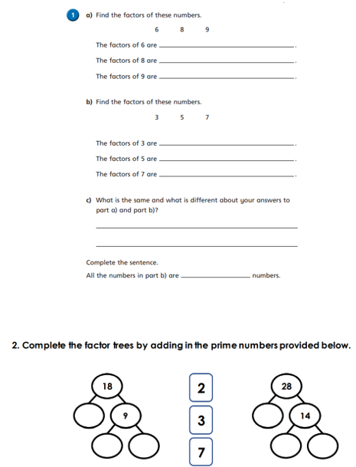
Independent Activity
Paddling Snorkelling Diving

Slide 17



