Slide 1
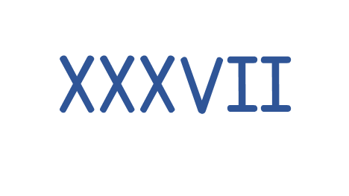
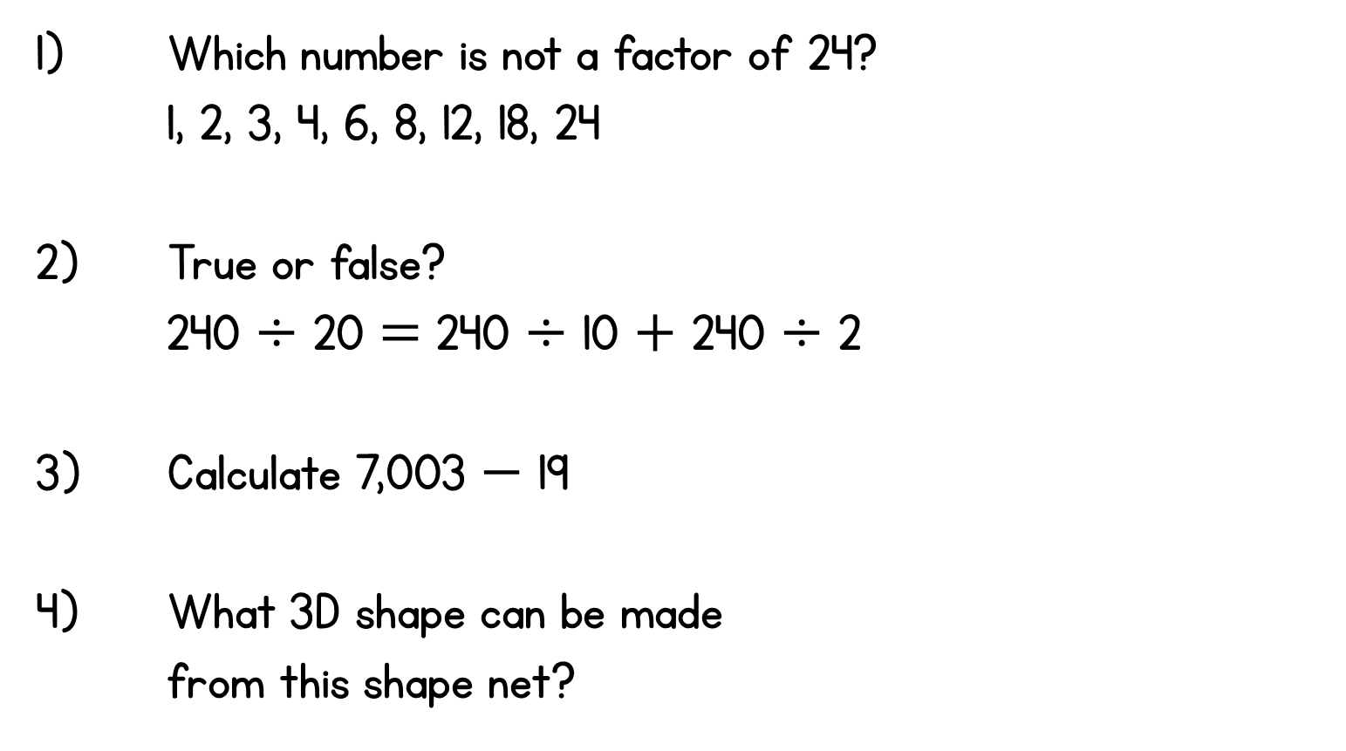
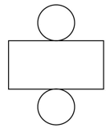
Year 6 | Week 5 | Day 4

Slide 2


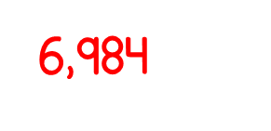

Year 6 | Week 5 | Day 4

Slide 3


Arithmetic Starter

Slide 4
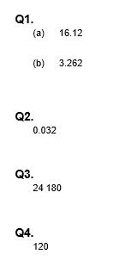
Arithmetic Starter - Answers

Slide 5


Slide 6
1) Complete the sequence:
7, 14, ___, ___, 35, 42, ____
2) Complete the sequence:
___, 12, ___, 24, 30, ___
3) Complete the sequence:
___, 9, 18, ___, 36, ____
4) Complete the sequence:
4, ___, 12, ___, 16, ___

Slide 7
1) Complete the sequence:
7, 14, ___, ___, 35, 42, ____
2) Complete the sequence:
___, 12, ___, 24, 30, ___
3) Complete the sequence:
___, 9, 18, ___, 36, ____
4) Complete the sequence:
4, ___, 12, ___, 20, ___
21
28
49
6
18
36
0
27
45
8
16
24

Slide 8
Multiples and factors
Factors of 12
1 and 12
12
3 and 4
2 and 6
12 is a multiple of 1, 2, 3, 4, 6, 12

Slide 9
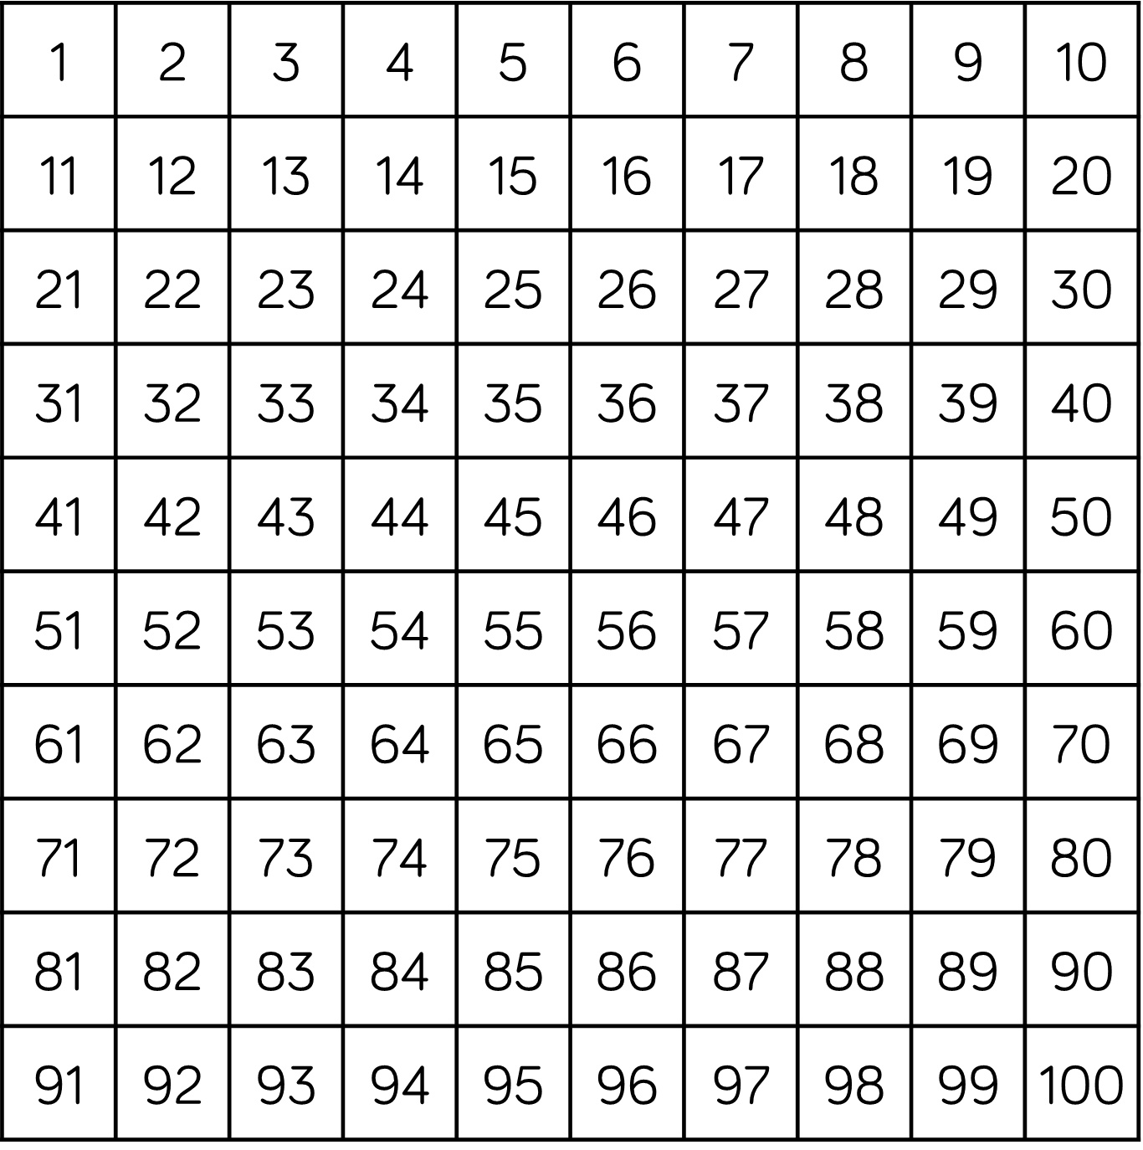
Find all the multiples of 5 on the number square

Slide 10
Find all the multiples of 6 on the number square
30
60
90
120
Find all the common multiples of 5 and 6

Slide 11

Complete the sorting diagram
12
35
28
70
56
20
Multiples of 4
Multiples of 7
Have a think

Slide 12
Complete the sorting diagram
12
35
28
70
56
20
Multiples of 4
Multiples of 7

Slide 13

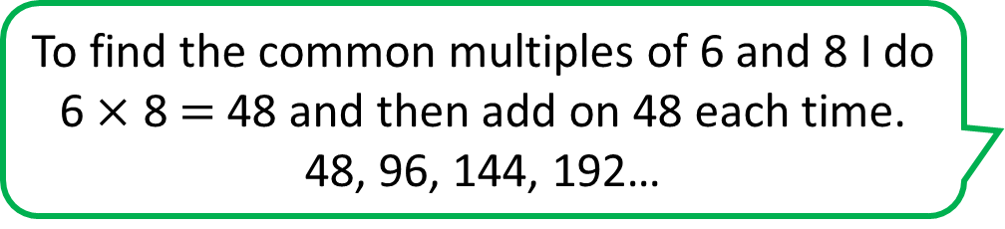
To find the common multiples of 6 and 8 I do 6 $×$ 8 $=$ 48 and then add on 48 each time.
48, 96, 144, 192…
Multiples of 6:
6, 12, 18, 24, 36, 42, 48
Multiples of 8:
8, 16, 24, 30, 40, 48
72
Have a think

Slide 14

Annie’s mum is 56 years old
56 is a multiple of Annie’s age
Annie goes to school
How old could Annie be?
1 and 56
56
7 and 8
2 and 28
4 and 14
1, 2, 4, 7, 8, 14, 28, 56
4, 7, 8, 14
Annie’s age is also 1 away from a multiple of 7
How old is Annie?

Slide 15
Annie’s mum is 56 years old
56 is a multiple of Annie’s age
Annie goes to school
How old could Annie be?
1 and 56
56
7 and 8
2 and 28
4 and 14
4, 7, 8, 14
Annie’s age is 1 away from a multiple of 7
Multiples of 7: 7, 14, 21, 28, 35, 42, 49, 56
Have a think

Slide 16
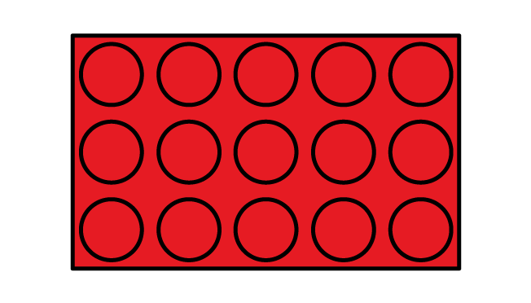
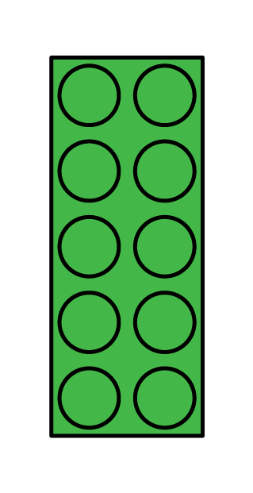
Dora is making two towers using lego.
She makes her two towers exactly the same height.
How tall could the towers be?
Have a think
8 cm
5 cm
8 cm
5 cm

Slide 17
Dora is making two towers using lego.
She makes her two towers exactly the same height.
How tall could the towers be?
Multiples of 5:
5, 10, 15, 20, 25, 30, 35, 40, 45, 50, 55, 60
Multiples of 8:
8, 16, 24, 32, 40, 48, 56, 64, 72, 80, 88, 96
40 cm tall
80 cm tall

Slide 18
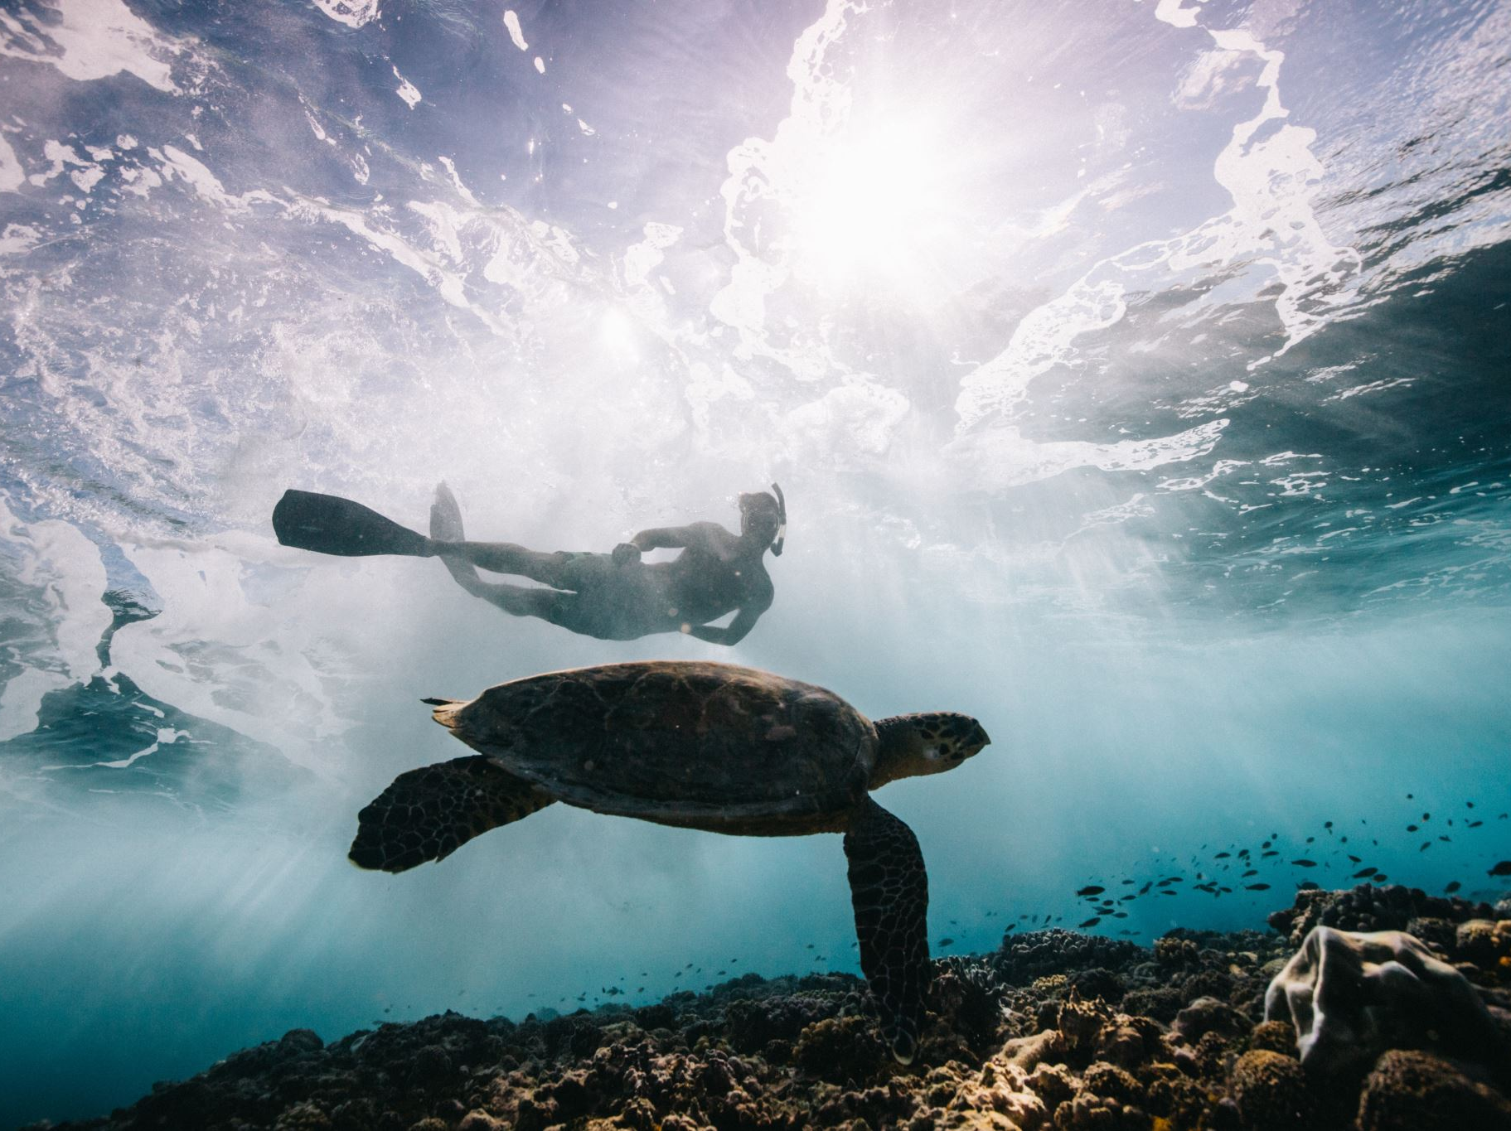
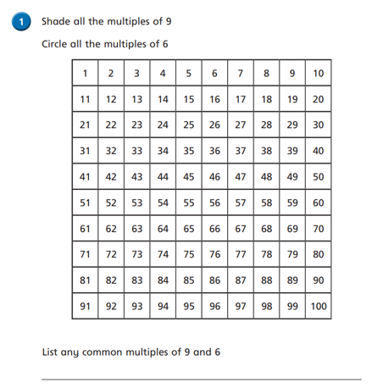
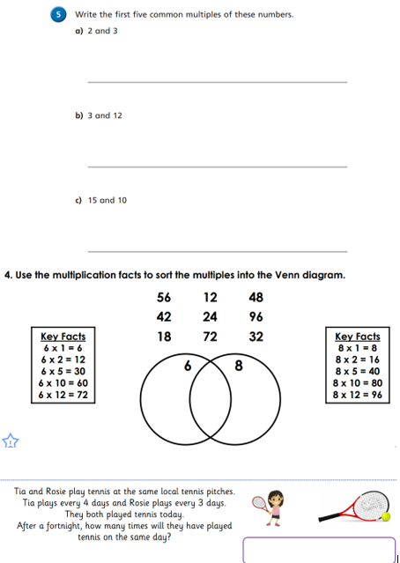
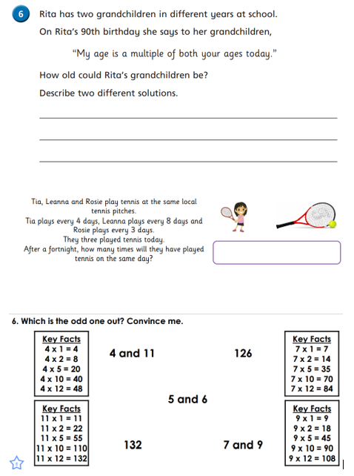
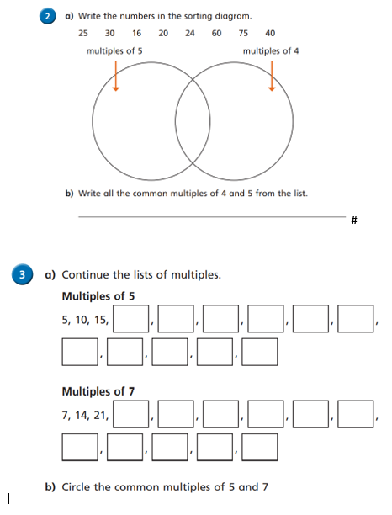
Independent Activity
Paddling Snorkelling Diving

Slide 19
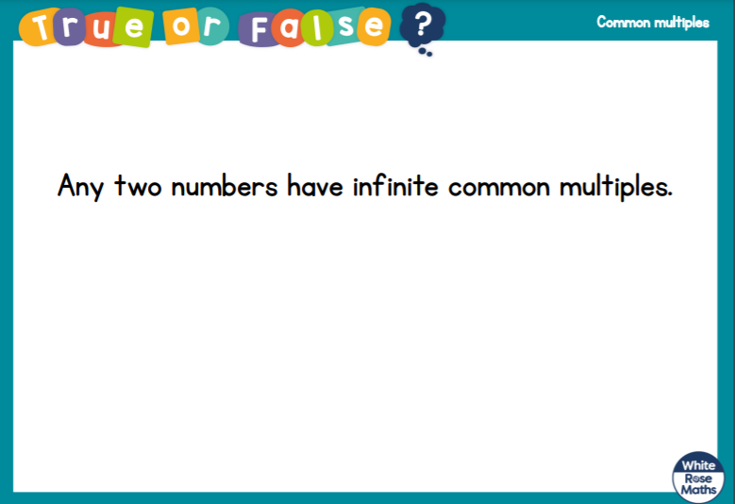




Slide 20


