Slide 1


Friday 15th January 2021
L.O: To understand that everybody’s family is different and important to them.
C: Celebrating Differences!

Slide 2
“One way our families are the same is…”
“One way our families are different is...”

Slide 3
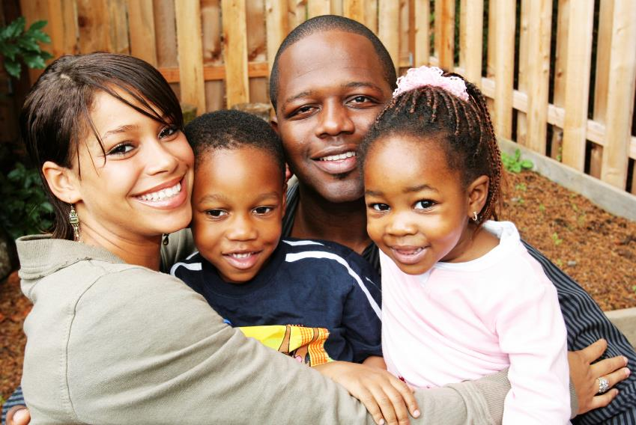

Slide 4
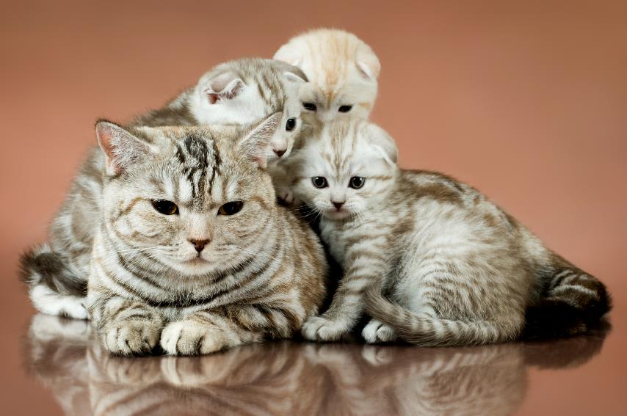

Slide 5
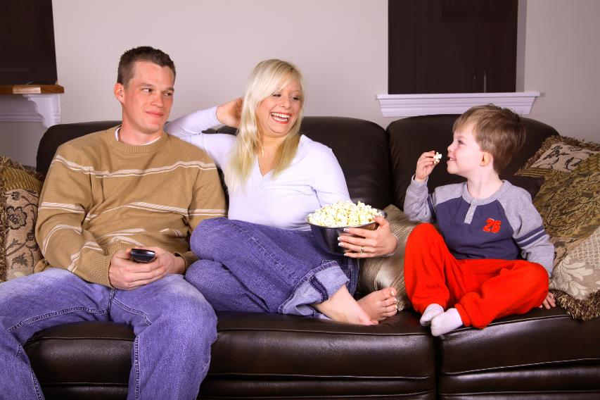

Slide 6
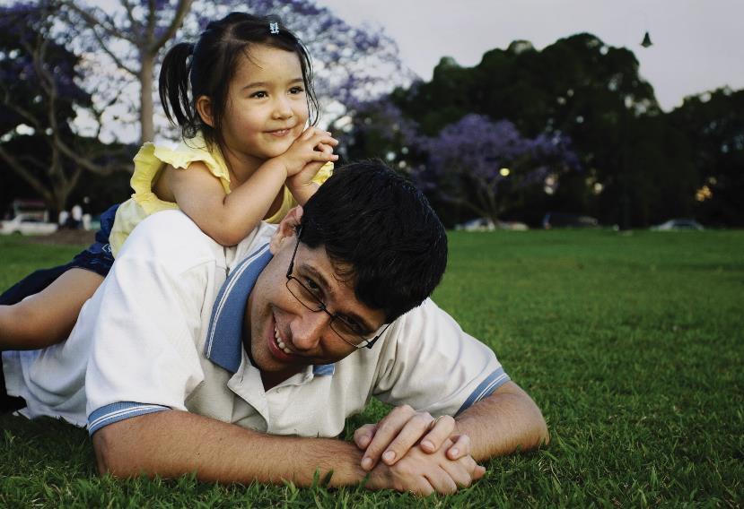

Slide 7
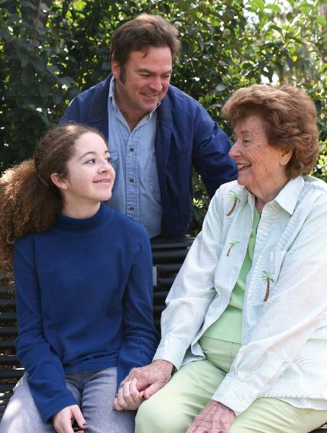

Slide 8
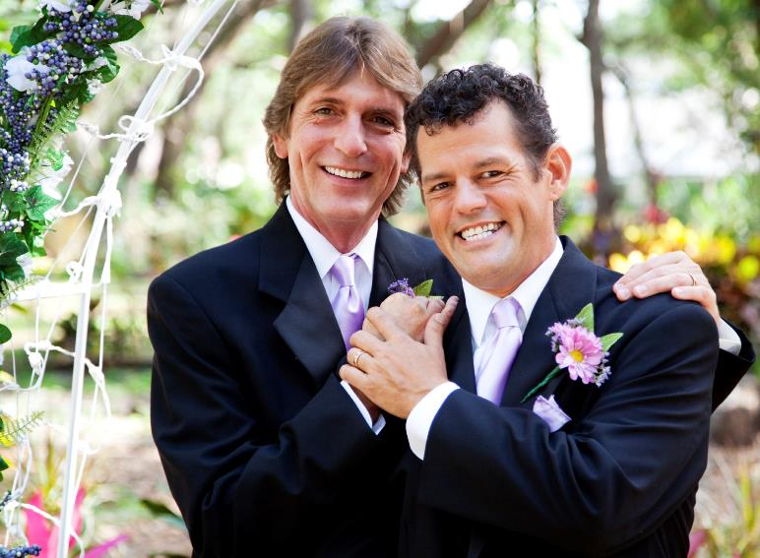

Slide 9
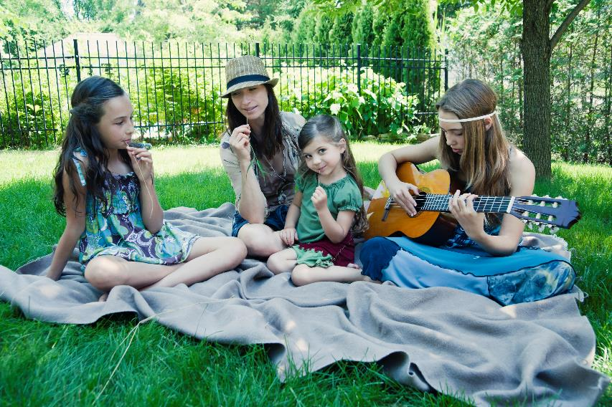

Slide 10
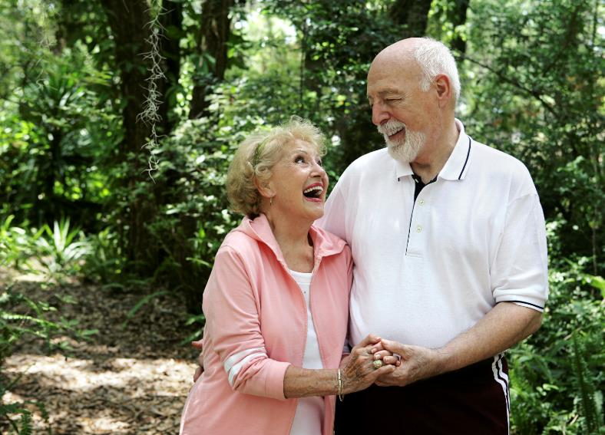

Slide 11
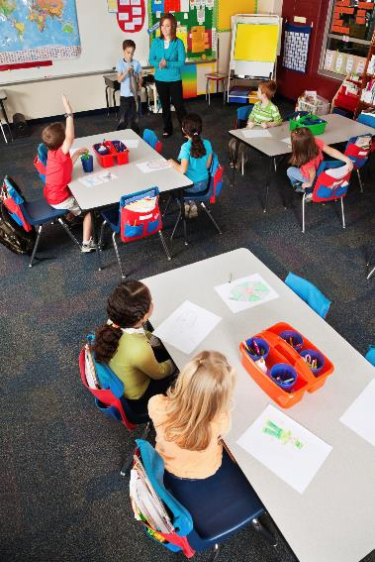

Slide 12
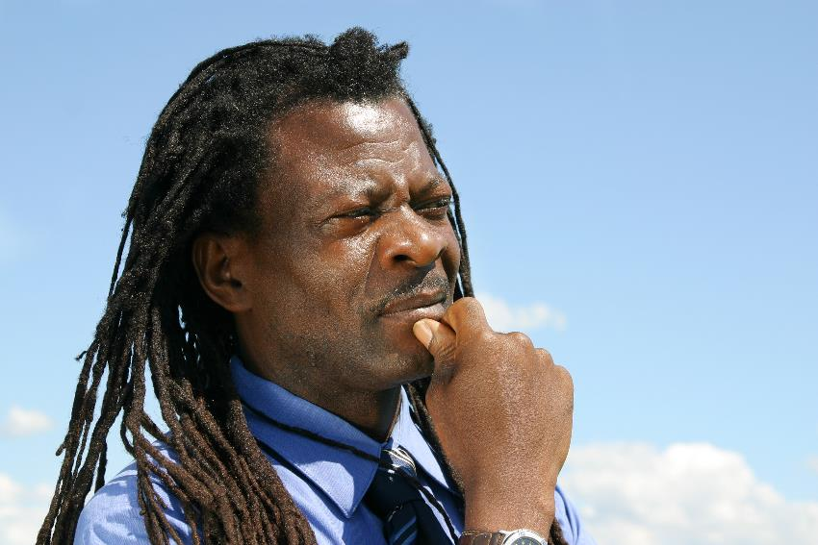

Slide 13
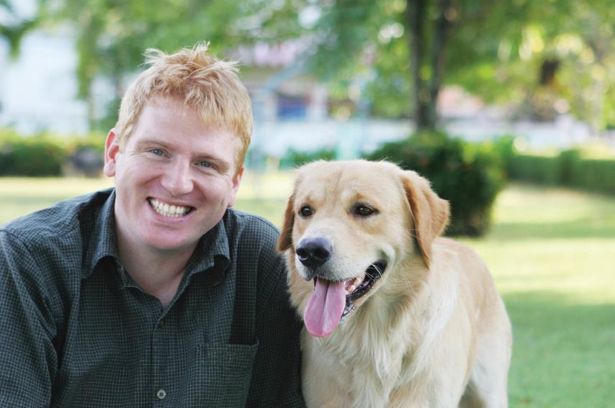

Slide 14
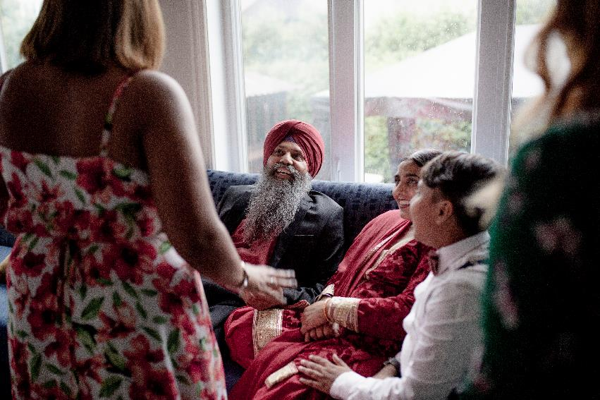

Slide 15

Your task!
Draw a picture of your family and write some words to show what your family means to you!

