Slide 1
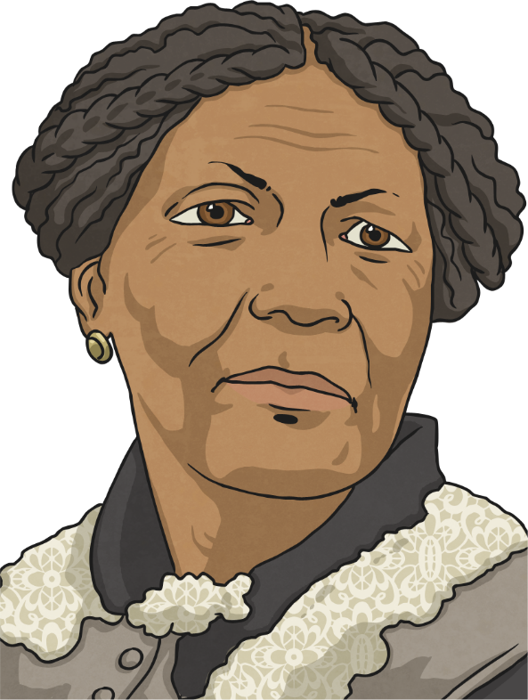
Finding the Facts
1
Day
Reading Focus – 2b: Retrieve and record information/identify key details from fiction and non-fiction.
Who Was Mary Seacole?
Mary Seacole (born Mary Grant) was a British-Jamaican woman who became famous in the 19th century as ‘Mother Seacole’ due to her work caring for injured soldiers in the Crimean War.
Mary’s Early Life
Mary Anne Grant was born in 1805 in Kingston, Jamaica. Her father was a Scottish soldier and her mother was a well-known Jamaican ‘doctress’ who treated people using herbal remedies (such as aloe vera and ginger) and Mary also had two siblings, Edward and Louisa.
As a child, Mary was fascinated by her mother’s work and practised the skills
she learned using dolls and pets as patients. By the age of 12, she was
helping her mother as a nurse. Because of her father’s connections, she was
also able to travel twice to visit England in her teens and this made her
quite unusual for a black person at that time.
When she was 31, Mary married a naval officer called Edwin Horatio Seacole.
She was a good businesswoman and together they ran a successful store.
Unfortunately, her husband died only eight years later.

Slide 2
Finding the Facts
1
Day
Reading Focus – 2b: Retrieve and record information/identify key details from fiction and non-fiction.
Why did Mary earn the nickname ‘Mother Seacole’? (1 mark)
Find and copy one word meaning a person who treats people with herbal remedies. (1 mark)
Using the information, tick one box in each row to show whether each statement is true or false. (2 marks)
Statement | True | False
Mary was born in Scotland.
Mary had a brother called Edward.
Mary was able to travel to England because her father was a doctor.
Mary’s husband died when she was 31.
Extension: What word in the text is the closest synonym to the verb ‘captivated’?

