Slide 1
Monday 18th October 2021
LO: To use sentences appropriately
To punctuate accurately
C: Grammar Recap

Slide 2
Mucking About with a Sentence
The cat ran along the wall.
Now, take out the verb – how does it sound?
The cat along the wall.

Slide 3
Mucking About with a Sentence
Can you add in an adverb?
e.g. The cat ran carelessly along the wall.
Can you think of different adverbs?
How does the choice of adverbs change the sentence?

Slide 4
Mucking About with a Sentence
Now, take out the nouns.
How does it sound?
The ran along the.

Slide 5
Mucking About with a Sentence
Can you add in an expanded noun phrases?
e.g. The sleek, black cat ran carelessly along the mossy, towering wall.
Can you improve your vocabulary?
How does the choice of adjectives change the sentence?

Slide 6
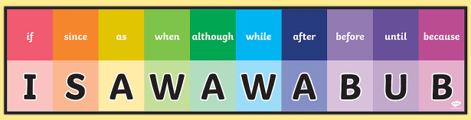
Mucking About with a Sentence
Now, extend the sentence using a subordinating conjunction, e.g. because.
The sleek, black cat ran carelessly along the mossy, towering wall, because the next door neighbour’s dog was barking.

Slide 7
Mucking About with a Sentence
Can you put the subordinate clause at the start of the sentence?
Remember to use a comma after the subordinate clause!
Because the next door neighbour’s dog was barking, the sleek, black cat ran carelessly along the mossy, towering wall.

Slide 8
Mucking About with a Sentence
Now, experiment with moving the adverb.
Where can it be moved, so that the sentence still makes sense?
Carelessly, because the next door neighbour’s dog was barking, the sleek, black cat ran along the messy, towering wall.

Slide 9
Mucking About with a Sentence
Challenge:
Can you use alliteration?
  The cool, crafty cat ran recklessly along the white, wobbly wall.
Can you use a simile?
  The cat, as quick as a tick, ran along the wall like a cheetah.
Can you use personification?
  The wall bent over and itched its back.

Slide 10
Mucking About with a Sentence – Book Work
We’re going to repeat the activity, but this time, you are going to do it with your own sentence!
Follow along with the PowerPoint, but write the sentences on your paper.
Remember to use correct punctuation and spelling!

Slide 11
Mucking About with a Sentence – Book Work
1. Write a simple sentence.
2. Add in an adverb.
  What different adverbs could we use? How does this affect your sentence?
3. Add in expanded noun phrases.
  What different adjectives could we use? How does this affect your sentence? Try to use impressive vocabulary.
4. Extend the sentence with a subordinating conjunction.
5. Can you put the subordinate clause at the start of your sentence?
  Remember to use a comma after your subordinate clause!
6. Experiment with moving the adverb.
  Where can it be moved, so that the sentence still makes sense?

Slide 12
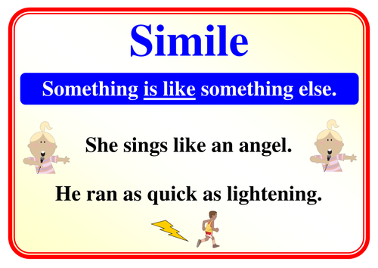
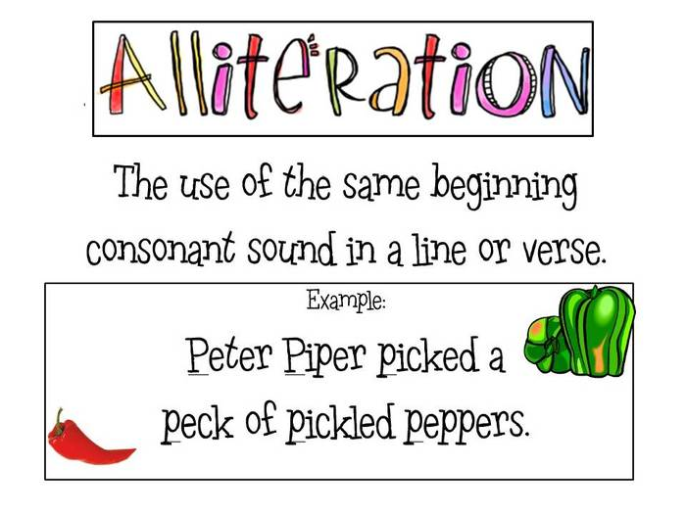
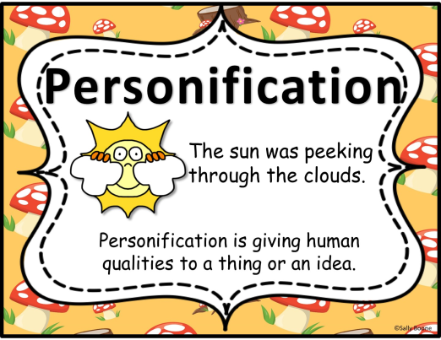
Red Pen Challenge
Add a simile, alliteration or personification to your original, simple sentence.
Remember to use correct punctuation and spelling!

Slide 13
Tuesday 19th October 2021
LO: To write with purpose
To punctuate accurately
C: Grammar Recap

Slide 14


Boring Sentences Activity
The man got in the car.
Vs
Pavarotti squeezed into a Skoda.

Slide 15
The mouse ate the cheese.
How could we improve this dull sentence?

Slide 16

There are only a few things that can be done to improve a sentence, for example:
1. Add words in:
The greedy mouse carefully ate the stale cheese.

Slide 17
There are only a few things that can be done to improve a sentence, for example:
2. Add on at the end:
The mouse ate the cheese, because it was hungry.

Slide 18
There are only a few things that can be done to improve a sentence, for example:
3. Add on at the beginning:
While it was waiting, the mouse ate the cheese.

Slide 19
There are only a few things that can be done to improve a sentence, for example:
4. Change words:
The rodent gnawed the cheddar.

Slide 20
There are only a few things that can be done to improve a sentence, for example:
5. Add in a simile:
The mouse, like a tiny vampire, sank its teeth into the cheese.

Slide 21
There are only a few things that can be done to improve a sentence, for example:
6. Alliterate:
The minute mouse marvelled at the mouldy cheese cheerfully.

Slide 22
Activity 1
Think of your own dull sentence!
Improve your sentence using the 6 ways we have looked at:
  1. Add words in.
  2. Add on at the end.
  3. Add on at the beginning.
  4. Change words.
  5. Add in a simile.
  6. Alliterate.
Make sure you are structuring and punctuating your sentences correctly.
Challenge: improve your vocabulary with a thesaurus!

Slide 23

When should you use commas?
You have 1 minute to jot down as many reasons for using commas as you can think of.

Slide 24

When should you use a comma?
  In a list
  In expanded noun phrases
  For speech
  After a fronted adverbial
  With a conjunction
  For an embedded clause
Can you think of sentences which use commas for each item on the list?

Slide 25
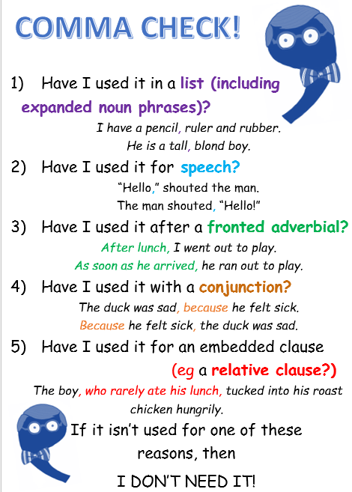

Slide 26
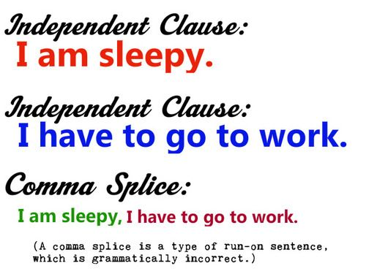
Comma Splice
A comma splice is where you join two sentences without using the correct punctuation.
In a comma splice, the two main clauses are joined by a comma.

Slide 27

Top tips to fix a comma splice
Charlie kicked the door, he was fed up.
1. Split the sentence in two two separate sentences with a full stop.
  Charlie kicked the door. He was fed up.
Use a semi-colon.
  Charlie kicked the door; he was fed up.
Use a conjunction.
  Charlie kicked the door, because he was fed up.

Slide 28
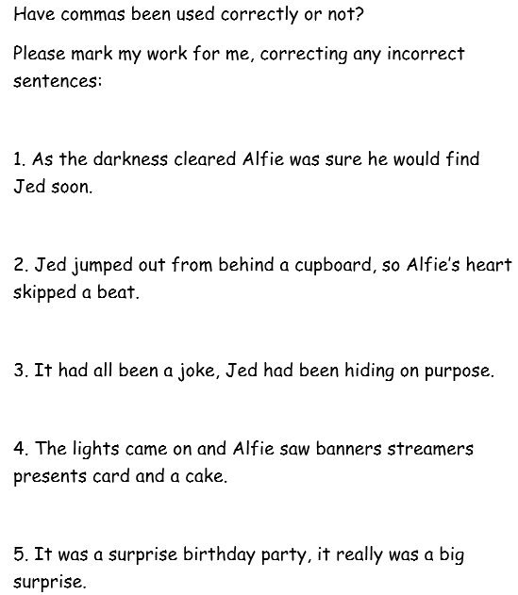
Activity 2
Look at the sentences on the sheet.
Decide if a comma has been used correctly and explain why.
If a comma has not been used correctly, correct the sentence in red pen.
Use your ‘Comma Check’ sheet to help you.

Slide 29
Red Pen
Ask an adult to write sentences with commas.
Check your adult’s sentences - have they used commas correctly?
How do you know?
Support your adult to correct their mistakes.

Slide 30
Wednesday 20th October 2021
LO: To use sentences appropriately
To spell correctly
C: Grammar Recap

Slide 31
When should you use apostrophes?
You have 30 seconds to jot down when you should use apostrophes in your writing.

Slide 32
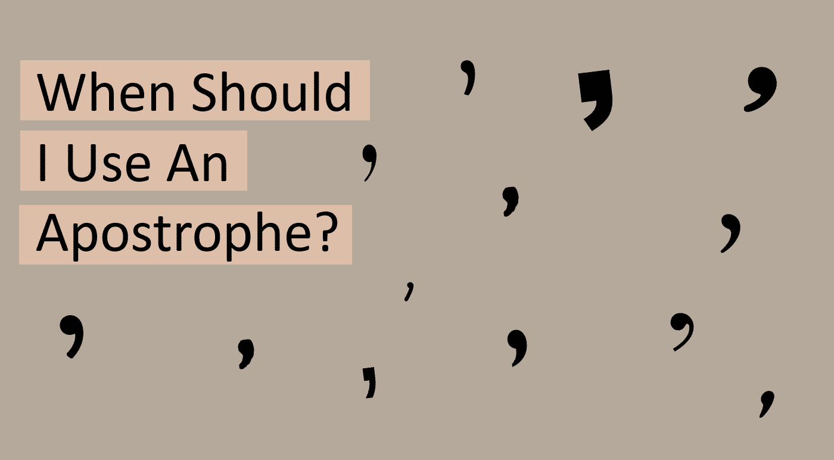
When should you use apostrophes?
For contractions
  To show that some letters are missing when joining two words
To show possession
  Before the ‘s’ for singular nouns
  After the ‘s’ for plural nouns
Can you think of sentences which use apostrophes for each item on the list?

Slide 33

Currently…
We are not using apostrophes correctly!
I am seeing lots of contractions with NO apostrophes and apostrophes being used for plurals/every time you see the letter ‘s’ at the end of a word!
You should run through an apostrophe check just as you have learned to do with commas!

Slide 34
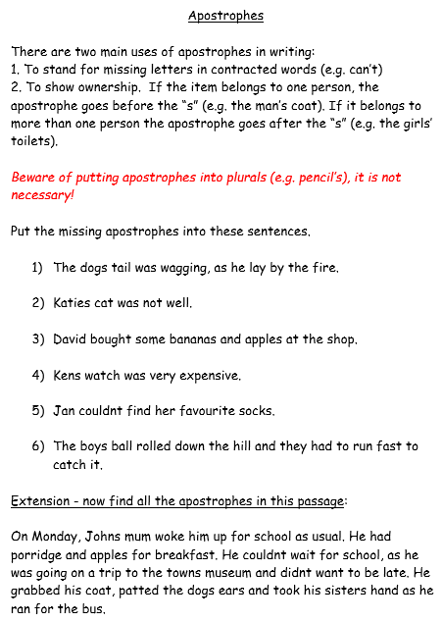
Activity 1
Look at the sentences on your sheet.
You need to insert apostrophes into the sentences IF they are needed.
Extension: Can you explain why an apostrophe is needed?
Challenge: Insert the missing apostrophes into the passage of text.

Slide 35

We are going to be writing exciting sentences today using the ‘Write Like a Ninja’ book to help us.

Slide 36

We will be using this image as a basis for our super sentences today.

Slide 37

2A – 2 Adjectives
A 2A sentence has two adjectives before the first noun, followed by two more adjectives before a second noun.
This type of sentence is useful for creating a strong visual image in the reader’s mind.
e.g. He was a tall, awkward man with an old, crumpled jacket.
It was an overgrown, messy garden with a lifeless, leafless tree.

Slide 38
Can you think of your own 2A sentence?
Make sure your sentence is structure, punctuated and spelt correctly.
Challenge: improve your vocabulary using a thesaurus.
Why are some sentences more powerful than others?

Slide 39
3---ed – Three Related Adjectives
A 3---ed sentence begins with three related words, each of which ends in -ed.
All of the words must be followed by commas.
Most -ed words for this sentence type describe emotions.
e.g. Frightened, terrified, exhausted, they ran from the creature.
Amused, amazed, excited, he left the circus reluctantly.
Confused, troubled, worried, she didn’t know what had happened.

Slide 40
Can you think of your own 3---ed sentence?
Make sure your sentence is structure, punctuated and spelt correctly.
Challenge: improve your vocabulary using a thesaurus.
Why are some sentences more powerful than others?

Slide 41
2 Pairs
A 2 pairs sentence begins with two pairs of related adjectives.
Each pair is followed by a comma and separated by the conjunction ‘and.’
e.g. Exhausted and worried, cold and hungry, they did not know how much further they had to go.
Injured and terrified, shell-shocked and lost, he wandered aimlessly across the battlefield.

Slide 42
Can you think of your own 2 pairs sentence?
Make sure your sentence is structure, punctuated and spelt correctly.
Challenge: improve your vocabulary using a thesaurus.
Why are some sentences more powerful than others?

Slide 43
Verb, Person
It is possible to start a sentence with a verb in order to give greater importance to that verb.
The verb should always be followed with a comma and then the name of a person (or a personal pronoun such as ‘he,’ ‘she,’ ‘they’ or ‘it’) and then the rest of the sentence.
e.g. Flinching, she turned quickly as the door slammed shut.
Hiding, he breathed as quietly as he could.

Slide 44
Can you think of your own verb, person sentence?
Make sure your sentence is structure, punctuated and spelt correctly.
Challenge: improve your vocabulary using a thesaurus.
Why are some sentences more powerful than others?

Slide 45
Noun: which/where/who
This sentence contains an embedded clause.
An embedded clause can be removed and the sentence would still make sense without it.
The sentence begins with a noun, followed by an embedded clause, which starts and ends with a comma.
The final part of the sentence gives some detail.
e.g. Snakes, which scare me, are not always poisonous.
My bicycle, which is covered in mud, needs cleaning with warm soap and water.

Slide 46
Can you think of your own noun: which/where/who sentence?
Make sure your sentence is structure, punctuated and spelt correctly.
Challenge: improve your vocabulary using a thesaurus.
Why are some sentences more powerful than others?

Slide 47
Ad, same ad
An ad, same ad sentence contains two identical adjectives, one repeated shortly after the other.
The first is used in the opening clause of a sentence and the second is used immediately after the comma.
Repeating adjectives like this can make them stick in the reader’s mind.
e.g. He was a smart dresser, smart because he had the money to buy the best.
She was a fast runner, fast because she needed to be.

Slide 48
Can you think of your own ad, same ad sentence?
Make sure your sentence is structure, punctuated and spelt correctly.
Challenge: improve your vocabulary using a thesaurus.
Why are some sentences more powerful than others?

Slide 49
Activity 2
Look at the image.
For each exciting sentence type, you should write down 2 sentences.
Set your work out neatly – write and underline the name of the sentence type and then write the sentences underneath, e.g.:
2A – 2 Adjectives
He was a tall, awkward man with an old, crumpled jacket.
It was an overgrown, messy garden with a lifeless, leafless tree.
Challenge 1: Write more than 2 sentences.
Challenge 2: Experiment with vocabulary choices (using a thesaurus) to explore the strength/power of different words.

Slide 50
Red Pen
Which exciting sentence type is the most effective in your opinion?
Can you explain why?
Which sentence types were not as effective?
Why?
Did word choice have an impact on the effectiveness of the sentences?

