Slide 1
Friday 18th June 2021
LO: To describe the social, ethic, cultural or religious society of the past
LO: To describe characteristic features of the past.
C: Did Stone Age people have wars?

Slide 2
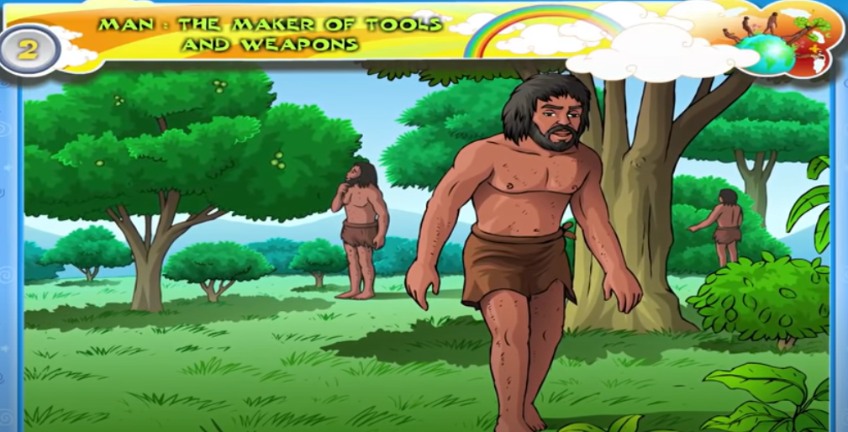
Let’s Watch
http://www.youtube.com/watch?v=hG7QpXM170I

Slide 3
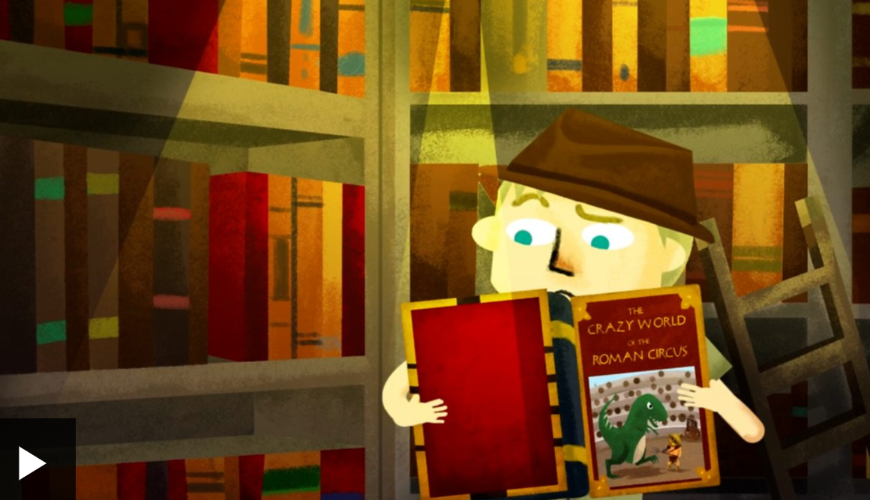
Primary and Secondary Sources
Can you remember what primary and secondary sources are?
If you can’t watch the video below:
https://www.bbc.co.uk/bitesize/topics/zs3487h/articles/ztnvgk7

Slide 4
Can you find the answers to the following questions?
- What were the first weapons?
- Pick one and write about what they uses the weapons for?
How did they make the weapons better?
Remember to use a variety of different sources

