Slide 1
Celebrating difference
PSHCE

Slide 3
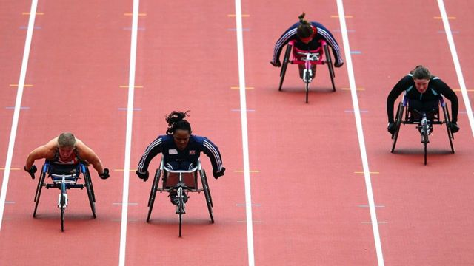
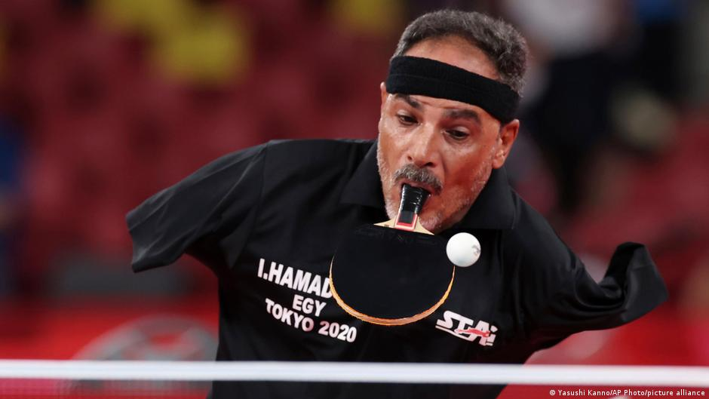
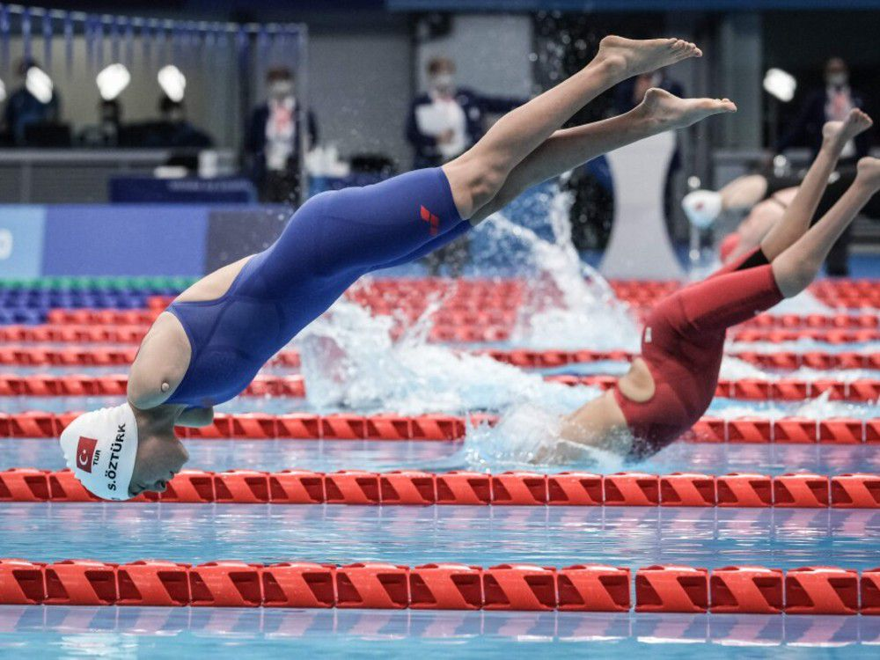
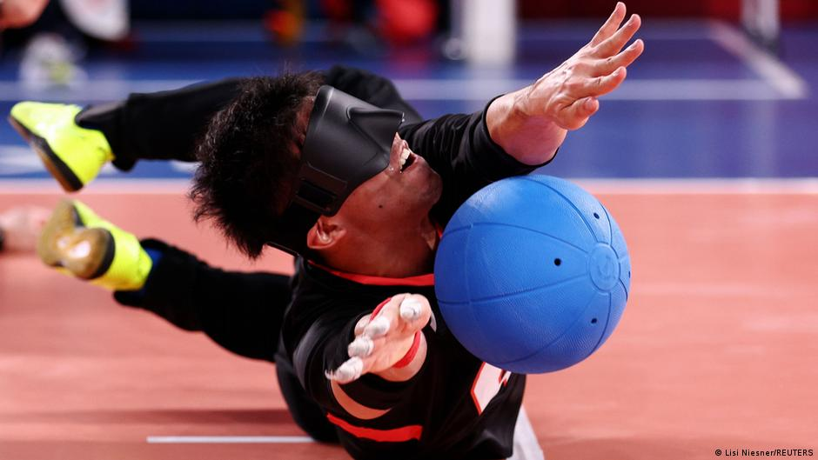
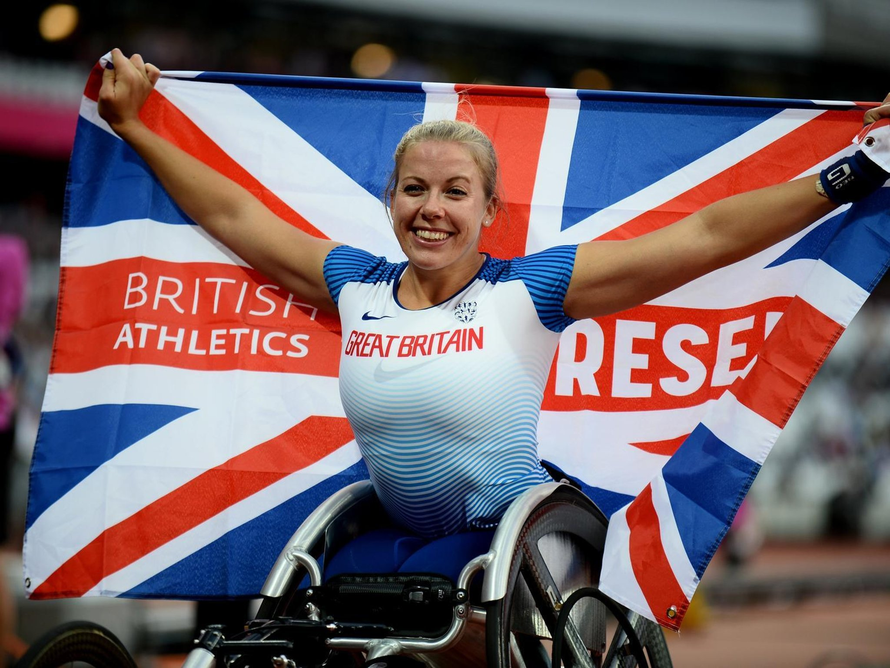

Slide 4

Did you watch any of the Paralympic Games this year?
What did you think of them?

Slide 5
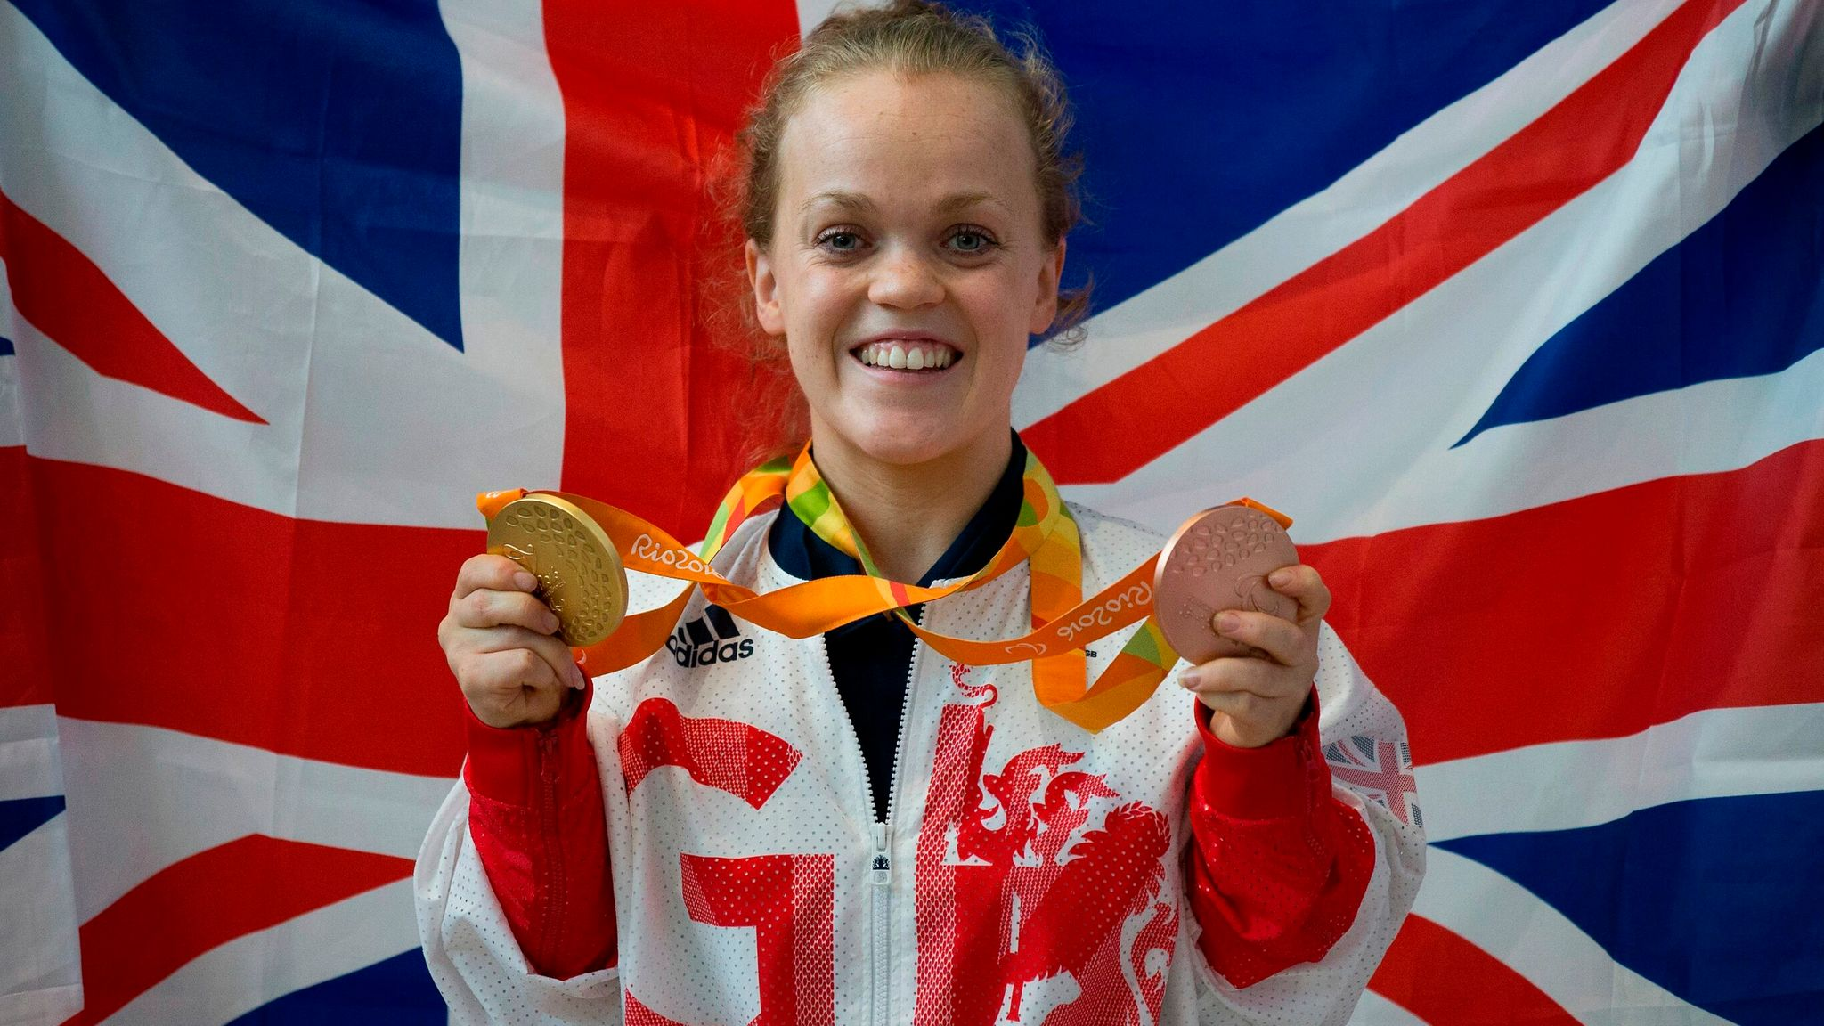
Watch: https://www.youtube.com/watch?v=xnllAGomYXA
Write down three words to describe Ellie.

Slide 6
What do you admire about Ellie?
What barriers has she overcome?
Do you think that winning a medal was worth all the years of training and hard work?

Slide 7

Activity:
Research a Paralympic athlete/sportsperson.
You need to find out about their life and achievements.
Then, design an AA (Admiration Accolate, e.g. like an Oscar or an award) for your Paralympian.
Underneath, write a short presentation speech as if you were presenting the AA to your Paralympian. Include powerful and emotive words to celebrate the achievement.

