Slide 1
LO: To investigate living things
To work scientifically
C: Classification

Slide 2
Starter
Hello! I am the Hog-Nosed Shrew Rat! One of the latest creatures to have been discovered by scientists in Sulawesi, Indonesia!
I just want to feel like I belong, but the scientists can’t classify me!

Slide 3
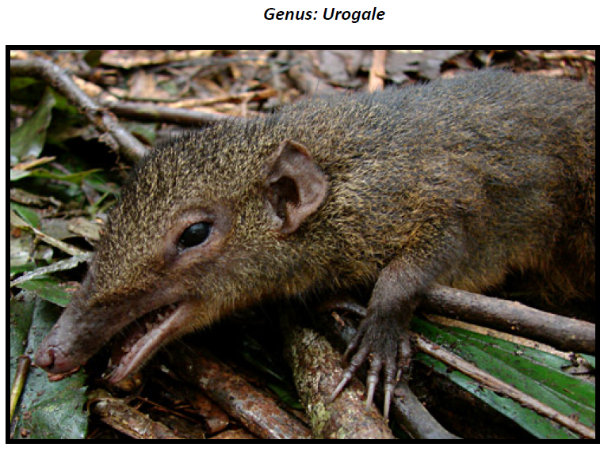
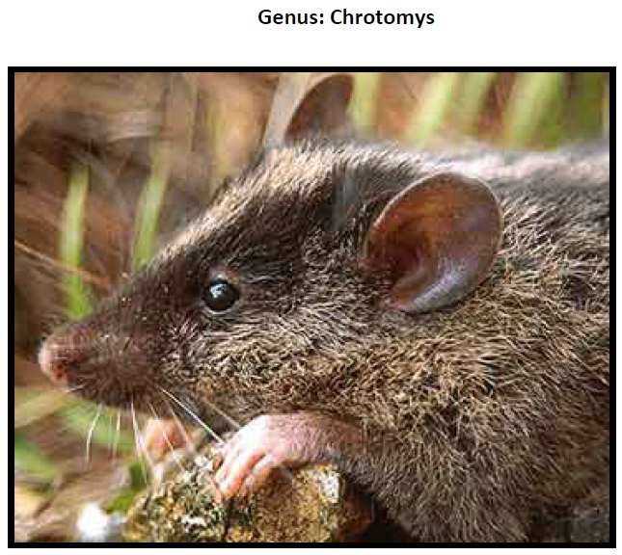
Look at the features of two close relatives and try to make a decision - which genus will you put the Hog-Nosed Shrew Rat in?

Slide 4
Starter
Would there be any other options available to scientists?
They could create a whole new genus if the creature really doesn’t fit an existing one precisely.
This is exactly what they did with the Hog-Nosed Shrew Rat!

Slide 5

Today, you are going to imagine you have discovered a new creature within the Animal Kingdom!
You need to:
  Sketch it (remember the detailed botanical drawings you looked at in Lesson 4)
  Describe it (think back to last lesson)
  Name it and classify it

Slide 6
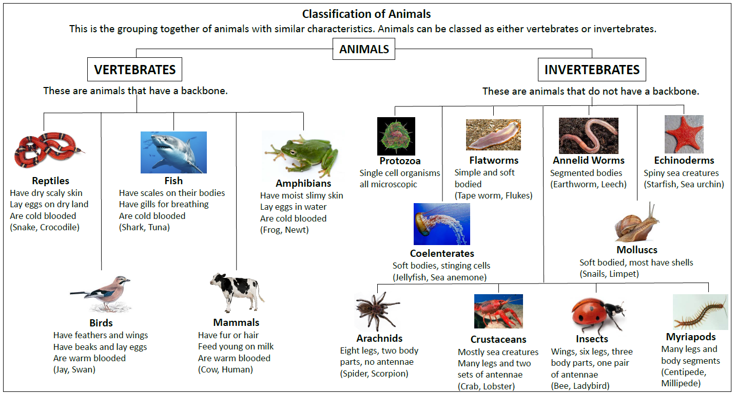
You are not to create a creature completely outside of our classification system.
You need to decide on a path and create the final unique characteristics towards the end of that path.

Slide 7
How might unicorns be classified?
Do they share similarities with any real living things?
What makes them unusual?

Slide 8
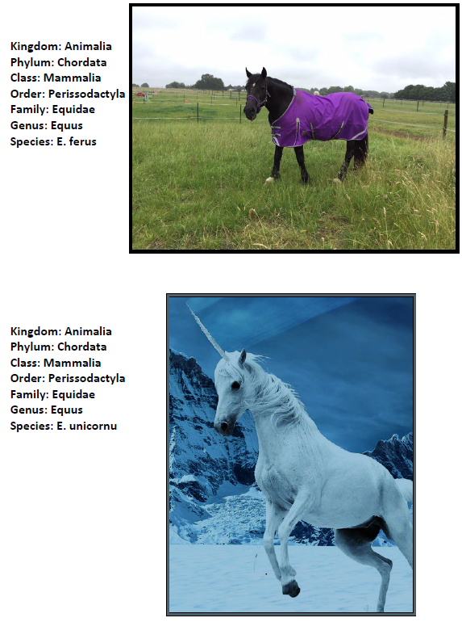
A unicorn’s classification route will be shared with horses.
Note what happens when we get to the genus stage, what makes it unique and different so that you can differentiate the species.

Slide 9
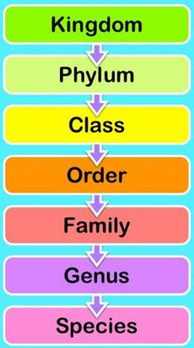
Remember:
Kingdom: Most scientists now list 5 kingdoms – Animal, Plant, Protists (amoebas and such), Fungi and Montera (bacteria).
Phylum: There are more than 30 phyla in the Animal Kingdom and 9 or 10 in the Plant Kingdom. Phylum Chordata is the one we're most familiar with – it includes humans, birds, fish, and all other vertebrates (animals with a backbone). Phylum Arthropoda includes insects, spiders, lobsters, etc. Arthropods have segmented bodies with the segments grouped into two or three distinct sections. They have hard external skeletons, or exoskeletons, that are shed and regenerated as the animals grow.

Slide 10
Remember:
Class: The various phyla are divided into classes – Phylum Chordata is divided into the classes: amphibians, birds, mammals, reptiles and fish.
Order: Scientific groupings don't follow hard and fast rules. Once we get to the ‘order’ of a living thing, there sometimes begins to be some disagreement about where it belongs. You may find that different sources group creatures in different orders or families. You may find that a creature has its order or family changed as more information is learned.

Slide 11
Remember:
Family: The family is a relatively new scientific concept. It is a way scientists group similar genera together. This is not the ‘mum, dad, brother and sister’ type of family!
Genus: Two or more species that share unique body structures or other characteristics are considered to be closely related and are placed together in a genus. Sometimes a genus might include only a single species if there is nothing else in the world that has similarities with it. The genus is the first part of the scientific name of a species. The genus is always spelled with a capital letter and in italics.

Slide 12
Remember:
Species: A species can be defined as a group of individuals that breed together to produce fertile offspring. Individuals of a species cannot breed with other such groups. It is sometimes possible for different species to breed, but the offspring will be sterile. A mule is the sterile offspring of a donkey and a horse, and the mule can never mate and reproduce itself. The species is the second part of the scientific name of a species. The species is always spelled with a lower-case letter and in italics.

Slide 13
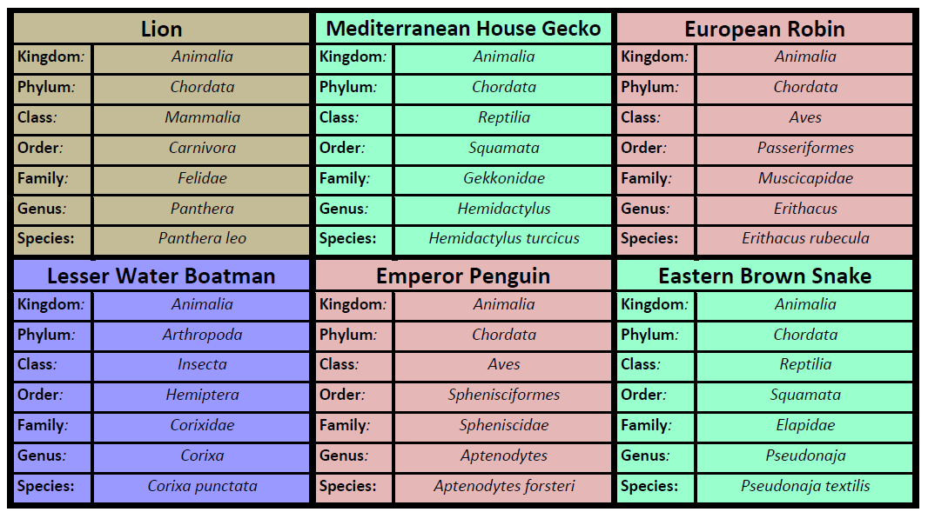
Activity
Identify the classification route you will take.
Look at the different Animalia classes and their classification route to help you identify the main characteristics of your creature (see resources on the website).

Slide 14
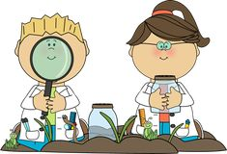
Activity
Identify the characteristics which will make your creature unique.
Sketch your creature, thinking carefully about your sketching technique.
Label your sketch to make it a descriptive, scientific ‘technical’ drawing.
Include a detailed scientific description and the classification route.
Remember to come up with a common name.

Slide 15

Red Pen
Based on your learning from this topic, do you think classification is important?
Explain your thinking.

Slide 16
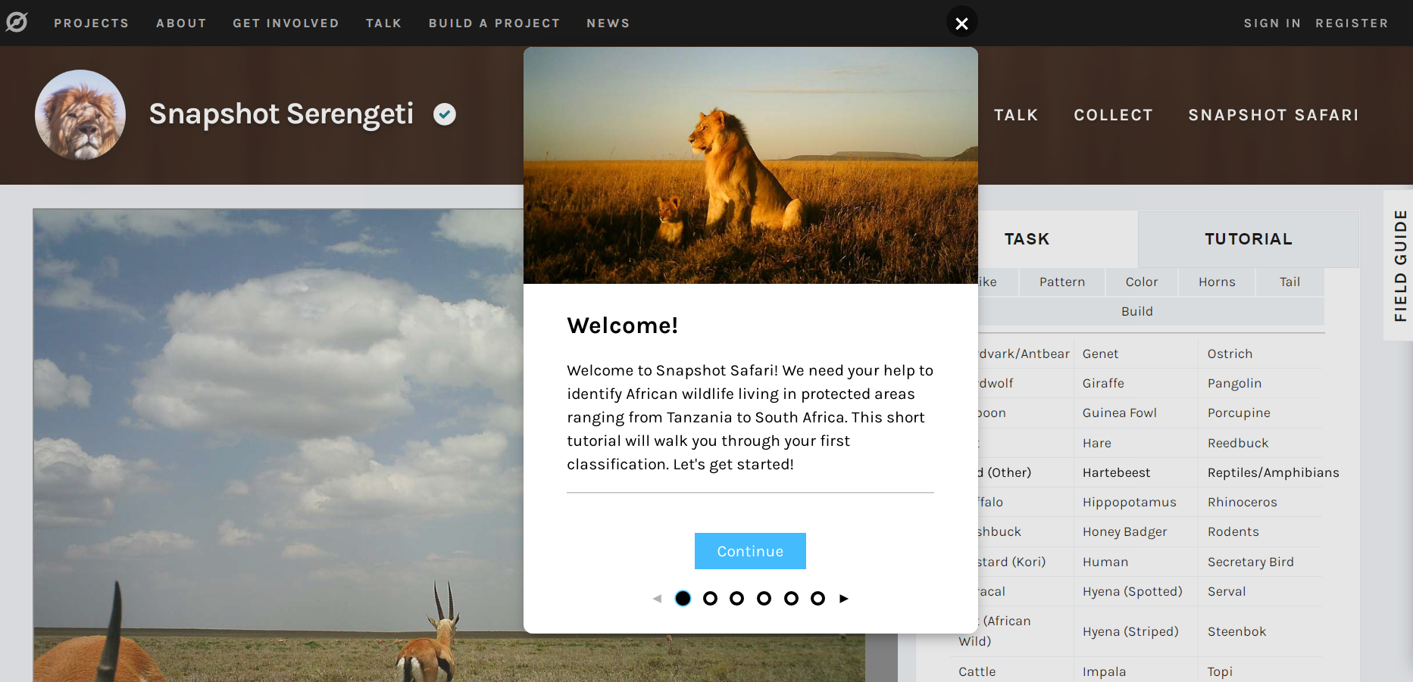
Plenary – Snapshot Serengeti
https://www.zooniverse.org/projects/zooniverse/snapshot-serengeti/classify
Everyone can help with classification!
This website shows how tricky it can be to classify living things.

