Slide 1
LO: to reflect
C: Christianity

Slide 2
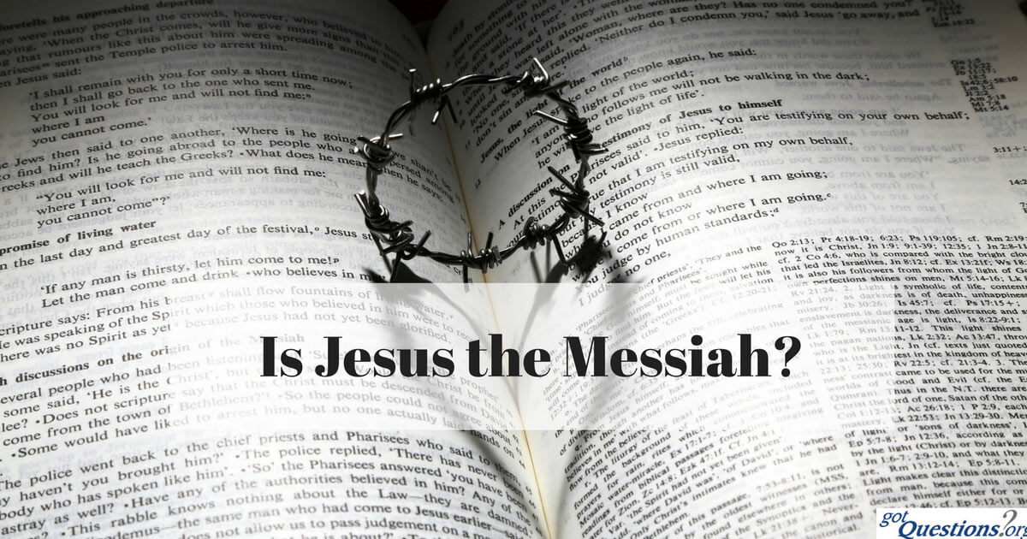
Starter
Christians think Jesus is the Messiah and Jewish people are still waiting for a Messiah.
Why do Christians think Jesus is the Messiah?

Slide 3
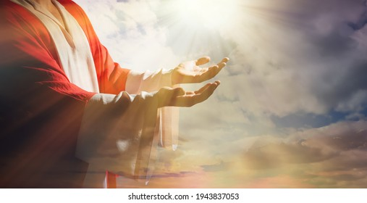
Christians think Jesus is the Messiah because…
Messianic Prophecies:
  Isaiah - a baby will be born in extraordinary circumstances, will be a descendant of King David and will be called ‘God with us.’
  Micah – a baby will be born in Bethlehem and will become a leader, and saviour, of the Jews
Transfiguration - Jesus’ followers realised he was special, connected to the old prophecies and a link between God and humanity.
Jesus’ miracles; he healed people.

Slide 4
‘The world doesn’t need a messiah
– it just needs people to love each other.’
Jot down three points that agree with this statement and three points that disagree with the statement.
You can weigh up different responses to the quotation with phrases like ‘on the one hand’ and ‘on the other hand.’
Can you come up with a balanced argument in response to this statement?

Slide 5
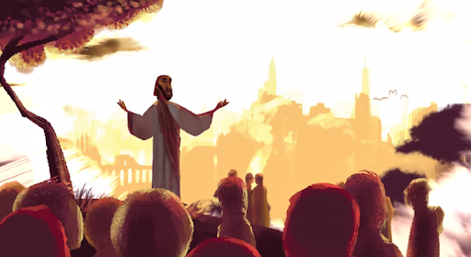
Messiah
The term Messiah is Hebrew and means ‘anointed one’.
This is a title given to the person believed to be the saviour, who has been chosen to bring salvation to humankind
The term ‘anointed one’ is used in both Christianity and Judaism. Christians believe that the Messiah was sent by God to save humanity.

Slide 6
Activity
Write a balanced argument in response to the statement:
The world doesn’t need a messiah – it just needs people to love each other.
Make links to your learning about Jesus the Messiah and Son of God.
Paddling – use the sentence starters below to help you.
  On the one hand, I think the world needs a messiah because…
  On the other hand, I don’t think the world needs a messiah because…
  If people loved each other then …
  If people didn’t love each other then…

Slide 7

Red Pen
Why do you think that the transfiguration is so important for Christians?
What if it never happened?

