Slide 1

Lesson 3
L.O: To investigate and interpret the past.
C: Investigating what it was like to be an evacuee in WW2.

Slide 2

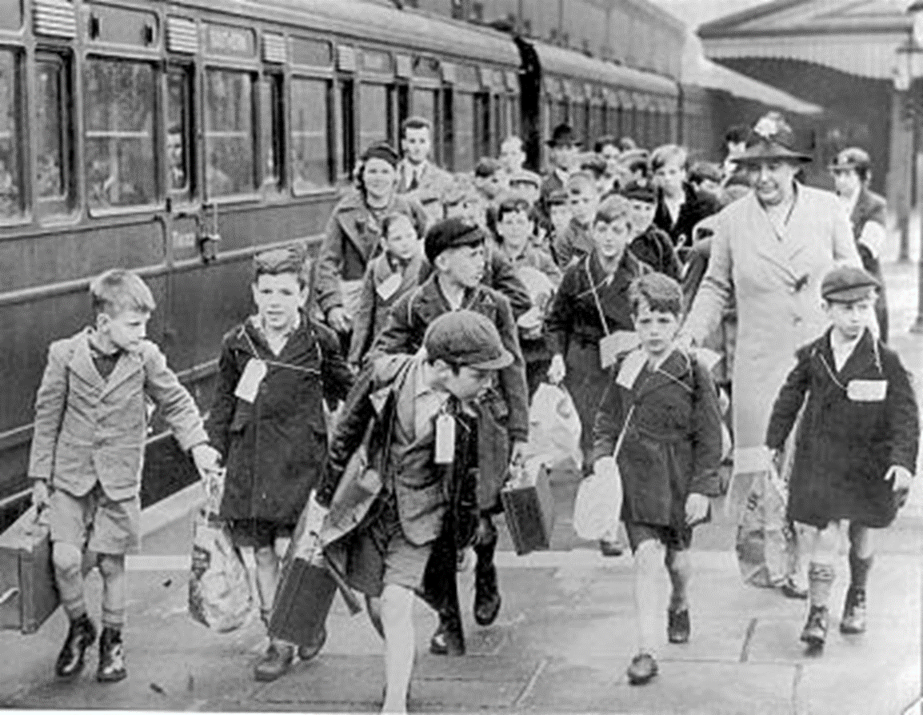
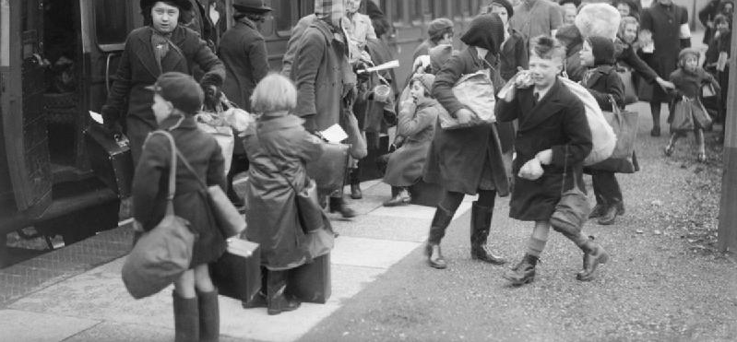
Think, pair and share! What is an evacuee and why were children evacuated?
https://www.youtube.com/watch?v=ijh7_OrM23I
https://www.youtube.com/watch?v=ZPs8hbksOg8

Slide 3

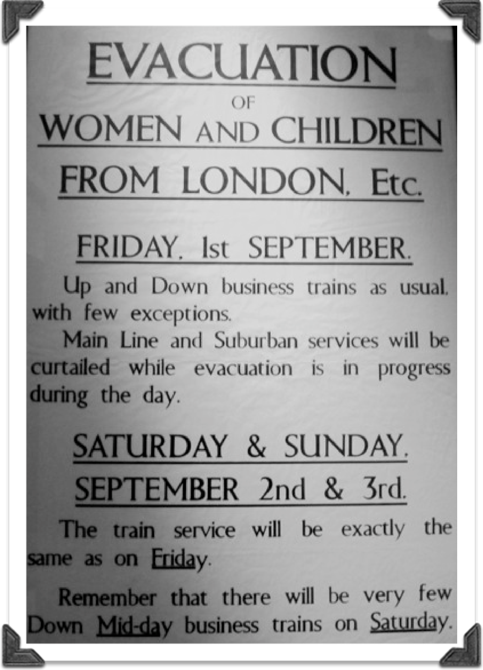
Evacuation
When the war started in 1939, the government was concerned about people being killed by possible bombings so evacuation was introduced to try and make people as safe as possible. It was mainly children who were evacuated but some other groups of people were evacuated too, like schoolteachers, mothers with children under 5 years old and some disabled people. The British evacuation was named ‘Operation Pied Piper’ and began on Friday 1st September 1939.

Slide 4
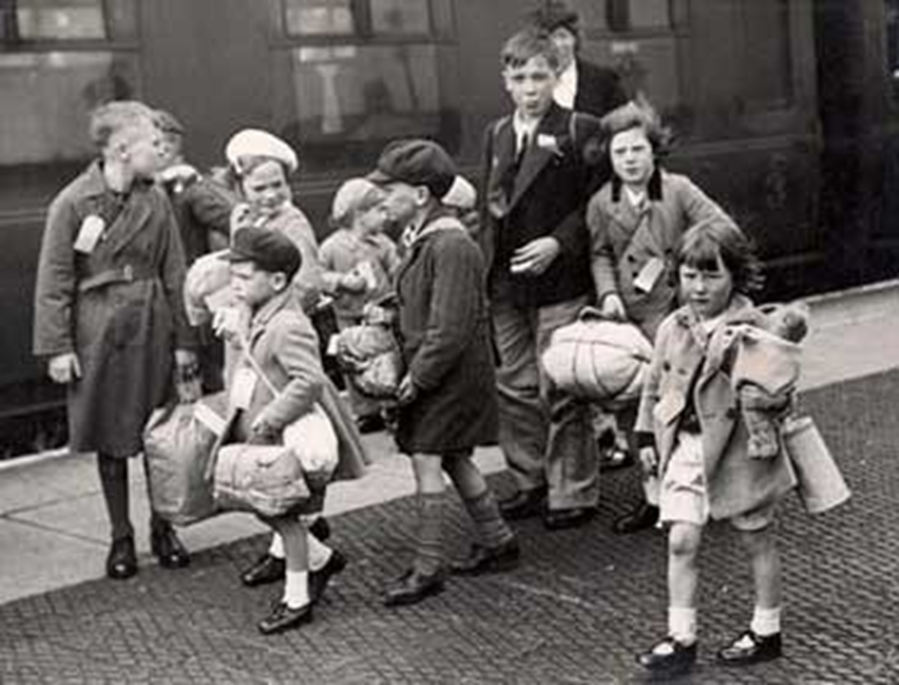
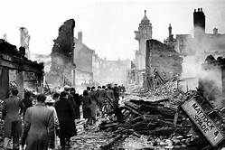

Evacuation
The idea behind evacuation was to send children out of the dangerous cities where bombs were more likely to fall and to take them to live with host families in the country where they would
be safer. Evacuation was not compulsory but it was a free scheme set up by the government which millions of families took advantage of. If the government decided that an area was at risk, a letter was sent to parents explaining that their child could be evacuated if they wished.

Slide 5

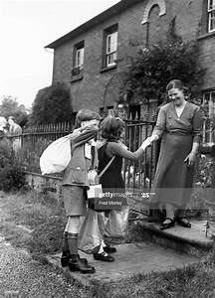
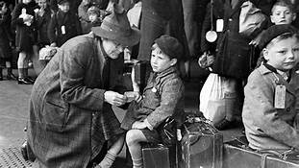
Evacuation
Offering evacuees a home was considered to be national service and anyone who refused to house evacuees with no good reason could be fined. Host families were given some money each week to help care for the children they took in. They were given 10 shillings and 6 pence for children over 10, and 8 shillings and 6 pence for children younger than 10.

Slide 6
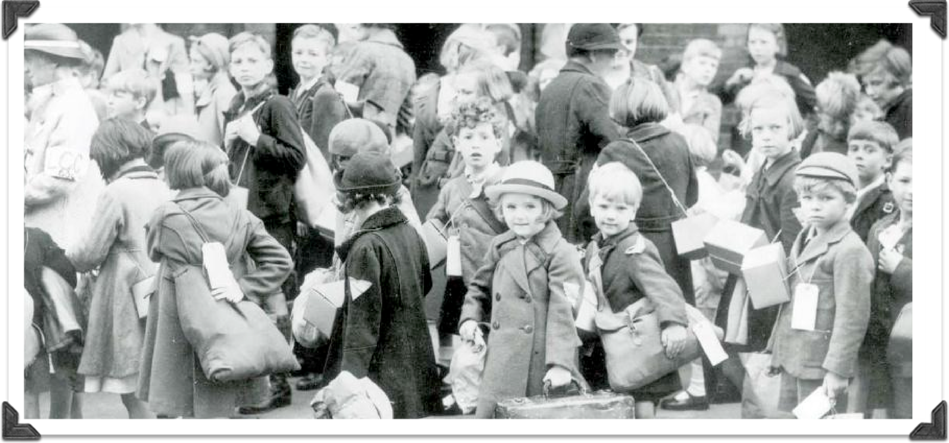
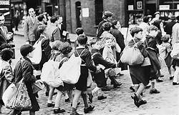
Evacuation
When the evacuees arrived at their destination they had to be chosen by their host family. Lots of evacuees found this very difficult as host families would choose children they thought looked ‘nice’. Children who had spots or were considered ‘ugly’ were often left until last.

Slide 7
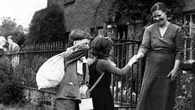
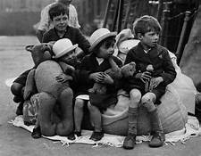
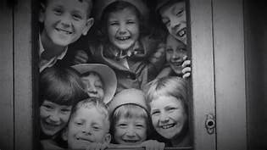
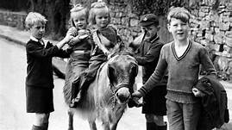
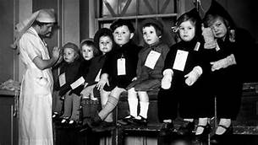
How do you think evacuees would have felt?
Talk to your partner – imagine you have been evacuated during World War Two. Let’s create a list of adjectives and phrases to describe your emotions.

Slide 8
Task:
Paddlers:
Complete table describing positive and negatives aspects of being an evacuee
Snorkellers and Divers:
Imagine you are an evacuee during WW2. Write a letter home, explaining your experiences, both positive and negative, and explain how you are feeling.
Include descriptive language – use expanded noun phrases, relative clauses, similes and emotive language.

Slide 9
Plenary
Do you think you would have liked to have been an evacuee or would you have preferred to stay in the city with your parents?
Share your ideas, giving reasons for your choices.
.

