Slide 1
Monday 6th December 2021
LO: To write with purpose.
To use sentences appropriately.
To punctuate accurately.
C: Persuasive Writing.

Slide 2
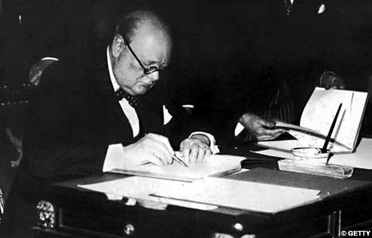
Starter
This week we are going to write a formal letter from Winston Churchill thanking the soldiers for their participation in WWII.

Slide 3

https://www.bbc.co.uk/bitesize/articles/z6hvgwx
The purpose of a thank you letter is to show your appreciation for a gift or service that someone has provided for you.
If someone has done something for you, it's nice to acknowledge with some heartfelt written words.

Slide 4
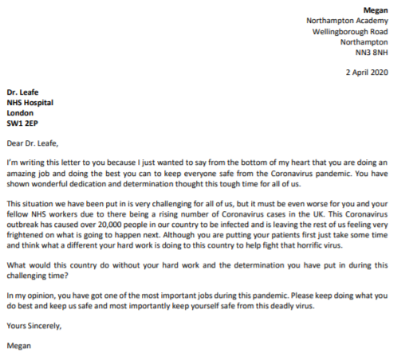
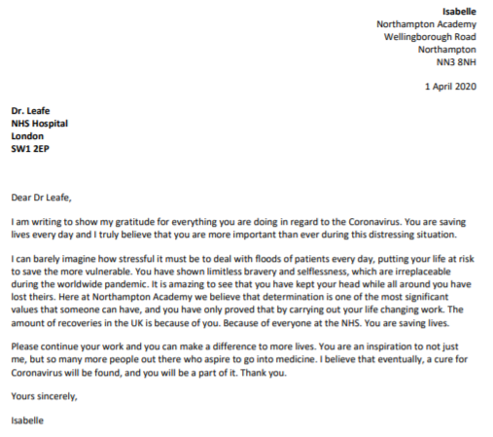

Slide 5
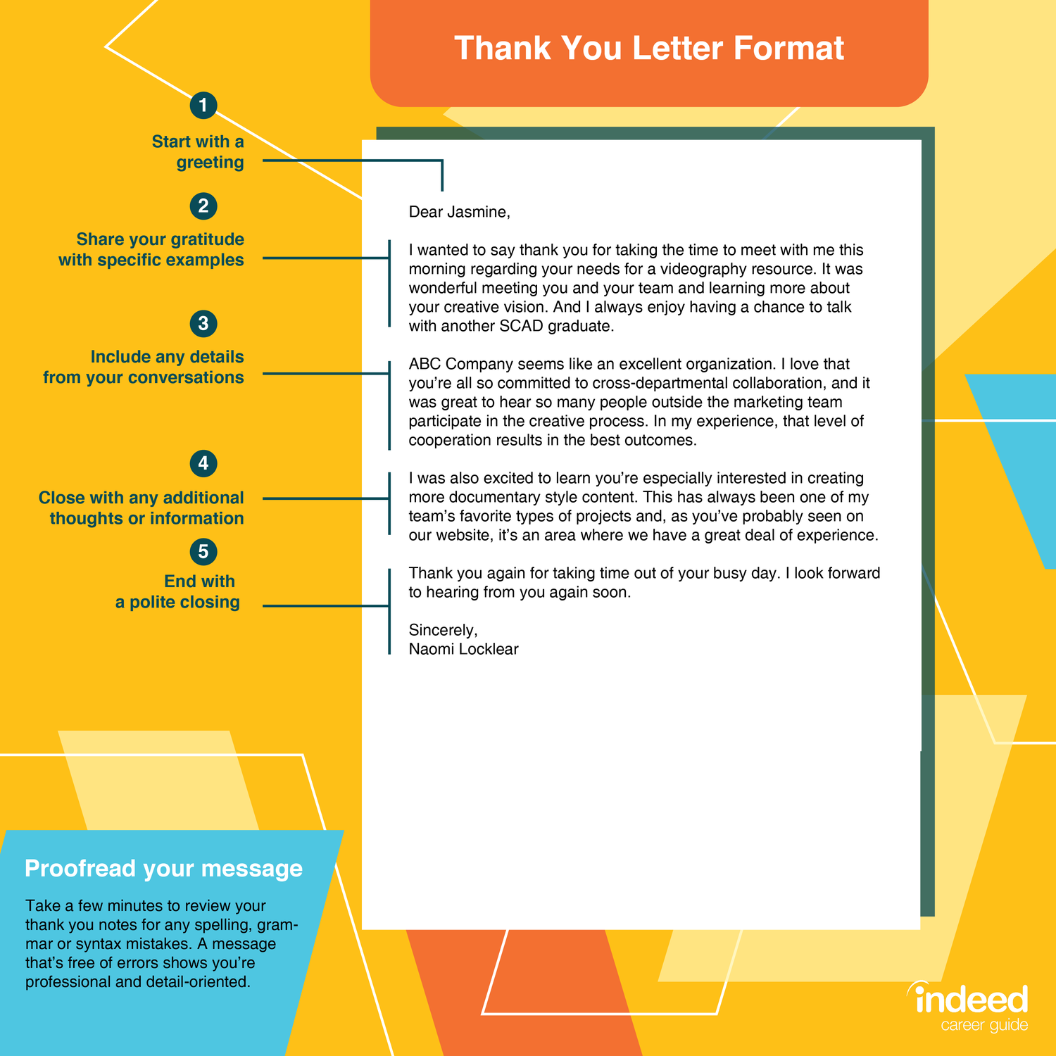
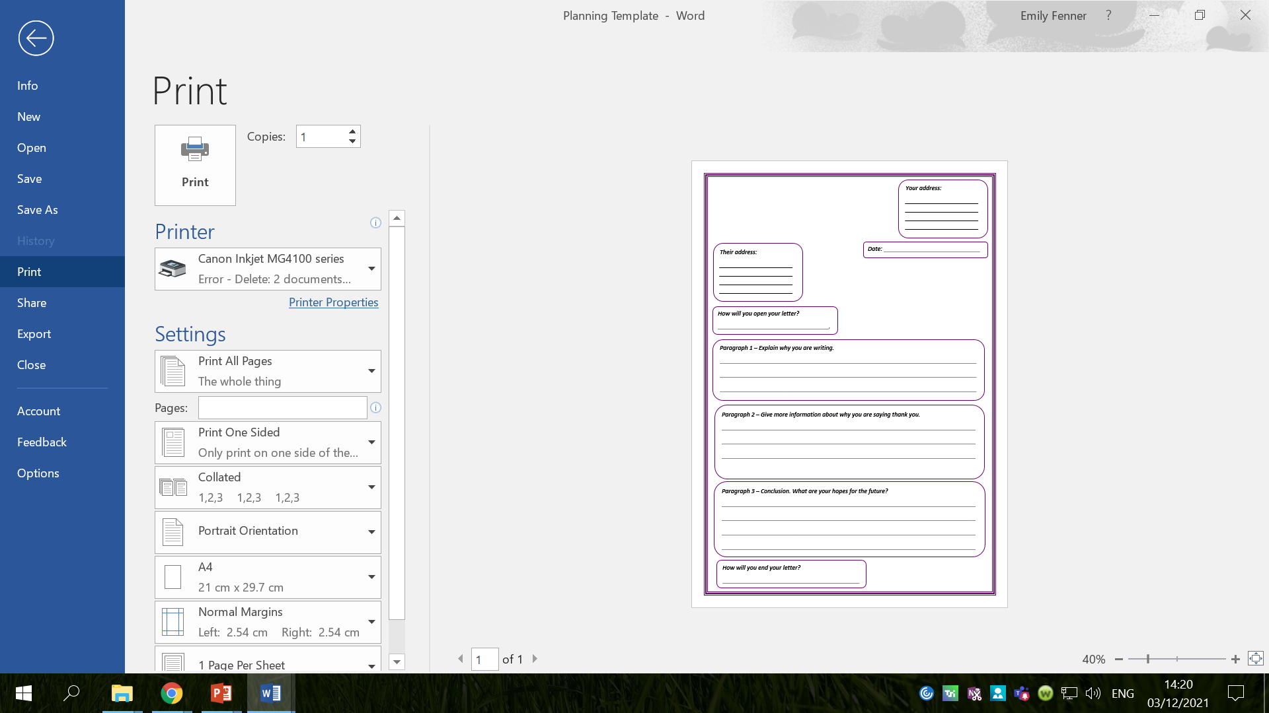

Slide 6

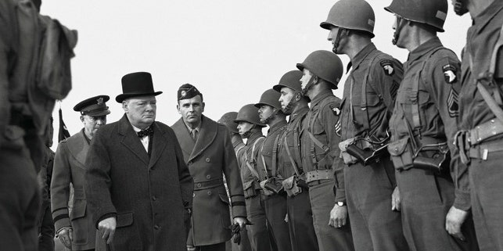
What would Churchill be thanking the soldiers for?
What things might he include in his letter?
What points might he make?

Slide 7
Activity 1
Create a bubble map of ideas for the contents of your letter.
Examples:
  Thank you for risking your life.
  Your efforts should be applauded.
  Your bravery has not gone unnoticed.

Slide 8
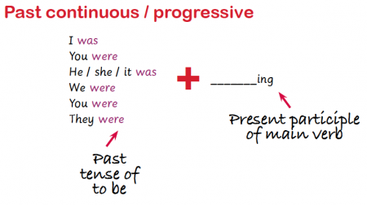
We are going to be using the past progressive tense in our formal letters.
Remember: the past progressive is a form of the past tense where an action goes on for a period of time in the past.
The past progressive is formed by using the past for the verb ‘to be’ and by adding the suffix ‘ing’ to the main verb.

Slide 9
Examples
My teacher was drinking a cup of tea.
Here we see that the action (drinking) went on for a period of time.
We use the past form of the verb ‘to be’ (was) to indicate that the action took place in the past, and the present participle of the main verb (drinking) to indicate that this is a continuous or progressive action.

Slide 10
Examples
We were making friendship bracelets all afternoon.
Again, there is a past form of the verb ‘to be’ (were) and the present participle of the verb ‘to drink’ (drinking), showing us that the action took place for an extended period of time in the past.

Slide 11
Think of sentences in the past progressive tense which could be used in our letters.
Examples
  You were fighting with undeniable bravery.
  I was marvelling at your bravery and dedication throughout this testing time.

Slide 12


We are also going to be using the passive voice in our letters.
Have you heard of the passive voice?

Slide 13
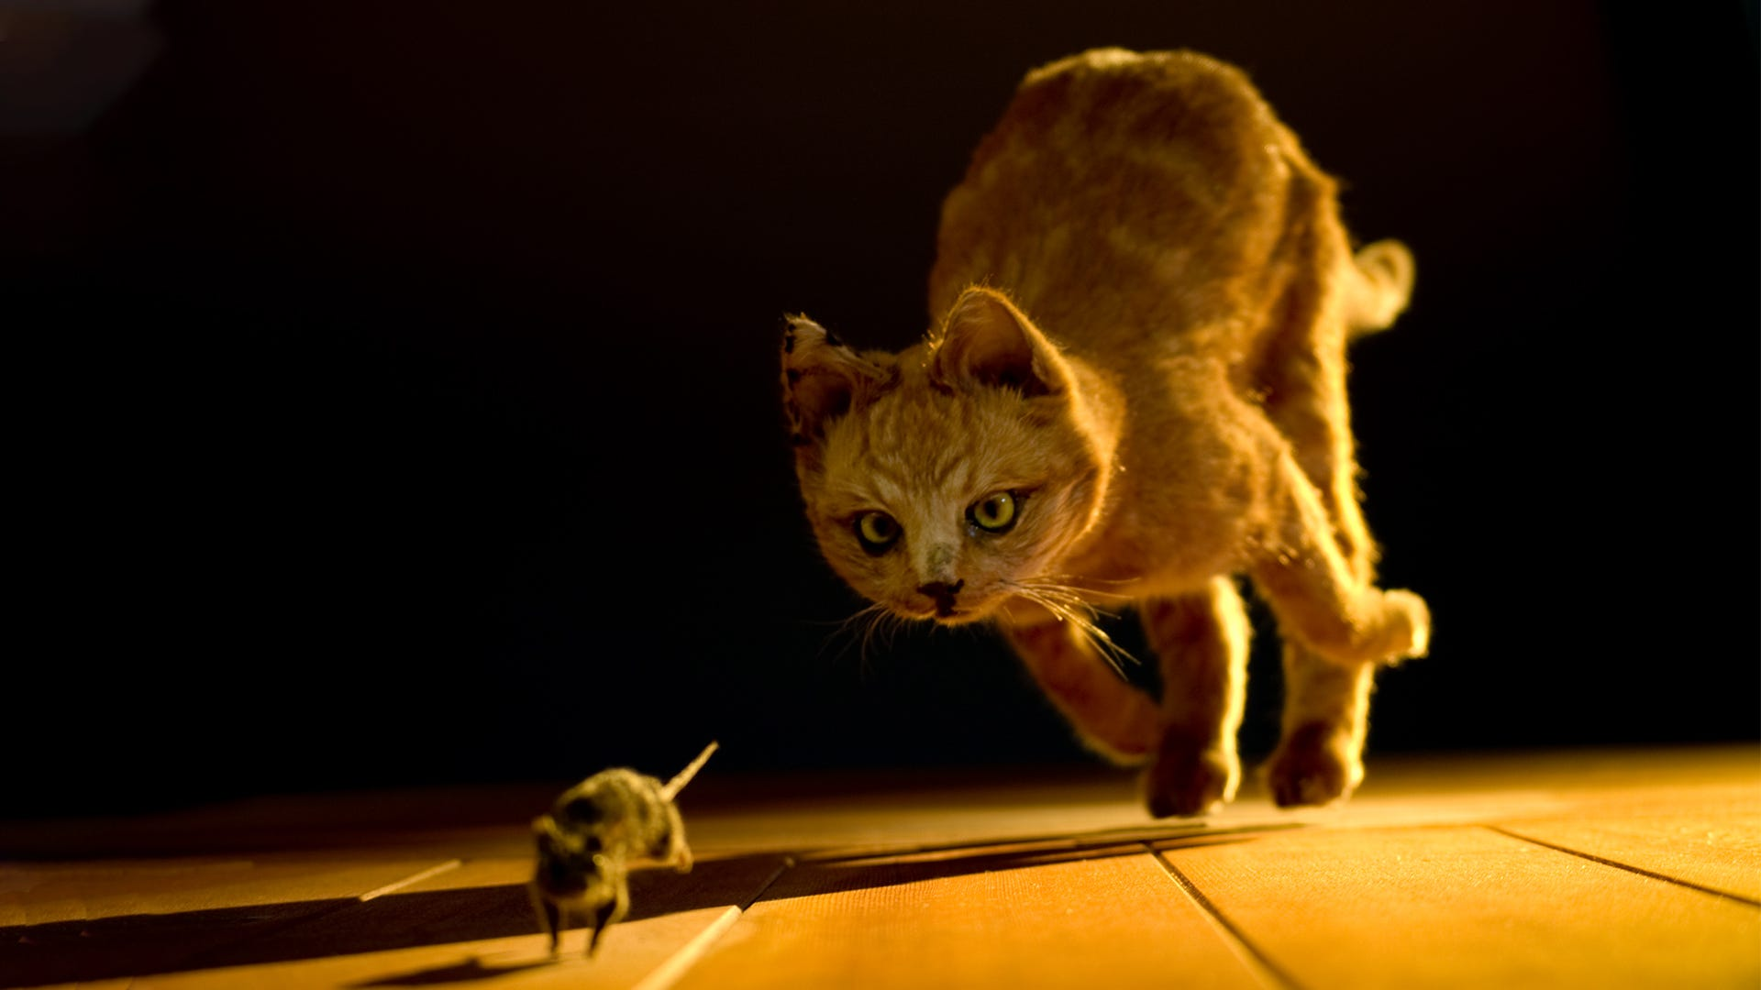
A sentence is written in active voice when the subject of the sentence is performing the action.
Active Voice: The cat was chasing the mouse.
In this sentence, ‘the cat’ is the subject, ‘was chasing’ is the verb and ‘the mouse’ is the object.

Slide 14
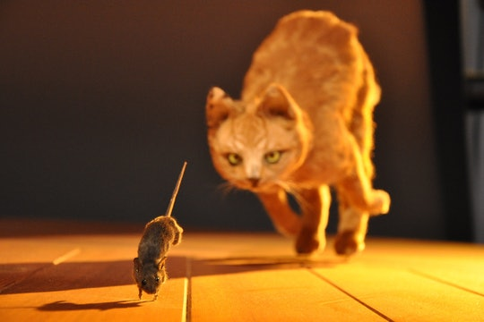
A sentence is written in the passive voice when the subject of the sentence has something done to it by someone or something.
Passive voice: The mouse was being chased by the cat.
In this sentence, ‘the mouse’ has become the subject which is having something done to it by ‘the cat.’

Slide 15
Examples
Active Voice
The pupil read the book.
The whole family ate the meal.
Susan will paint the wall.
I haven’t written the essay yet.
Passive voice
The book was read by the pupil.
The meal was being eaten by the whole family.
The wall will be painted by Susan.
The essay had not yet been written.

Slide 16
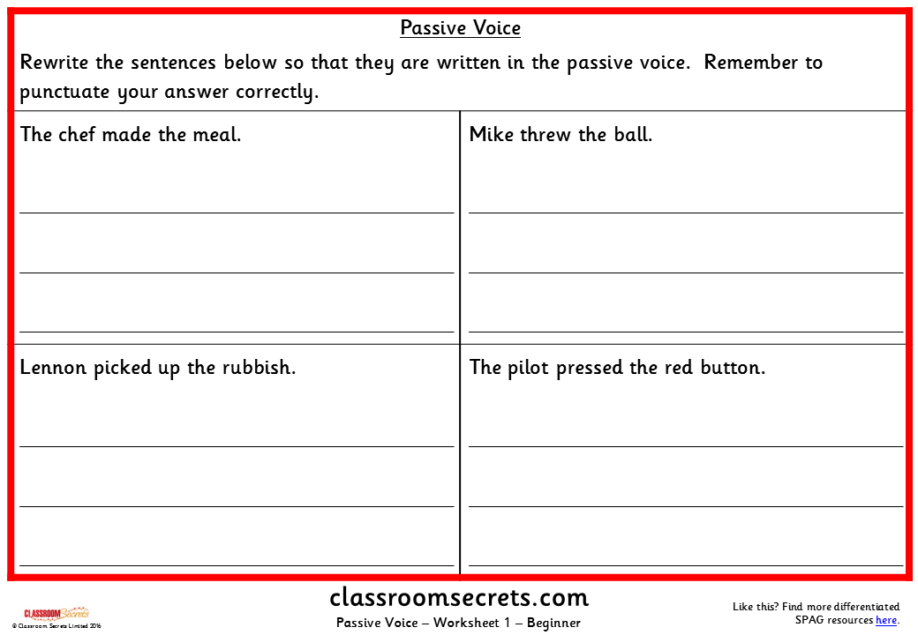

Slide 17
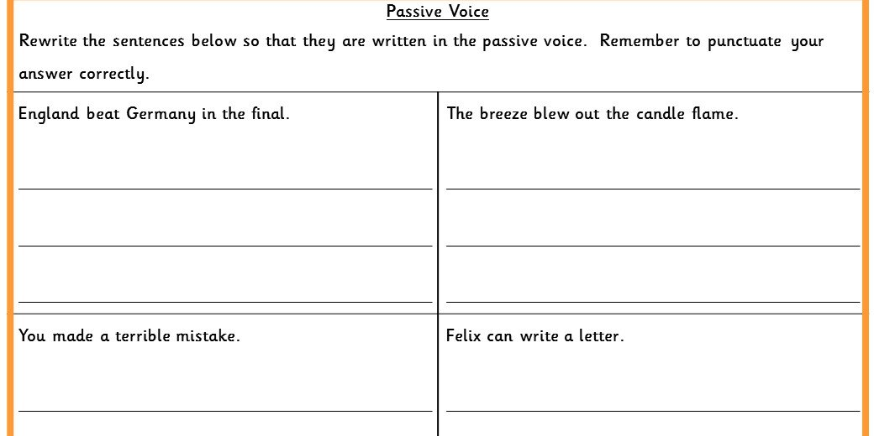

Slide 18
Think of some sentences written in the passive voice which could be used in our letters.
Examples:
  The war was won by the soldiers.
  Countless citizens were destroyed by the bombs.
  Citizens were injured by the gunfire.

Slide 19
Activity 2
Fold your page in half.
On one side, write sentences which are in the past progressive tense.
On the other side, write sentences which are written in the passive voice.
Your sentences should link to your WWII thank you letter.
Red Pen: look at the vocabulary you have used in your sentences. can you improve the vocabulary to make it more powerful or emotive?

Slide 20
Tuesday 7th December 2021
LO: To write with purpose.
To use sentences appropriately.
To punctuate accurately.
C: Persuasive Writing

Slide 21
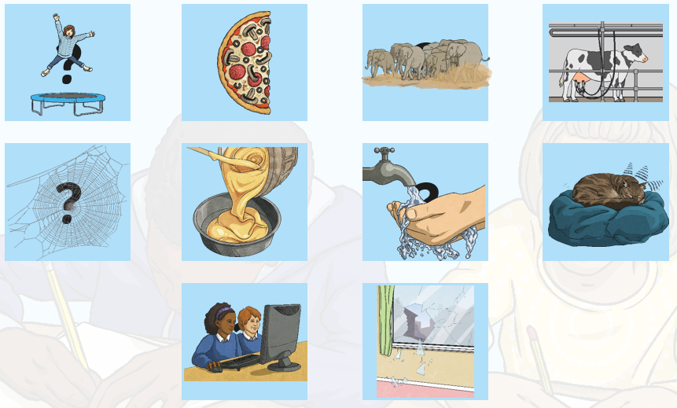
Starter
Write a sentence in the passive voice about the picture(s).

Slide 22

Do you know what this punctuation mark is?
When do we use it?

Slide 23
A colon is a punctuation mark that can be used to introduce a list or to separate two independent but linked clauses.
Colons are used to stress that both clauses in the sentence are closely linked and the second clause emphasises, adds clarification, or adds further detail to the first clause.

Slide 24
Examples
Your child will need many items for their residential trip: a sun hat, trainers, pyjamas and a towel.
Common foods rationed during WWII were: bacon, cheese, milk and flour.
A whale is not a fish: it is a warm-blooded mammal.
All the children agreed: chocolate was the best ice cream flavour.

Slide 25
Think of some sentences which use colons that could be used in your letter.
Examples
  War is not enjoyable: it is a traumatising, deadly experience.
  You have given up so much for your country: your time, your lives and your freedom.
  Everyone in parliament is in agreement: every single one of you is a hero.
Have you used colons in your sentences correctly?
Can you explain why a colon has or hasn’t been used correctly?

Slide 26
Parenthesis
Have you heard of this word before?
Do you know what it means?

Slide 27
https://www.bbc.co.uk/bitesize/topics/zmfc7ty/articles/z7hppg8
Parenthesis is adding extra information to a sentence using brackets, dashes or commas.
Parenthesis adds extra information to a sentence or a paragraph, but the passage should still make sense without it.
Example: James (who was terrified of heights) was taking part in a charity skydive at the weekend.
The sentence still makes sense without the words inside the brackets, it’s just a bit more interesting with the added detail!

Slide 28
Think of some sentences with parenthesis that we could use in our WWII thank you letters.
Examples
  Your bravery (which was admirable) has not gone unnoticed.
  It is thanks to you – and your bravery – that we have triumphed over our enemies.
  The soldiers, who fought fearlessly, risked their lives every single day during the war.
Have you used parenthesis in your sentences?
Can you explain whether parenthesis has or hasn’t been used correctly?

Slide 29
Activity
Fold your page in half again.
On one half, you should write sentences which contain colons.
On the other half, you should write sentences with parenthesis.
These sentences should be linked to your WWII thank you letters.
Red Pen: look at the vocabulary you have used in your sentences. Can you improve the vocabulary to make it more powerful or emotive?

Slide 30
Wednesday 8th December 2021
LO: To write with purpose.
To use sentences appropriately.
To punctuate.
C: Persuasive Writing

Slide 31
What do you notice about these sentences?
That’s the woman who bought my house.
The horse, which Mary was riding, was very friendly and beautiful.
We found the wood where I used to go.
The mother, whose child is missing, is very sad.

Slide 32
Relative Clauses!
A relative clause can be used to give additional information about a noun.
They are introduced by a relative pronoun like 'that', 'which', 'who', 'whose', 'where' and 'when’.
A relative clause does not make a sentence all on its own. Because of this, we call it a 'subordinate clause'. This means that it is dependent on being matched with another phrase to create a sentence and make sense.

Slide 33
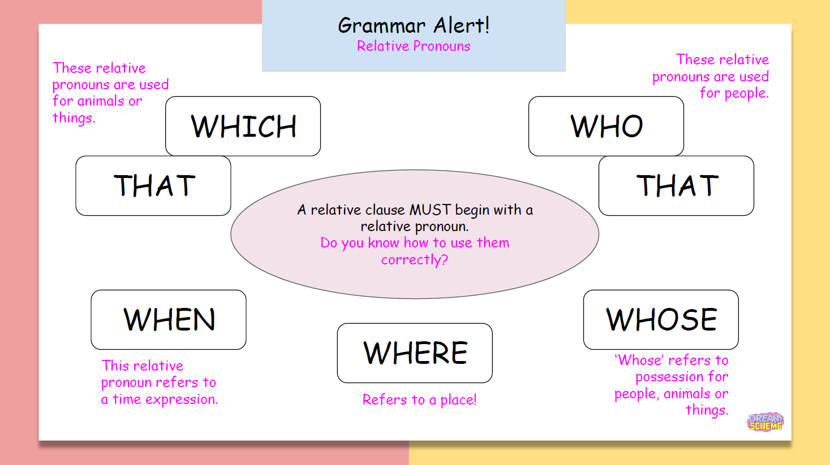

Slide 34

An embedded clause is a clause used in the middle of another clause to give the reader more information about a sentence. Embedded clauses rely on the main clause and don't make sense in isolation.
We separate embedded clauses from the main sentence with punctuation on either side of the clause.
You will need to use a comma BEFORE and AFTER the clause.
My bike, which is very old, is broken.
Jumbo the elephant, who was rather large, couldn’t fit through the doorway.

Slide 35
Think of some sentences with relative pronouns that we could use in our WWII thank you letters.
Examples:
  The soldiers, who have demonstrated incredibly courage and bravery, deserve to be celebrated and remembered for their contributions to the war effort.
  It is thanks to you that the children who were evacuated are now safely home with their parents.
Have you used the correct pronoun?
Have you punctuated any embedded clauses correctly?

Slide 36
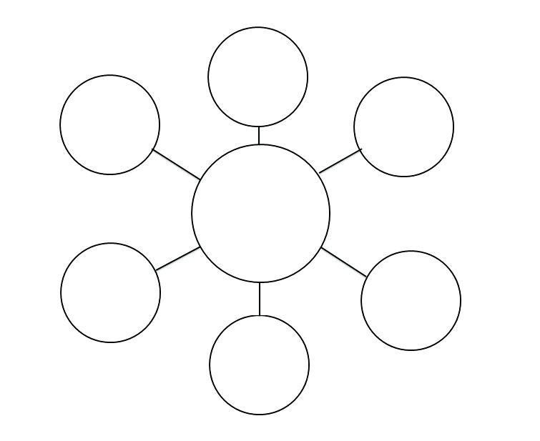
Activity 1
Create a bubble map of sentences with relative clauses which you could use in your letter.

Slide 37

You are going to plan your letter today!
What points will you make in your paragraph?
Why are these points important?
How will you explain or expand on these points?

Slide 39
Activity 2
Complete the planning template for your thank you letter.
Red Pen: consider any sentence starters or powerful vocabulary that you would like to use in your letters. Create a bubble map of your ideas.

Slide 40
Thursday 9th December 2021
LO: To write with purpose.
To organise writing appropriate.
To use sentences appropriately.
To punctuate accurately.
C: Persuasive Writing

Slide 41
For example…
Notice how everything in the paragraph is linked and all of the points are clearly explained!
This is how you should be setting out the paragraphs in your letter.
I realise that this was a huge sacrifice which can never be repaid. You have given so much to your country: your life, your time, your energy and your love. All you have given up is greatly appreciated. I am eternally grateful for your selflessness: you have put others above yourself throughout this testing time.
Undoubtedly, the war was won by the soldiers who were selflessly fighting on the front lines. Countless service men were injured (and tragically, killed) by bombs and gunfire, yet you bravely soldiered on in our fight. I was praying every single day for your safe return, while you were courageously risking your life to protect the lives – and futures – of others.

Slide 42

You will be writing your letters today!
You only have one lesson to write and complete your letter.

Slide 43
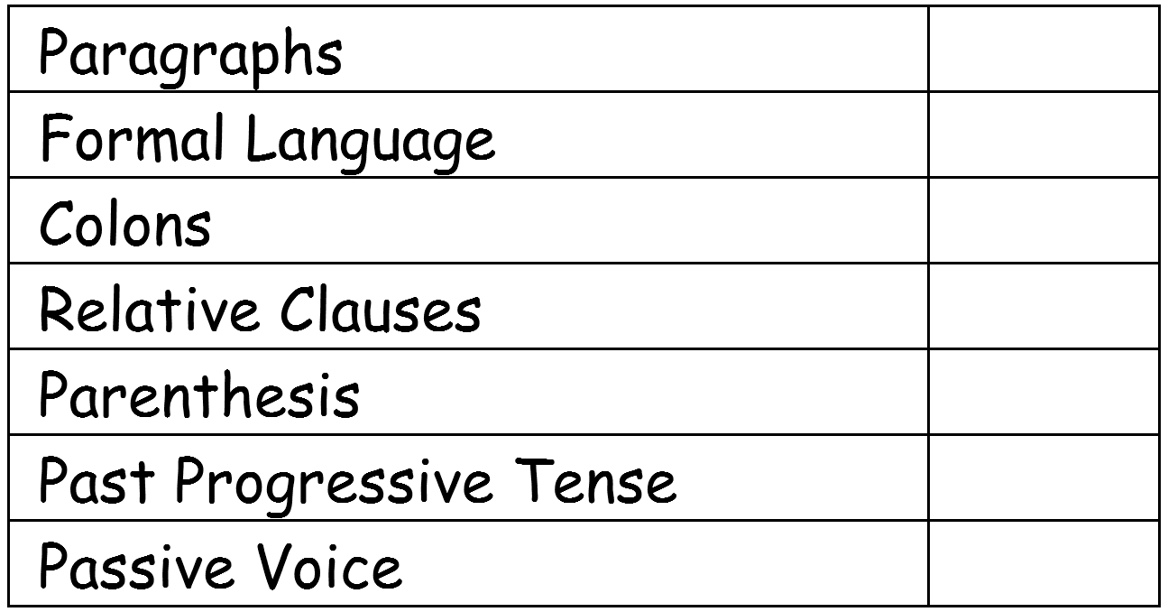
This is what I am looking for in your writing today.
Do you know what all of these features are?
We have explored all of these features in our learning this week! You just have to look back at your work!
Use your learning from the previous lessons in your writing today.

Slide 44
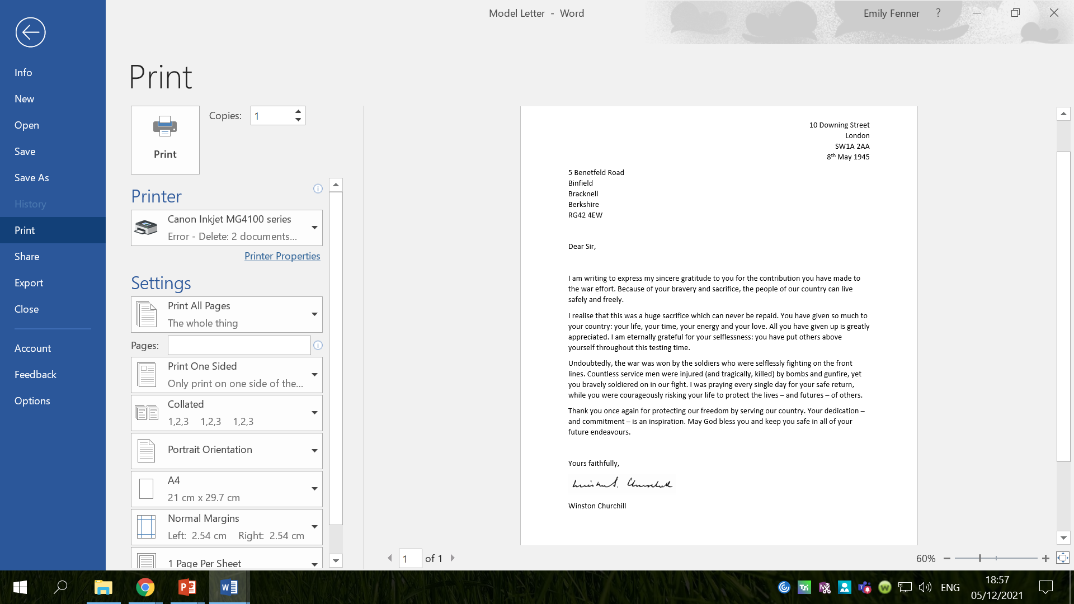
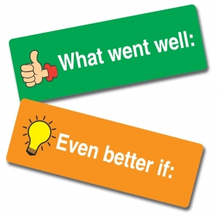
What features can you identify in my model?
Is there anything you would like to magpie?

Slide 45
Activity
Spend some time looking through your plans from last lesson before you begin writing.
Write your WWII thank you letters using the checklist and your work from this week to help you.

Slide 46
Red Pen
Read back over your work. Check that it makes sense.
Have you used the correct punctuation?
Have you used the correct spellings?
Look at the writing checklist – which features have you used?
Which features do you still need to include?
Can you write a sentence or two to tick off any more features from the checklist?
Look back at the vocabulary you have used. Use a thesaurus to improve the vocabulary. Try to make it as powerful and descriptive as possible.

