Slide 1
L.O: To develop ideas.
C: Enhance digital media by editing (including sound, video, animation, still images and installations). .

Slide 2
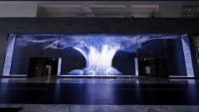
https://www.youtube.com/watch?v=Ij0U3v4nlKc
Digital media art
Let’s remind ourselves what this is.

Slide 3
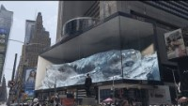
Digital media art
https://www.youtube.com/watch?v=PvOTMXAOyoY

Slide 4
Digital media art
To create digital media art, we will need to use computer software to present our ideas.
We are going to be using a software package called ‘Sumopaint’.
Your task today will be to freely explore this software and discover what you are able to do.

Slide 5
Digital media art
You should be experimenting with the following tools, that you will use in your next lesson to alter a digital image:
Change brush Change gradient fill
Symmetry tool Add layers
Rotate Free transform / Rotate tool
Change colours / sizes / opacity etc.
https://sumo.app/paint/en

