Slide 1
LO: To understand beliefs and teachings.
To understand how beliefs are conveyed.
C: Christianity – Eternality

Slide 2

Starter
Does anything last forever?
What did we think last lesson?

Slide 3

Does love last forever?
Can you explain and justify your thoughts?

Slide 4
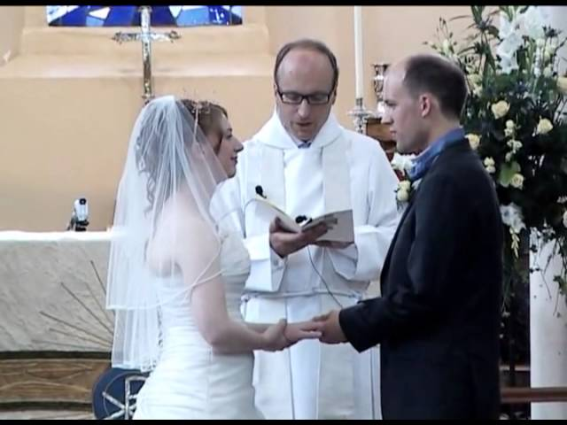
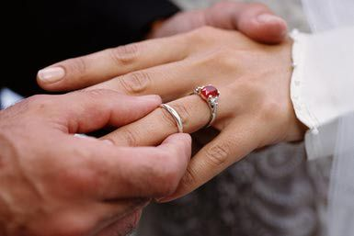
https://www.truetube.co.uk/film/christian-marriage (from 4:05 - 5:10)
Listen carefully to the vows and promises that are made.
Look carefully as the rings are exchanged.

Slide 5
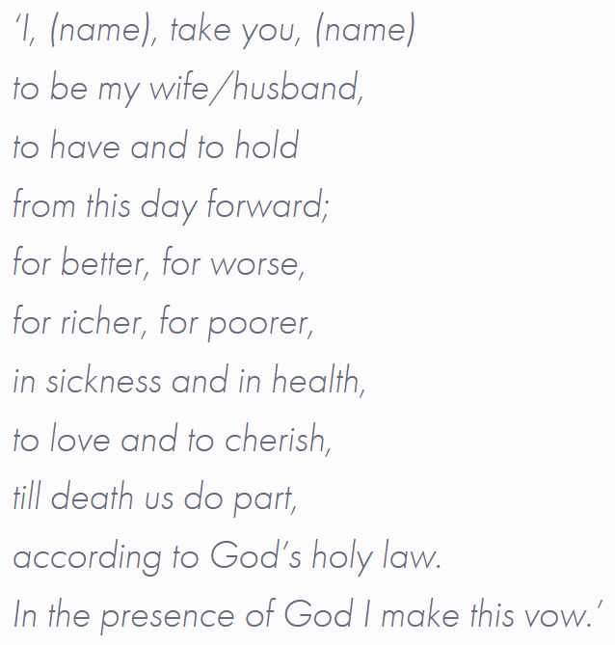
https://www.yourchurchwedding.org/article/wedding-vows/
What do they promise each other?
To love each other for their whole lifetime.
How does the ring symbolise eternity?

Slide 6
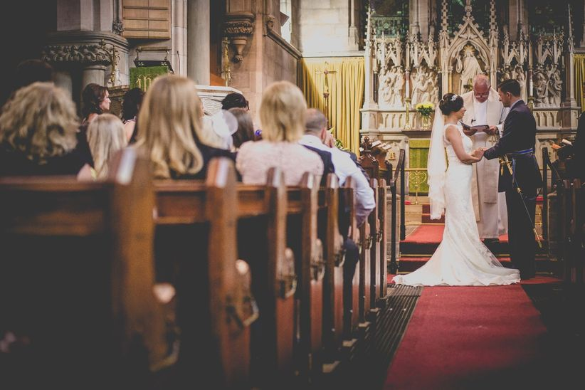
The marriage vows are spoken before God and in front of family and friends.
Many Christians choose to get married in a church before God, because they believe by making these promises in church, they are inviting God to help them keep them.

Slide 7
Do you think the marriage between a couple can last forever?
Try to explain and justify your thoughts.

Slide 8
Is anything ever eternal?
Can love last forever?
What are your responses to these questions now?
What might a Christian response be?
What do Christians believe about love?

Slide 9
Activity
Paddling | Snorkelling | Diving
Write a short paragraph outlining Christian beliefs about love. Make reference to the promises made at a Christian wedding and the symbols used in a wedding, e.g. the rings. | Can love last forever? Write a paragraph explaining how Christians would answer this question. You should outline Christian beliefs about love and refer to the promises made at a Christian wedding and the symbols used in a wedding, e.g. the rings. Write a second paragraph explaining your answer to the question; your own personal thoughts and responses. Try to consider reasons for and against. | Can love last forever? Write a paragraph explaining how Christians would answer this question. You should outline Christian beliefs about love and refer to the promises made at a Christian wedding and the symbols used in a wedding, e.g. the rings. Write a second paragraph explaining your answer to the question; your own personal thoughts and responses. Consider reasons both for and against.

Slide 10
Red Pen
Paddling Red Pen: Can love last forever? Explain your thinking.
Snorkelling/Diving Red Pen: Can love last forever even if you aren’t married? Explain your reasoning.

Slide 11

Plenary
What other love exists?
e.g. love between a parent and child.
What does ‘unconditional’ mean?
Not having conditions or limits; unlimited or absolute.
Can love be unconditional? Why? Give some examples.

