Slide 1
Hook lesson – Decimals

Slide 2
Key vocabulary
Decimal place
Thousandth
Remainder
Partitioning
Recurring decimal
Tenth
Rounding to decimal place
Equal to
Equivalent fraction
Decimal point
Hundredth
Exchanging
Sharing
Decimal fraction

Slide 3
During the next few weeks we will be learning about using decimal numbers
What is a decimal number?
When will we use decimal numbers in everyday life?
What rules or strategies do you know relating to decimal numbers?
What resources can we use to help us?

Slide 4
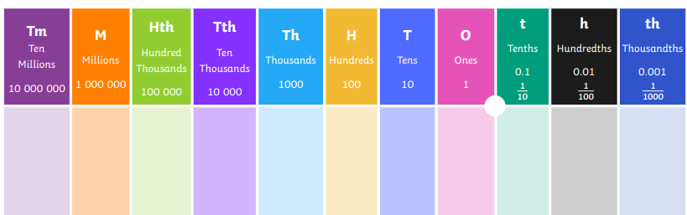
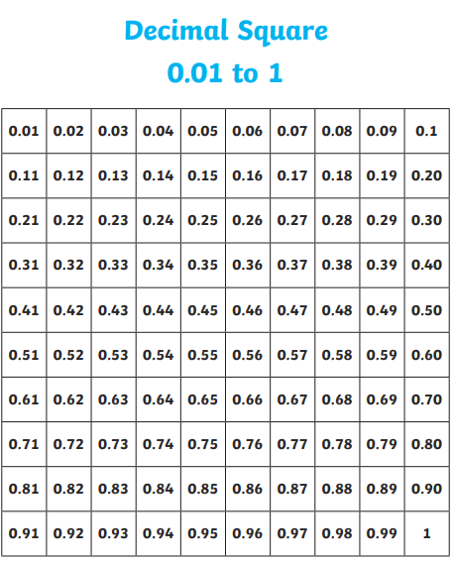
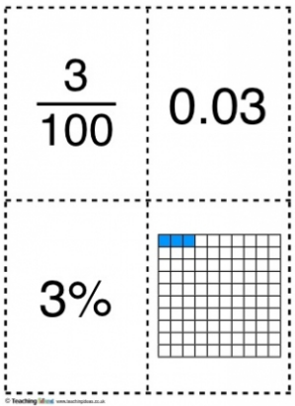
We could use some of these resources to help us.

Slide 5
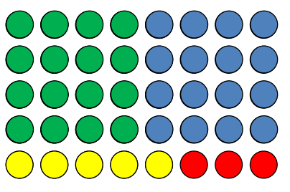
What decimal calculations can you see here?

Slide 6
Your activity
You will be given some challenges to complete – work in groups and discuss different approaches. One task is to compete against each other in a decimal-based spinner game; play in teams or face each other one-to-one. Another task is to create a triangle shape from a decimal puzzle, matching the correct sides of a variety of triangles.

Slide 7
Plenary
Write down a fact that you have learnt about decimals.
Tell your partner something you need to remember from today’s lesson. Ask your partner what they need to remember.

