Slide 1

13.1.2021
L.O: Multiplication and Division
C: Arrays.

Slide 3
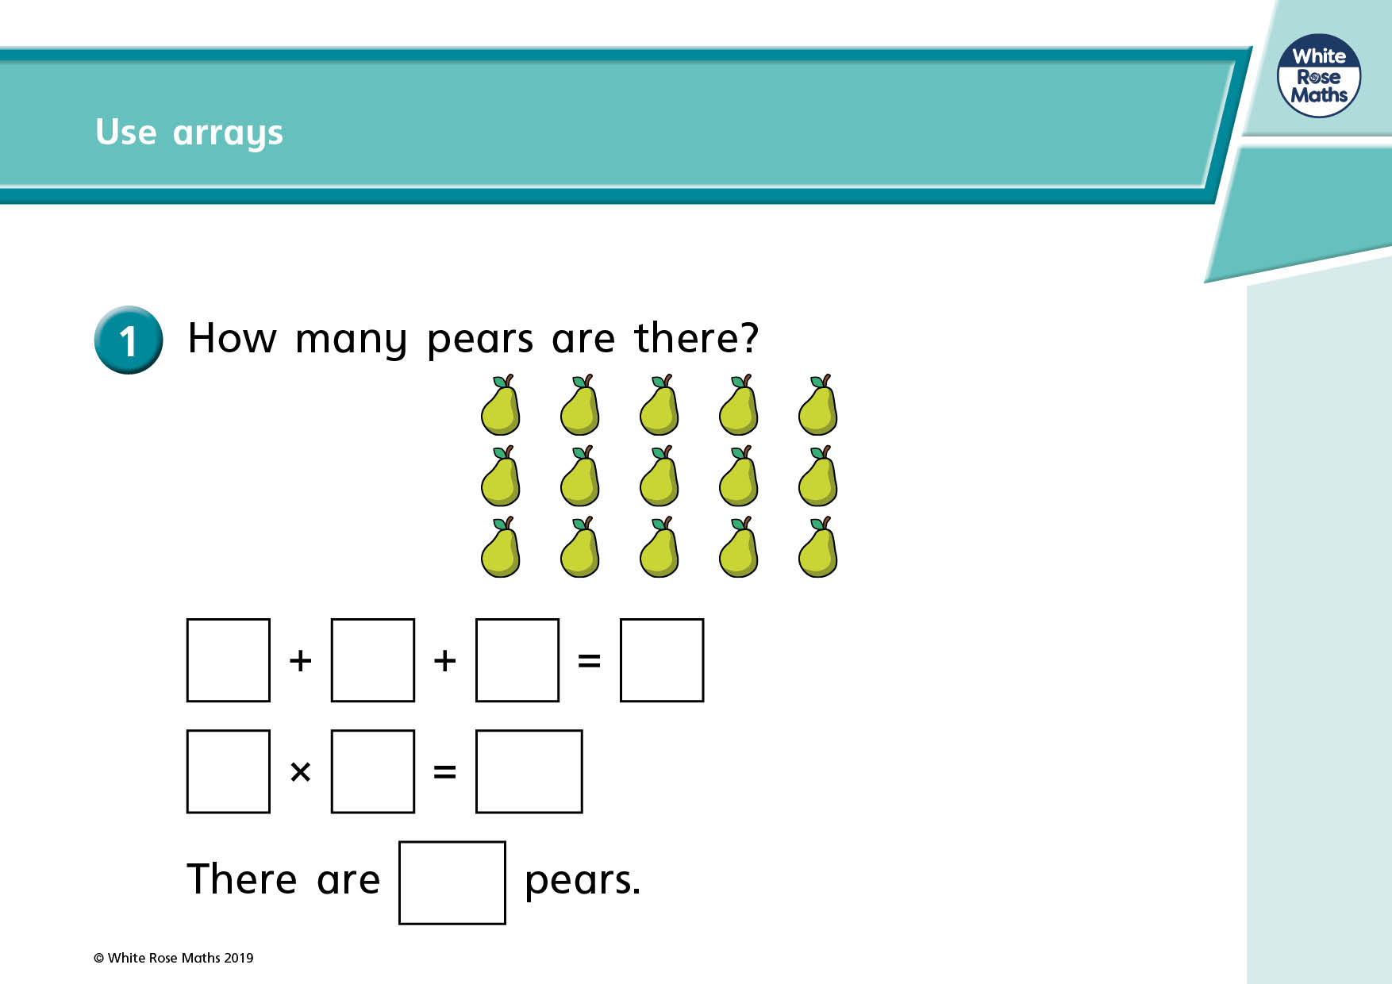

Slide 4
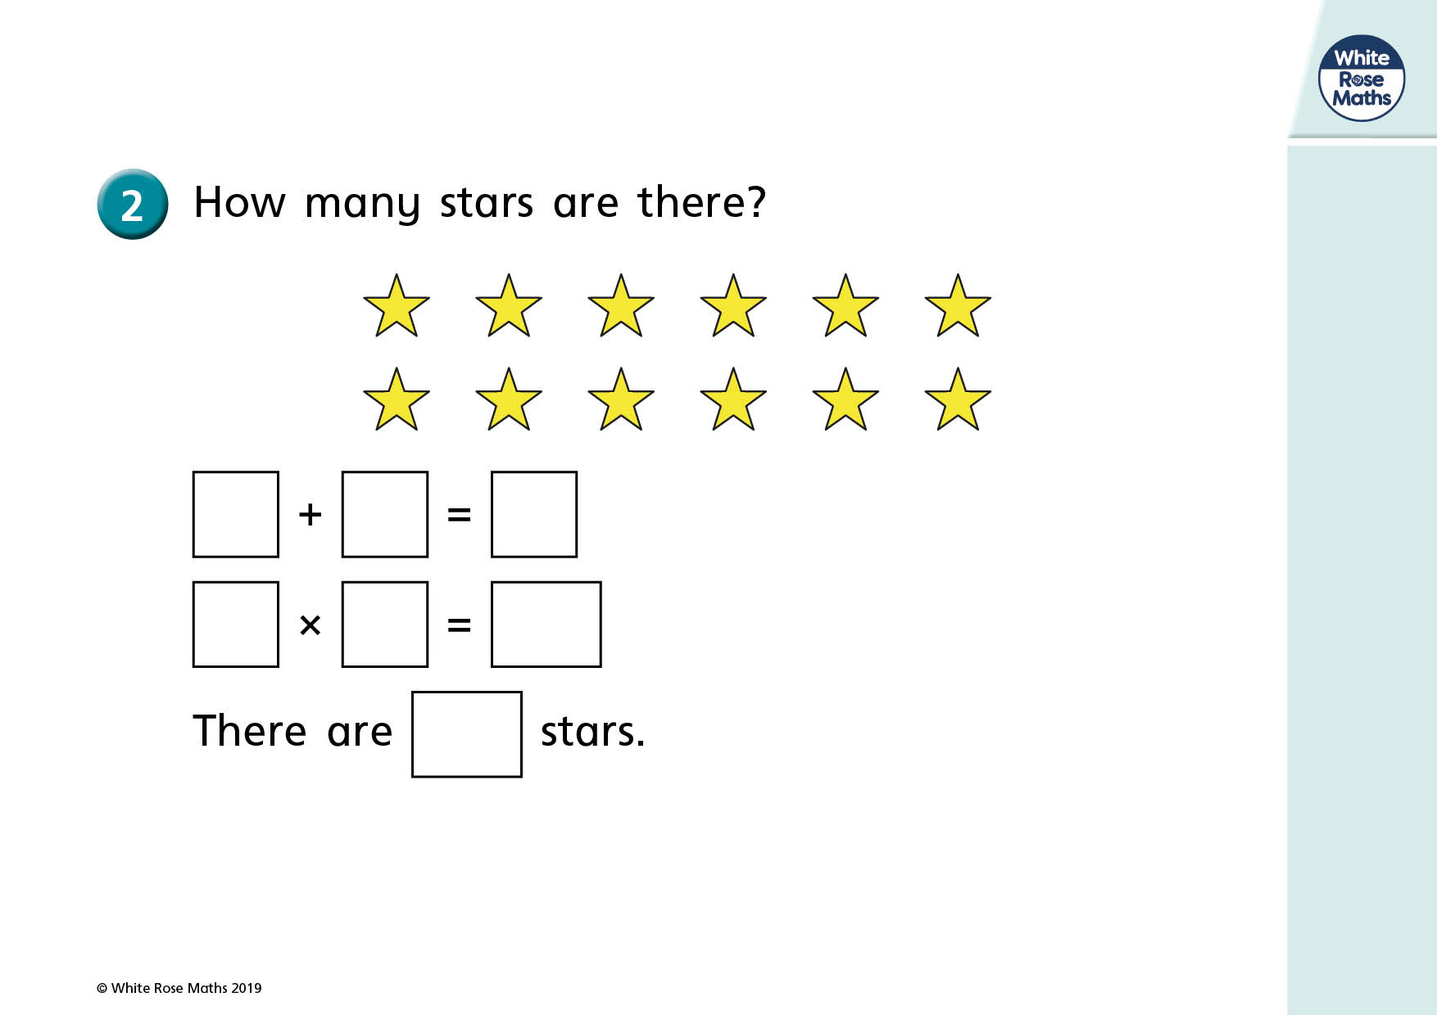

Slide 6

What is an array?

Slide 7
What is an array?
An array is a way of showing our times tables!
They use rows and columns to make them really clear!

Slide 8
We are going to watch an array song!
Pay super close attention because I am going to challenge you to make your own arrays soon!
https://www.youtube.com/watch?v=IYkKJDUn41o

Slide 9
We are going to watch an array song!
Let’s work with the Numberblocks to make the arrays in the song!
https://www.youtube.com/watch?v=IYkKJDUn41o
If you are at home: Try drawing the arrays or making them with play doh or lego!

Slide 10
Now it’s your turn!
Paddlers:
Complete the matching game with help if you need it
Snorkellers:
Complete the matching game on your own
Divers:
Complete the matching game on your own + Red Pen Question

Slide 11

Let’s Play One Last Mystery Game!
Watch video on class pages!

