Slide 1


Women in History
LO: To build an overview of world history
C: To describe the social, ethnic, cultural or religious diversity of past society

Slide 2

Different eras
The lives of women were very different in different eras.
Using the knowledge you have gained, tell your partner an era in which you would like to have been a woman, and an era in which you would not like to have been a woman.
We have become experts in the lives
of women in various eras.
We will look at a couple of eras to
remind ourselves of some things we
may have learned.

Slide 3
Different eras
The Victorian era spanned the years 1837 - 1901.
Tell me what you know about the lives of women in this time period.
A Victorian lady wants to tell you about her life: https://www.youtube.com/watch?v=e4FZkXvAY94
Let’s look at some evidence from this era.

Slide 4
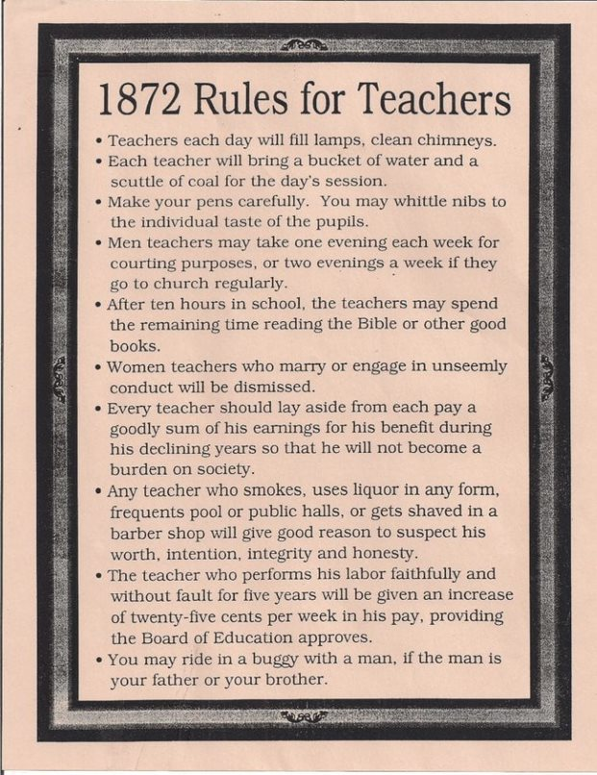
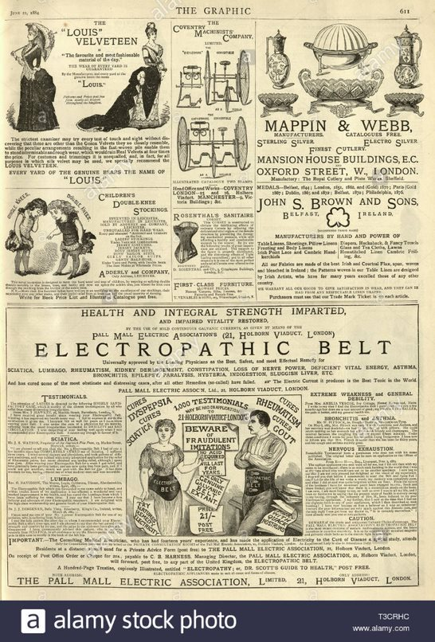

Slide 5
Different eras
The Tudor era spanned the years 1485-1603.
Let’s look at some facts from this era.

Slide 6
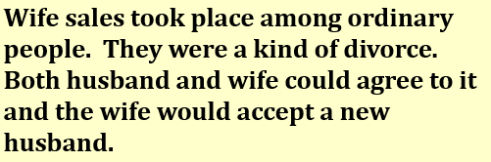

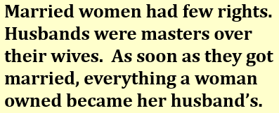
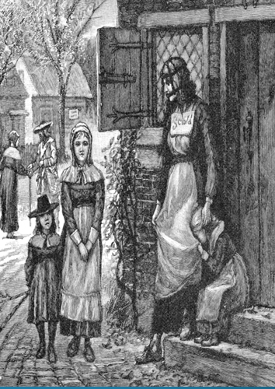
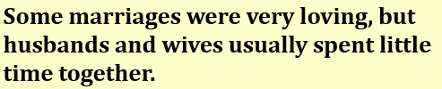
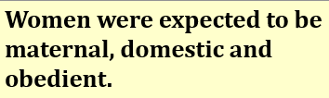
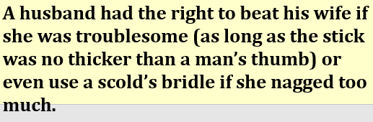


Slide 7
Activity
Your task is to answer a question on which era you would prefer to live in and why.
Look at the ‘would you prefer’ worksheet, decide which era you would like to compare and answer the question, giving evidence for your opinion.
You should add in details relevant to each era, comparing them to explain your decision. For example: Modern day women are allowed to vote, whereas only men were allowed in the Victorian times.

