Slide 1
L.O: To develop ideas.
C: Editing digital pictures.

Slide 2
Last lesson we looked at editing software that can be used to edit digital pictures.
Today, continue editing your digital image, or upload a new picture of Macbeth and use the tools you have been investigating to create a new image​.
Continue for a reminder of how to do this.
​
https://sumo.app/paint/en ​

Slide 3
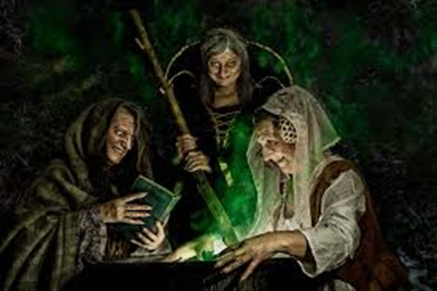
Search google for an image of Macbeth.
Right-click on the image and choose
‘Copy image address’.
Hover over the ‘Layer’ tab at the top of your screen, scroll down to ‘Import to layer’, then click on ‘From URL’.
When this opens, right-click and select ‘Paste as plain text’ and click ‘Open’.
Your image will appear in the app. Drag it around and adjust it until you are happy with its position, then click ‘Apply transform’ on the top-left of your screen. This image is now fixed into your layer.

Slide 4
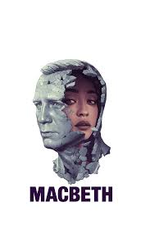
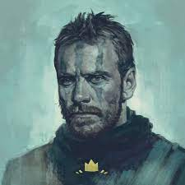
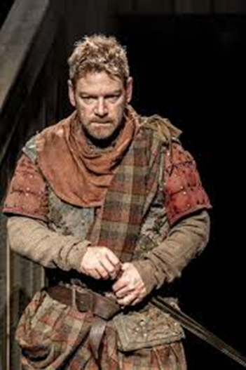

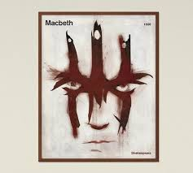
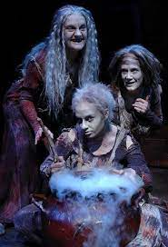
Use the skills you have learned to create your own artwork. Your interpretation does not have to look like the original picture or, indeed, be recognisable at all – it is an abstract interpretation. However, you might want to use what you know about the play to add to the picture (use blood / colours / madness / witches etc…).

Slide 5

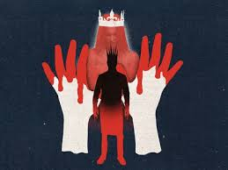
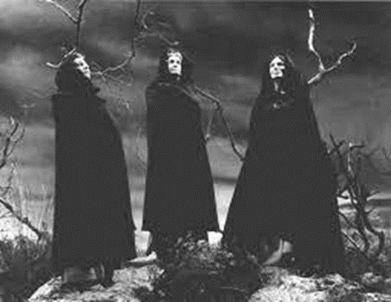
Save the image you have created on your laptop and
email it to your teacher using your Microsoft 365 account.
Click ‘Save’, then save as ‘JPEG’. Name your file and save
it. Your image will then download. Open it and save it
into the laptop’s ‘Document’ folder. Email to your teacher.

