Slide 1
LO: To be able to introduce family members in French.
https://translate.google.com/?sl=fr&tl=en&text=Tu%20est%20des%20fr%C3%A8res%20et%20de%20soeurs&op=translate

Slide 2
Let's practise and warm up with a song.
https://www.youtube.com/watch?v=q6mJ0TPGf64

Slide 3
Let’s listen to some songs about family!
https://www.youtube.com/watch?v=MFk9YmJv-jc
https://www.youtube.com/watch?v=kLMdxx4UiZM

Slide 4
What is Sarah saying?
Say it to your partner.
Bonjour. Je m’appelle Sarah. Je te presénte ma mère et mon père.

Slide 5
What does soeur mean?
What does frere mean? Say it to your partner.
Je te presénte mon frère et ma soeur.
J’ai une soeur et un frère.

Slide 6
What does this mean?
Say it to your partner.
Je te présente ma grand-mère et mon grand-père.

Slide 7
What does oncle mean?
What does tante mean? Say it to your partner.
Je te présente mon oncle et ma tante.

Slide 8
Match the French word with the English word
Ma mère
Ma soeur.
Ma grand-mère
Ma tante
Mon père.
Mon frère.
Mon grand-père
Mon oncle
My aunt
My dad
My mum
My grand-mother
My brother
My uncle
My grandfather
My sister

Slide 9
The more French you speak, the easier it becomes? https://www.youtube.com/watch?v=fZUUsIlYYeQ

Slide 10
Task:
In groups of 4, rehearse introducing different family members.
Try to change who you introduce each time.
EXTENTION:
If you feeling really clever why not try telling the other person their name.
For example:
Je te présente ma tante. Elle s’appelle Sandra.
Je te présente mon père. Il s’appelle Robert.

Slide 11
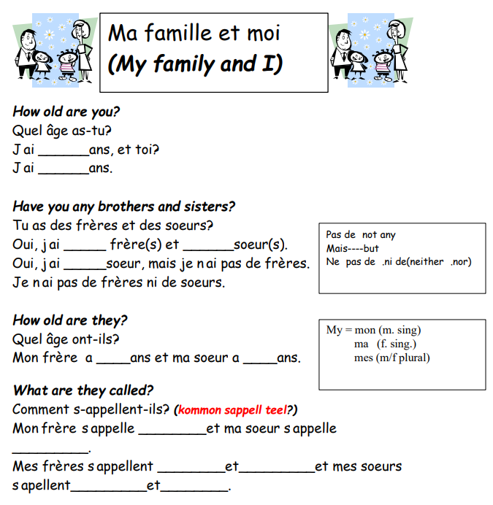
Task:
Complete worksheets about your own family.

