Slide 1

LO: To learn about the discrimination experienced by black people and how they overcame this adversity.
C: Discrimination and perseverance in politics

Slide 2
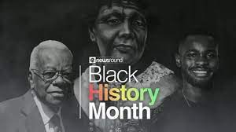
This month is ‘Black History Month’.
Discuss with your partner:
What is ‘Black History Month’?
Who we celebrate and why?
Black History Month is an annual observance that commemorates the history and achievements of members of the black community.
It is an opportunity to celebrate the outstanding contributions that black people have made to society, whether that be today or historically.

Slide 3
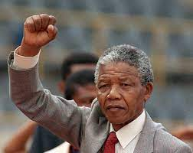
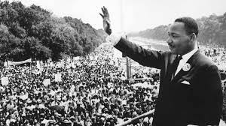
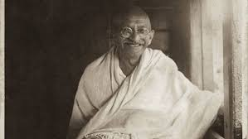
Have you ever heard of Nelson Mandela, Martin Luther King or Mohandas Gandhi?
Tell your partner anything you know about these famous people.

Slide 4
At the time that Nelson Mandela was growing up, there was a huge racial divide in the country. White people ran the country, and they generally led privileged lives.
Most black people, however, worked in low-paid jobs, and lived in poor communities with poor facilities. They had far fewer rights, too – they weren’t even allowed to vote in elections!
Nelson Mandela felt that everyone deserved to be treated the same, regardless of their skin colour. He joined a political group that strived for equal rights for whites and blacks - this group was involved in some bombings of government targets.
In 1948 the South African government introduced a system new of racist laws, black people and white people were forced to lead separate lives. They weren’t allowed to live in the same areas, attend the same schools or even sit together on a train or bus!
Due to Nelson Mandela’s political actions, he was imprisoned for 27 years. Upon his release he became president of South Africa and forgave his former enemies, seeking to reconcile all the people of his country.
Discuss with your partner:
What would you have done in Nelson Mandela’s position? Would you be able to forgive people who had oppressed you?
Watch this video about Nelson Mandela https://www.bbc.co.uk/newsround/25263229

Slide 5
Time for a class debate!
One half of the class will argue on behalf of the government – why would you want to imprison Mandela? What did he do wrong? Did he break laws?
The other half of the class will argue on behalf of Nelson Mandela – was the system he was living under fair? Did he have a right to break laws?

Slide 6
Let’s look at the life of Mahatma Gandhi https://www.bbc.co.uk/bitesize/topics/zjkj382/articles/z4fwy9q
Gandhi led the fight for Indian independence from the British Empire. He organized several non-violent civil disobedience campaigns. During these campaigns, large groups of the Indian population would do things like refusing to work, sitting in the streets and boycotting the courts. Each of these protests may seem small by themselves, but when most of the population does them at once, they can have an enormous impact.
Gandhi was put in prison several times for organizing these protests. He would often fast (not eat) while he was in prison. The British government would eventually have to release him because the Indian people had grown to love Gandhi. The British were scared what would happen if they let him die. One of Gandhi's most successful protests was called the Salt March. When Britain put a tax on salt, Gandhi decided to walk 241 miles to the sea in Dandi to make his own salt. Thousands of Indians joined him in his march.
Discuss with your partner:
What would you have done in Mahatma Gandhi’s position? Would being imprisoned have changed
your actions?

Slide 7
Time for a class debate!
One half of the class will argue on behalf of the British rulers – why would you want to imprison Gandhi? What did he do wrong? Did he break laws?
The other half of the class will argue on behalf of Gandhi– was the system he was living under fair? Did he have a right to break laws? Did the British have the right to rule his country?

Slide 8
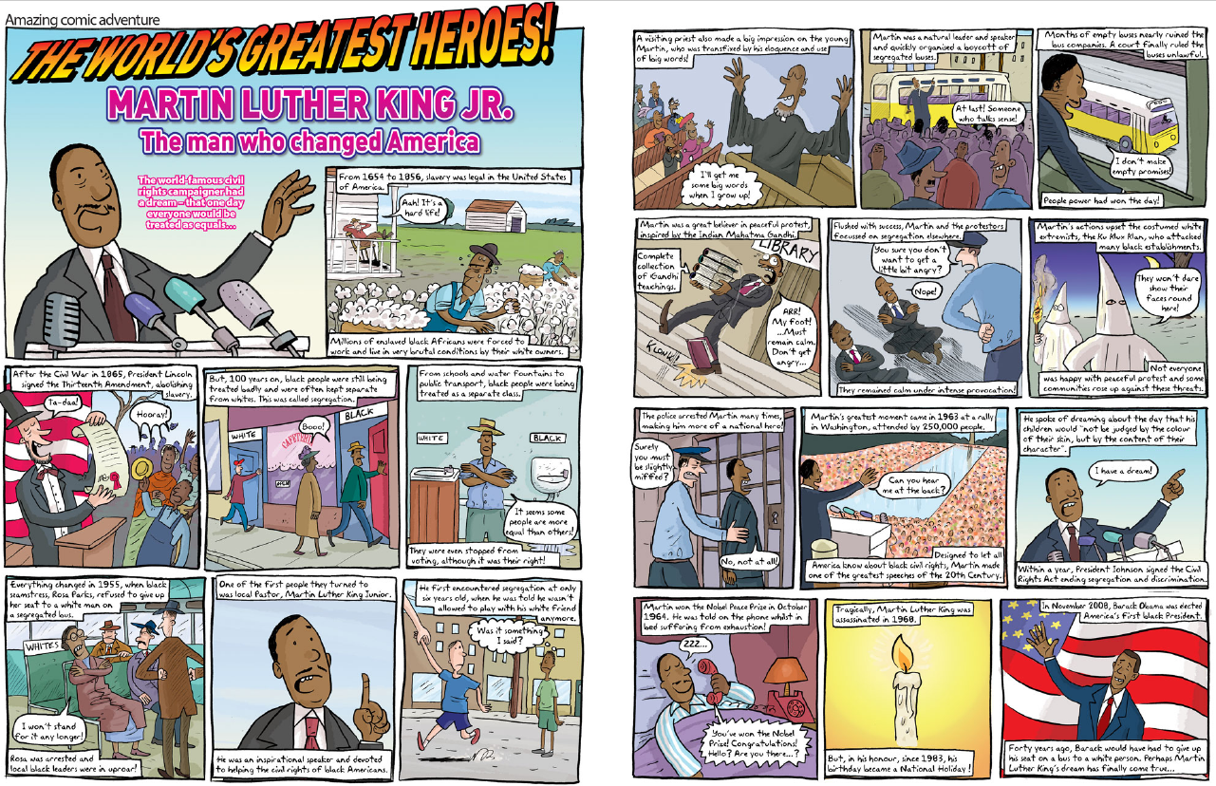
Let’s look at the life of Martin Luther King https://www.bbc.co.uk/teach/school-radio/assemblies-ks2-martin-luther-king-mlk-dream-on-black-history-month/zwtxwnb
Read the comic book about Martin Luther King and discuss with your partner:
What would you have done in Martin Luther King’s position? Could you have called for peace when your people were being treated as a lesser people?

Slide 9
Time for a class debate!
One half of the class will argue on behalf of the American government – why would you want to arrest Martin Luther King? What did he do wrong? Did he cause trouble?
The other half of the class will argue on behalf of Martin Luther King– was the system he was living under fair? Was he doing anything wrong? Did he call for violence against anybody?

Slide 10
Activity
Paddlers: choose one of the activists we have discussed and write a paragraph telling me what you know about them.
Snorkellers: choose two of the activists we have discussed and write a paragraph about their life and their achievements.
Divers: write a paragraph about each of the activists, explaining what they did and how they changed the lives of black people.
Red Pen: explain how the actions of a chosen activist could have affected the lives of people outside
of their own country.

