Slide 1
LO: To understand evolution and inheritance
To work scientifically
C: Evolution

Slide 2
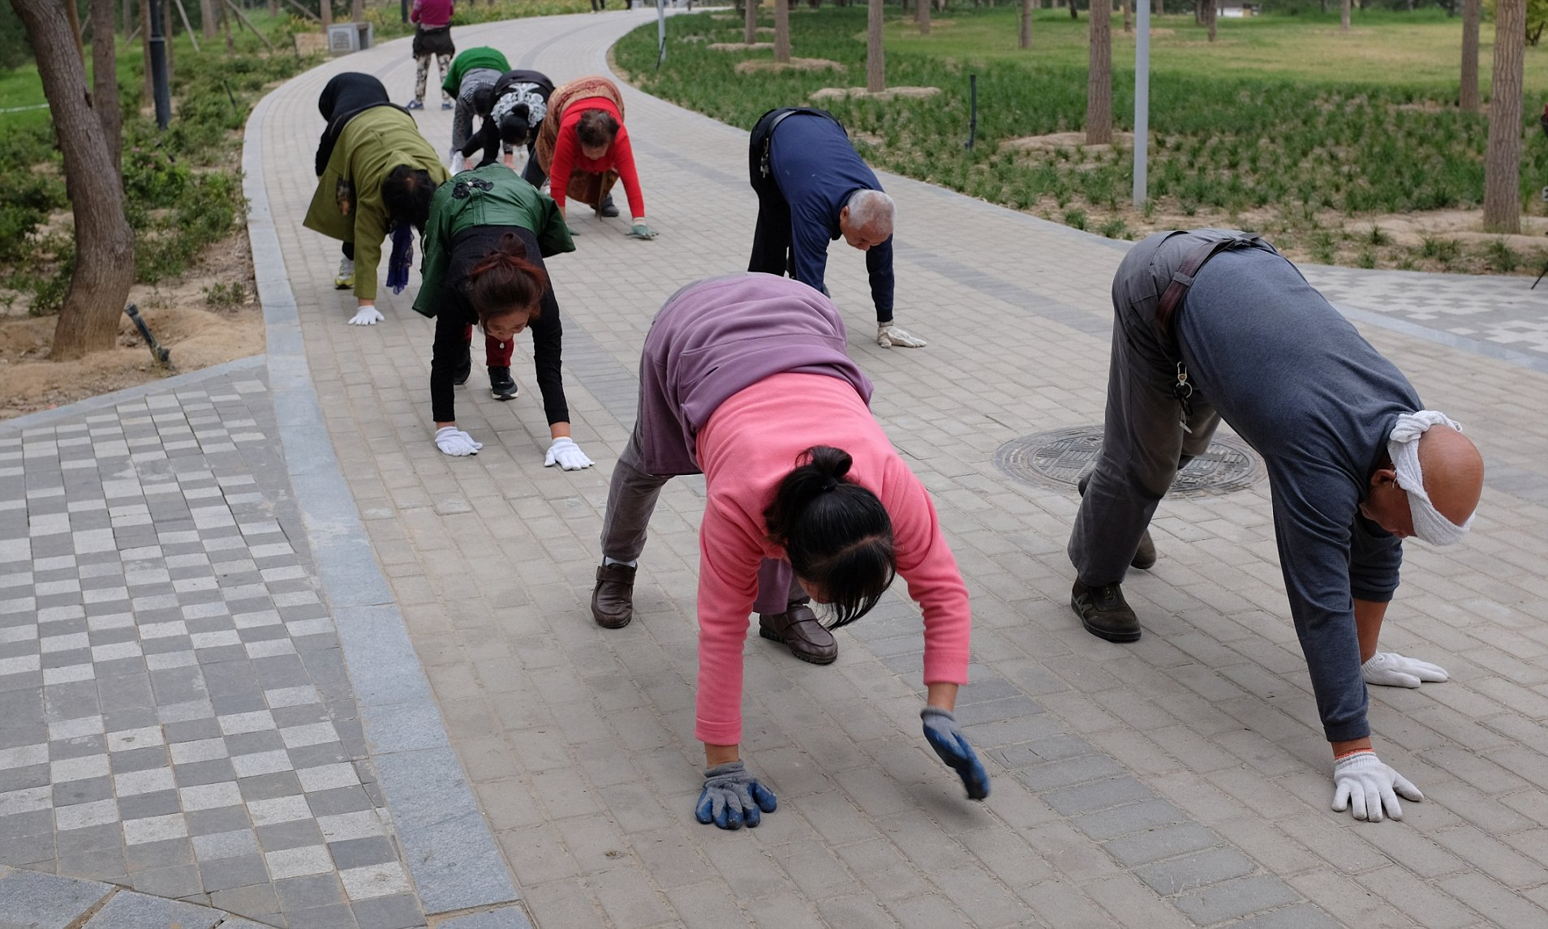
Starter
Can you walk around on all fours?
Before humans evolved, early common ancestors with other mammals walked on all fours.
The fossil record tells us that early humans ‘evolved’ to walk on two legs.

Slide 3

Starter
What are some of the advantages and disadvantages that this evolution might have given early humans?

Slide 4
Starter
Advantages
Disadvantages
Ability to pick food from low branches
Freeing hands to carry food
Hold tools
Carry babies
Enabling early humans to appear larger and more intimidating
See predators more easily
Helping early humans to move over wide, open landscapes quickly and efficiently.
Back pain and other skeletal problems
Less ability to climb steep slopes or trees
More easily seen by predators

Slide 5

Starter
Are there more advantages or disadvantages?
The advantages outweigh the disadvantages, so, although there are still some disadvantages, in terms of survival, the advantages outweigh them!

Slide 6
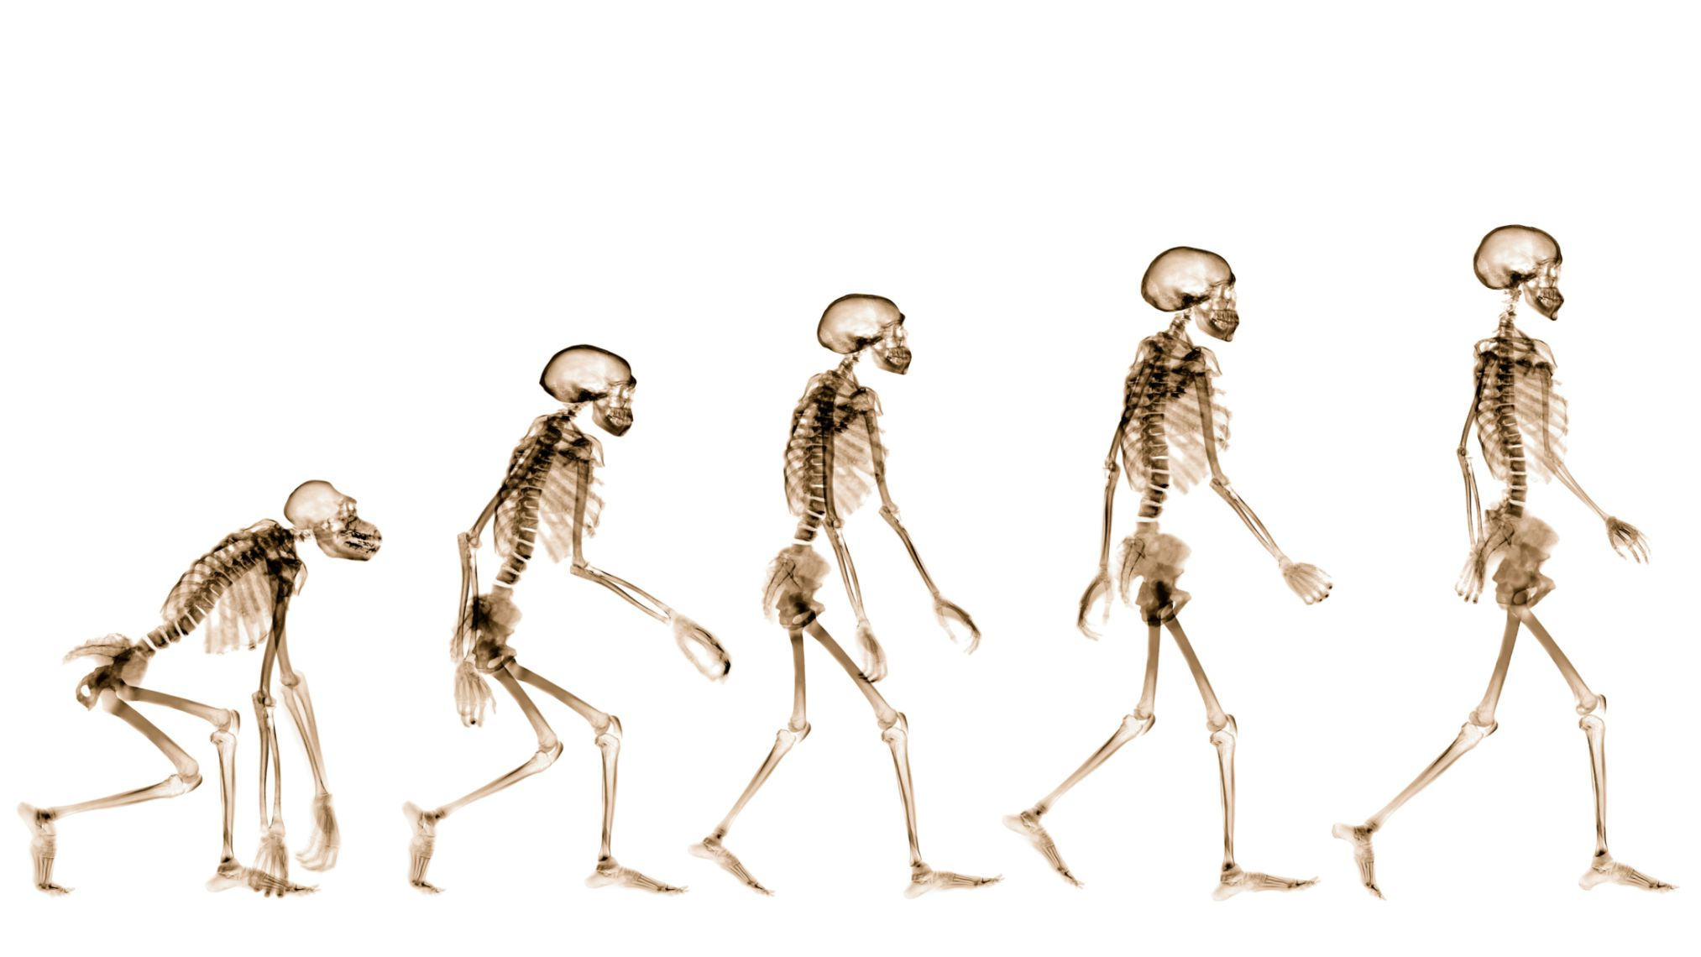
Starter
Bipedalism is a unique evolution in terms of the great apes and contributed to helping humans to survive in a diverse range of environments.
As ‘great apes,’ we are related to other primates (the chimpanzee is our closest living relative with around 97% identical DNA), we did NOT evolve from them – we share a common ancestor from about 14 million years ago.

Slide 7
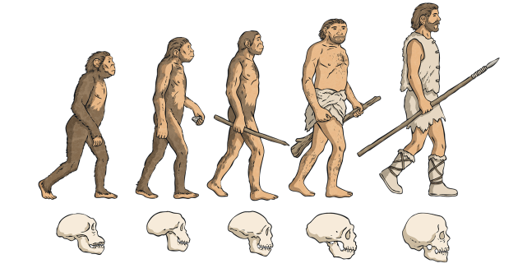
Evolution is not a straightforward, linear process.
Many species become extinct along the way, often being simply ‘related’ rather than direct ancestors.

Slide 8
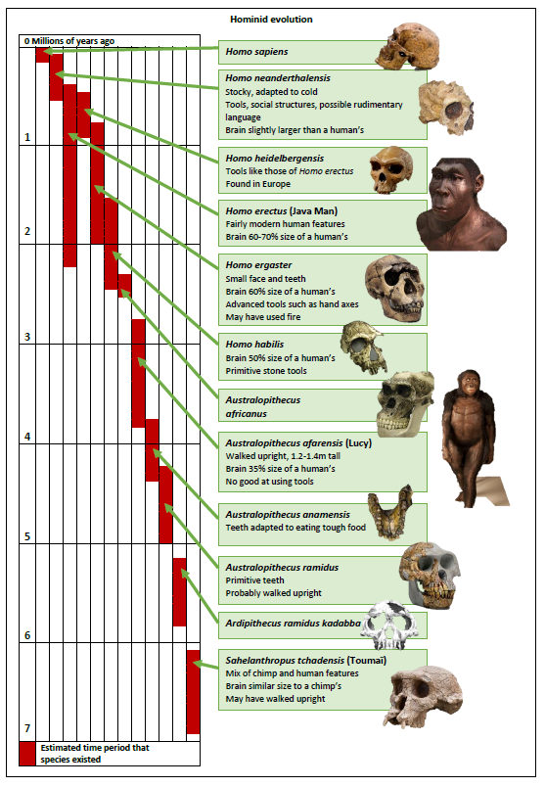

Slide 9
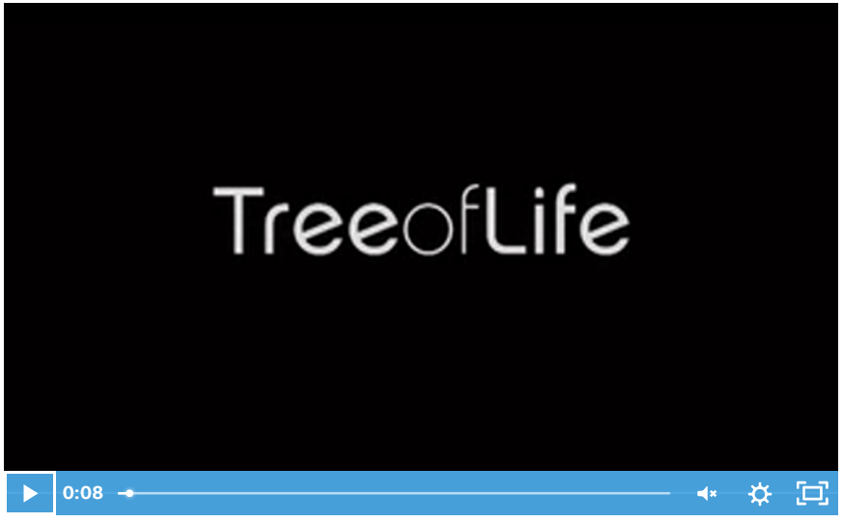
https://www.stem.org.uk/elibrary/resource/30498

Slide 10
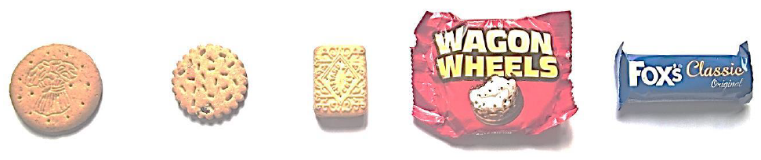
Look at the images of biscuits below.
Can you order them by complexity?
E.g. simple digestives to biscuits with an added ingredient, then maybe layers and eventually layers AND chocolate coated.

Slide 11
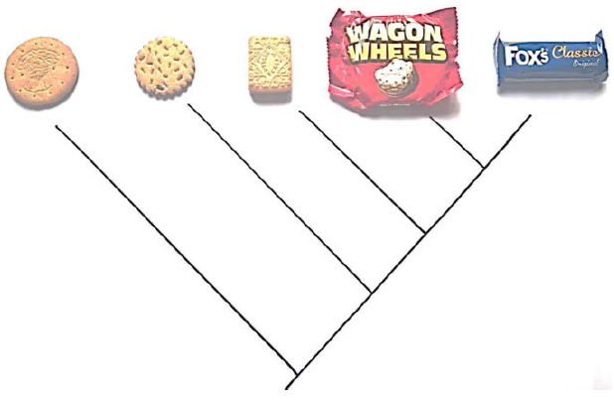
We can create an evolutionary tree for the biscuits.
We can lay out the biscuits and draw a ‘V’ between the most complex (and closely related) biscuits and drawing relative links between all biscuits, identifying ‘common ancestors’ and features that ‘evolved.’

Slide 12
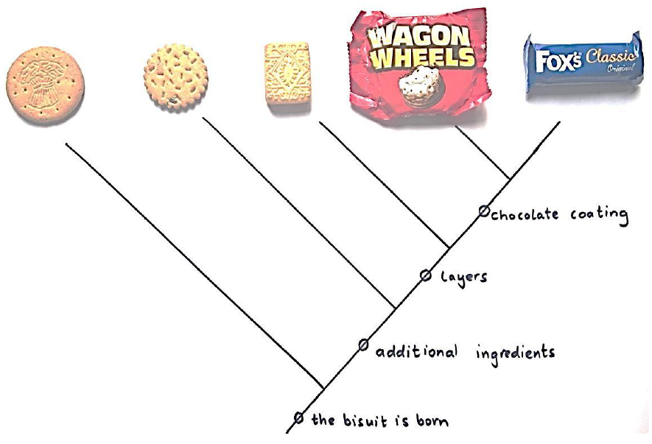
This is called a ‘cladogram.’
Cladograms are diagrams that show the evolutionary relationships between organisms.
They are used to represent a possible relationship between two groups.
They resemble a tree with branches off a main tree and are used to compare organisms visually.

Slide 13
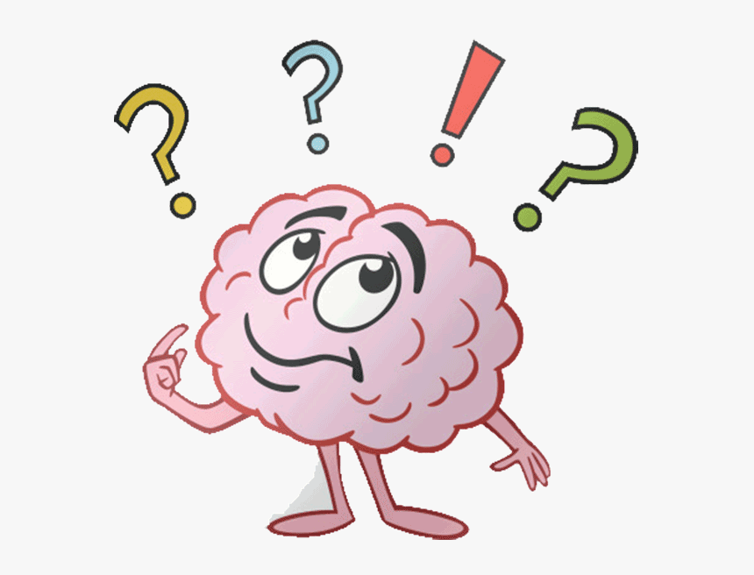
Why do you think some early biscuits continue to be popular today and others aren’t?
E.g. digestives keep well, aren’t too rich or indulgent and don’t melt. They are also great to dunk in tea! They are a success story and are fit for purpose.

Slide 14
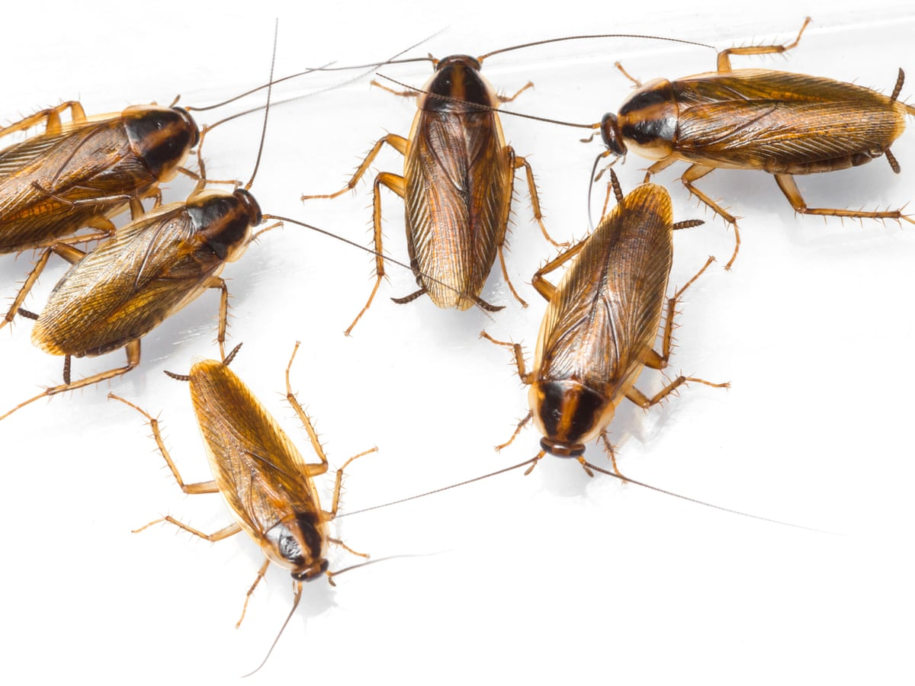
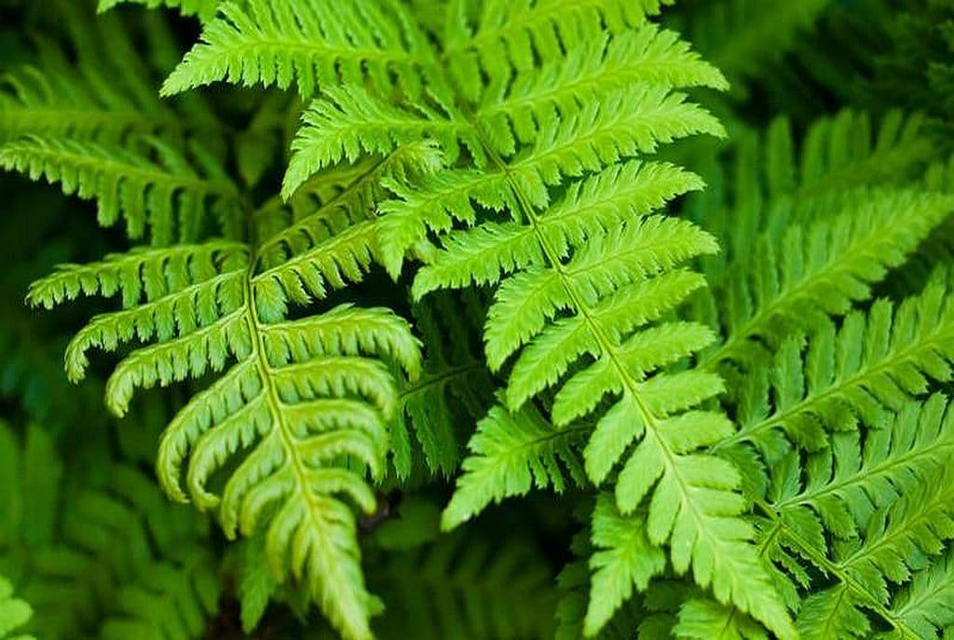
This happens in nature too!
E.g. cockroaches – they have changed over time, through evolution, but the basic ‘model’ remains the same, as with ferns.
Remember: it is not always the strongest or most successful at that moment in time that necessarily survives long term, but the most adaptable – think about bacteria!
We are going to be creating and interpreting our own cladograms today!

Slide 15
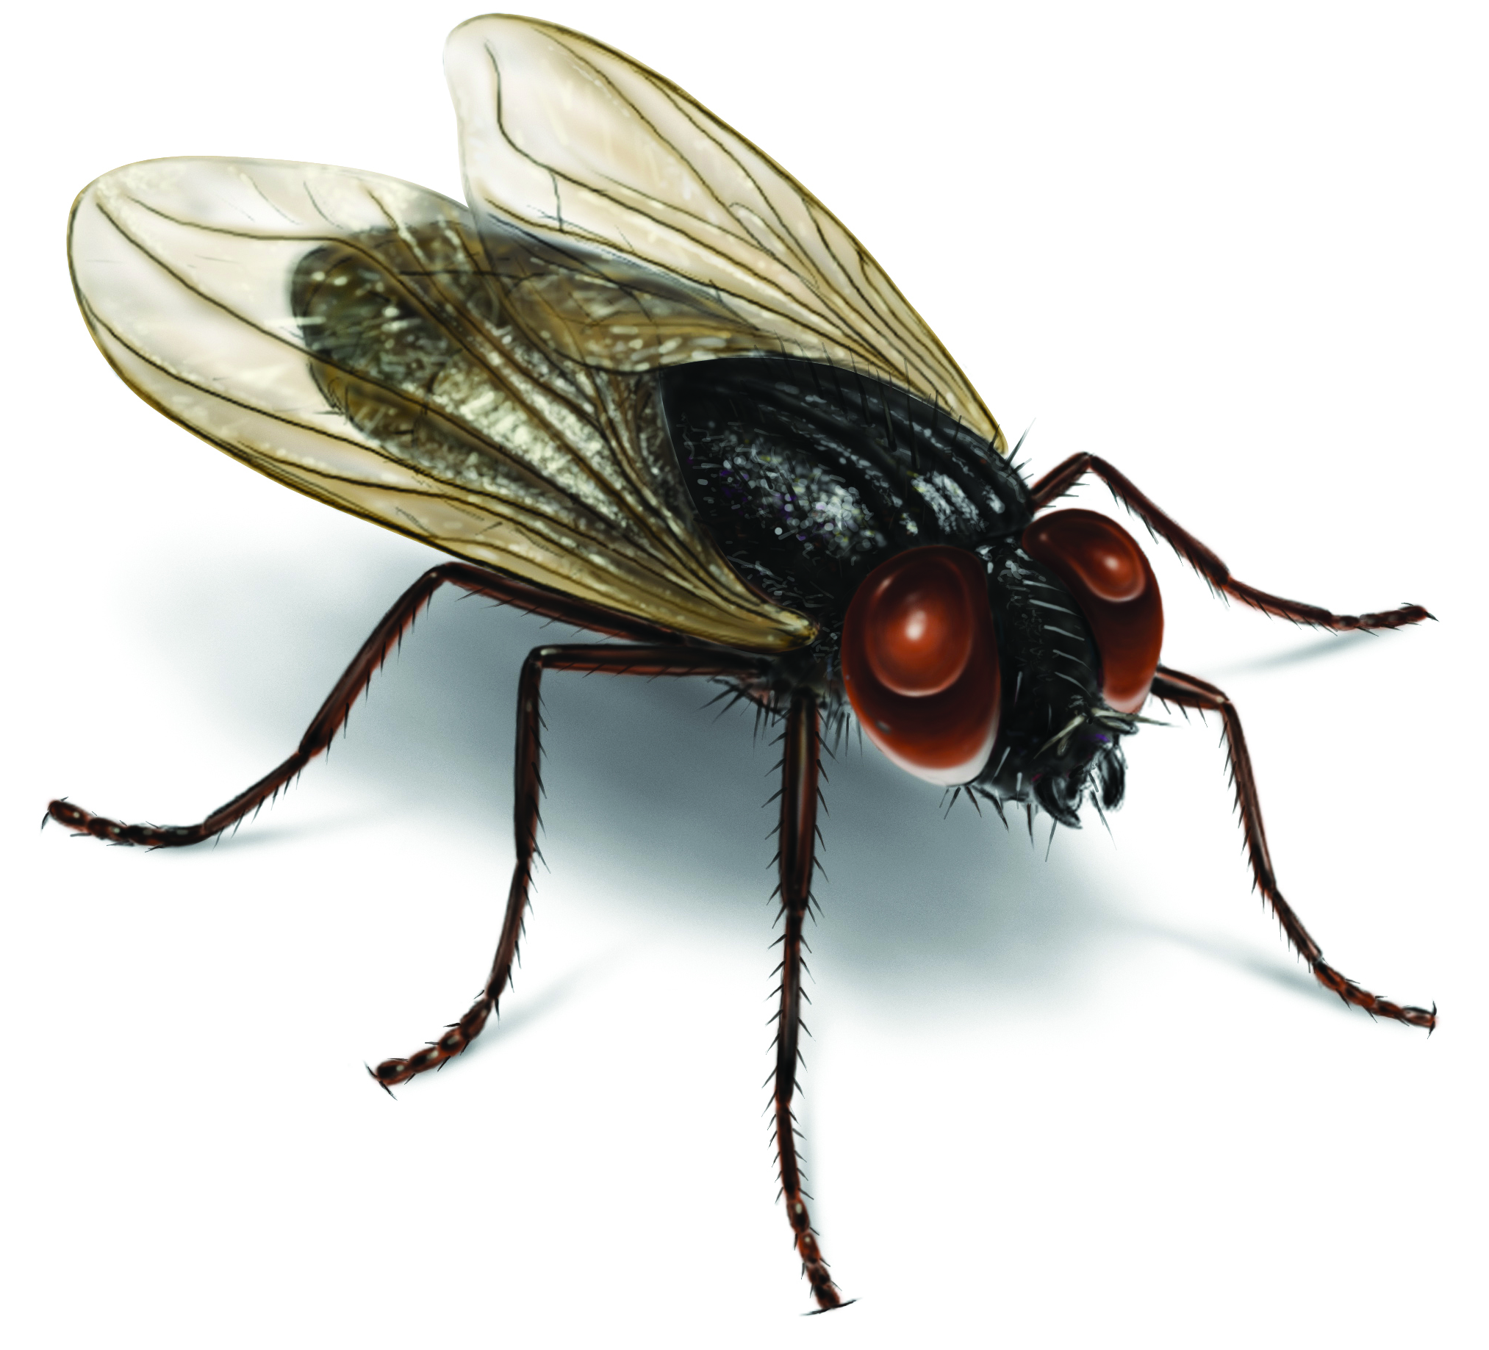
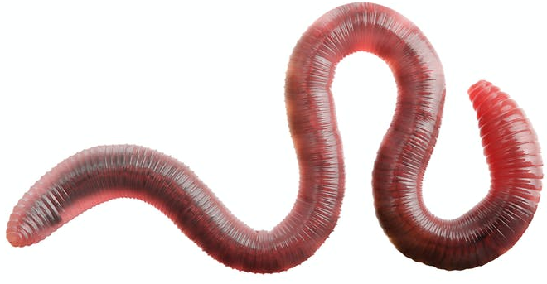
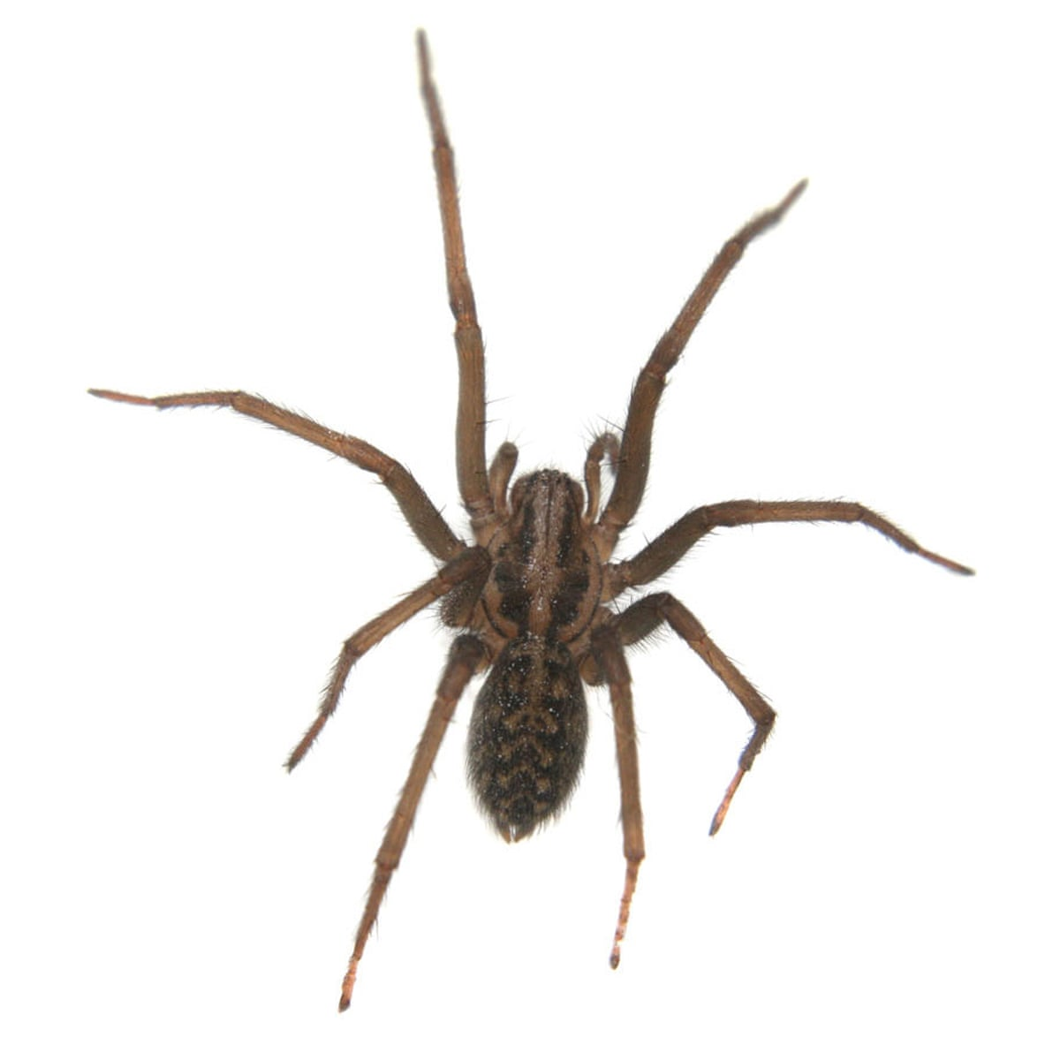
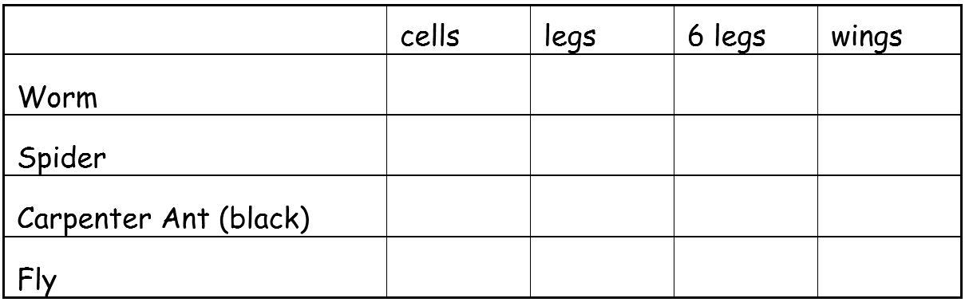
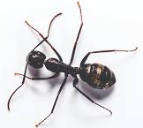
Step 1
Begin by filling in the table.
Mark an X if the species has the trait and O if they do not.

Slide 16
Step 1 - Answers
X
X
X
X
X
X
X
X
X
X

Slide 17
Step 2
Next, count how many times you chose ‘yes’ (X) for each characteristic.
Those characteristics with a large number of ‘yeses’ are more ancestral characteristics because they are shared by many.
X
X
X
X
X
X
X
X
X
X

Slide 18
Step 2
Those traits with fewer ‘yeses’ are derived characters and have evolved later.
“Derived characters are advanced traits that only appear in some members of an evolutionary group.
X
X
X
X
X
X
X
X
X
X

Slide 19
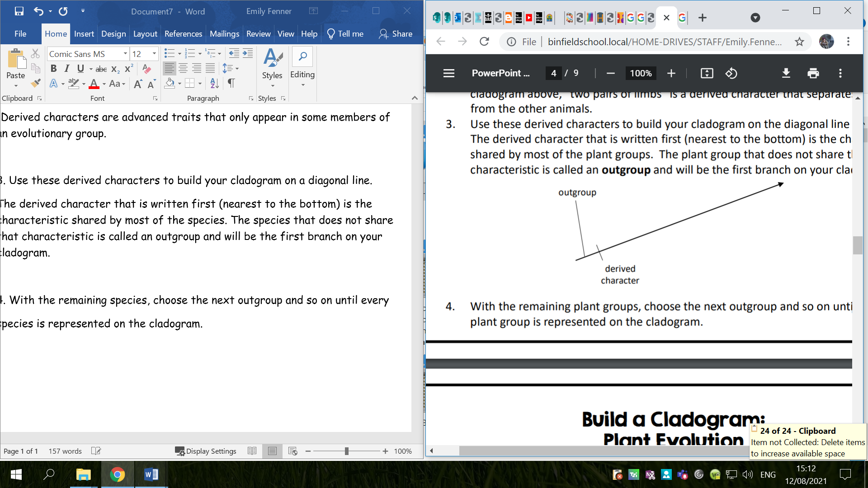
Step 2
Use these derived characters to build your cladogram on a diagonal line.
The derived character that is written first (nearest to the bottom) is the characteristic shared by most of the species. The species that does not share that characteristic is called an outgroup and will be the first branch on your cladogram.
With the remaining species, choose the next outgroup and so on until every species is represented on the cladogram.

Slide 20
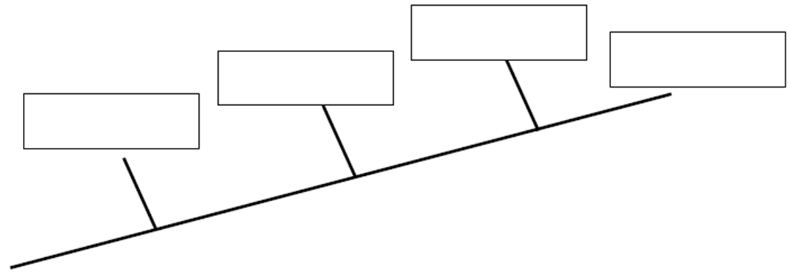
Step 2
Add each of these organisms to the cladogram below: worm, spider, ant, fly.

Slide 21
Step 2 - Answers
Ants
Fly
Spiders
Worms

Slide 22
Step 3
Using complete sentences, explain why you put each organism where you did on the cladogram.
Ants
Fly
Spiders
Worms

Slide 23
Step 4
On the cladogram, add traits that make the organisms different from each other.
Ants
Fly
Spiders
Worms

Slide 24
Step 4 - Answers
On the cladogram, add traits that make the organisms different from each other.
Ants
Fly
Spiders
Worms
wings
6 legs
legs
cells

Slide 25
Step 5
According to your cladogram, which two species are more closely related: worms and spiders or worms and ants? How do you know?
According to your cladogram, what species are flies most closely related to? How do you know?
Ants
Fly
Spiders
Worms
wings
6 legs
legs
cells

Slide 26
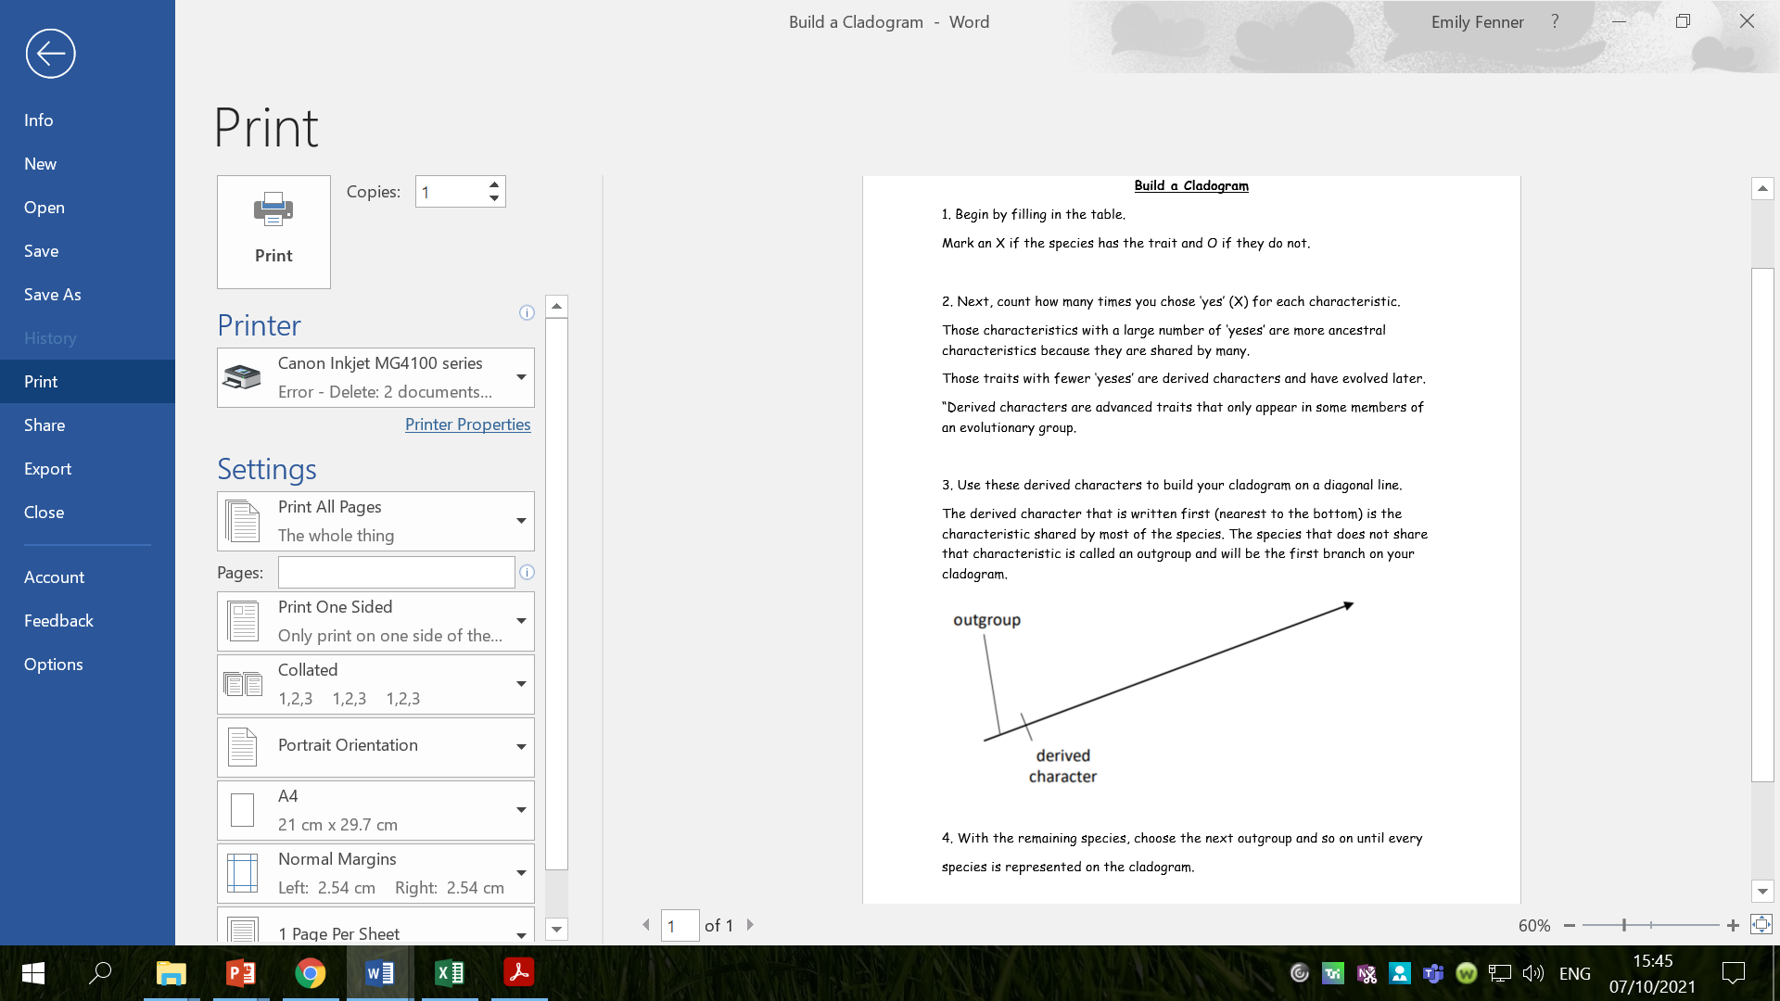

Slide 27
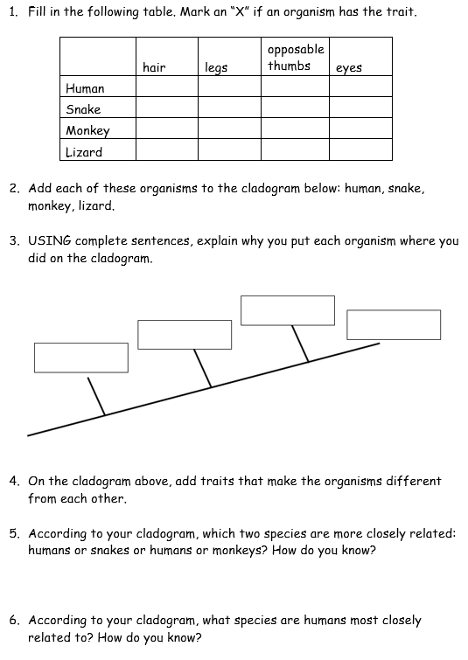
Activity
Make your own cladogram for the species provided and use the cladogram to answer questions.

Slide 28
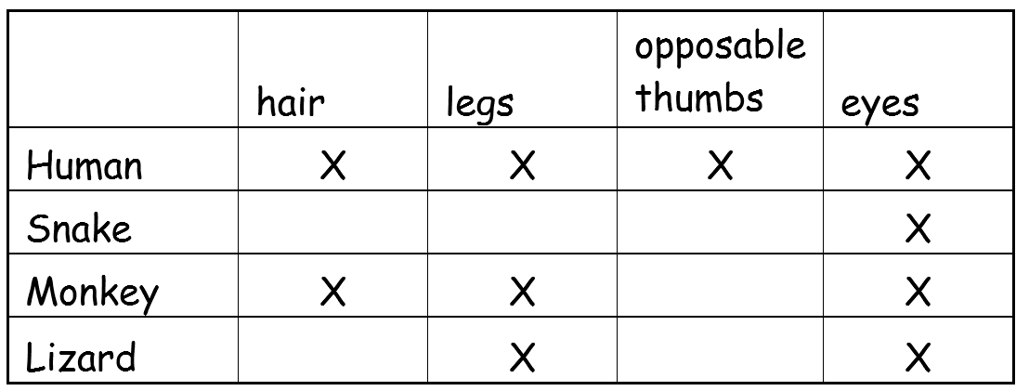
Answers

Slide 29
Answers
Monkey
Human
Lizard
Snake
opposable thumbs
hair
legs
eyes

Slide 30
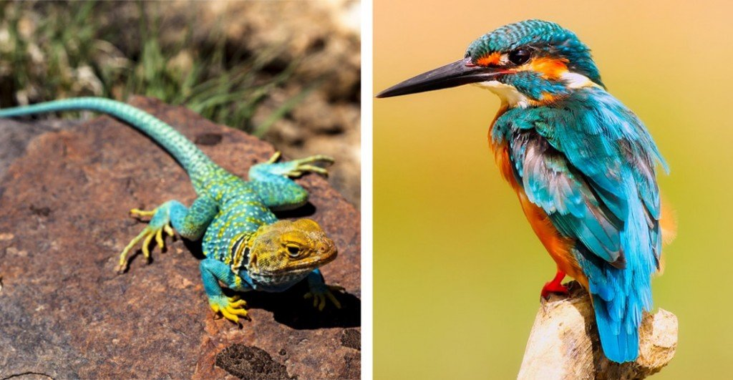
Red Pen
Explain why reptiles and birds are placed in the same clade.
Hint: what do the two living creatures have in common?

Slide 31
Red Pen Answer
Reptiles and birds are placed in the same clade because they both have jaws, lungs, and claws or nails and they include some of the same common ancestors.

Slide 32
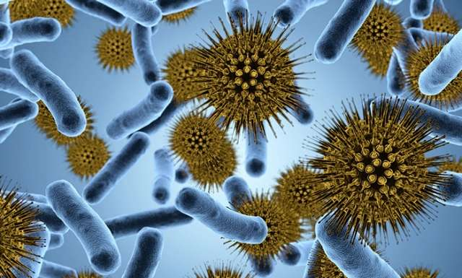
Plenary
Is evolution still happening today?
Yes it is!
Bacteria continue to mutate and evade antibiotics, while Darwin’s finches and other animals continue to be studied.

Slide 33

Plenary
How do you think that modern day humans might be influencing evolution, both positively and negatively?
E.g. climate change, destruction of habitats, breeding programmes, introduction of evasive species

